Slide 1
Authority Control for the Semantic Web
Encoding Library of Congress Subject Headings (LCSH) in SKOS

Slide 2
Outline
Library Controlled Vocabularies and the Semantic Web
Library of Congress Subject Headings
Encoding: MARC, MADS, SKOS
XML & XSLT: Intentions and Problems
Alternate Approaches
Conclusion - Benefits, Related & Future Work

Slide 3
“The vast bulk of data to be on the Semantic Web is already sitting in databases … all that is needed [is] to write an adapter to convert a particular format into RDF and all the content in that format is available.”
-Tim Berners-Lee
in an interview with the Consortium Standards Bulletin

Slide 4
Library Controlled Vocabularies: Benefits
Reputation - Trusted Tradition
Mature - Time tested and carefully developed
General & Comprehensive - Cover large knowledge spaces

Slide 5
Library Controlled Vocabularies: Drawbacks
Overly Complicated - extraneous information
Archaic Syntax - MARC Records
Slow to evolve - authorities control the authority control

Slide 6
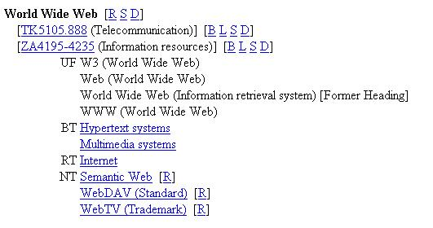
LCSH
Notes:
Both the benefits and drawbacks are at their strongest when dealing with Library of Congress Controlled Vocabularies. LCSH is a prime example of the best and worst of Library Authority Land.
Syndetic Structure - Relationships between concepts.
Relationships to other Controlled Vocabularies (LC Classification)

Slide 7
LCSH in Dublin Core
Encoding Scheme for DC Subject
No easy way to draw on equivelent terms and cross-references
Abstract Model, RDF and SKOS could enable applications to make use of the whole vocabulary

Slide 8
Vocbaluary Encodings
MARC - Great for Library Applications
MARC-XML
MADS
SKOS - Designed for use with RDF
}Helping Get Library Apps online

Slide 9
LCSH in SKOS
<skos:Concept rdf:about="http://example.com/lcsh#95000541">
<skos:prefLabel>World Wide Web</skos:prefLabel>
<skos:altLabel>W3 (World Wide Web)</skos:altLabel>
<skos:altLabel>Web (World Wide Web)</skos:altLabel>
<skos:altLabel>World Wide Web (Information Retrieval System)</skos:altLabel>
<skos:broader rdf:about="http://example.com/lcsh#88002671" />
<skos:broader rdf:about="http://example.com/lcsh#92002381" />
<skos:related rdf:about="http://example.com/lcsh#92002816"/>
<skos:narrower rdf:about="http://example.com/lcsh#2002000569"/>
<skos:narrower rdf:about="http://example.com/lcsh#2003001415"/>
<skos:narrower rdf:about="http://example.com/lcsh#97003254"/>
</skos:Concept>
Notes:
Talk a bit about the benefits, merging data stores and all that jazz.
As tom mentioned Tuesday in the Opening, SKOS and RDF are like building blocks - bricks that fit together nicely with Dublin Core Data Model to support interoperability and Sementic Web Development ( &to enable more interesting and robust applications.)

Slide 10
XML to XML
MARC can be represented as XML
SKOS can be represented as XML
XSLT is easy and effective
MARC-XML to MADS exists (in Beta)
Should be easy, right…

Slide 11
WRONG!

Slide 12
Many Challenges
Records only include broader terms
References identified by Label, not ID
Pre-coordinated subject strings
What to keep, what to exclude?
Inconsistent identifier format

Slide 13
Alternate Approaches
X-Query - Allows parsing of XML in chunks rather than tree based X-Path
Intermediary structures:
  Internal to a scripting language like Perl
  Using a relational database

Slide 14
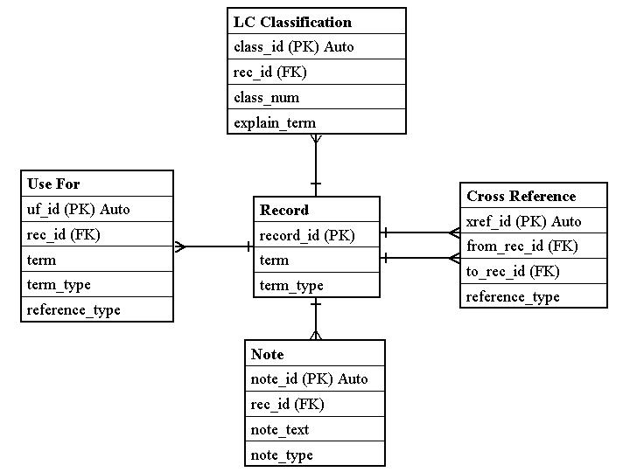

Slide 15
Expected Benefits
Common RDF Semantics
Many Possible Web Services
Publish Vocabulary in Multiple Formats
  Ease of re-use
Entertainment

Slide 16
Related Work
OCLC’s Terminology Services Project
NSDL Registry Project

Slide 17
Next Steps
Finish parsing using an intermediary
Discuss publishing options with LC
Publish LCSH-SKOS as a test case
Experiment with FAST
SKOS extensions to represent additional data
Experiment with other Library Vocabs
Test web-services and tools

Slide 18
Tools and Web Services
SRU/SRW
Use to enhance metadata creation and search
Facilitate Controlled Vocabularies in Social Tagging Environments

Slide 19
Thank You
Any Questions

