Slide 1
Dublin Core as a tool for interoperability
Common presentation of data from archives, libraries and museums
DC-2006 - 4 October 2006
Leif Andresen
Danish National Library Authority

Slide 2
The speaker
Leif Andresen
Library Advisory Officer
Danish National Library Authority
Chair Danish Standards S24 - Information and Documentation (Mirror committee ISO TC46)
ISO TC46/SC4 Technical Interoperability
Chair DCMI Standards
Member Danish ALM standard WG
Notes:
The objectives of bibliotek.dk:
Public access via web-interface
Give the user the option to request books, cd's etc
" See – but not touch" would be a wrong attitude
The service should open quickly.
We don't require new technology, but only a brief development span.
The new library act was passed in May 2000 - bibliotek.dk opened at the end of October.
No new requirement to local libraries
It should be possible for all libraries to participate without changing policy or
changing their computer systems.

Slide 3
Presentation
Introduction
ABM standard working group
2003 report
2006 report
Common content format
National addition: dkdcplus
XML schema
How to transport DC records
Conclusion
Notes:
User interface was developed starting from scratch.
A web-interface company was hired to develop the user interface.
The requirement was: a user interface for “normal” people – not specifically for librarians.
* A test panel gave input. They said:
* ”subject” should be high-rated
* We want a simple user interface
* No gimmicks
And on the next slide you can see the user interface.

Slide 4
Introduction
In 2003 the Danish Ministry of Culture entrusted the three national authorities:
  Danish State Archives
  Danish National Library Authority
  National Cultural Heritage Agency
to develop recommendations for data content, data formats and data transport to facilitate presentation of joint information from archive, library and museum sectors
Notes:
User interface was developed starting from scratch.
A web-interface company was hired to develop the user interface.
The requirement was: a user interface for “normal” people – not specifically for librarians.
* A test panel gave input. They said:
* ”subject” should be high-rated
* We want a simple user interface
* No gimmicks
And on the next slide you can see the user interface.

Slide 5
ABM standard working group
Steering group: the heads of A, L and M national authorities
Working group members:
  Danish State Archives
  City archives of Aalborg
  Danish National Library Authority
  State and University Library Aarhus
  National Cultural Heritage Agency (2)

Slide 6
First report (2003)
Point out Dublin Core as basis for interoperability - the WG don’t find alternatives
Drafts for mapping between sector specific formats and Dublin Core
Mapping cause loss of data
Recommend XML and work out mapping

Slide 7
Refine requirements
Only data relevant to the public for search and presentation to be converted
No need for all details in a common database
Important to get a pointer (a link) to the original database
No duplication of functionality, e.g. requests of library holdings - but links

Slide 8
Final report 2006
Based on first report
Involvement of consultants from The Royal School of Library and Information Science and the company Index Data
Complete mappings
Develop XML schema

Slide 9
Staring point
Mapping from the ALM-formats should point to one of the fifteen basic Dublin Core elements if possible
Refinements of Dublin Core should only be used if absolutely necessary
Other metadata formats should only be used if absolutely necessary
New additional Danish metadata elements should be the last option

Slide 10
Conditions
Different traditions in sectors
Different registrations levels
Collections with no details about the units
Relation versus record databases
Only libraries and local archives on document/unit level

Slide 11
Mappings
Developed mappings from four sector
specific formats:
Daisy for governmental archives
Arkibas 4 for local archives
danMARC2 for libraries
Regin for museums

Slide 12
Dissimilarity for DC Creator
Museum: person responsible for composition of museums file
Library: Author, composer etc.
Archive: institution or part of institution who established the archive
So: some additional information needed to ensure informative presentation

Slide 13
Dissimilarity for DC Title
Museum: constructed - normally not titles in source system
Library: mandatory
Archive: constructed - normally not titles in source system

Slide 14
Common content format
The dkabm format consists of:
dc: Dublin Core 15 basic elements
dcterms: Dublin Core refinements
ac: Administrative Components
dkdcplus: Danish additions

Slide 15
Both general and specific
dkabm include guidelines for how to map to metadata elements
not all elements in dc, dcterms and ac are used
but no elements are excluded:
the format is for broader use in the A, L and M sectors
in library sector a extend profile is planed

Slide 16
dc: Dublin Core 15 basic elements
Title
Creator
Subject
Description
Publisher
Contributor
Date
Type
Format
Identifier
Source
Language
Relation
Coverage
Rights

Slide 17
dcterms: Dublin Core refinements
Used are:
Alternative (Title)
Extent and Medium (Format)
isPartOf and HasPart (Relation)
Spatial and Temporal (Coverage)

Slide 18
ac: Administrative Components
Metadata about metadata needed to describe the source
Metadata about metadata outside the scope of Dublin Core
AC Identifier: Identification in original system for linking
AC Source: Identify the delivering organisation/institution

Slide 19
dkdcplus: Danish additions
Elements:
preferredName (Creator)
alternativeName (Creator)
actPeriod (Creator) with scheme Period
version (Description)
Schemes:
SubjectType (Subject)
Danish translation DCMI Type (Type)

Slide 20
dkdcplus: Version
Version is the only general refinement
hasVersion (Relation) is not useable: Definition is “A reference to a related resource”
Many application profiles have version, edition or synonymous elements
the IFLA metadata report is consulted http://www.ifla.org/VII/s13/guide/metaguide03.pdf

Slide 21
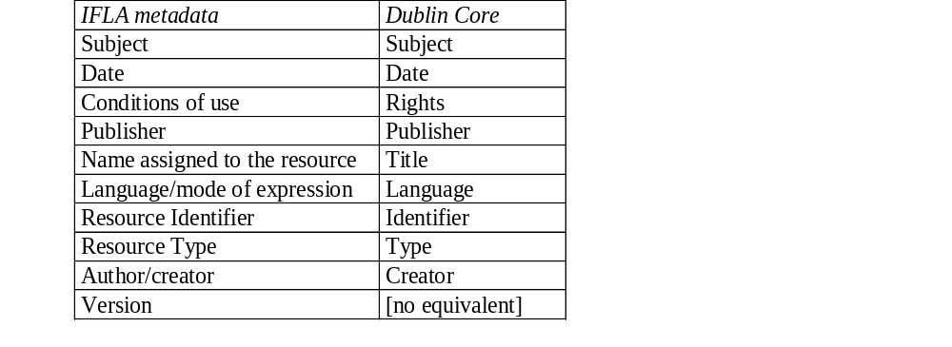
Comparison IFLA metadata and DC

Slide 22
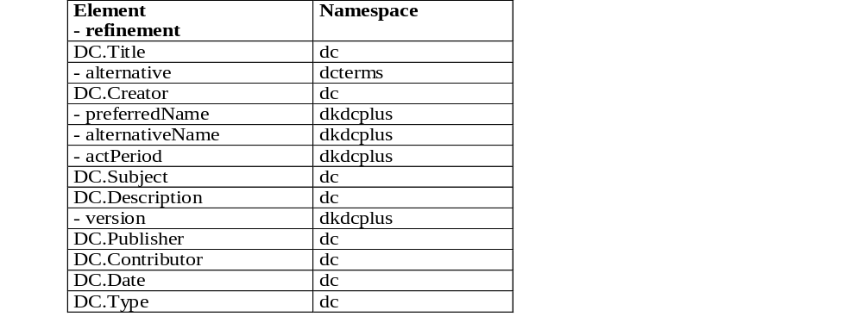
The combined schema (1)

Slide 23
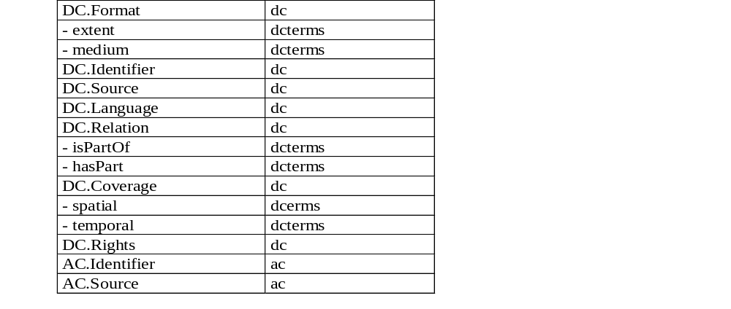
The combined schema (2)

Slide 24
Survey of XML schemas (1)
dkabm.xsd: collecting schemas below
dc.xsd: 15 basic Dublin Core elements
ac.xsd: Administrative Components
dkdcplus.xsd: defines Danish elements and subject lists
dcterms_ext.xsd: import Danish elements from dkdcplus.xsd together with dcterms and dc

Slide 25
Survey of XML schemas (2)
dcterms.xsd: defines Dublin Core refinements
dcmitype.xsd: defines Dublin Core resource types
dktype.xsd: defines Danish language of DCMI types
ISO639-2.xsd: defines valid language codes

Slide 26
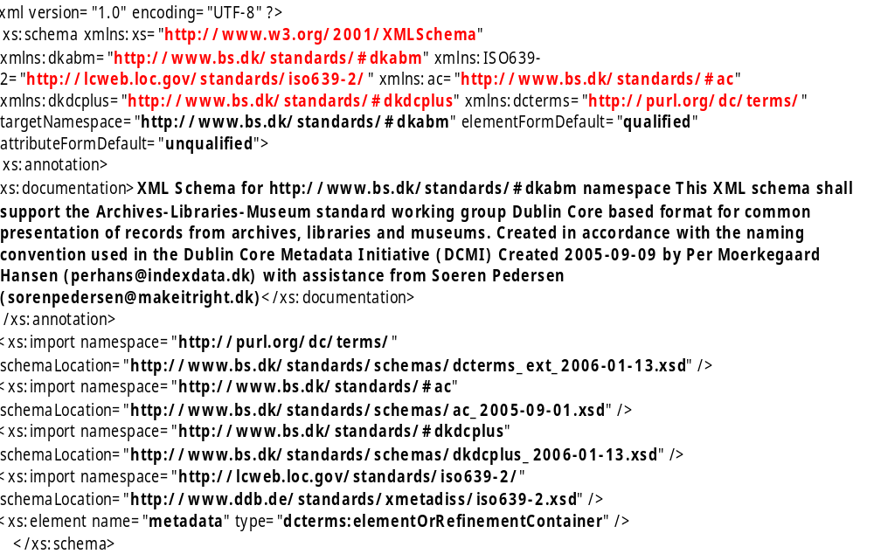
dkabm XML schema

Slide 27
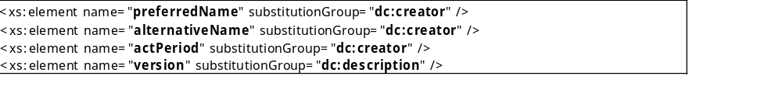
Extract of dkdcplus XML schema

Slide 28
Transport of metadata records
Harvesting
  OAI-PMH
Search and retrieve
  SRU
File transport
  National guidelines

Slide 29
Harvesting with OAI-PMH
<ListRecords>
<record>
[DKABM-record]
</record>
<record>
[DKABM-record]
</record>
</ListRecords>

Slide 30
Search and retrieve with SRU
<searchRetrieveResponse>
<records>
<record>
[DKABM-record]
</record>
<record>
[DKABM-record]
</record>
</records>
</searchRetrieveResponse>

Slide 31
File transport (national/local model)
<collection>
<record>
[DKABM-record]
</record>
<record>
[DKABM-record]
</record>
</collection>

Slide 32
Conclusion (1)
Dublin Core has three different roles in
practical work:
the original: a simple schema to register Internet documents
the extended: as basis for project and domain specific registration schemas
interoperability: as basis for interchange of information between domains

Slide 33
Conclusion (2)
This paper shows a way to use Dublin Core for interoperability between three related sectors.
Arguably the sectors are related but with major differences.
This indicates that Dublin Core has a more general role as carrier for interoperability.

Slide 34
Contact
Leif Andresen
Danish National Library Authority
lea@bs.dk
Report:
http://www.kulturarv.dk/tjenester/publikationer/emneopdelt/kulturarv-it/abm2006/index.jsp

