Slide 1
RDA & DC: An update
Diane I. Hillmann
DC2006 RDA Special Session

Slide 2
What is RDA?
Resource Description and Access
Successor to Anglo-American Cataloging Rules, 2nd ed., revised
Standard for content description, assisting those who create metadata in determining the appropriate (values) for metadata statements

Slide 3
First, the Good News
RDA attempts to appeal to communities outside traditional libraries
Begins to address fundamental problems inherent in the history of AACR, including:
  Focus on ISBD (International Standard Bibliographic Description) and card-style organization
  Expansion to new formats that was built on presumed similarities to textual published entities
  Primitive view of relationships between resources

Slide 4
... and now, the Bad News
Still no general model of what RDA is attempting to describe: continuing emphasis on “static” published resources
Attempts to maintain backward compatibility are in contradiction to goal of extension to other communities and a more digital world
Not moving quickly enough to address fundamental problems in time for 2008 version

Slide 5
Issues
Lack of explicit “first principles” or data model
Continuation of many legacies from the past:
  Transcription as basis for description
  Identification based on transcribed textual information
  “Primary access points” remain a focus
  Textual approach to relationships still assumed
  Reliance on notes for information not deemed “primary”
Still too complex for widespread adoption

Slide 6
What “First Principles” or a Model could do for RDA
Make more explicit the use of FRBR relationships: Work, Expression, Manifestation, Item
Improve the way RDA deals with other relationships and entities
  Ex.: Place/publisher, contributors, roles
Allow a true implementation of “application profiles” or community specific usages--based on principle rather than practice assumptions

Slide 7
Why Transcription Doesn’t Work
Assumes resources don’t change (or change in predicable ways)
  Based on print notions of “edition” where publishers followed strict standards for indication of sufficient change
Relies on tests of equivalency based on textual matching of specific elements

Slide 8
Why Transcription Doesn’t Work (2)
Specifies named “sources of information” which don’t always exist in digital resources
  ex.: title page, t.p. verso, colophon
Mandates arcane rules to separate “cataloger supplied” data from transcribed data
  ex.: [sic] for misspellings, bracketed supplied titles (these interfere with sorting and searching)

Slide 9
Transcription as Identification
Requires rules for every situation to create reasonably unambiguous results
  Specialist communities have tended to create special rules, undermining predictability
Can’t be done effectively by machines
Expensive add-on for digital materials already containing identifiers
Leads to solutions like uniform titles when ambiguity remains

Slide 10
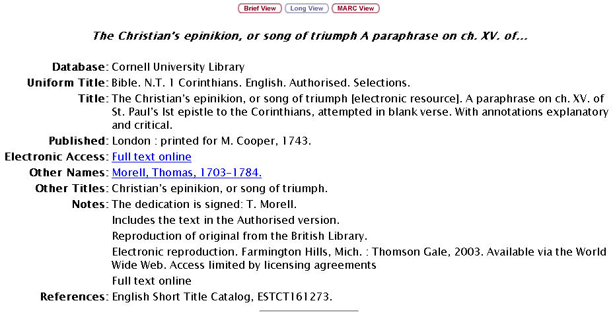
A Note, not a
relationship

Slide 11
“Primary Access Points”
Useful when relationships between resources were expressed ONLY as textual notes and when results were sorted in rigid ways
Practice has been chaotic, with specialist communities insisting on exceptions for “their stuff”
Distinction between access points not necessary in a machine-manipulated world

Slide 12
Resource Relationships
Continuing reliance on human mediated text notes to express relationships
Emphasis on FRBR for derivative relationships; no model for others
Relationships between different kinds of entities still text-oriented
  Ex.: Persons, topics, geographic entites

Slide 13
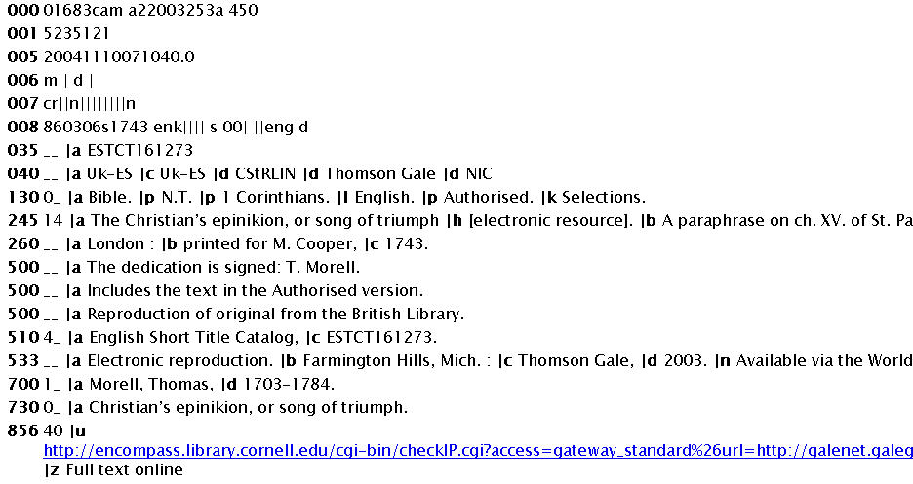
Record
describes two
versions
Original
Version
Digital
Version

Slide 14
Notes ... NOT
Notes are inherently intended to be human-readable; machines can usually display but not parse them
Putting “secondary” info in notes often relegates them to total obscurity (even library catalog brief views don’t usually show notes)
Repeatability may be more functional, and doesn’t mean giving up entirely notions of “primary” and “secondary”

Slide 15
Legacy Ties
Inherent in the process: catalogers are the primary audience AND the primary developers of RDA
No real attempts to bring in communities who were originally “shut out” of AACR2 (archivists, for example)

Slide 16
Complexity vs. Interoperability
RDA will be a hard sell for implementers who are not library-based
Lack of principles makes distinction between general and specific rules more difficult
RDA developers generally not looking at interoperability outside the library domain

Slide 17
ALA Proposed Solutions
“Application Profiles”
  Guidelines within RDA tagged for applicability to other communities
  Links out to specific guidelines for other communities
Two RDA’s (“The Balkan Solution”)
  RDA Lite for other communities
  RDA Complete for libraries

Slide 18
Will These Solutions Work for the Dublin Core Community?
Probably not well--see crosswalked data from MARC as an example of what can go wrong
Legacy decisions will turn off everyone but librarians already familiar with complex AACR rules
Without principled basis, may not be worth the trouble to integrate with DC Guidelines

Slide 19
What’s the problem?
Separate but equal solutions don’t necessarily support interoperability very well
RDA notion of “application profiles” doesn’t fit DCMI’s very closely
Rules for formation of access points (soon to be released) still based on text strings rather than URIs
Significant human effort will be required to make these approaches work for DCMI

Slide 20
Longer term issues
Library community metadata sharing agreements threatened:
  If large, important players decline to use RDA because of the cost
  If libraries fail to see RDA assisting them to make sense of a more complicated world
Will there be another chance to get this right?

Slide 21
“Whether we like it or not, other packaging formats are now well-established (and there will be more). We can choose competition or collaboration with them. If we compete we will lose; whereas if we collaborate, we may have a chance of spreading the core gospel before it is too late. Most of the newer formats are becoming aware of the need for content standardisation. If RDA doesn’t suit them, they will invent their own (which is certainly their natural inclination).”
-- Hugh Taylor, CILIP response to RDA drafts

Slide 22
“ ... if we in the library field do not develop cataloging rules that can be used for this digital reality, we will find once again that non-librarians will take the lead in an area that we have assumed is ours. We need to apply the principle of least effort, since we know that cataloging as it has been done is increasingly un-affordable. And we need to create cataloging rules that take into account the reality of machine-to-machine communication and the derivation of data elements by algorithms.”
-- Karen Coyle, email to the MARC list

Slide 23
Late Breaking News
The US Committee on Cataloging: Description and Access (CC:DA) is challenging the current process (again)
Straw poll of current CC:DA members showed clearly that few would vote for the current version of the rules

Slide 24
CC:DA Recommendations
Adopt a top-down development approach
Revise the development timeline
Provide additional development support
Do not use AACR2 as sole source of ideas
Clarify decision-making authority and responsibility

Slide 25
Where’s This Going?
Joint Steering Committee for RDA meeting in Washington, D.C. in the week of Oct. 16
Representatives of IEEE LOM and DC have been invited to meet with the JSC at the end of that week
What do we want to tell them?

