Slide 1

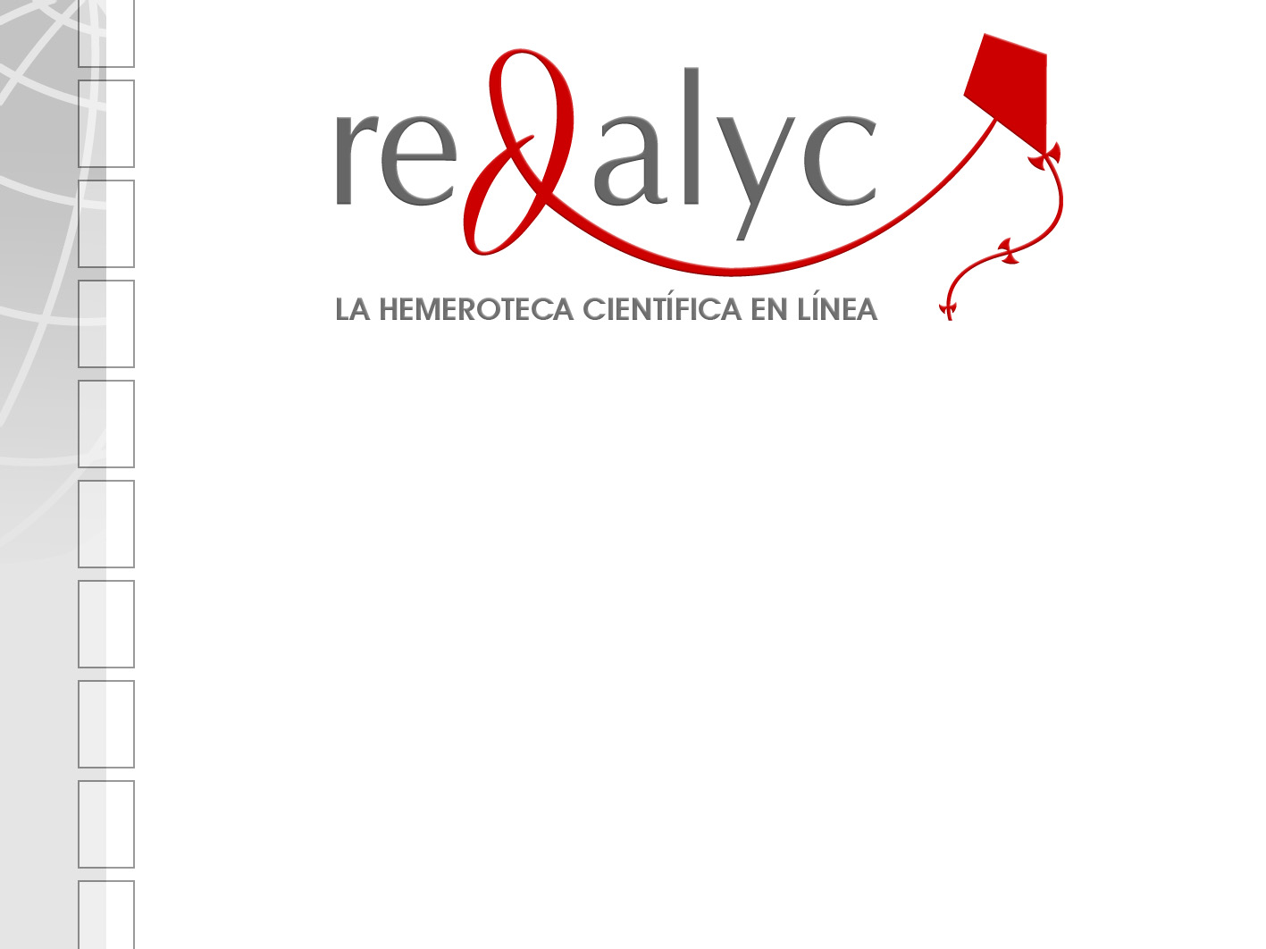


Network of Scientific Journals of Latin America, the Caribbean, Spain and Portugal
Redalyc
The Open Archives Initiative
Protocol for Metadata Harvesting
Eduardo Aguado López
Rosario Rogel Salazar
Arianna Becerril García
Honorio García Flores
  Universidad Autónoma del Estado de México
International Conference on Dublin Core and Metadata Applications

Slide 2

Main challenges of scholary journals
Survival
Lack of diffussion
Local interactivity
Low visibility
Low impact
Scientific production is messured by the published papers and their impact
The production of scholary journals in Latin America is increasing each year...
Nevertheless, there are some exceptions…
Their impact in the production of global knowlegde is still local or institutional

Slide 3
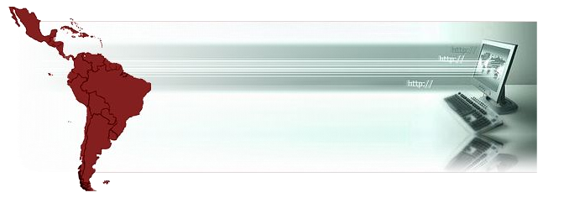

Thinking about that we developed ............
www.redalyc.org

Slide 4
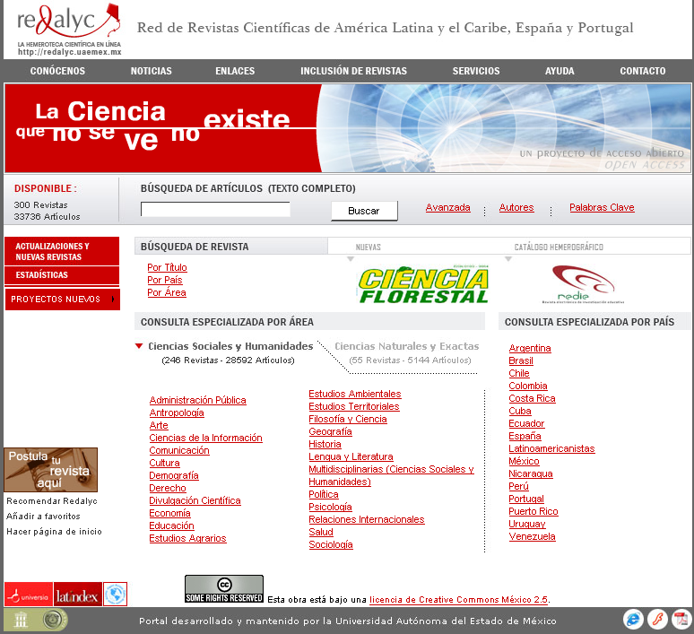
www.redalyc.org

Slide 5

Redalyc works under the “open access” philosophy
Its functions are as follows:
Have free of charge access to a large collection of journals with their published issues and the complete text of every paper in them.
Have searching tools classified by: key word, discipline, journal, country and year.
Articulate electronically the Latin American scientific editorial community.
Promote discussion meetings (either virtual or physical) about the scientific editorial issues in the region.
Create bibliometric statistics that allow us to know how the Latin America scientific community is working.

Slide 6
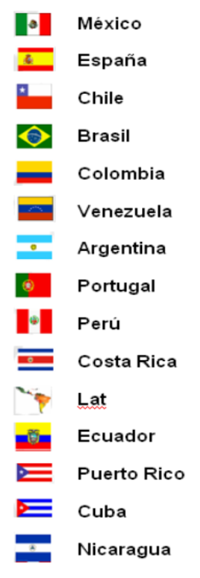


28.6%
15.5%
11.5%
10.5%
9.5%
7.9%
6.3%
2.0%
1.6%
3.0%
1.0%
0.7%
1.0%
0.3%
0.3%
0.3%
87
47
35
32
29
24
19
6
5
9
3
2
3
1
1
1
Social Sciences & Humanities
Natural Sciences
314 scholary journals
36,000 full text papers
47 (15.5%)
257 (84.5%)
Information until july 2006
Uruguay

Slide 7
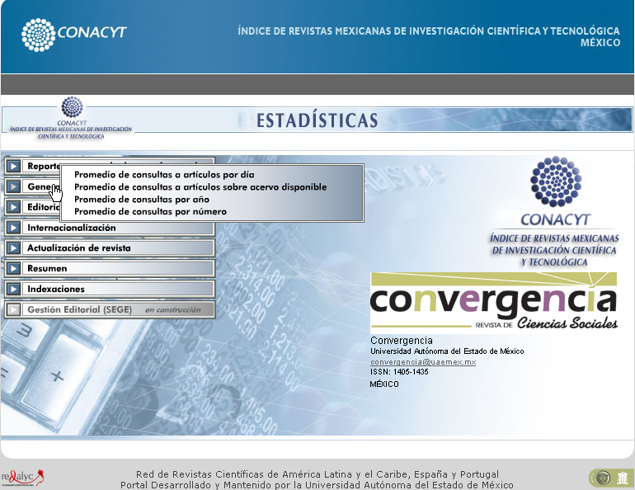

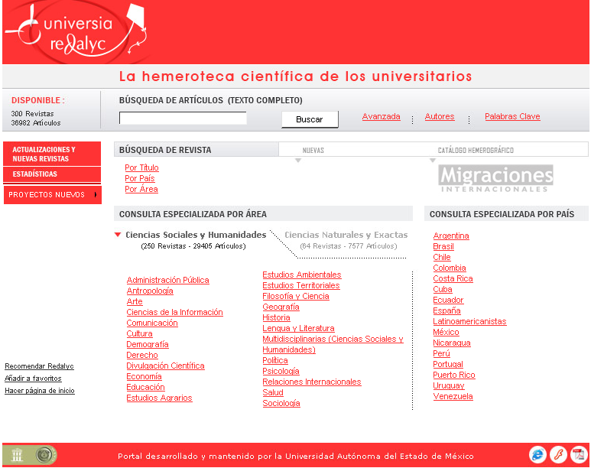

Slide 8
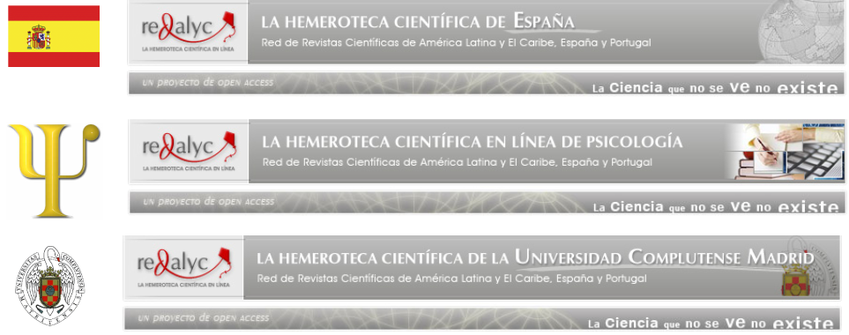

Slide 9
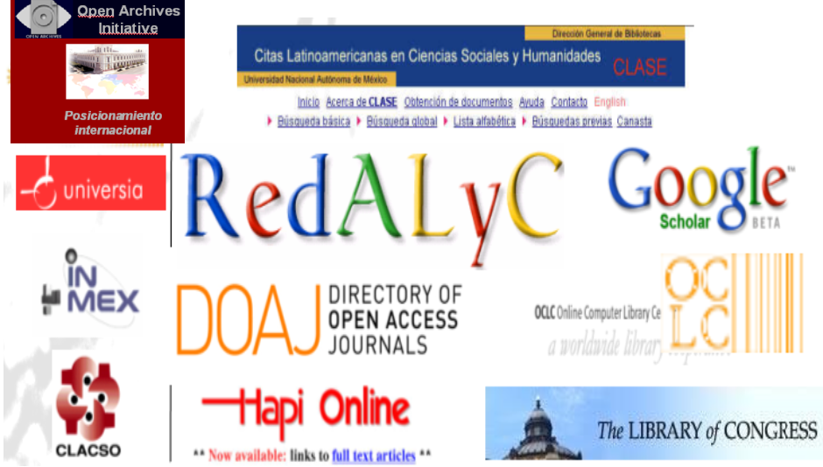

Slide 10

The use of new communication technologies has allowed us to achieve the main objectives of this project:
Visibility is attained by having the complete collection of journals on-line,
Interactivity is intensified firstly, by promoting communication between readers, authors, journals, universities and research centres; and secondly, by creating researcher and editor networks.

Slide 11
According to Ricyt (2002), the participation of the Latin American scientists in “the main current of science”, measured by the percentage of articles signed by authors of Latin America in the main databases that register scientific publications was practically null, less than 3% in the important repositories.
Although there was a growing, for example, 2,7% in the Science Citation Index (SCI).

Slide 12
The under-representation of the Latin American production is shown in the composition of the Journal Citation Reports (JCR) of ISI - Thomson Scientific, about 9.000 journals where social sciences only participate with 1712 journals of that universe.
Only 12 Latin American journals - of the 1712- have been able to be indexed in the JCR. If we consider that it is the main base to measure the impact, the conclusion is clear: the Latin American production is not present.

Slide 13
United to this, there are still few periodic publications that achieve the access to the electronic format.
Great part of that scientific production is unknown and its area of influence is limited.
Social sciences were under-represented in databases that determined “the great current of science” .
The challenge: v i s i b i l i t y

Slide 14
The use of interoperability standards is a fundamental requirement for the scientific production diffusion that made necessary the adoption of Dublin Core.
It has required to analyze the structure of metadata, in order to implement the OAI-PMH, to fortify the search, recovery and indexing the database through harvesters and search engines.

Slide 15
The number of oa-articles citations increases between a 300% and 500% compare to non oa-articles (Steve Lawrence, Brody and Harnad), and as a consequence the raise to the consulted content is evident (read articles-citation correlation).

Slide 16
OAI-PMH implementation
Redalyc metadata mapping Dublin Core
Implemented Tool
VOAI, software developed by Udlap, Universidad de las Americas, Puebla. (Open Source)
Programming Interface
Java-Servlet
Record
Redalyc has nowadays more than 30,000 records ready to be available through OAI-PMH.

Slide 17
Header
identifier: composed of a prefix followed by a Redalyc’s id
datestamp: the day since it was available on the web in Redalyc
setSpec: the Redalyc’s id of the logical partition of the repository
Metadata
Redalyc covers the following DC elements.
<dc:title>
<dc:creator>
<dc:subject>
<dc:contributor>
<dc:publisher>
<dc:date>
<dc:type>
<dc:format>
<dc:identifier>
<dc:relations>
<dc:rights>

Slide 18
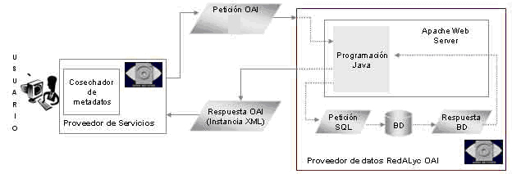
Software architecture
OAI Request
Java
Application
Apache
web
server
Metadata
harvester
OAI Response
SQL Request
BD
SQL Response
Service provider
Redalyc data provider
Base URL:
http://www.redalyc.org/redalyc/servlet/Oai_Handler

Slide 19
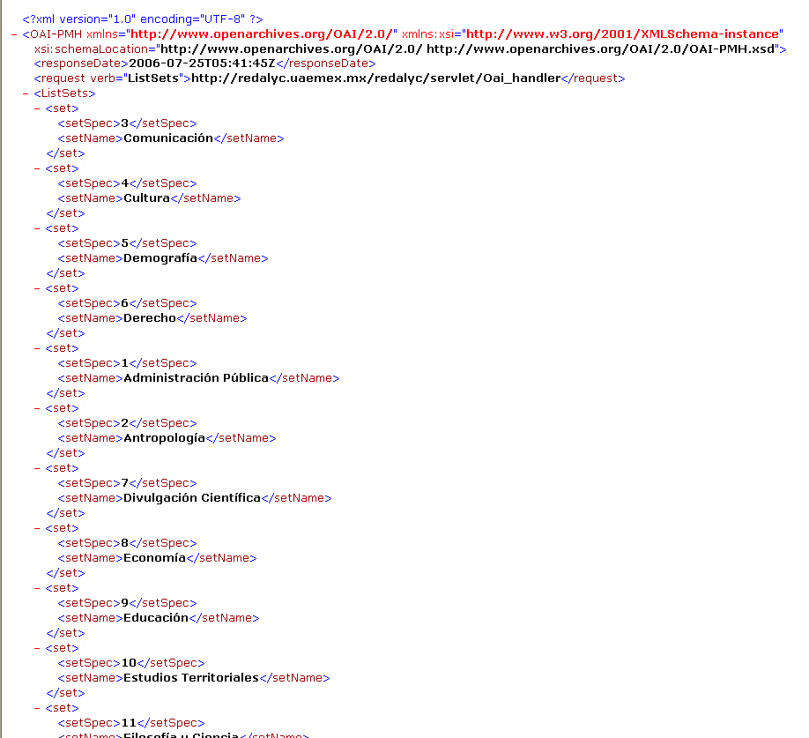

Slide 20
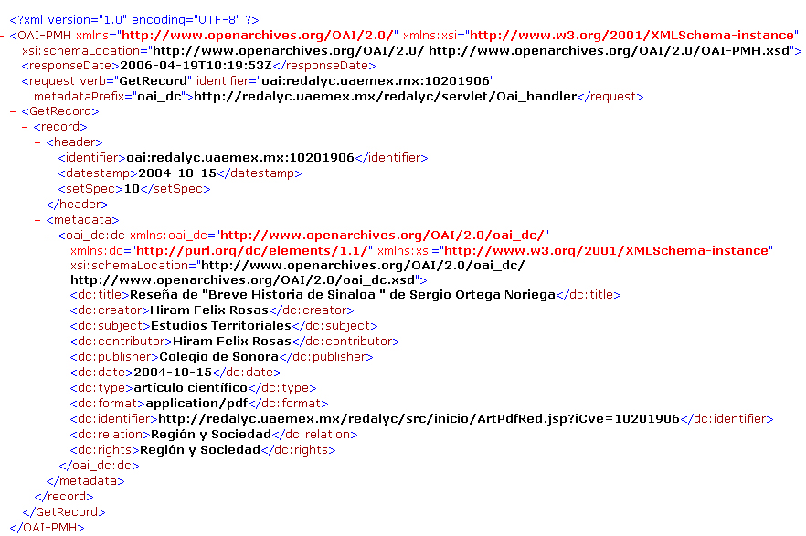

Slide 21
Conclusion
With the migration of our metadata to the Dublin Core format, we had the possibility to incorporate Redalyc as a data provider using OAI-PMH.
Increased the visibility, access and diffusion of the scientific production of Ibero-America.
We are available of being located and indexed in an standard way by different search engines and databases, contributing to the Redalyc’s main objective to make scientific resources accessible through the Web.
The internationalization of knowledge is an urgent task of the scientific communities: Redalyc is making its part to reach this goal.

Slide 22
Redalyc’s research group
Eduardo Aguado
Principal manager
Rosario Rogel
Editorial manager
Emilio Arriaga
Research coordinator
Arianna Becerril
Systems coordinator
Honorio García
Library Coordinator
Thank you !
Universidad Autónoma del Estado de México

