Slide 1
The Semantic Network Service
Supporting Heterogeneous Environmental Information Systems
Federal Environment Agency
Matthias Menger / Maria Rüther
{matthias.menger|maria.ruether}@uba.de

Slide 2
Background
environmental community
cover many disciplines -> many topics, terms, objects emission, waste, biodiversity, energy, sustainability, climate change, chemicals, health, economics, legislation, nature protection…
wide range of specific applications
already only in one organisation
difficulties to exchange information (if needed!)
difficulties to search + retrieve information
metadata approach
several trials to GET real metadata
providing the framwork, tools and assistance

Slide 3
Obstacles
waiting for metadata
not sufficient amount of metadata (keynote today!)
manuel indexing not acceptable
lack of commitment to create + provide metadata
data providers use different approaches
waiting for harmonisation
agree on a environmental standard takes time
every sector feels `special` - you`ll never meet their `needs` (= expectations)
effort and benefit seems not balanced

Slide 4
Overcome Obstacles
serve user
provide `useful` (= wanted!) information
do not wait for metadata
support user in search+retrieval
serve provider
lower burden of providing metadata
automatic `intelligent` indexing
seek the `lowest common denominator` to network different environmental resources
let them feel `special`…

Slide 5
Approach of SNS
User Oriented
semantic
improve search & retrieval: ‘find what you are looking for’
support user to find appropriate search term
share environmental terminology and semantic methods
networking environmental information (systems)
technology
one central service - multiple usage (WebService) …political obstacles arise again -`I want my own service`

Slide 6
Approach of SNS
provide a concept-based automatic indexing
  automated detection of significant terms
provide retrieval assistance
  `translating`search terms in useful terms

Slide 7
Project History
started in 2001
build on automatic indexing of www-documents in GEIN German Environmental Information Network
modular approach based on services
flexibility in adding further semantic, i.e. specific vocabulary like micro-thesauri,…

Slide 8
Components of SNS
3 main components (lowest common denominator)
  TOPIC = environmental thesaurus
  LOCATION = geographic gazetteer
  TIME = environmental chronicle
associated and implemented common semantic structure (TopicMap)
specific services `make use of` TopicMap
  autoClassify, getSimilarTerm, findTopic,…

Slide 9
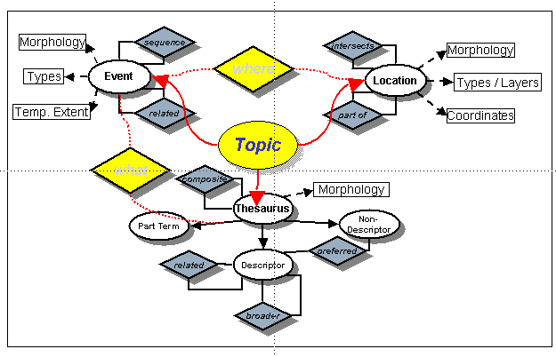
3 Main Components
TopicMap (XML format XTM 1.0)
Location
national gazetteer
Time
chronicle
Term
thesaurus

Slide 10
3 Main Components
Location
national gazetteer
where
20.000
when
1.000
Time
chronicle
Term
thesaurus
what
40.000

Slide 11
Example of Association
Topic
Topic class
Topic instance
Association
Thesaurus
Location
Event
Descriptor
Nation
Community
International
convention
Deutschland
Conference
broader
Berlin
situated in
climate convention
what
where
First UNFCC
Conference, Berlin
3/28/1995 - 4/7/1995
occurrences
http://unfccc.int/cop5/resource/docs/cop1/07.htm
http://unfccc.int/cop5/resource/docs/cop1/07a01.htm

Slide 12
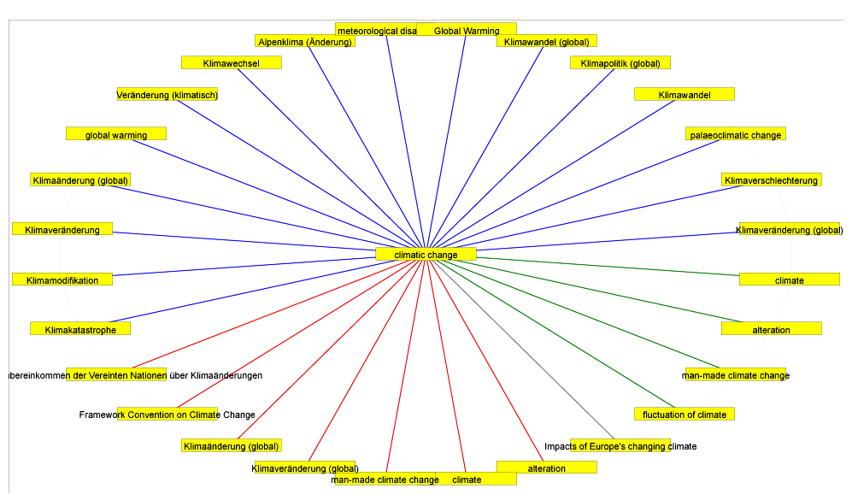
Graphical View
1 Level of Associations

Slide 13
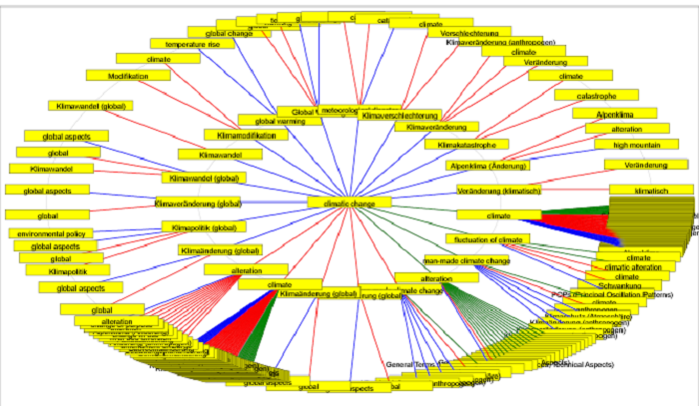
Graphical View
2 Levels of Associations

Slide 14
Services
Make Use of Semantic Structure (TopicMap)
findTopics
  search topics by names and topic types
getPSI
  reference of topic characteristics and its associations (Published Subject Identifier)
  navigating along the relations of a specific term (tree of related topics)
autoClassify
  automatic classification indexing (html, xhtml, pdf)
  resource can be a document or just an URL
  result list with significant topics (ranking mechanism)
Notes:
findTopics:
getPSI: list all relevant references
(e.g. search in Portal U ‚erweiterete Suche/Thema/Fachwörterbuch)

Slide 15
Services
Make Use of Semantic Structure (TopicMap)
getSimilarTerms
  returns ‘somehow’ similar terms for a given search term
findEvents
  events matching the given search term
anniversary
  events in chronicle happened x years ago by reference date as a reminder
Notes:
getSimilarTerms:
e.g. PortalU Suche + ‚ähnliche Begriffe‘

Slide 16
autoClassify
significant topics of a document
1.
read document
3.
discover terms
relevance by frequency
recognise term positions
… by term positions
find matching topics
… by clustering
index
2.
replace non-descriptors
understand composite terms
resolve ambiguities

Slide 17
Topic Clusters
`topic space`
document
·
primary topic cluster
topics
grouped around addressable information objects
loner
secondary topic cluster

Slide 18
autoClassify
service provides metadata time, location, topic
use only descriptors of a thesaurus
synonyms in the document are converted to descriptors => harmonisation, better retrieval

Slide 19
SNS-Metadata
unique identifiers for each topic in all the services - can be used in a URL to retrieve all known properties
SNS provides refined search methods to find topics by different criteria

Slide 20
SNS-Metadata
metadata is stored with the URL
  at application site (e.g. PortalU)
  not at in the original document
use of same algorithm for
  analysing and indexing of documents…
  analysing user`s search request

Slide 21
Integrate DC Metadata
currently not used – because there are not enough DC metadata available
concept allows to integrate DC metadata in the classification process
currently used meta tags:
  title, keywords (and headers h1-h3) with higher priority for ranking
  terms in the body (text)
  parser allows to analyse HTML, XHTML, and PDF documents

Slide 22









Used in…
…environmental portals + Spatial Data Information brokers
Geodaten Infrastruktur
2004
SNS
semantic
Web Services
Umweltinformationsnetz
Deutschland
2003
Geodaten Infrastruktur
Rheinland-Pfalz
2005
Seit Juni 2006
Umweltdaten-
katalog,
in Planung 2006
Geodaten Infrastruktur
Thüringen
2004
Umwelt-Portal
Baden-Württemberg,
in Entwicklung 2006
Geodaten Infrastruktur
Mecklenburg-Vorpommern
2006

Slide 23
www.PortalU.de
German environmental portal
100 different information providers
SNS analyse documents, create an index,
and harvest the content of each provider
matching to one topic
SNS currently handle each document
seperately one-by one

Slide 24
User
IT professionals
  integrating the services in their applications
scientific user
  searching and indexing (their) web objects
public
  searching relevant information more easily

Slide 25
Outlook
make use of available data services
gazetteer of Federal Agency for Cartography
no double efforts in maintainance
OWL instead of TopicMap
interoperability
integrate additional semantics
if needed!
develop additional services
if needed!

Slide 26
Outlook (2)
integrate SNS in further applications
if central service is not desired
consider the context of document
currently documents handled one-by-one
derive Ontologies automatically
avoid manual maintenance of vocabularies
integrate more metadata
if available! Educate and convince people + offer more automated approaches

Slide 27
Information + Contact
http://www.semantic-network.de
maria.ruether@uba.de
matthias.menger@uba.de
http://www.umweltbundesamt.de

