Slide 1
Customising Location of Knowledge
Ann Apps and Ross MacIntyre
MIMAS, The University of Manchester, UK

Slide 2
Outline
Supporting scholarly research
Overview of finding articles using Zetoc and OpenURL linking
Institution customisation
Personal customisation
Current awareness personalisation
Evolving research process

Slide 3
Scholarly Research Process
Research paradigm:
  Discover
  Locate
  Request
  Delivery
  Alert / PublishSubscribe
Selection of services available
  Institution library customisation
  Personal customisation

Slide 4
Zetoc
Current awareness bibliographic citation service
Articles & papers – every subject
Based on The British Library’s Electronic Table of Contents data
Free to UK HE/FE; others by subscription
Funded by JISC, data owned by BL

Slide 5
Using Zetoc
Search via Web interface
Email Alert
  Table of Contents of new issues
  Saved search: title keywords or author
  RSS for journal issues
Z39.50 for m2m information retrieval
  Metasearch
  Personal Bibliographic Databases

Slide 6
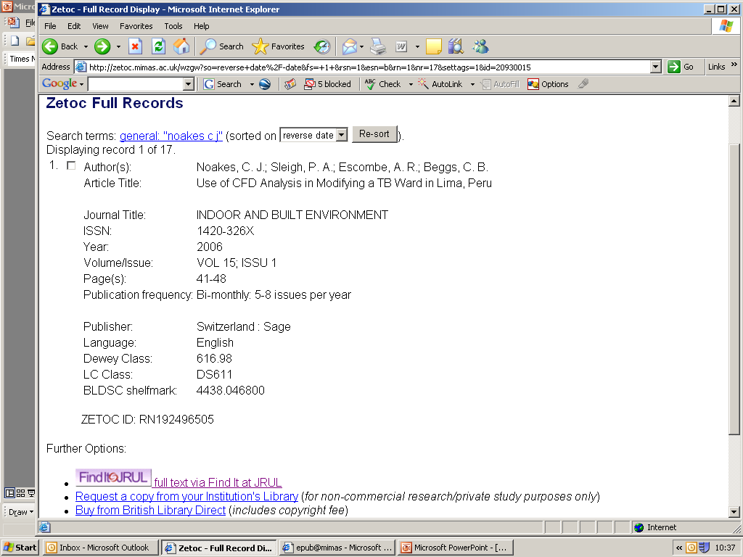

Slide 7
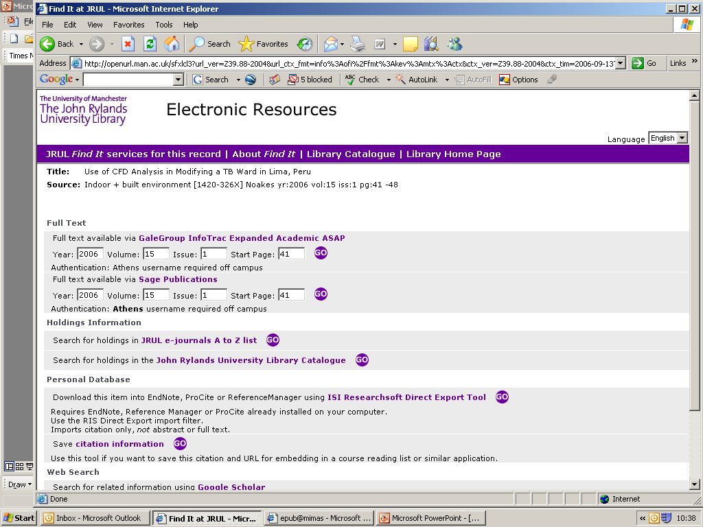

Slide 8
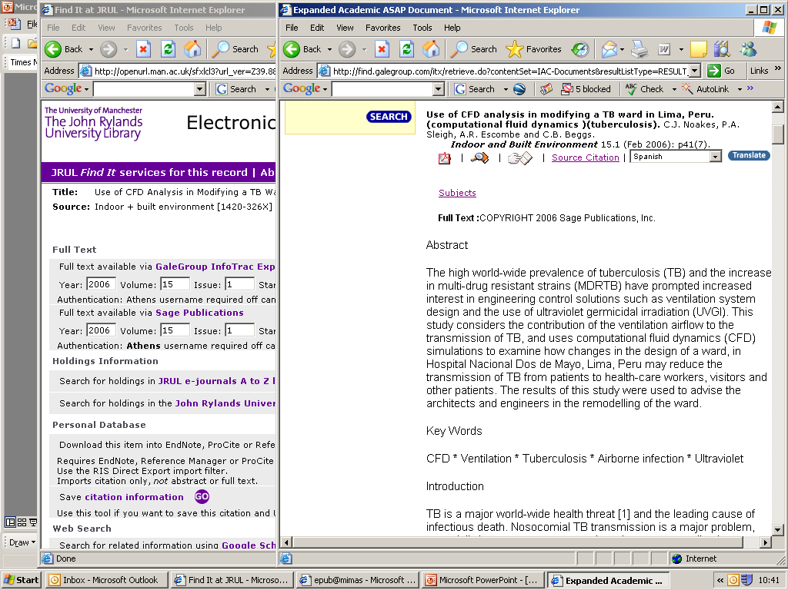

Slide 9
Link to Appropriate Copy
Link to copy for which user has valid subscription
Zetoc generates OpenURL link (Z39.88)
User’s institution runs OpenURL resolver: Knowledgebase:
  Institution subscriptions
  Where articles available
  How to link to target e-journal sites

Slide 10
Link Customisation
Institution known from Zetoc Authentication
Institution registers with Zetoc:
  Address of OpenURL Resolver
  Link text
  Image button
Enhance users’ discovery experience
  Consistent links within resources
  Institution branding

Slide 11
Resolver Registries
UK OpenURL Router
OCLC OpenURL Resolver Registry
Institutions register resolver once
Useful for free services
Keep internal registries up-to-date
Can register Router address with Zetoc
Issues: global identification of organisations and resolvers

Slide 12
Personal Customisation
For majority institution customisation is OK, but...
User’s institution has no resolver
  Zetoc default page is minimal
  User may have a resolver available
User may have several resolvers
User visiting another institution
  Prefers ‘home’ resolver

Slide 13
COinS: ContextObject in Span
Latent OpenURL hidden in web page
Encoded in (X)HTML <span> element
OpenURL ContextObject
  Details of a reference
  The ‘payload’ of an OpenURL
  Standard interoperable metadata
Activate by resolver address prefix

Slide 14
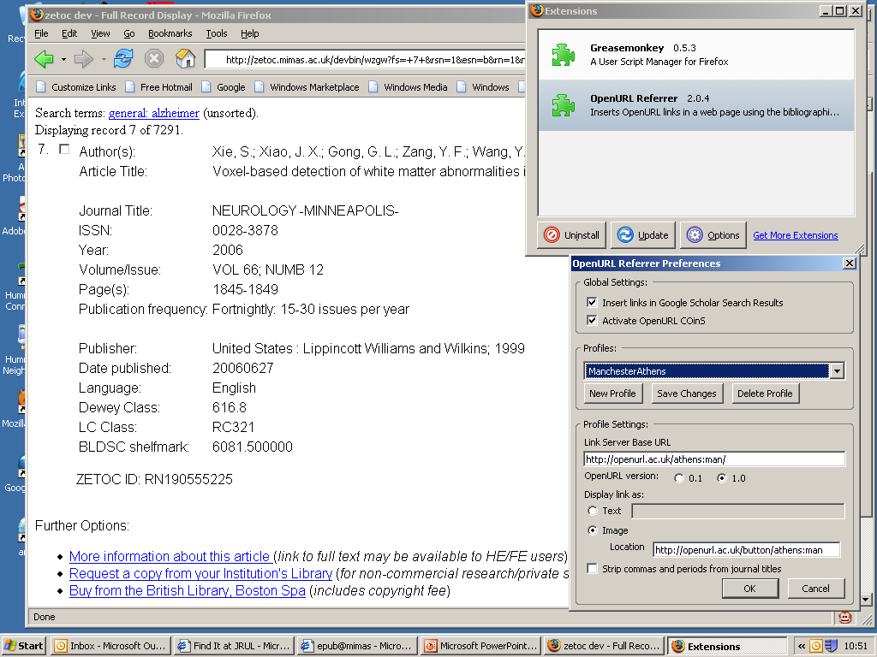

Slide 15
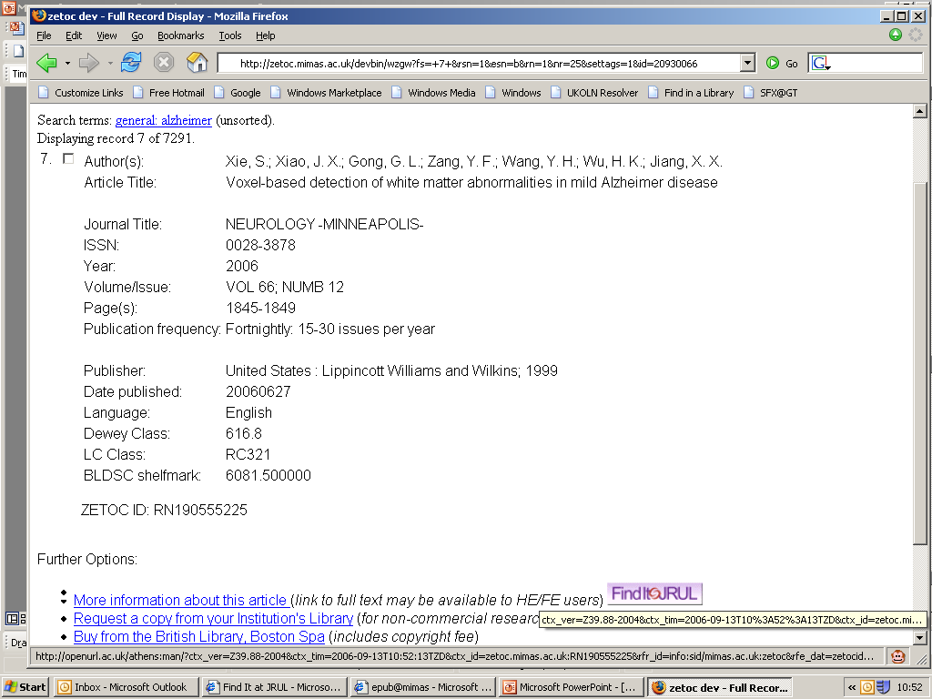

Slide 16
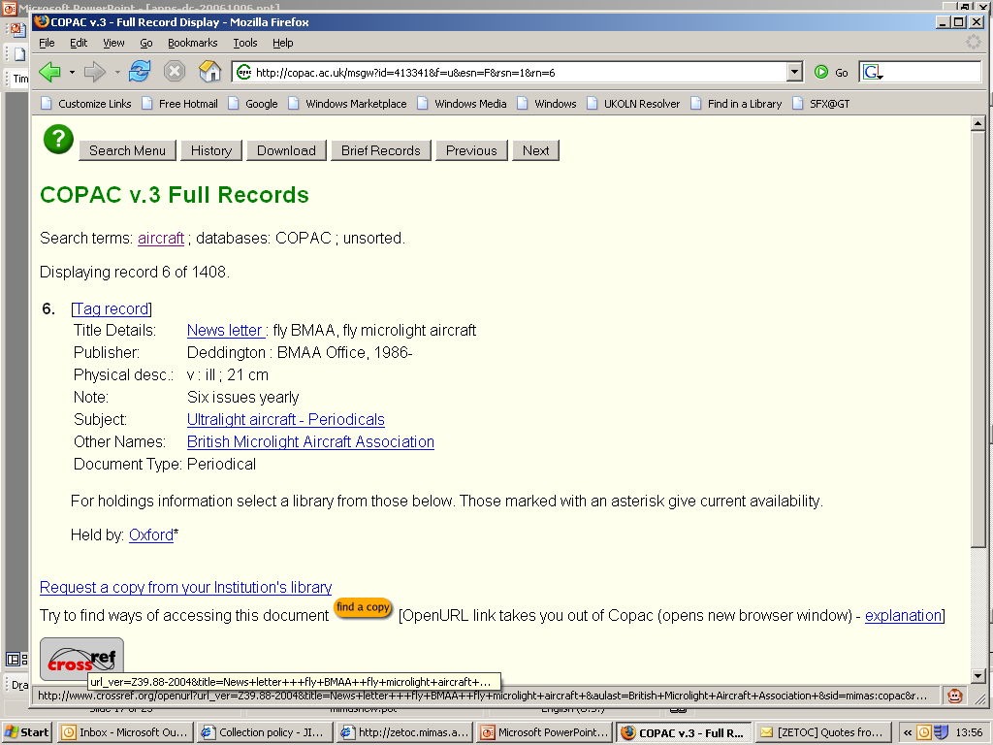

Slide 17
Zetoc Alert: PublishSubscribe
Timely notification of new publication
  Email alert
  Journal issue Table of Contents
  Search alert: articles and papers
RSS
  Journal issues
  Includes DC bibliographic citation

Slide 18
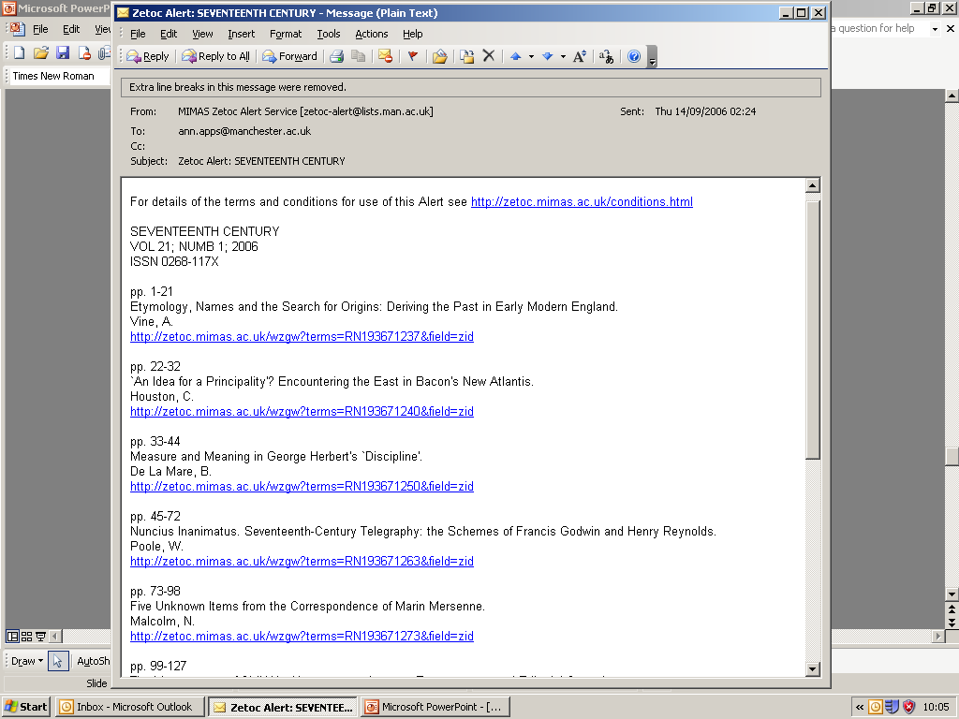

Slide 19
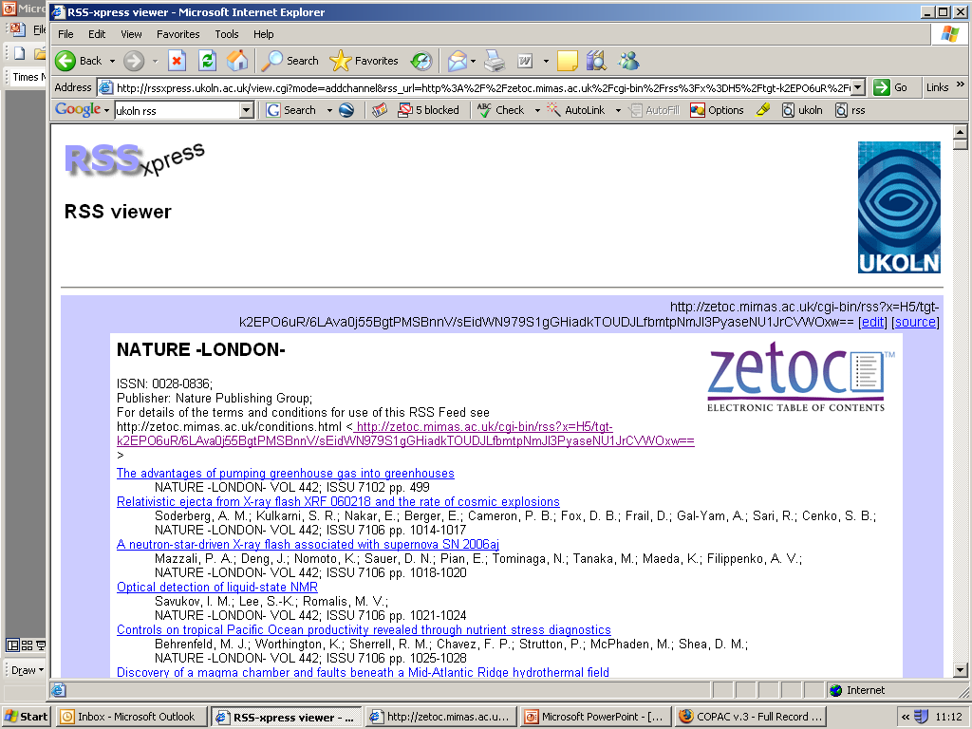

Slide 20
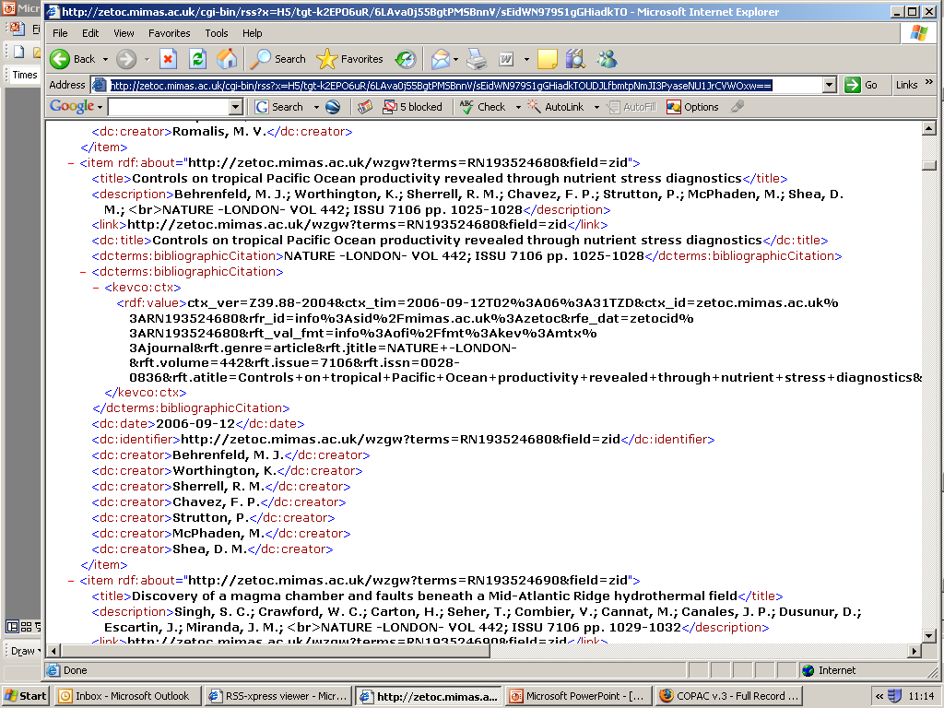

Slide 21
Service oriented research
Citation service
Library
Locate: Resolver
Discover
COinS
Alert
COinS
RSS Alert
Service (more like)
Deliver: article
Service

Slide 22
Personalised Research Workflow
Chudnov: “Change from resolver rules and service pre-coordination by libraries, to enabling dynamic post-coordination of services by a user”
Miller: “Applications should work for the user rather than forcing us to conform to the paths laid out for us”
Social bookmarking, e.g. Connotea

Slide 23
Future Research Scenario
Majority happy with institution provision
  Institutions keen to customise resources
Researchers can choreograph their own research workflow
Discovery services throwing citations as interoperable components
May be caught by unknown downstream serendipitous services

Slide 24
Thank You!
Questions?
ann.apps@manchester.ac.uk

