Slide 1
Making Information Work: the Dublin Core Way

Slide 2
In a nutshell
Challenge: Targeted delivery of Web content – of all types and sources
Solution: Automatic filtering using descriptive “metadata”
The Dublin Core Way: Simple, recombinant modules based on a standard model – the “DCMI Abstract Model”

Slide 3
The Problem
Organizations, even small, possess information worth millions, but cannot get it to the right people DM Direct Special Report, 2006
Users want information simply and quickly, but are satisfied only one time in seven Delphi Group, 2006
Knowledge workers look for information up to 2.5 hours per day, with only 40% success. They re-create existing content more often than they create new Kit Sims Taylor, 1998

Slide 4

What is metadata?
Imagine a supermarket...
  Cans without labels?
  No signs or pointers?
  No promotional booths?
Imagine a library...
  No labels on books?
  No subject shelves?
Now picture Web information...

Slide 5
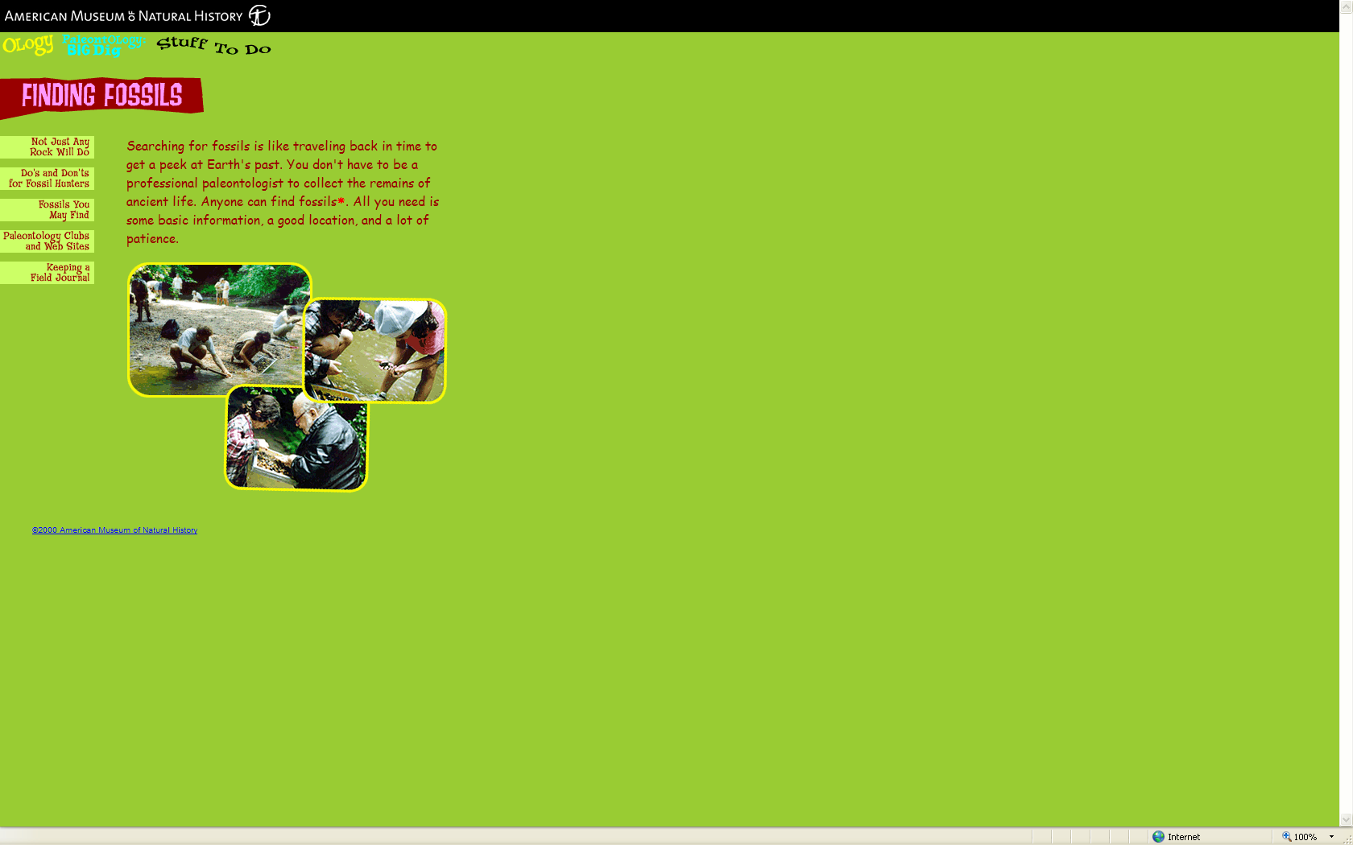
...such as this...
Used by permission

Slide 6
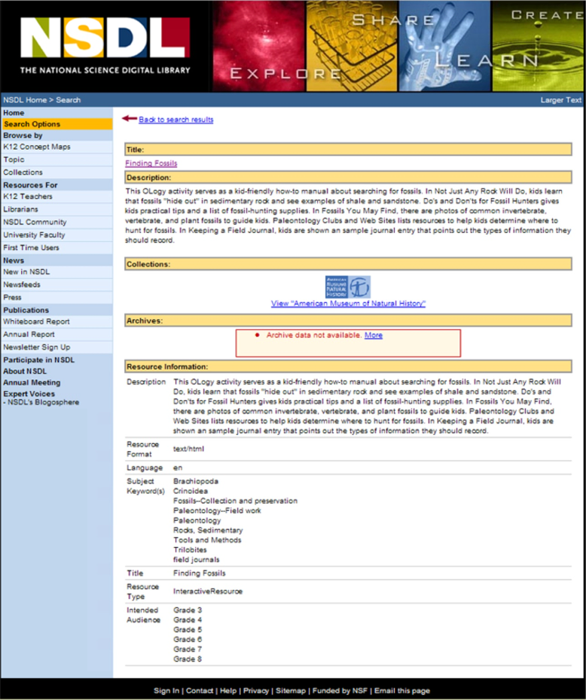
...with added descriptions
This is “metadata”
Used by permission

Slide 7
...the Dublin Core Way
Shared basic elements
  International standard categories
  Many compatible vocabularies – or make your own!
Shared Model
  DCMI’s Abstract Model plugs into Semantic Web applications
Shareable Descriptions
  Customized Application Profiles
  Re-use modular components
+
=

Slide 8
Works with any technology
Database
Website
Intranet
Library
One model – many implementation choices
Widely accepted international standard
Powerful applications using simple building blocks
Integration across platforms and departments
Seamless fit with Semantic Web applications
Can be flexibly extended and customized

Slide 9
Complements full-text search
Full-text search is great for
  Seeking unique names (“Al Gore home page”)
  Browsing general topics (“restless legs syndrome”)
  Finding texts
Metadata improves on full-text search by
  Supporting control of completeness and quality
  Providing images, audio, or other non-textual things
  Enabling structured filtering and exploration

Slide 10
Targeted delivery
Cluster similar resources for browsing
Same author, similar subject, same year...
Personalize delivery
Match topic with audience
“When were these last revised?”
Manage sources
Provide images, recordings, video...
Describe them in words!

Slide 11
Example uses
Legal Department gets all reports on a product in a given year, filtered by type
Customer Service lets user personalize their view of selected content
Human Resources portal pushes dynamic content based on user profiles
Technical managers send automatic updates based on user criteria

Slide 12
Testimonials...
“Adding metadata to unstructured content allows it to be managed like structured content. Applications that use structured content work better.” Merrill Lynch
“Enriching content with structured metadata is critical for supporting search and personalized content delivery.” Forrester
“Content that has been adequately tagged with metadata can be leveraged in usage tracking, personalization and improved searching.” GIGA
Source: J. Busch, 2005

Slide 13
Benefits
Better information means better decisions
Target information for the task at hand
Connect people with information efficiently
Make information available across the enterprise
Promote re-use of existing content
Personalize and customize the user experience
Push content to multiple applications, clustering and grouping “on the fly”

Slide 14

Try a DCMI Tutorial...
http://dublincore.org/resources/training/

Slide 15
Making Information Work: the Dublin Core Way
For more information:
http://dublincore.org/
or
info@dublincore.org

