Slide 1
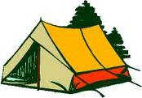
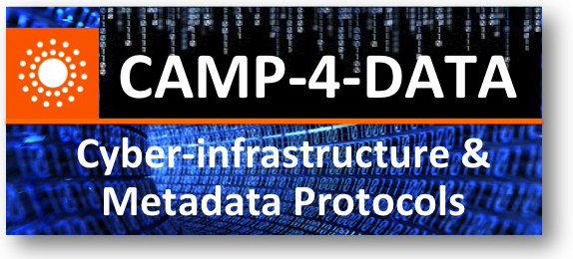




CAMP-4-DATA
  #CAMP4DATA
Alex Ball
Jane Greenberg
Keith Jeffery
Rebecca Koskela
Jian Qin
Sandra Collins
Johannes Keizer
John Kunze
José Merlo
Eloy Rodrigues Robin Rice
Naijla Rettberg
DC-SAM
J. Greenberg/CAMP-Introduction

Slide 2
Overview
DC-SAM and RDA (Research Data Alliance)
Workshop inspiration and goals
ACKOWLEDGEMENTS (brief!)
Around the room

Slide 3
DCMI Science and Metadata Community
…DC-SAM “is a forum for individuals and organizations to exchange information and knowledge about metadata describing scientific data (data methodologically collected for research, analysis, tracking, forecasting, and other uses). The Community focuses on metadata challenges specific to scientific data curation, and solutions that will benefit from the architecture and global reach of the Dublin Core Metadata Initiative.”
MEMEBERS
x
~ 270 ● transdisciplinary ● range of agencies ● GLOBAL
Wiki: http://purl.org/dc/science.
DCMI community page: http://dublincore.org/groups/sam/.

Slide 4
“implements…technology, practice, and connections”… make data work across barriers
RDA ~ Metadata Standards Directory (MASDIR) Working Group “…supported by individuals and organizations involved in the development, implementation, and use of metadata for scientific data….overriding goal to develop a collaborative, open directory of metadata standards applicable to scientific data can help address infrastructure challenge” (~25 members)
    RDA wiki space: https://rd-alliance.org/working-groups/metadata-standards-directory-masdir-working-group.html (and mailing list)
* RDA/Metadata Interest Group (MIG)

Slide 5
Workshop inspiration & goals
Evolved (inform MASDIR & RDA-MIG)
“Explore infrastructure design, applications, and policies that can advance the support of open, collective and sustainable access to metadata standards used for managing scientific data.”
Dialog, share, debate (passionately and productively) about approaches and solutions
Participate
Proceeding to-be-published; a record

Slide 6
CAMP-4-DATA acknowledgements
Alex Ball
Jane Greenberg
Keith Jeffery
Rebecca Koskela
Jian Qin
~~~
Sandra Collins
Johannes Keizer
John Kunze
José Merlo
Eloy Rodrigues Robin Rice
Naijla Rettberg
DC-SAM
J. Greenberg/CAMP-Introduction

Slide 7
Overview
DC-SAM and RDA (Research Data Alliance)
Workshop inspiration and goals
ACKOWLEDGEMENTS (brief!)
Around the room…
Any questions, anyone tweeting
  #CAMP4DATA

