Slide 1
What is a DC Application Profile?
A DCAM-conformant Application Profile (“DC Application Profile”) is packet of documentation which consists of:
  Functional requirements (desirable)
  Domain model (mandatory)
  Description Set Profile (DSP) (mandatory)
  Usage guidelines (optional)
  Encoding syntax guidelines (optional)

Slide 2
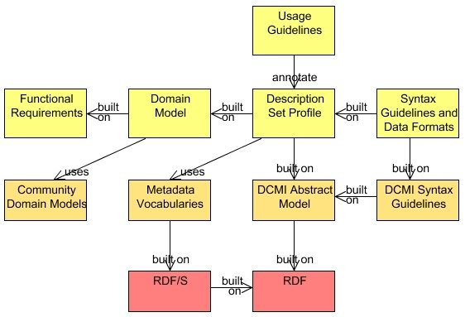

Slide 3
Application Profile
Domain standards
Foundation standards

