Slide 1
‘AGENTS’ proposal
dc-DC Nov.3, 1998
ad-hoc “agents” group
drafting committee: Priscilla Caplan, Martin Dillon & David Bearman
presented by David Bearman

Slide 2
AGENTS PROPOSAL
In dc 2.0, we should have one element for AGENT (perhaps called contributor) in place of Creator, Contributor, Publisher
AND
we should employ a maintained scheme (such as LC Relator, Interested Parties etc.) to assign values specific to the nature of the actions to enable operation/interoperation

Slide 3
Discussion
Does not undo/de-stabilize dc1.0
Will over time deprecate use of Publisher and Creator unless specifically intended to mean author and publisher of text resource
Will enable, if we can find adequate schemes, the integration of metadata with precise operational implications (as in rights community, museum documentation,etc.)

Slide 4
Experience
Each of the implementations reported yesterday had trouble with these elements; some only used one, others two, others wanted more qualifiers
Instructors finding it difficult to clearly differentiate when to use which element
Logical map shows close, but not precise, fit between the 3 and 3 concepts of ‘stuff’

Slide 5
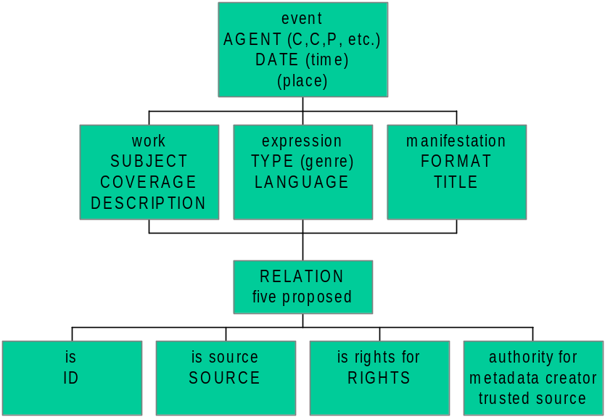
Possible dc 2.0 item model

