Slide 1
Netscape’s SPF
Site Preview Format
The 6th Dublin Core Workshop
Eric Miller
Research Scientist
OCLC Office of Research
emiller@oclc.org
http://purl.org/net/eric/talks/spf/

Slide 2
SPF Overview
Publishers agree to provide metadata content about resources
  ABCNEWS, Amazon.com, CNN, NY Times, etc
  http://www.netscape.com/newsref/pr/newsrelease488.html
Netcenter is Netscape’s integration and navigation service for this metadata

Slide 3
SPF Metadata Integration
Integration requires common syntax, structure and semantics of content’s metadata
  XML is the syntax
  RDF data model defines structure
  (DC+) define the semantics
SPF is an RDF application that builds on the Dublin Core 1.0 semantics

Slide 4
DC+ Semantics
Uses Dublin Core semantics and extends
Changes labels
  “Summary” is label, dc:Description is token
Adds additional domain-specific semantics
  Image, channelTitle, etc.
Builds on DC using RDF schemas
  RDF schemas provide foundation for reusable vocabularies

Slide 5
SPF Schema
Labels and Resource IDs
“Title”
“Author”
“Title of Channel”
“Text of Content”
“Image”
“Content Summary”
“Related Items”
“Category”
“Provider”
“Date”
dc:Title
dc:Contributor
spf:channelTitle
spf:contentText
spf:Image
dc:Description
dc:Relation
dc:Subject
dc:Publisher
dc:Date

Slide 6
SPF Metadata Integration
Netscape’s
Netcenter
SPF
SPF
SPF
SPF

Slide 7
<rdf:RDF xmlns:rdf = “http://www.w3.org/TR/WD-rdf-syntax#”
xmlns:dc = “http://purl.org/dc/elements/1.0/”
xmlns = “http://rdf.netscape.com/spf/1.0/”>
...
<Spotlight rdf:about="et1100998">
<channelTitle>ET Spotlight</channelTitle>
<contentText>interviews/sharonstone/sharonstone_int.html</contentText>
<image>images/people/sharonstone/sharonstone_mighty1-108.jpg</image>
<dc:Title>
Week of 10/12/98 - 10/19/98 - Sharon Stone Is Mighty
</dc:Title>
<dc:Description>
From sexy seductress to nurturing mom,
Sharon Stone boldly breaks the mold in her
new film 'The Mighty.' ET sits down with Sharon
to talk about her new role as a protective mom, as
she reveals some of her own feelings about motherhood.
</dc:Description>
<dc:Subject>Sharon Stone, Interview</dc:Subject>
</Spotlight>
…
</RDF>

Slide 8
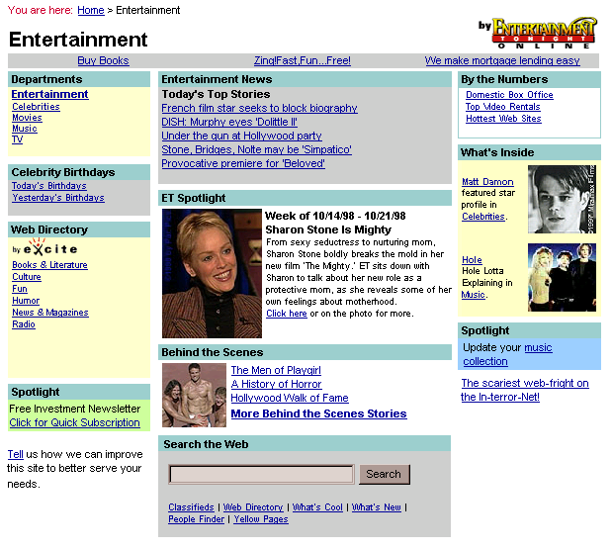

Slide 9
Why is this important?
Proof this that RDF and DC 1.0 have reached a level of maturity for corporate use
Proof that a common Data Model is critical when aggregating data from multiple sources
Excellent case of semantic “reusability”

Slide 10
More Information
Netscape Contacts
  Eckart Walther (eckart@netscape.com)
  R.V. Guha (guha@netscape.com)
Dublin Core Contact
  Eric Miller (emiller@oclc.org)

