Slide 1
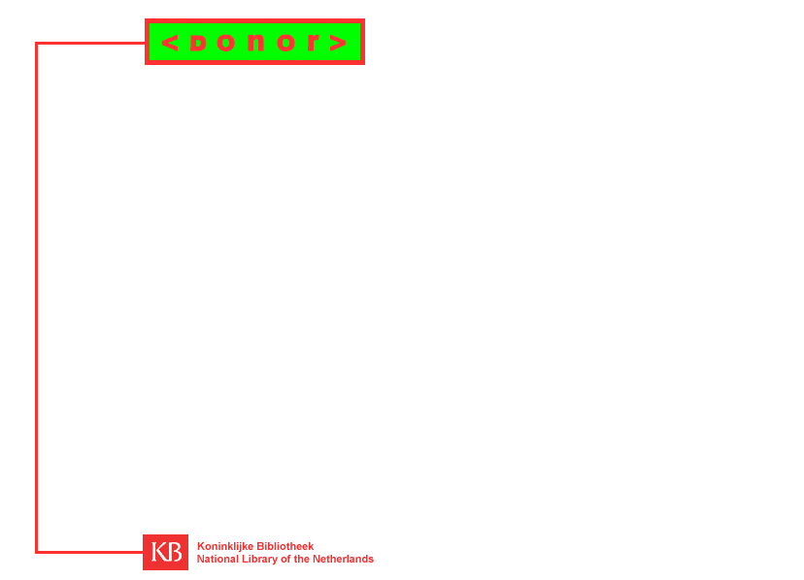
THE DONOR PROJECT
Titia van der Werf-Davelaar

Slide 2
Project
Financed by: Innovation of Scientific Information Provision (IWI)
Duration:
  phase 1: 1 may 1998 - 1 may 1999
  phase 2: 1 may 1999 - 1 may 2000

Slide 3
Partners
Koninklijke Bibliotheek (KB), National Library of the Netherlands
SURFnet bv, national research network organisation
Academisch Computer Centrum Utrecht (ACCU), university computer centre of Utrecht

Slide 4
Aim
DONOR aims to create an enabling information infrastructure on SURFnet. In particular for:
  information management
  information retrieval

Slide 5
Target group
DONOR target group = SURFnet target group.
DONOR looks at the target group from 2 perspectives:
  as information suppliers
  as information intermediares

Slide 6
testgroep
User group
Test group
Target group

Slide 7
Areas of investigation
DONOR-phase-1: bibliographic perspective
  to identify and to describe resources
user needs ?
  For example: export metadata from existing databases; cross-referencing
DONOR-phase-2 :
  content description and selection
  trusted metadata

Slide 8
Areas of investigation
Metadata
Granularity
Versioning
URL-management
Identification

Slide 9
Metadata
Requirements
  for resource discovery on the web
  for harvesting, indexing and searching via SURFnet Search Engines
  for re-use by third parties
best choice: Dublin Core

Slide 10
Metadata
User Guide
  Dutch translation of DC user guide
  Localisation for indexing purposes
    Creator, Publisher, Contributor: syntax rule (Lastname,Firstname,in between words)
    Date: scheme = ISO 8601
    Format: scheme = MIME TYPES (RFC 2046)
    Language: scheme = ISO 639-1

Slide 11
Metadata: user guide
Localisation for specific purposes:
  Relation.IsPartOf for granularity requirements
  Source: Requirement for digitized resources: searching on the source should result in finding the digitized resource. In DONOR we recommend nesting of DC elements as sub-elements (as discussed at DC-5)
    DC.Source.x-Title
    DC.Source.x-Creator
    …

Slide 12
Metadata
Metadata generator
  specification of requirements
  comparison of existing tools
  develop tool on the basis of:
    Nordic Metadata Template
    DC.dot (BIBLINK)
SURFnet Search Engines
  DONOR index
  query interface

Slide 13
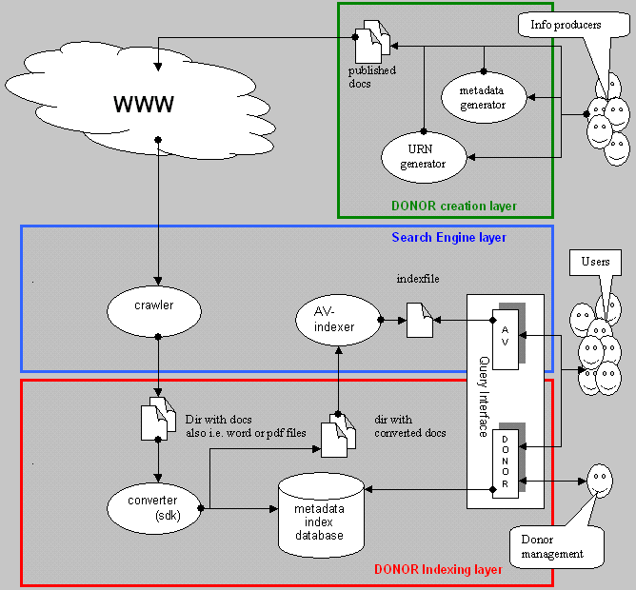
Architecture

Slide 14
Granularity and identification
Problem: file-based search engine
Requirements
  identify content entities not files
  recognize content structure independently from file directory structure: whole/part relations
Solutions
  encode structure as part of content (navigation map, content index, XML/XLink,, etc.)
  encode structure in identifier (eg. SCICI)
  encode structure in metadata

Slide 15
Granularity and identification
DONOR Solution
  encode structure in metadata
  DC.Relation.IsPartOf
  the pointer to the parent resource is a URL
  preferred solution: URN pointer for the parent
    metadata maintenance
    re-use of metadata by third-parties

Slide 16
Versioning and identification
Problem
  no standard updating procedures
  no standard method to distinguish different versions
Requirements
  identify different versions of same work
  record version history

Slide 17
Versioning and identification
Scenarios
  update overwrites older version: only most recent version available at one location. One URN only needed. Metadata-set needs updating too. Version history in metadata?
  Different versions co-exist: different URLs. Do they require different URNs and different metadata-sets?
  Archiving older versions, most recent version at same URL: older versions have archive-URL.

Slide 18
Versioning and identification
Solutions
  versioning info + authentication in identifier (UUI)
  versioning info in metadata:
    HTTP-header level negotiation : metadata server-bound
    HTML meta-tag embedded in resource: metadata resource-bound
  versioning info in archive:
    record version history in archive metadata

Slide 19
Versioning and identification
Concept of persistent and changeable metadata:
  persistent elements (title, author, etc.) are resource bound.
  changeable metadata (location, access rights, etc..) are not resource bound.
Consequences for identification of versions
  resource bound: each version gets its own URN
  not resource bound: one URN for several versions.

Slide 20
Metadata and identification
1-to-1-relationship between URN and persistent metadata
  embedded in resource
1-to-many relationships between URN and variable metadada
  NOT embedded in resource
  provided by resolution service

Slide 21
Versioning
Version info as persistent metadata embedded in resource: DC solutions
  version nr. As sub-element of title (proposal Denmark)
  version date as (creation) Date
  version relationships with Relation.IsVersionOf and Relation.HasVersion.

Slide 22
Promote use of metadata
DONOR-L discussion-list
DONOR helpdesk
tools to assist with creation of metadata
success of DONOR depends on:
  how much actual (measurable) DC metadata is created
  how representative the user group (considering the target group) is

Slide 23
DONOR DC-implementation issues
Metadata for non-networked resources:
  DC.Source?
Metadata for granularity:
  DC.Relation
Metadata for versioning:
  DC.Title ?
  DC.Date
  DC.Relation

Slide 24
DONOR DC-implementation issues
User Guide
  implementors need to make concrete choices for use of DC. The DC user guide leaves much room for different interpretations/implementations
DC stability for implementors
  versioning of DC
  compatibility between different versions and different implementations

Slide 25
Other DONOR implementation issues
Identification of resources with URNs
  which existing scheme is appropriate to be used as URN in the DONOR context?
  Resolution protocol for URNs
URL management
  identification with URNs is not *only* or even *best* solution for URL-management
  how to ensure persistence of location?

