Slide 1
Meta Data Concepts in the European Environment Information and Observation Network
* * *
Thom Pick, European Topic Centre on Catalogue of Data Sources, Hannover
DC-8, Ottawa, 2000-10-5
Notes:
This is a general presentation about EIONET, what it is an where it is going.
This title page shows all the major institutions or companies that have been instrumental in shaping the current EIONET.
See
http://www.eea.eu.int/ (EEA)
http://www.eionet.eu.int/ (EIONET Public)
http://eea.eionet.eu.int/ (EIONET Extranet)
http://www.ispo.cec.be/ida/ida.html (IDA)
This presentation has been prepared by Hannu Saarenmaa.
It is updated regularly. This is version 20.

Slide 2
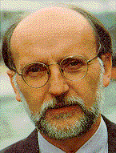
The EEA's Mission
... is to deliver
timely, targeted, relevant and reliable information
to policy-makers and the public for the development and implementation of sound environmental policies in the
European Union and other EEA member countries.
http://www.eea.eu.int/
Domingo Jiménez-Beltrán
Executive Director, EEA

Slide 3
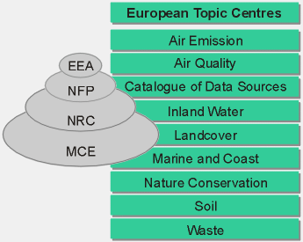
EIONET - The Network
EIONET is the main vehicle of the European Environment Agency to collect data, information and knowledge for the process of reporting on the state of environment.
The core network connects more than 500 institutions in the 18 EEA member countries.
Each country operates a co-ordinating institute (National Focal Point - NFP) and nine expertise centres (National Reference Centres - NRCs).

Slide 4
EIONET - The Network
EEA: the central node.
ETCs: multi-national consortia,
contracted by EEA to execute tasks of
EEA's work programme. ETCs work
as an extension of the Agency and
are responsible for data collection
in their topic area.
NFPs: are appointed and funded by
member countries and responsible for
coordination of national activities
related to the EEA work programme.
NRCs:institutions with expertise in
areas corresponding to ETC areas.
Collectors and providers of
national environmental data.
Contact Information is a (the)
central requirement/asset

Slide 5

Data Flows in EIONET
Data access and visualisation
E2RC
Reports
Information Retrieval System
Reference Centre Concept
EEA Warehouse
European Layer
National Layer

Slide 6
A network of networks
Spatial levels
EEA
National Data Providers
National Data Providers
Coordination
Coordination
EIONET
Reporting
Sytem
ETC ETC
European Level
OECD
UNEP
EU
NFP
Eurostat
Other
Coordination
EEA
Coordination
National Data Providers
National Data Providers
ETC ETC
National Level
NFP
NRC NRC NRC NRC
NRC NRC NRC NRC
Data collecting and reporting networks: EIONET, European Statistical Sytem, ...
Notes:
2 main levels
main types of nodes
NFP in both levels
data & information flows bottom-up
comments by Jan
ideal situation of a running system

Slide 7
Current situation: Overlapping data flows
The Public and Decision-Makers
Eurostat
EC
EEA
OECD
UNEP
Other
DG
DG
ETC
DG
DG
NRC
NFP and other National Authorities
Notes:
This is the current reality.
Result of a historical development.
The same people will have to report the same or slifghtly different data repeatedly to the various international institutions.
Then these international institutions again have the problem to synchronise their data between each other.

Slide 8
Target situation: Streamlined data flows
The Public and Decision-Makers
Eurostat
EC
EEA
OECD
UNEP
Other
DG
ETC
DG
EIONET
Server
NRC
NFP and other National Authorities
Notes:
This is where we could be in two years.
Add one more level of abstraction.
All data is reported to the data warehouse in EIONET servers, be they at ETC or NFP.
From there the international players can then take what is needed.
The data must of course be often packaged to dossiers: “This is the report of the Country of X to EC.” This can be handled by software.
Data entry could initially be through forms or by importing spreadsheets and such.

Slide 9
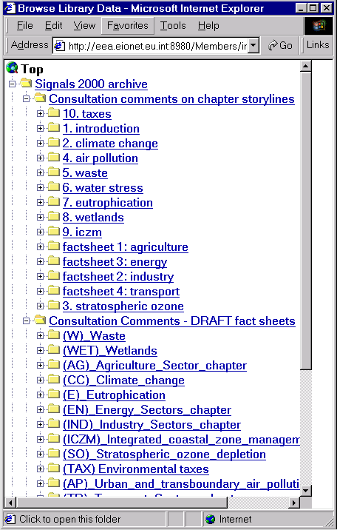
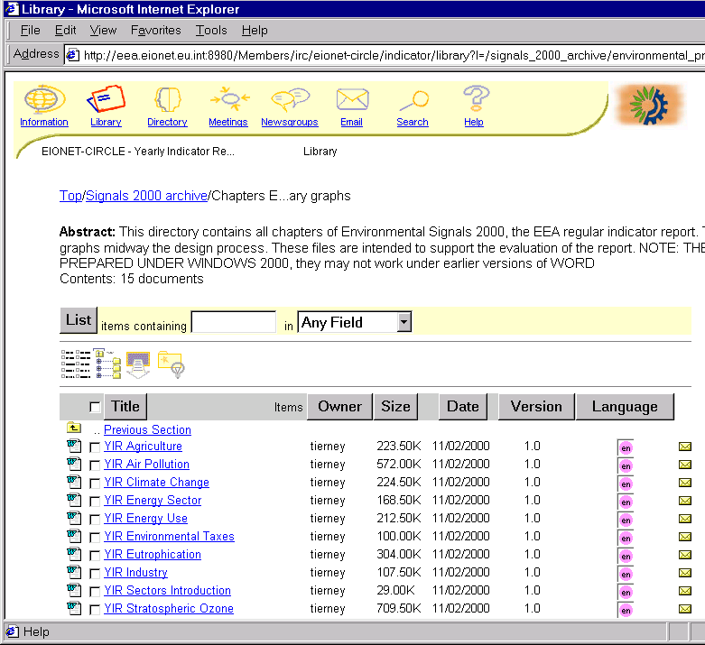
CIRCLE Library Service

Slide 10
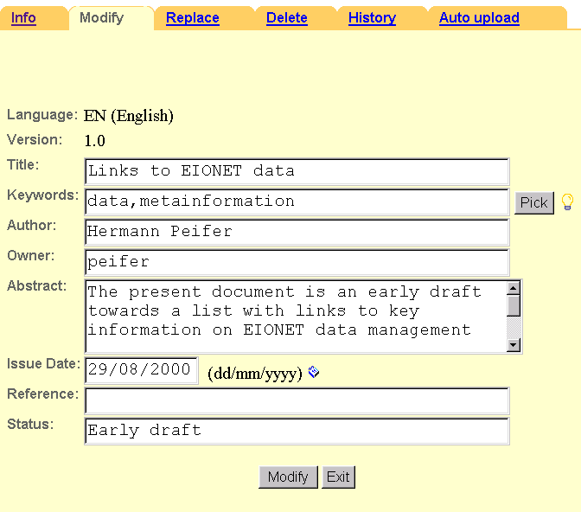
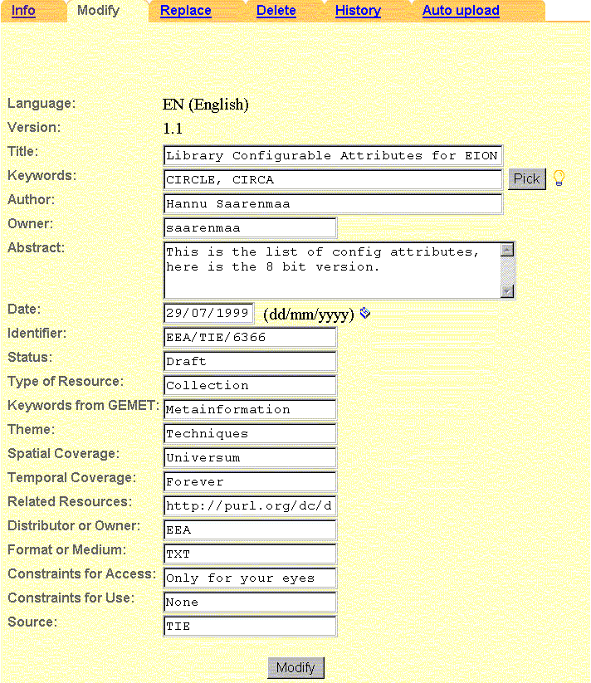
Customised CIRCLE Library Meta Data
Default library attributes
Customised library attributes

Slide 11
EIONET Meta Data Standard
Global Environmental Locator System Element Set (GELOS)
  adopted from G7 working group on environmental metadata in late 1996
  based on GILS
  DC compliant
  focus on both, discovery and description
  contains qualifiers for contact information
  however, datamodel and applications consider actors as individual resources
XML as exchange format

Slide 12
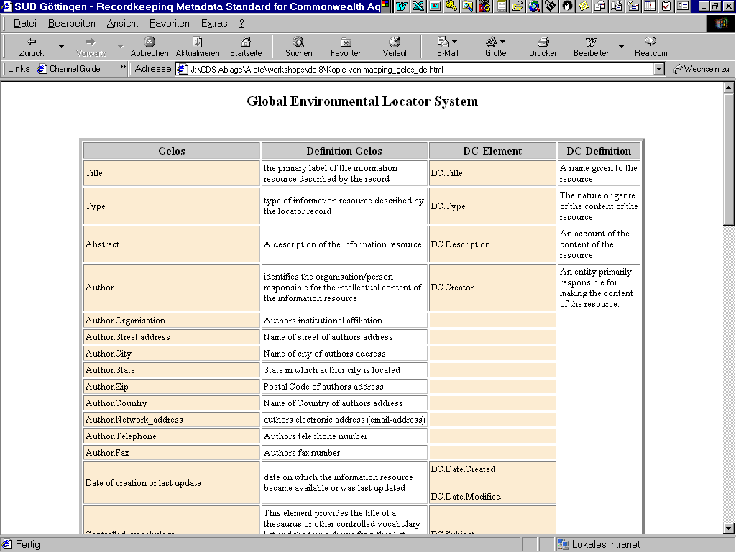

Slide 13
Multilingual Aspects
General Multilingual Environmental Thesaurus
consists of ~5200 terms
translated into 15 european languages
polyhierarchical
includes synonyms
‘sorted’ by environmental themes
used for indexing and discovery
ISO 639-2 for language coding

Slide 14
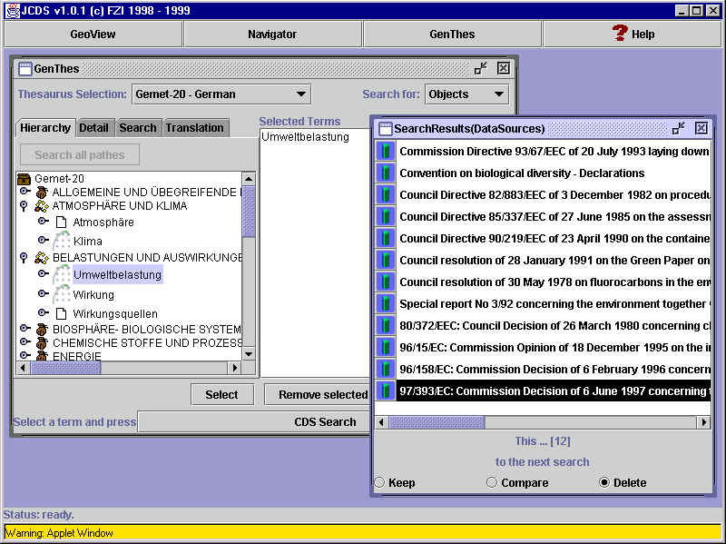
Searching and Indexing with GEMET

Slide 15
Contact Information
Name Name of Institution or Person
Type Person, Organisation
Contact Postal Address, electronic address
Original Identifier Database ID
Terminology controlled vocabulary, uncontrolled voc.
Description
Relation to other contact(s), to resources
Date Date of Creation, last modification

Slide 16
Geographical Information
NUTS Code V7
ISO 3166
Lambert - Azimuthal projection for bounding box

Slide 17
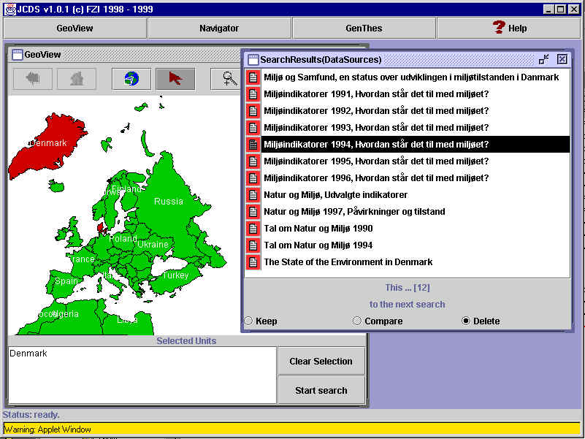
Searching records through maps

Slide 18
Need for environmental domain?
The environmental community is a cuts across almost every
domain:
Administration
Legislation
Geographical Information
Science (Geology, Chemistry, Physics, Biology .....)
Harmonisation efforts are basically hopeless, unless built on existing initiatives like DC
Construct environmental schema/application that builds on existing namespaces

Slide 19
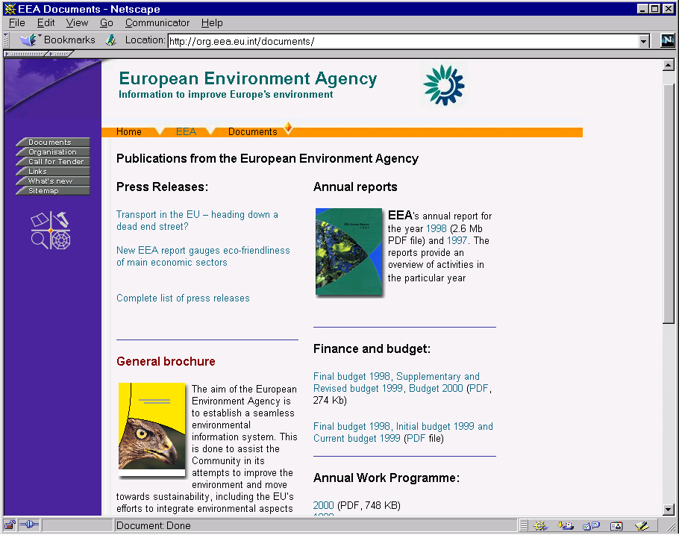
More information available at: http://org.eea.eu.int

Slide 20
Even more information available at:
http://www.mu.niedersachsen.de/cds
thom.pick@mu.niedersachsen.de

