Slide 1
METS-Based Cataloging Toolkit for Digital Library Management System
Dong, Li
Tsinghua University Library

Slide 2
Introduction
Digital Library Management System of Tsinghua University(TH-DLMS)
  a platform to preserve various kinds of digitalized resources
  manage distributed repositories and provide kinds of service for research and education
  Based upon Fedora(Flexible Extensible Digital Object and Repository Architecture ) System.

Slide 3
Introduction
Fedora provides powerful functions for various kinds of digital objects management.
No cataloging tool is available for digital objects creation and preservation in Fedora System.
Developing a cataloging toolkit is necessary for TH-DLMS.

Slide 4
Metadata for Digital Objects Preservation
Not only the digitalized resources themselves should be saved, the metadata of the digitalized resources should also be saved and packaged with them properly, so that those resources can keep original status after transmission and refreshment.

Slide 5
Metadata for Digital Objects Preservation
Three types of metadata for preservation
  Descriptive Metadata
  Structural Metadata
  Administrative Metadata

Slide 6
Descriptive Metadata
Dublin Core (DC) metadata element set is chosen as the standard for TH-DLMS resource description.
  The need of managing various kinds of digital resources.
  DC is widely used for cross-domain information resource description.

Slide 7
Structural Metadata
Representing the relationships inside a digital object.
<structMap> section of METS(Metadata Encoding and Transmission Standard) is used to record the structural metadata.

Slide 8
Administrative Metadata
Data that supports the unique identification, maintenance, and archiving of digital objects, as well as related functions of the organization managing the repository.
Simplified administrative metadata standards recommended by METS Official Web Site is chosen for TH-DLMS.

Slide 9
Administrative Metadata
Technical metadata
Rights metadata
Source metadata
Digital provenance metadata

Slide 10
Standard for Encoding Metadata
METS(Metadata Encoding and Transmission Standard) is used to incorporate metadata of digital objects in TH-DLMS.
  A standard for encoding descriptive, administrative, and structural metadata regarding objects within a digital library.
  Provides an XML document format for encoding metadata necessary for both management of digital library objects within a repository and exchange of such objects between repositories.

Slide 11
Functions of the Cataloging Toolkit
Metadata Cataloging
  input and edit metadata
Cataloging the Structure
  use this toolkit to create a complete structure of the resource: from the whole book node, chapter node, and section node to page node.
  node can extend to any level with free types.
  auto-construction of page nodes.

Slide 12
Functions of the Cataloging Toolkit
Resource Linking
  organize the metadata and digital resources with correct structure.
Importing Metadata
  designed for some existing metadata records stored in other formats.
  metadata mapping should be made between the importing format and DC.

Slide 13
Functions of the Cataloging Toolkit
Packaging and Creating METS Objects
  package all types of metadata with linking information to create METS objects.
  documents are saved in standard METS format.

Slide 14
Implementation
J2SE SDK(Java2 Standard Edition Software Development Kit) 1.4.2 or later.
use XML as the final format of metadata storage, define XML Schema for each metadata definition.
JWSDP(Java Web Services Developer Pack) 1.2 or later; including JAXB(Java Architecture for XML Binding) 1.01 or later as XML processing framework, which is a high level interface for processing XML as Java Objects, and easy to do validation of XML.

Slide 15
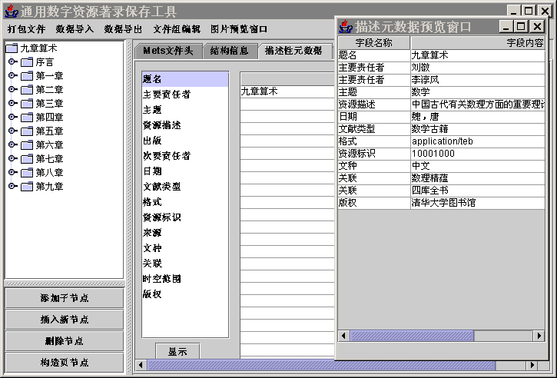
Results and Example
Some digitalized Chinese ancient books.

Slide 16
Results and Example
Simple Image of Chinese Ancient Architecture
  Original metadata records
  Result metadata records after importing.

Slide 17
Demo Show
Cataloging Toolkit Show
DLMS Show

Slide 18
Thank you!

