Slide 1

Open Source Software to Manage Digital Collections in a Decentralized Environment
14 October 2004

Slide 2
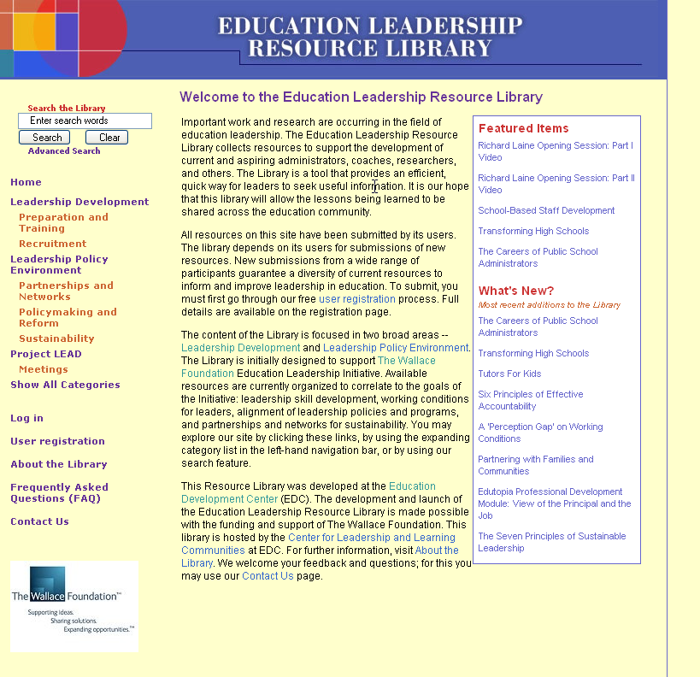

Slide 3
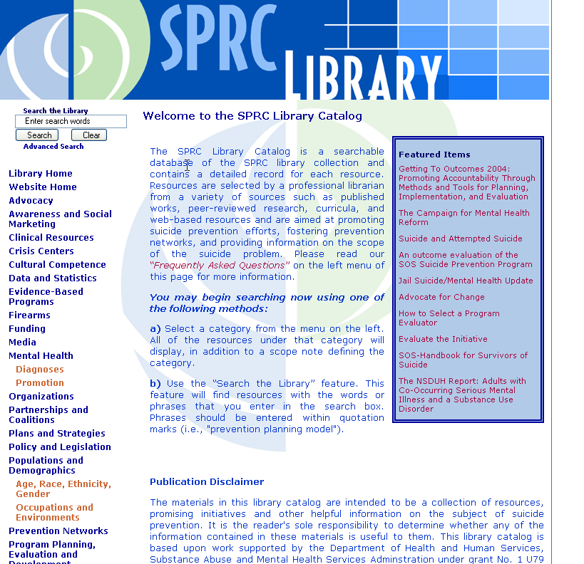

Slide 4
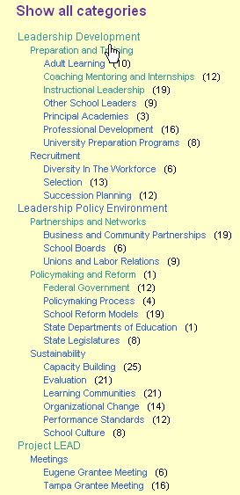

Slide 6
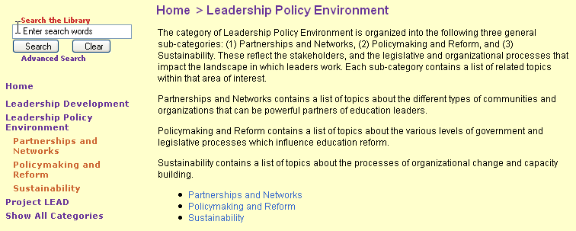

Slide 7
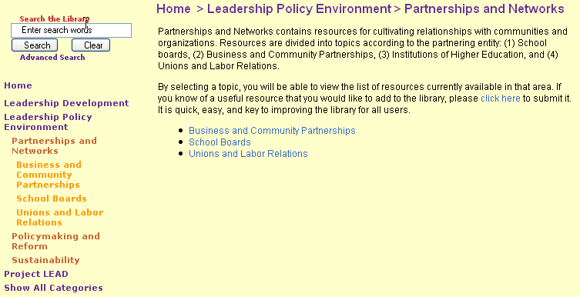

Slide 8
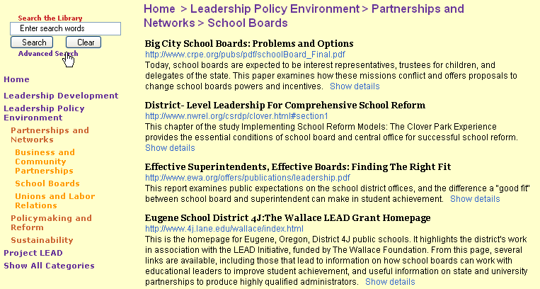

Slide 9
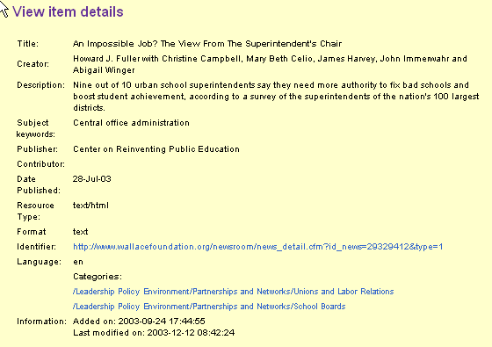

Slide 10
DC Elements
Title, Creator, Subject, Description, Publisher, Contributor, Date, Type, Format, Identifier, Language
EDC namespace
Center, Project (name, code, person)

Slide 11
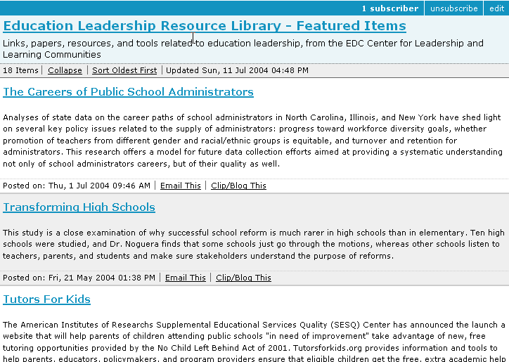

Slide 12
Scott Gunn
sgunn@edc.org
http://cllc.edc.org/rl/

