Slide 1
Improving Metadata Quality: Augmentation and Recombination
Diane I. Hillmann
Naomi Dushay
Jon Phipps
National Science Digital Library

Slide 2
Introduction
Useful services depend on good metadata, but most metadata not very good
Human created metadata is expensive
Automated crawling strategies limited by:
  Accessibility barriers (rights issues, technical issues)
  Variability of crawling technologies for non-text
Best metadata does not rely solely on information contained within the resource itself
  Ex.: Controlled vocabularies, descriptions, links

Slide 3
The NSDL Environment
Functions as a metadata aggregator
  Simple, two-level hierarchy (Collections & items)
  Based on OAI-PMH harvest model
  Each harvested item associated with a collection
Collection records managed via internal system that also drives automated harvest/ingest processes
  Harvested records split into elements for storage and reassembled for output

Slide 4
Why Transform Metadata at All?
Four categories of problems associated with decreased user capability
  Missing data: elements not present
  Incorrect data: values not conforming to proper usage
  Confusing data: embedded html tags, improper separation of multiple elements, etc.
  Insufficient data: no indication of controlled vocabularies

Slide 5
Transforming Metadata “Safely”
Enhance original data with no risk of degradation
Provide low cost, scaleable way to improve the quality and predictability of data
  Remove “noise”: empty elements, useless values
  Detect and identify controlled vocabularies: DCMIType and IMT values
  Normalize presentation: clean up values, remove double XML encodings, extra whitespace, etc.

Slide 6
Replacing Safe Transforms with Metadata Augmentation
Managing each "record" separately made automated maintenance and enhancement difficult
Many sources of data required better definitions of “quality”
“Augmentation” makes the knowledge and expertise of NSDL data managers available to consumers of the data

Slide 7
From Records to Elements
Metadata record -- “a series of statements about resources” which can be aggregated to build a more complete profile of a resource
Statements come with source information, and links to detail about the service that created them

Slide 8
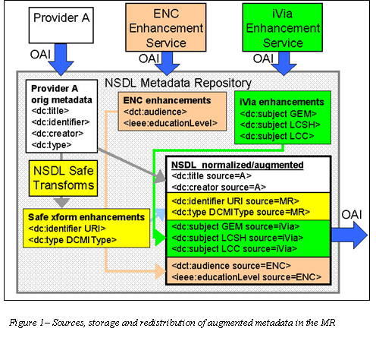

Slide 9
Exposing Quality Information
Metadata statements vary in quality, and may be subjective
Quality of statements can be determined by knowledge of the source, and knowledge of the methodology used to create it
Detailed provenance itself is an indicator of quality metadata

Slide 10
Exposing Data to Downstream Users
Two major issues:
  Linking statements to particular harvested source records (including the datestamp of the harvest)
  Linking records to the services that provided them (including descriptions of those services and the methods used to create the metadata)
Required the creation and exposure of service records and a service vocabulary to categorize them

Slide 11
<dc:identifier sourceRecordID="993251" xsi:type="dct:URI">http://www.chem.qmw.ac.uk/surfaces/scc/</dc:identifier> -
<dc:title sourceRecordID="332518">An Introduction to Surface Chemistry</dc:title>
<dc:creator sourceRecordID="332518">Nix, Roger</dc:creator>
<dc:description sourceRecordID=" 332518">Theoretical and descriptive material for an introductory surface science course. Topics covered include structure of surfaces and detailed information on a variety of surface analytical techniques.</dc:description>
<dc:type sourceRecordID="993251" xsi:type="dct:DCMIType">Text</dc:type>
<dct:medium sourceRecordID="993251" xsi:type="dct:IMT">text/html</dct:medium>
<dc:subject sourceRecordID="753681" xsi:type="dct:LCSH">colloids</dc:subject>
<dc:subject sourceRecordID="753681" xsi:type="dct:LCSH">surface chemistry</dc:subject>

Slide 12
<oai:about>
<sourceRecords>
<sourceRecord ID="332518" sourceServiceID="316878">
<originDescription harvestDate="2004-07-22T14:10:02Z" altered="false">
<baseURL>http://services.nsdl.org:8080/nsdloai/OAI</baseURL>
<identifier>oai:nsdl.org:316878:oai:asdlib.org:asdl001709</identifier>
<datestamp>2002-11-11T15:19:15Z</datestamp>
<metadataNamespace>http://ns.nsdl.org/nsdl_dc_v1.02/</metadataNamespace>
</originDescription>
</sourceRecord>

Slide 13
<sourceServices>
<sourceService ID="316878">
<dc:title>Analytical Sciences Digital Library (ASDL)</dc:title>
<dc:description>The ASDL is an electronic library that collects, catalogs and links web-based information or discovery material ... </dc:description>
<serviceType>collection</serviceType>
<serviceDescription xsi:type="nsdl:html">http://nsdl.org/mr/xhtml/316878</serviceDescription>
</sourceService>
<sourceService ID="9947365">
<dc:title>iVia</dc:title>
<dc:description>The iVia metadata augmentation service provides subject keyword and LCSH subject headings...</dc:description>
<serviceType>augmentation</serviceType>
<serviceDescription xsi:type="nsdl:xml">http://nsdl.org/mr/xml/4718</serviceDescription>
</sourceService>

Slide 14
Conclusions
New role for “metadata aggregators”—providing enhanced metadata for other services to re-use
  Integrating fragmentary metadata created by automated services
  Improving metadata in standard ways
  Exposing all relevant data in ways that allow consumers to evaluate quality and usefulness

