Slide 1
New and traditional descriptive formats in the library environment
DC2004: IFLA session
13 Oct. 2004
Rebecca Guenther (rgue@loc.gov)
Library of Congress

Slide 2
Overview of presentation
MARC 21 overview
Evolution to XML formats
MARCXML
MODS
Transformations between formats
METS
MADS
Future considerations

Slide 3
MARC 21
MARC 21: an international descriptive metadata format
Components
  Markup: data element set
  Semantics: meaning of elements (but content defined by other standards)
  Structure = syntax for communication

Slide 4
MARC environment
High degree of conformance and limited number of implementations
1000s of MARC systems
Widespread use of bibliographic utilities and ILS implementations world-wide based on MARC: 1 billion MARC records in local & network systems
Standard communication format with predictable content has enabled sharing records

Slide 5
The new environment
Importance of descriptive metadata
  Major focus of library catalog
  Increased number of descriptive metadata standards for different needs
  Most standardized of types of metadata
MARC systems are retooling to make use of the flexibility of XML
Gradual evolution because of large investments in MARC systems
Need for additional metadata for electronic resources

Slide 6
Descriptive metadata evolution in libraries
Need to take advantage of XML
  Establish standard MARC 21 in an XML structure
Need simpler (but compatible) alternatives
  Development of MODS
Need interoperability with different schemas
  Assemble coordinated set of tools
Need continuity with current data
  Provide flexible transition options

Slide 7
Interaction between metadata standards
MARC will continue to be exchanged, perhaps in XML
Libraries may receive records using other metadata schemes (DC, ONIX, TEI, etc.)
Descriptive metadata may come as part of digital objects in any XML schema
Collaborative use of metadata for access
  OAI harvesting
  SRU/SRW (Search and retrieve for the Web)
Reuse of existing standards (e.g. DC adoption of MARC relators/roles)

Slide 8
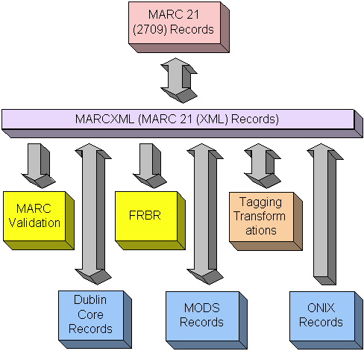
MARC 21 evolution to XML
13 Oct. 2004
<footer>DC2004-IFLA

Slide 9
MARC 21 (2709) record (machine view)
00967cam 2200277 a 4500 001000800000005001700008008004100025020005300229040001800282050002400312082002100336100003000357245007400387260004400461300003500505440001200540500002000552650004200572651002500614_x001e_
3471394_x001e_19990429094819.1_x001e_931129s1994 wauab 001 0 eng _x001e_ _x001f_a 93047676 _x001e_ _x001f_a0898863872 (acid-free, recycled paper) :_x001f_c$14.95_x001e_ _x001f_aDLC_x001f_cDLC_x001f_cDLC _x001e_00_x001f_aGV1046.G3_x001f_bG47 1994_x001e_00_x001f_a796.6/4/0943_x001f_220_x001e_1 _x001f_aSlavinski, Nadine,_x001f_d1968-_x001e_10_x001f_aGermany by bike :_x001f_b20 tours geared for discovery /_x001f_cNadine Slavinski._x001e_ _x001f_aSeattle, Wash. :_x001f_bMountaineers,_x001f_cc1994._x001e_ _x001f_a238 p. :_x001f_bill., maps ;_x001f_c22 cm._x001e_ 0_x001f_aBy bike_x001e_ _x001f_aIncludes index._x001e_ 0_x001f_aBicycle touring_x001f_zGermany_x001f_xGuidebooks._x001e__x001d_

Slide 10
MARC 21 in XML – MARCXML
MARCXML record
  XML exact equivalent of MARC (2709) record
  Lossless/roundtrip conversion to/from MARC 21 record
  Simple flexible XML schema, no need to change when MARC 21 changes
  Presentations using XML stylesheets
  LC provides converters (open source)
  Adopted by OAI to replace oai_marc
http://www.loc.gov/standards/marcxml

Slide 11
MARC21 (2709) to MARCXML
<record xmlns="http://www.loc.gov/MARC21/slim">
<leader>00967cam 2200277 a 4500</leader>
<controlfield tag="001">3471394</controlfield>
<controlfield tag="005">19990429094819.1</controlfield>
<controlfield tag="008">931129s1994 wauab 001 0 eng </controlfield>
<datafield tag="020" ind1=" " ind2=" ">
<subfield code="a">0898863872 (acid-free, recycled paper) :</subfield>
<subfield code="c">$14.95</subfield>
</datafield>
<datafield tag="040" ind1=" " ind2=" ">
<subfield code="a">DLC</subfield>
<subfield code="c">DLC</subfield>
<subfield code="d">DLC</subfield>
</datafield>
<datafield tag="050" ind1="0" ind2="0">
<subfield code="a">GV1046.G3</subfield>
<subfield code="b">G47 1994</subfield>
</datafield>
<datafield tag="082" ind1="0" ind2="0">
<subfield code="a">796.6/4/0943</subfield>
<subfield code="2">20</subfield>
</datafield>
<datafield tag="100" ind1="1" ind2=" ">
<subfield code="a">Slavinski, Nadine,</subfield>
<subfield code="d">1968-</subfield>
</datafield>

Slide 12
MARCXML record (continued)
<datafield tag="245" ind1="1" ind2="0">
<subfield code="a">Germany by bike :</subfield>
<subfield code="b">20 tours geared for discovery /</subfield>
<subfield code="c">Nadine Slavinski.</subfield>
</datafield>
<datafield tag="260" ind1=" " ind2=" ">
<subfield code="a">Seattle, Wash. :</subfield>
<subfield code="b">Mountaineers,</subfield>
<subfield code="c">c1994.</subfield>
</datafield>
<datafield tag="300" ind1=" " ind2=" ">
<subfield code="a">238 p. :</subfield>
<subfield code="b">ill., maps ;</subfield>
<subfield code="c">22 cm.</subfield>
</datafield>
<datafield tag="440" ind1=" " ind2="0">
<subfield code="a">By bike</subfield>
</datafield>
<datafield tag="500" ind1=" " ind2=" ">
<subfield code="a">Includes index.</subfield>
</datafield>
<datafield tag="650" ind1=" " ind2="0">
<subfield code="a">Bicycle touring</subfield>
<subfield code="z">Germany</subfield>
<subfield code="x">Guidebooks.</subfield>
</datafield>
</record>

Slide 13
What is MODS?
Metadata Object Description Schema
Bibliographic element set
Initiative of Network Development and MARC Standards Office at LC
Uses XML Schema
Specifically for library applications, although could be used more widely
A derivative (and subset) of MARC elements
Notes:
Element set: list of elements that can be used; list that must be used; other standards/policies define levels
Semantics=meaning of fields
Syntax: defines Leader, Directory, tags, indicator structure
AACR2-- traditional use, now broadened
Other metadata conent standards can use MARC (e.g. archival rules)

Slide 14
Why MODS?
XML (Extensible Markup Language) is the markup for the Web
Investigating XML as a new more flexible syntax for MARC element set
Need for rich hierarchical descriptive metadata in XML but simpler than full MARC, especially for complex digital library objects
Need compatibility with existing library descriptions

Slide 15
Potential Uses of MODS
Need for a rich (but not too rich) XML metadata format for emerging initiatives
  as a Z39.50 Next Generation specified format
  as an extension schema to METS (Metadata Encoding and Transmission Standard)
  to represent metadata for harvesting (OAI)
  As an interoperable core for convergence between MARC and non-MARC XML descriptions
For original resource description in XML syntax compatible with existing library descriptions
For packaging metadata with a resource (e.g. METS)

Slide 16
Features of MODS
Uses language-based tags
Elements generally inherit semantics of MARC
MODS does not assume the use of any specific cataloging code
Reuse element descriptions throughout schema
Not intended to be round-trippable
Not intended to be a MARC replacement

Slide 17

Status of MODS
Open listserv collaboration of possible implementors, LC coordinated (1st half 2002)
First comment and use period: June – December 2002
Version 2.0 Feb. 2003-Dec. 2003
MODS version 3.0 now available; includes citation information for journal articles
Registered by National Information Standards Organization (NISO)
Working on companion for authority metadata (MADS)

Slide 18
MARCXML to MODS
<mods xmlns="http://www.loc.gov/mods/">
<titleInfo><title>Germany by bike : 20 tours geared for discovery /</title></titleInfo>
<name type="personal">
<namePart>Slavinski, Nadine,</namePart>
<namePart type="date">1968-</namePart>
<role><roleTerm type=“text”>creator</roleTerm></role>
</name>
<typeOfResource>text</typeOfResource>
<originInfo>
<place><placeTerm type=“code” authority="marc">wau</placeTerm>
<place> <placeTerm type=“text”> Seattle, Wash. :</placeTerm></place>
<publisher>Mountaineers,</publisher>
<dateIssued>c1994</dateIssued>
<issuance>monographic</issuance>
</originInfo>
<language> <languageTerm type=“code” authority="iso639-2b">eng</languageTerm> </language>
<physicalDescription><extent>238 p. : ill., maps ; 22 cm.</extent></physicalDescription>
<note type="statement of responsibility">Nadine Slavinski.</note>
<note>Includes index.</note>

Slide 19
MODS (continued)
<subject authority="lcsh">
<topic>Bicycle touring</topic>
<geographic>Germany</geographic>
<topic>Guidebooks.</topic>
</subject>
<classification authority="lcc">GV1046.G3 G47 1994</classification>
<classification authority="ddc" edition="20">796.6/4/0943</classification>
<relatedItem type="series">
<titleInfo><title>By bike</title></titleInfo>
</relatedItem>
<identifier type="isbn">0898863872 (acid-free, recycled paper) :</identifier>
<identifier type="lccn">93047676</identifier>
<recordInfo>
<recordContentSource>DLC</recordContentSource>
<recordCreationDate encoding="marc">931129</recordCreationDate>
<recordChangeDate encoding="iso8601">19990429094819.1
</recordChangeDate>
<recordIdentifier>3471394</recordIdentifier>
</recordInfo>
</mods>

Slide 20
LC uses of MODS
Describing electronic resources
  AV project, web archiving
Incorporation with XML resources
  METS projects for digital resources (e.g. IHAS, Blackmun)
OAI collections
  LC offers MODS, MARCXML, DC simple
Further use planned for lightweight descriptions for Web resources

Slide 21
MINERVA at LC
MINERVA: LC’s web archiving project (based on specific themes)
Exploring issues with born digital resources
MODS used for descriptive metadata
Election 2002 Web archive
  Collaboration with Internet Archive, Webarchivist.org
  Selective collection of archived sites July-Nov. 2002
  MODS records for each site (multiple captures)
Other collections: 9/11, 107th Congress, War in Iraq, Election 2004

Slide 22
Election 2002 Web archive
MODS descriptions for each web site (but not each capture)
Transformation from XML to HTML display
Links to web archive
Example: XML record

Slide 23
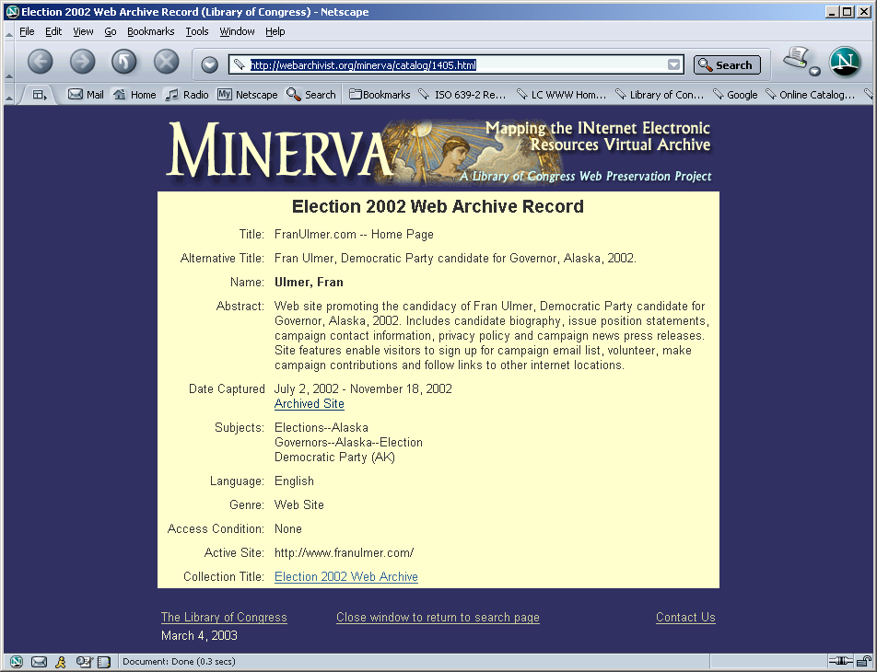

Slide 24
A few MODS projects
University of California press
  Using METS with MODS for freely available ebooks
Digital library projects (Library of Congress)
  AV-Prototype: digital preservation for audio and video
    Uses METS and MODS with focus on metadata
  I Hear America Singing, Blackmun
  Cataloging report to use as intermediate level of description
MusicAustralia
  MODS as exchange format between National Library of Australia and ScreenSoundAustralia
  Allows for consistency with MARC data

Slide 25
Differences between MODS and Dublin Core
MODS has structure
  Names
  Related item
  Subject
MODS is more MARC-like so more compatibility with existing descriptions
  Semantics
  Conversions
  Relationships between elements
MODS includes record management information

Slide 26
Choosing MODS for descriptive metadata
MODS is particularly useful for
  compatibility with existing bibliographic data
  embedded descriptions in relatedItem
  Rich, hierarchical descriptions that work well with METS structural map
  “out of the box” schema; can use <extension> for local elements and to bring in external elements from other schemas

Slide 27
MARCXML to DC
<rdf:Description xmlns:rdf="http://www.w3.org/1999/02/22-rdf-syntax-ns#" xmlns:dc="http://purl.org/dc/elements/1.1/">
<dc:title>Germany by bike : 20 tours geared for discovery </dc:title>
<dc:creator>Slavinski, Nadine, 1968-</dc:creator>
<dc:type>text</dc:type>
<dc:publisher>Seattle, Wash. : Mountaineers,</dc:publisher>
<dc:date>c1994.</dc:date>
<dc:language>eng</dc:language>
<dc:subject>Bicycle touring</dc:subject>
</rdf:Description>

Slide 28
MARCXML and ONIX
  ONIX: emerging standard for publishers/booksellers
  ONIX record converted to MARC (2709) via MARCXML
  Complex XML format with
    potentially useful descriptive data as initial bibliographic record
    Some publisher/bookseller data not of current interest can be dropped
  LC looking at using ONIX descriptions from publishers

Slide 29
Uses of MARCXML and related tools
Standardize MARC 21 across community for XML communication and manipulation
Open MARC 21 to XML programming tools and presentation style sheets
Standardize MARC 21 for OAI harvesting
Standardize transformations to and from other standard formats (DC, ONIX, …)
Basis for evolution while maintaining standardization

Slide 30
Metadata Crosswalks at LC
Dublin Core-MARC
ONIX-MARC
FGDC-MARC
MODS-MARC
UNIMARC-MARC
GILS-MARC
http://www.loc.gov/marc/marcdocz.html
Notes:
15 elements have been mapped to MARC.
Not an official mapping in other direction; many to one is harder
FGDC: proposal in 1994 to define any elements from CSDGM that didn’t map to a defined MARC field; MARC used for catalog access
SGML DTD for elements in MARC
Need to standardize for interoperation

Slide 31
Problems with crosswalks
Complex vs. simple scheme
Some data might be lost
Differences in semantics
Differences in use of content standards
Properties may vary (e.g. repeatability)

Slide 32
Transformation tools
MARC toolkit
  Converter from MARC 21 to MARCXML
  Transformations between metadata formats
    MODS
    Dublin Core
    ONIX
  http://www.loc.gov/marcxml

Slide 33
Other tools
Other tagging transformations with XSLT stylesheets
  MARC 21: Name instead of number tags?
  Different language tags for MODS?
  Various display options
Character set transformations
MARCXML to FRBR tool (for experimentation)
MARC record validation tool

Slide 34
Additional metadata needs
Explosion of digital resources requires additional metadata
  Structural
  Administration
  Preservation
  Rights
Need for packaging metadata
Digital repositories to be a focus

Slide 35
Metadata Encoding & Transmission Standard
DLF initiative; LC maintenance agency
XML document that packages metadata with digital object
Use for retrieving, storing, preserving, serving resource
“Information package” in digital repository
Interchange of digital objects with metadata
Focus on “extension schemas”
Non-proprietary—developed by library community

Slide 36
MADS development
XML format for authority data
Derivative of MARC 21 authorities
Descriptions for names, subjects, titles, geographics, genres
First draft out for review July 2004; currently evaluating comments
Uses same structures as MODS

Slide 37
MADS elements
Authority
  Name
  Title
  Topic
  Temporal
  Genre
  Geographic
  Hierarchical geographic
  Occupation
References
(same subelements as above)
Other elements
  Note
  Affiliation
  URL
  Identifier
  Field of activity
  Extension
  Record Info

Slide 38
Conclusions
Libraries are retooling to make use of a wide variety of metadata standards
XML allows for an easy path for converting existing records and flexibility in display and further transformations
Established library standards are being reused in different ways outside of the library domain
METS with appropriate extension schemas allow for additional forms of metadata

