Slide 1
Leveraging Metadata
Inductively and Subjectively
Stephen Davies
Roger King
University of Colorado, Boulder (USA)

Slide 2
What do people do with information?
Obtain and make use of isolated facts
    information retrieval (IR)
Identify objective patterns and tendencies
    data mining (KDD)
Discern the overall structure
    “information space organization” (ISO)
Notes:
So we’ve got all this information (Web, dig libs, structured info) – what do people do with it, anyway?
I think there are at least 3 things:
Obtain and make use of isolated facts (find a phone #, buy a computer)
Identify objective patterns in the data (factors correlating to loan defaults, job performance, etc.)
Appreciate the overall structure – “get their head around it,” know the lay of the land, where the details fit in. This is actually what I find myself doing most of all!

Slide 3
“Information Space Organization”
Help users find “the lay of the land”…
…see “the big picture”…
…know how to “find their way around”…
To function competently in any field, experts must possess this kind of knowledge. But when approaching a large information space for the first time…ouch! Where to begin?
Notes:
When I try to explain what I mean by “ISO,” I find myself using the same phrases over and over again…
This structural knowledge is vital to everything we do. Can’t be overstated. How can we help users bootstrap it when they encounter a new information space?

Slide 4
How might metadata help us?
Use it inductively:
Draw fuzzy conclusions based on metadata trends (e.g., “similarity” of instances)
Use it subjectively:
Honor the individual’s personal perception of how the data is organized
Notes:
Using metadata as a clue to help us do this.
The whole idea of induction is that we render tentative conclusions based on tendencies rather than irrefutable conclusions based on hard facts and deductive logic.
Each user brings their own intuitive notions about the meaning of the data they view. They perceive semantics individually and personally. We envision an interface in which users can express the semantics they perceive, and the system can attempt to pick up something in the metadata that correlates with this user perception.
So this differs from clustering because it takes user input into account.

Slide 5
Advantages to ISO tools
Personal knowledge discovery (helps crystallize intuitive notions)
Raise the level of abstraction:
  From metadata to instances
  From instances to categories
Category-based search
Ask larger, category-based questions
Notes:
A researcher groups several articles together. The “metadata analyzer” might point out
- authors from the same institution
- authors who tend to publish in the same journal
- common set of keywords
- authors who frequently cite the same core set of older publications
Relieves the user from the burden of learning the metadata

Slide 6
Focusing on categories
Humans think in terms of categories to reduce complexity
Assumption: categories are fuzzy, and often based on intuition, but are nevertheless real
  “Third-world countries”
  “Soccer moms”
  “Homes for young families”
Notes:
One organizational construct is the “category.” Grouping like things together. Helps us get the big picture of an information space.
Some categories have crisp boundaries, for instance when they align with a metadata field, but often they don’t.

Slide 7
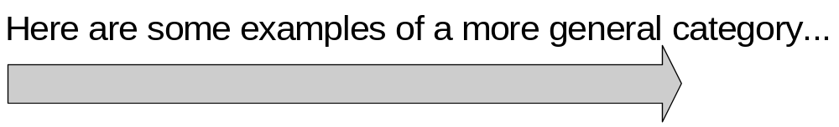
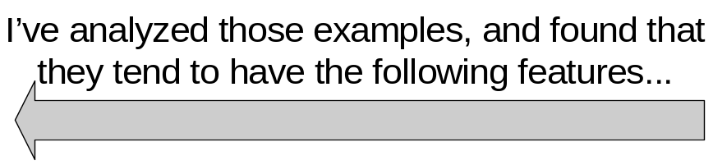
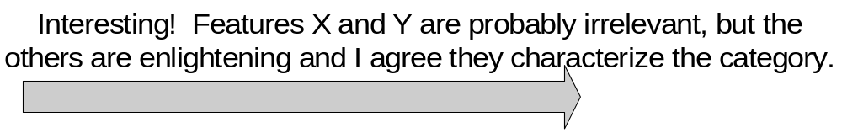
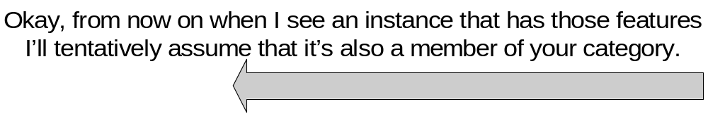
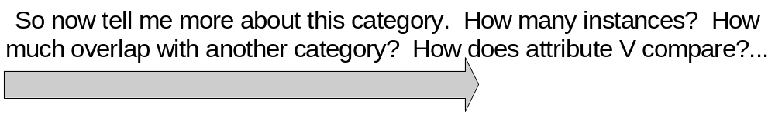
General interaction paradigm
Notes:
This is a tentative view of how we foresee people interacting with a category-based system. We picture human-computer interaction as a kind of conversation between user and system. Left=user, right=system
User begins by identifying examples. “I have a more general category in mind…”

Slide 8
A simple domain: IMDB
The IMDB (“Internet Movie Database”) contains information about nearly every film ever produced – over six million in all
Metadata includes:
  Director(s)
  Actors
  Writers
  Keywords (describing prominent plot elements)
Notes:
The metadata that we use include directors, etc.
Keywords are interesting; they are metadata that users have attached to films based on interesting facets of the movie. “Witness for the Prosecution,” e.g., has “based-on-play courtroom twist-in-the-end bloodtype microphone trial perjury murder remake based-on-adaptation”

Slide 9
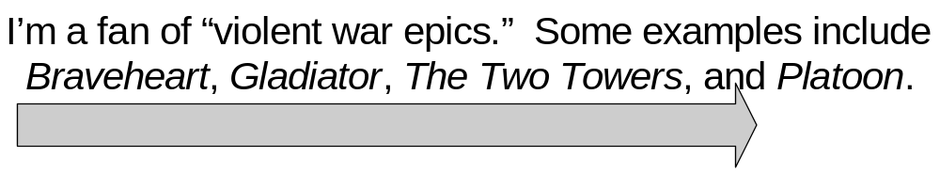
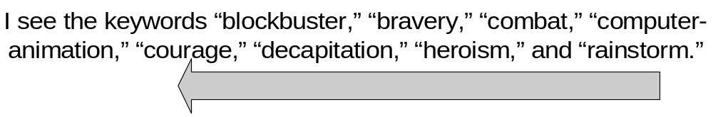
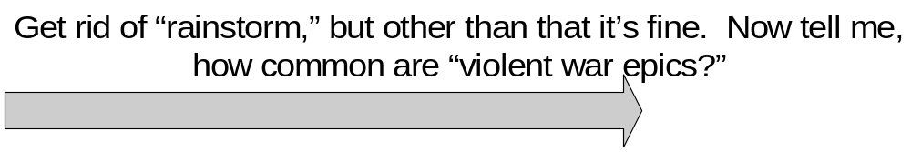
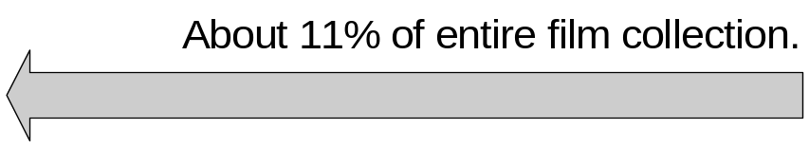
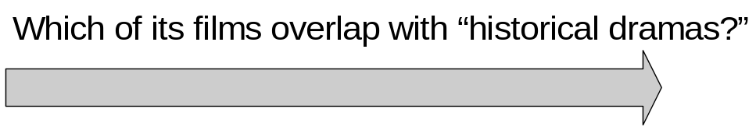
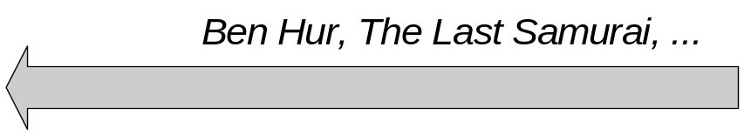
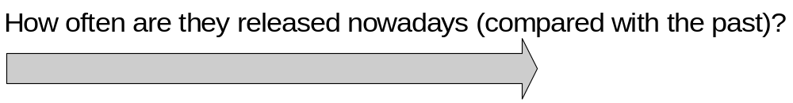
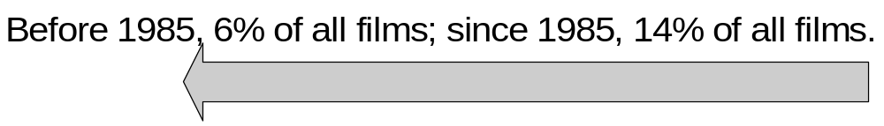
Notes:
Two things here: (1) “violent war epics” is an abstract category in a user’s head. (2) Normally, counterexamples will also be provided.
Let me say what is not true: (1) it’s not true that every single example had every single feature. (2) The system is not suggesting a hard boolean AND of all these features.
User has to be able to edit. Correct misconceptions, add semantic value.
Now one thing the user can do is category-based retrieval. New form of IR. But he can also ask abstract questions, like…
Note these are abstract, and the answers are fuzzy. But this is what most users want, right? They don’t start with quantitative, so they don’t expect quantitative.

Slide 10
Results and continuing work
Simple prototype that suggests films for critique based on user responses
Informally, results are encouraging (seems to “converge” on a category)
Plans include:
    Quantitatively measure convergence
    User testing to determine utility
    Improve classifier algorithms
    Introduce category-based operators
Notes:
We’re really just beginning – we have created a simple prototype that helps users identify a category. It suggests films randomly from the space based on which films the user has said are “IN” or “OUT” of the category.

Slide 11
Leveraging Metadata
Inductively and Subjectively
Stephen Davies
Roger King
University of Colorado, Boulder (USA)
Notes:
Any questions?

