Slide 1




Opening the legal literature Portal to multilingual access
E. Francesconi, G. Peruginelli
ITTIG – CNR Institute of Legal Information Theory and Technologies
Italian National Research Council,
Florence, Italy

Slide 2
OUTLINE
The 2 phase of legal literature portal
Why a multilingual legal literature portal
Multilingualism in the field of law
Towards an harmonisation of different legal systems through metadata
Strategies and tools for multilingual legal information access

Slide 3
WHY A MULTILINGUAL LEGAL
LITERATURE PORTAL
To foster and facilitate world wide communication in the legal
academic world, in the legal professional sector, in business world and in public administration services to citizens
Opening up the system to a wider user community (foreign patrons)
Providing multilingual
access to foreign legal resources

Slide 4
MULTILINGUALISM IN THE FIELD OF LAW
Globalization
and transnational issues
Need for integration of diverse legal cultures
Preserving legal identity

Slide 5
MULTILINGUALISM IN THE FIELD OF LAW
Obstacles
Goals
Global sharing of legal
knowledge
Access to information
regardless of geographic or
language barriers
Quick and efficient
information access and
exchange among different
legal systems
1) Complexity and richness of each legal language
2) Differences between legal concepts inherent to the diverse national legal systems

Slide 6
1. COMPLEXITY AND RICHNESS OF EACH LEGAL LANGUAGE
Rule of the Church = Roman Canon law
CANONE
Rate for lease of estates = Private law
Contextualisation has three main functions:
1) avoiding lexical semantic ambiguity
2) avoiding imprecise or irrelevant results
3) making users aware of the various contexts pertaining to the diverse legal systems

Slide 7
2. DIFFERENCES BETWEEN LEGAL CONCEPTS OF DIVERSE LEGAL SYSTEMS
Situations:
the same institution, governed in the same way. This case is extremely rare, if not non-existent
the same institution, governed differently
an institution that exists in one legal system but no longer exists in the other
an institution that exists in one legal system but does not exist in the other
Difficulties in finding effective equivalents

Slide 8
EXAMPLES IN FINDING APPROPRIATE
EQUIVALENTS
Example 1:
In U.K. a “mortgagee” becomes a conditional owner of the property mortgaged to him, but not its possessor
In Spain, in France the “hypothécaire” gains neither ownership nor possession of the mortgaged property unless he enforces the mortgage
Example 2:
In Italy the “Notaio” is an official lawfully authorized to attribute public faith to legal documents
In U.K. “Public notary” is an official who administrates oaths and performs certain witness functions

Slide 9
MULTILINGUAL LEGAL INFORMATION ACCESS
Different approaches
Different approaches
A) Comparative law study
B) Legal language consideration
and translation issues
C) Tools for managing key metadata

Slide 10
COMPARATIVE LAW STUDY
Definition: Comparison of legal systems. It is not a body of rules and principles, but a method, a way of looking at legal problems, legal institutions and entire legal systems.

Slide 11
LEGAL LANGUAGE AND TRANSLATION ISSUES
Legal language: a strictly technical language, a sort of internal code allowing communication between legal experts, making concepts understandable by using a restricted vocabulary
Legal translation: an activity comprising the interpretation of the sense of a legal text in one language - the source text – and the production of another equivalent text in another language – the target text

Slide 12
LEGAL LANGUAGE AND TRANSLATION ISSUES
Peculiarities of legal translation
System-bound nature of legal terminology (translation difficulties)
Awareness of the problems created by the absence of equivalents
Need to find FUNCTIONAL equivalents of legal concepts across legal systems

Slide 13
CROSS LANGUAGE RETRIEVAL OF LEGAL INFORMATION
Querying and retrieving multi-language documents involves problems of managing metadata through query translation
Especially in legal domain, a word in a native query language can be ambiguous
A word can have different translations in a target language, each corresponding to a legal category in the target legal system

Slide 14
QUERY EXAMPLE
Italian user query:
  “Give me back all the documents related to “dolo”
Italian system
English system
“fraud”
(private law)
“dolo”
Ambiguous
word
Documents
related to “dolo”
Documents
related to “fraud”
Documents
related to “malice”
“malice”
(criminal law)
Query contextualization is a key issue for a focused multi language document retrieval.

Slide 15
Opening the legal literature Portal to multilingual access
E. Francesconi, G. Peruginelli
ITTIG – CNR Institute of Legal Information Theory and Technologies
Italian National Research Council,
Florence, Italy

Slide 16
The portal software architecture
The single language software architecture of the Portal of Legal Literature was presented at DC03 Conference in Seattle;
Here is the extension dealing with multi-legal systems (multi-languages) documents and cross-language search facilities.

Slide 17
Features of the multilingual Portal
Server-side requirements:
  Integration into a unique point of access and a unique view for the user of:
    Data coming from structured repositories;
    Web documents;
  of different legal systems, that means different languages;
User-side requirements:
  Querying the portal in user native language;
  Retrieving query-related documents of different languages and legal systems.

Slide 18
Structured data in a multi-language environment
Structured repositories of different languages (different legal systems) are adapted as “OAI Data Providers”;
Data are harvested according to the OAI-PMH protocol;
The “Service Provider” level contains as many XML-DC metadata repositories as original languages (legal systems).

Slide 19
Harvesting of multi-language structured data
OAI-PMH
Metadata harvester
Service Provider
DC-XML
Italian records
DC-XML
English records
DC-XML
French records
DC mapping
Data Providers
Italian repositories
English repositories
French repositories
Structured Data Repositories

Slide 20
Web documents in a multi-language environment
Harvesting without accordance with data providers
(no metadata or no common metadata scheme);
Our approach to web document DC metadata harmonization:
  automatic generation of a DC metadata subset
  supporting the intellectual activity in organizing web documents.
Main criteria used for DC metadata generation:
  properties of the documents (URL as “dc:identifier”);
  Particular attention to document classification (“dc:subject”):
    We have used a Naive Bayes machine learning approach for document classification.

Slide 21
Harvesting and automatic qualification of multi-language Web documents
DC-qualified
Italian HTML
documents
DC-qualified
English HTML
documents
DC-qualified
French HTML
documents
Service Provider
Automatic metadata generator
Document features as URL for dc:identifier
Machine Learning approach (Naïve Bayes classifier for dc:subject)
Web
focused crawler
Italian legal literature
documents
English legal literature
documents
French legal literature
documents
Data Providers
Web Documents

Slide 22
Train and Test of the Naive Bayes Classifier
1220 document examples of one language to train the naive Bayes classifier;
10 classes:
c₀ Environmental law c₅ European law
c₁ Administrative law c₆ Computer Science law
c₂ Civil law c₇ Labour law
c₃ International law c₈ Criminal law
c₄ Constitutional law c₉ Taxation law
  Train accuracy: 87.2%
  Test accuracy: 75.4%

Slide 23
Multi-Language Document Indexing
at the Service Provider level
Italian
metadata index
English
metadata index
French
metadata index
Service Provider
Indexer
Italian
records
English
records
French
records
Italian
documents
English
documents
French
documents
DC-XML records
DC-HTML documents

Slide 24
User Access Modalities
Advanced search:
Metadata-Based Document Querying (MBDQ);
Simple search:
Keyword (KBDQ)
+
Category (CBDQ)
Based Document Querying
Key point of both: contextualization of the query in the native legal system language

Slide 25
Problems in querying a multi-language legal repository
Querying and retrieving multi-language documents involves problems of query translation.
Especially in legal domain, a word in a native query language can be ambiguous;
It can have different translations in a target language, each corresponding to a legal category in the target legal system.

Slide 26

Advanced Search: MBDQ
The user is required to choose the legal system of the query (that is choosing the language);
The user fills in the fields related to DC metadata using the native language of the chosen legal system;
Contexts have to be translated before being dispatched to different language indexes.
dc:………
“Context”

Slide 27
MBDQ – Query translation
Metadata can be divided into:
  Query-language dependent;
  Query-language independent.
Ex:
  dc:title is “query-language independent”
  the title of a document is queried in its native language, independently from the query language;
  dc:description is “query-language dependent”;
  dc:subject
    in bibliographical domain it is usually “query-language independent”;
    in legal domain it is “query-language dependent”.
Only the contents of query-language dependent fields have to be translated;

Slide 28



Query Translation
Query-language dependent contexts are translated in a “pivot” language (English);
From the “pivot” language the query is translated again to other languages of the Portal
Translation in a “pivot” language:
  allows the reduction of bilingual thesauri
    from a factor N² to N;
  allows the solution of the problem of the non-availability of some biligual thesauri.

Slide 29
Query Translation
Category:
“private law”
Translation
Italian legal system
English legal system
Ambiguos
word
“fraud”
(private law)
“fraud”
is the right
translation
W_{i} =
“dolo”
“malice”
(criminal law)

Slide 30
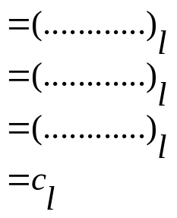
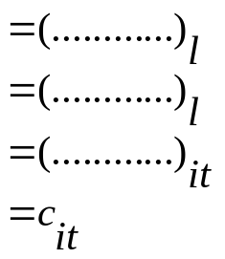
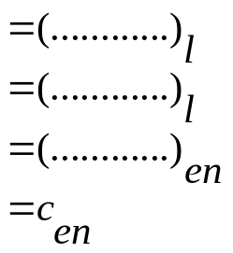
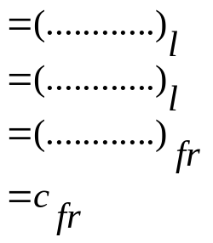
dc:…
dc:…
dc:description
dc:subject
MBDQ parameters
Query in native
language l
dc:…
dc:…
dc:…
dc:…
dc:…
dc:…
dc:description
dc:subject
dc:description
dc:subject
dc:description
dc:subject
Italian
document
index
English
document
index
French
document
index
Queries in different languages
with translated contents

Slide 31
Simple search: KBDQ+CBDQ
The user is required:
  To fill in an unqualified text box chosing a legal system;
  Optionally to choose a category of the query legal system.
The chosen legal category is mapped to the legal ones of the target legal system;
The query is translated;

Slide 32
Word sense disambiguation (WSD)
If a legal category is not supplied by the user a WSD procedure is activated.
In our Portal WSD is a problem of context categorization with respect to legal categories.
We use the same naive Bayes classifier trained to classify Web documents.

Slide 33
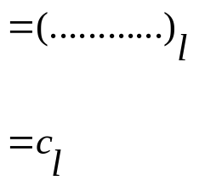
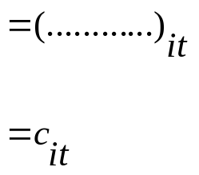
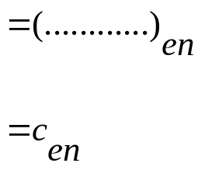
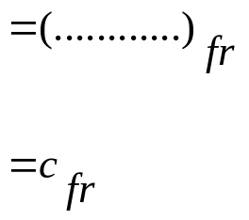
Unqualified text field
KBDQ+CBDQ
parameters
Query in native
language l
dc:subject
Unqualified
text field
dc:subject
Unqualified
text field
dc:subject
Unqualified
text field
dc:subject
Italian
document
index
English
document
index
French
document
index
Queries in different languages
with translated contents

Slide 34
Conclusions
Extension of Legal Literature Portal architecture to cross-language retrieval of structured data and Web documents;
Categories of law are one of the essential metadata content to point to relevant material irrespective of the language;
Approach based on legal query translation, eventually disambiguating ambiguous words by a machine learning approach.
Portal main feature:
  accessing multi-language legal documents respecting the identity and the peculiarities of different legal systems.

