Slide 1
Present at the International Conference on Dublin Core and Metadata Applications 2004
Shanghai China, 13 October 2004
Wei Liu
刘玮
School of Information Management,
Wuhan University
武汉大学信息管理学院
mayaya_cn@hotmail.com

Slide 2
A Metadata Description Scheme and Corresponding Visual Methods of Teaching Resources Libraries
教学资源库的元数据描述与可视化方法

Slide 3
Educational innovation is the key for knowledge economy;
To create a group of teaching resources libraries of kernel curriculums is an important task;
Using DCEd for designing and building teaching resources libraries is an effective way;
Teaching resources visualization is a vital direction in future.

Slide 4
1 Design and build of teaching resources libraries
2 Visualization of teaching resources

Slide 5
1 Design and build of teaching resources libraries
教学资源库的设计与建立

Slide 6
1.1 Breakdown into knowledge units and preferred representations
To transform the textbook into the least building blocks (knowledge units) of knowledge concepts;
To confirm representations of each knowledge unit.
An example.

Slide 7
1.2 Creation of multimedia materials about knowledge units
IO_Graphics
IO_Text
A multimedia
object database
IO_Image
There are many available tools to make multimedia materials;
To store these materials in different folders;
At last, there is a multimedia object database of teaching resources.
IO_Animation
IO_Video
IO_Audio

Slide 8
1.3 Description and storage of multimedia material objects
It is an effective way to describe these materials using DCEd, and create XML files according to XML/RDF frame.
For example……
iso/IO_Image/x515.xml

Slide 9
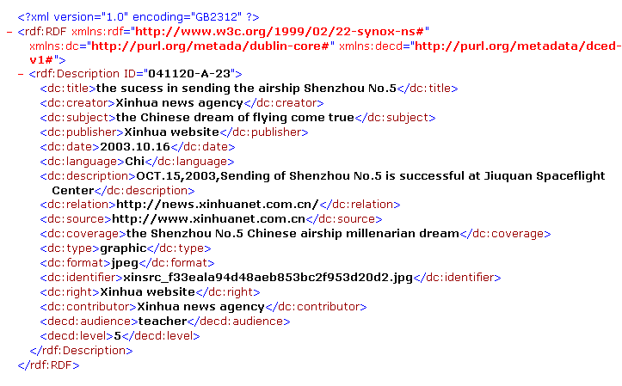

Slide 10
1.4 Mechanism creation of index
In order to improve speed of storing & extracting multimedia objects, we create corresponding index files.

Slide 11
Method
library
Index
database
User interface
Object
Description
database
Multimedia
Object
database
The structure of teaching resources database

Slide 12
1.5 Configuration of application programs and creation of method libraries
An application system
Sub-system
for teaching
Sub-system
for self-study
Sub-system
for exam
Sub-system
for training

Slide 13
2 Visualization of teaching resources
教学资源的可视化

Slide 14
Information resources management goes direct to visualization and intelligence
The knowledge structure system & knowledge unit
Visual description

Slide 15

2.1 Visualization of text information

Slide 16
2.2 Text information visualization about procedure
start
String filename
Long filenum,getlen,filelen
Blob a,b
// reading the data of image files
Filename=p_1.pieturename
If filename < > “” then
Filelen=filelength(filename)
Filenum=fileopen(filename,streammode!)
Getlen=fileread(filenum,b)
Do while getlen=32765
getlen=fileread(filenum,a)
B=b+a
Loop
Fileclose(filenum)
End if
string filename
long filenum,getlen,filelen
Blob a,b
filename=“”
Y
N
filelength(filename) filelen
fileopen(filename,streammode!) filenum
fileread(filenum,b) getlen
getlen=32765
Y
closefile
return
N
fileread(filenum,a) getlen
b+a b

Slide 17
2.3 Visualization of information classification on network

Slide 18
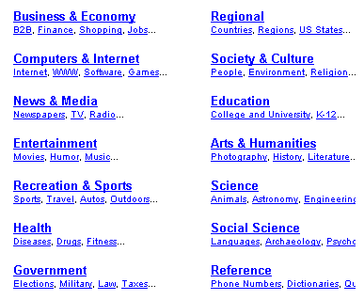
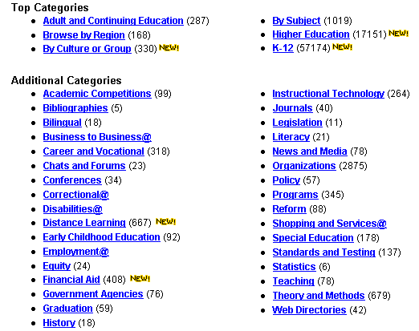

Slide 19
Adult and continuing education
Browse by region
By culture of group
yahoo
education
By subject
High education
K-12

Slide 20
3 Conclusions
结束语

Slide 21
Visual interface
Object description libraries and index databases
Using XML/RDF
Description of knowledge units
by DCEd

Slide 22
thank you!

