Slide 1

Providing metadata to historical material in viewer application iPalletnexus
Norio TOGIYA Mitsuhiro, TSUDA , Akira BABA
University of Tokyo Japan

Slide 2
Contents
1.Aim of this study
2.Metadata set for digitalized historical material
3.Case study of using the set
4.Conclusions & Future works

Slide 3
Part Ⅰ
Aim of this study

Slide 4
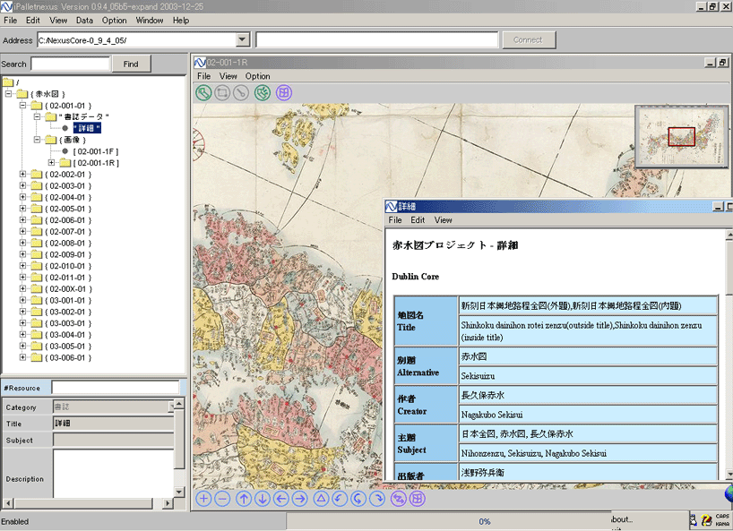
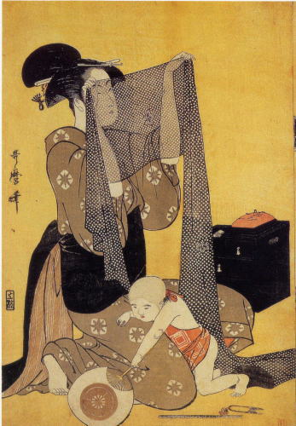


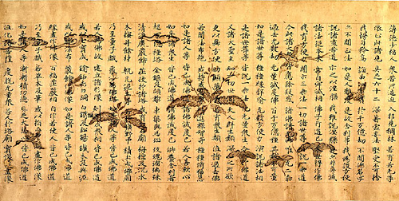
iPalletnexus is viewer application
Used by various kinds of historical material

Slide 5
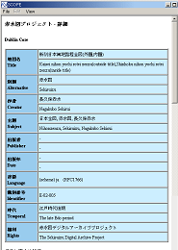
Aim of this study
Designing element set for digitalized historical material.

Slide 6
Part Ⅱ
Metadata element set for digitalized historical material

Slide 7
Metadata for digitalized historical material : Conditions
Adaptable to
1.Various kinds of material
2.Specific Information about the original
3.Information about digital data

Slide 8
What are the specific Information?
・Information about physical object
・ Detailed information about contents
Physical shape of the resource,
paper/canvas,
Printing / Painting method,
Type of ink/paint,
Other information about contents etc.

Slide 9
What are the information about digital data?
Format of the digital data,
Size of the data
Rights of the data,
Digitalizing method,
Person responsible for digitalization
Identification number of data

Slide 10
A single metadata is divided into 3parts
PART A
General information
PART B
PART C
Specific Information
Information about digital data

Slide 11
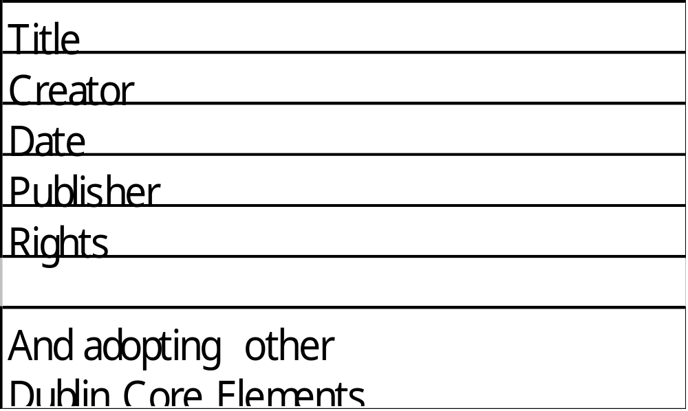
Elements in Part A

Slide 12
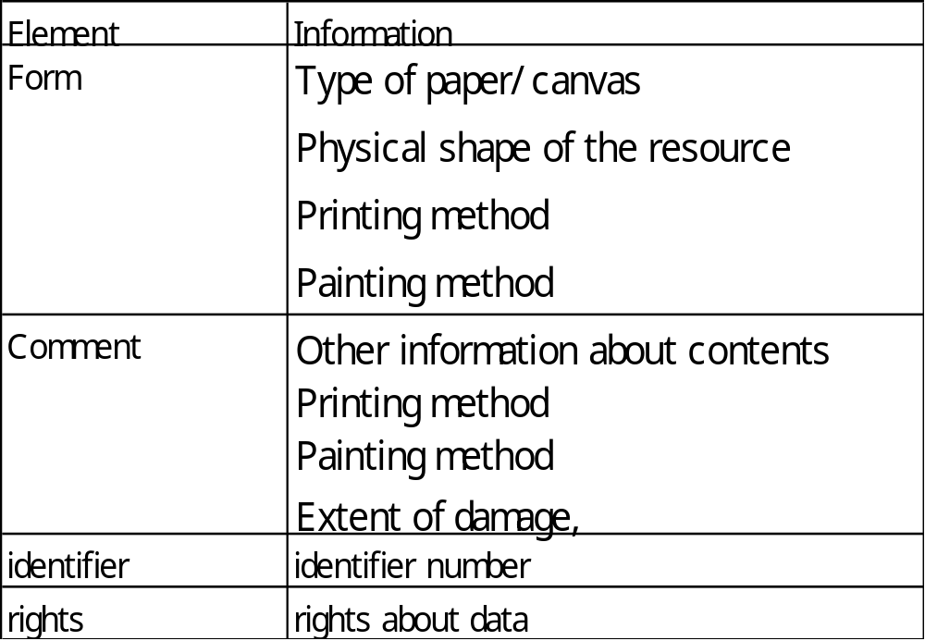
Elements in Part B

Slide 13
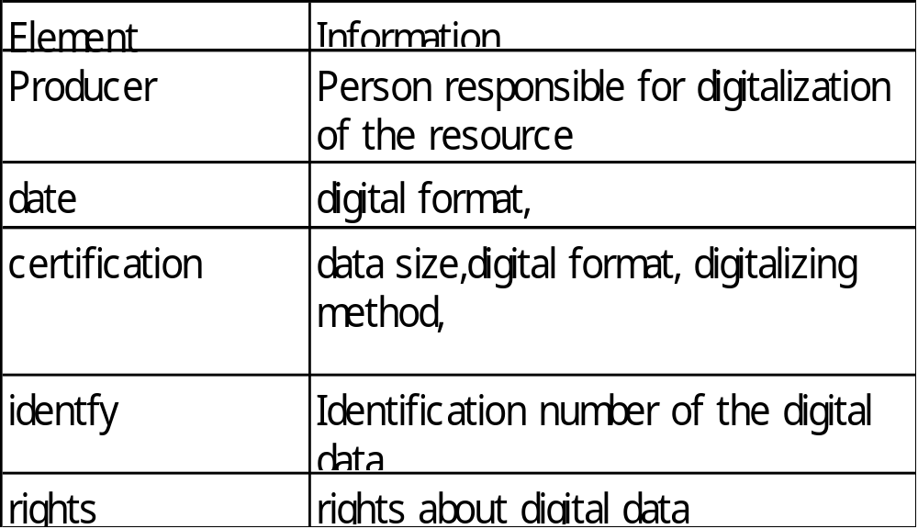
Elements in Part C

Slide 14
Part Ⅲ
A case study of using the metadata element set

Slide 15
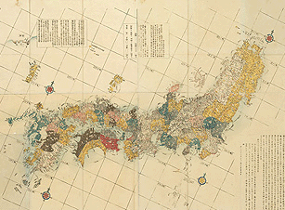
Sekisui-zu is Japanese old map
NGAKUBO,Sekusui
(17１7～1801)

Slide 16
Necessary items for the metadata of Sekisuizu 1
(1) Name of the Map
(2) Name of creator
(3) Keywords
(4) Publisher
(5) published Year
(6)Id number,
(7)Era and region
(8) Languages
(9)Rights
(10) Kind of paper,
(11)Printing method
(12)Extent of damage
(13)Colors
(14) Size

Slide 17
Necessary items for the metadata of Sekisuizu 2
(15) Id number for physical object,
(16)Other detailed information
(17)Holder of the map,
(18) Creator of the digital data,
(19)Date of digitization
(20) Size of data
(21)Volume of data
(22) format of data
(23)Holder of data
(24)ID of data

Slide 18
Elements in Part A
Information | Element(DC)
Name of the map | Title
Name of the creator | Creator
Keywords | Subject
Publisher | Publisher
Published year | Date
ID number | Identifier
Era and range | coverage
Languages used on the map | Language
Rights | Rights

Slide 19
Elements in part B
Information | Element
Kind of paper | Form
Printing method
Extent of damage
Size
Colors | Comment
Other detailed information
ID number of the map | Identifier
Holder of the map | Rights

Slide 20
Elements in part C
Information | Element
Creator of the digital data | Producer
Date of digitization | Date
Size of data | Certification
volume
format
ID number of digital data | Identifier
Holder of the digital data | Rights

Slide 21
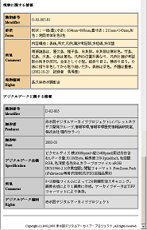
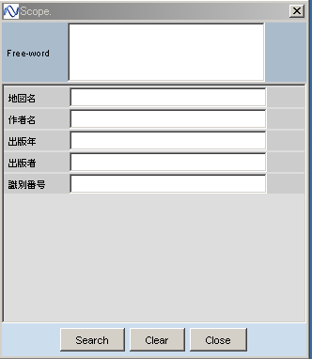
Metadata window
PART A
PART B
Search
window
Metadata
window
PART C

Slide 22
PART Ⅳ
Conclusions & Future works

Slide 23
The metadata element set for digitalized historical material
Adaptable to
1.Various kinds of material
2.Specific Information
3.Information about digital data

Slide 24
Construction of the metadata set
1.Metadata is divided to 3 Parts
2.Dublin Core is adopted for part A
3.Description in Xml format

Slide 25
Future works
1.Adapting our method to more historical material.
2. Increasing no. of users in various fields
3.Exchanging metadata with other databases or repository

Slide 26
Coexisting 3 parts
SLIDE 26
PART A
PART B
PART C

Slide 27
Thank you your kind attention

