Slide 1
Creating an Application Profile
Tutorial 3
DC2004, Shanghai Library
13 October 2004
Thomas Baker, Fraunhofer Society
Robina Clayphan, British Library
Pete Johnston, UKOLN

Slide 2
Contents
What problem do Application Profiles solve?
Application Profile basics
DCAPs and the DCMI Abstract Model
Case studies
  Describing “Collections” [Pete Johnston]
  Use in Libraries [Robina Clayphan]

Slide 3
What problem do DCAPs solve?
Implementors adapt standards to context:
  “DC is too small! We need more terms!”
  “Some of the terms must be more specific!”
A Profile describes how an application:
  Uses generic terms (e.g. Dublin Core)
  Uses more specialized terms
    To describe “photographs”, “products”, “collections”...
  Constrains the use of properties
    Example: “When using dc:language, values must conform to RFC 3066!”

Slide 4
Why do this?
Document the metadata model of your application
  Help other implementors design interoperable applications
  Merge metadata from many sources
  Promote convergence on “good practice” within communities of use
  Solve your specific problems while following common standards for interoperability

Slide 5
Examples
To describe “collections” [NISO Metasearch]
Government Information [Australian AGLS]
Agricultural development information [FAO]
European Environmental Agency
DC-Education

Slide 6
Basics of DCAPs
DCAP does not define new terms – it merely cites terms defined elsewhere (e.g., in Dublin Core)
DCAP is a set of Property Usages
A Property Usage describes how a (previously declared) Property is used in the metadata of an application.
All DCMI Elements and Element Refinements are Properties

Slide 7
A Property Usage
References (“uses”) exactly one property defined elsewhere
May provide additional documentation on how property is interpreted
May give it an application-specific label
May specify obligation (e.g., mandatory, optional, conditional)
May specify constraints on permitted values (e.g., “encoding schemes”)

Slide 8
“Readable” DCAPs for use by people
CEN CWA 14855: “DCAP Guidelines”
  ftp://ftp.cenorm.be/PUBLIC/CWAs/e-Europe/MMI-DC/cwa14855-00-2003-Nov.pdf
Emphasis on Readability
  “Optimal usefulness for the intended audience”
  Can include redundant information, if useful
  Identify terms with “appropriate precision” (i.e. by URI Reference when possible)

Slide 9
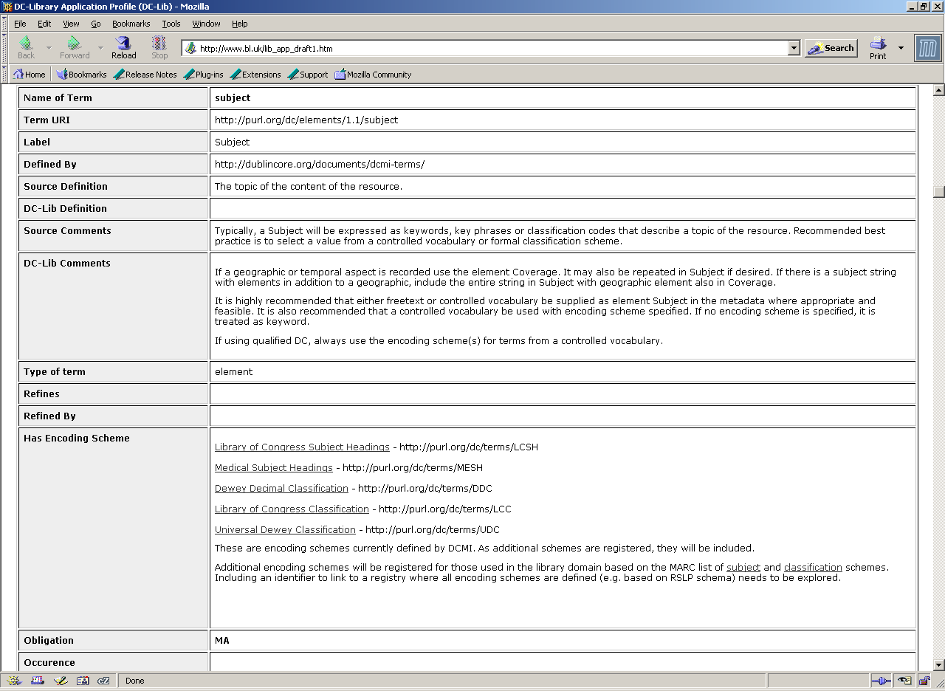

Slide 10
No DCAPs without
Metadata Vocabularies!
In foregoing example, DC-Libraries profile “uses” the Dublin Core element “Subject”
  DCMI declares this and other elements in a Metadata Vocdabulary
dc:subject uniquely identified by DCMI with URI reference http://purl.org/dc/elements/1.1/subject
Note that some information from DCMI “source” document is redundantly included in the DCAP

Slide 11
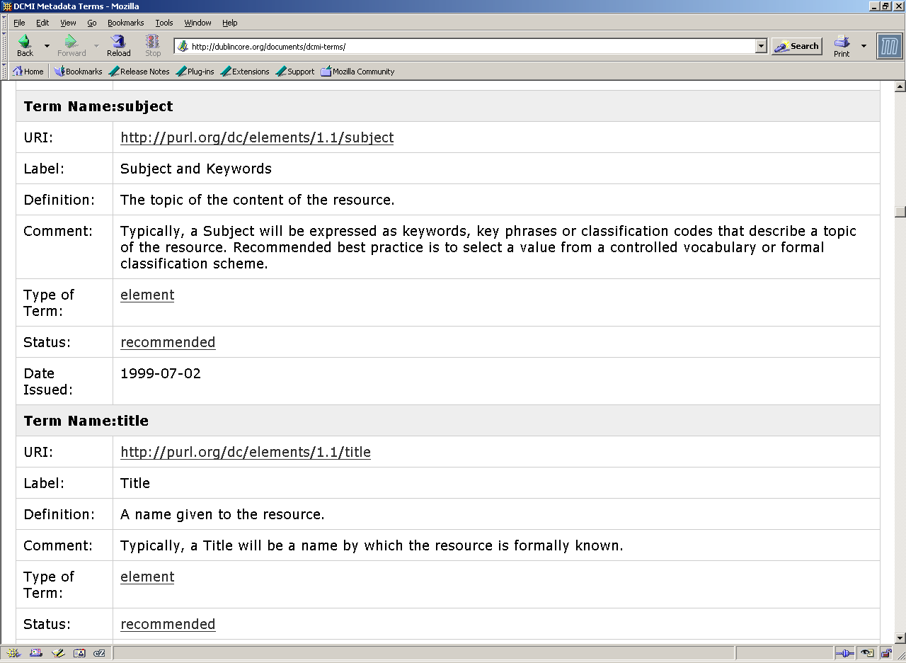

Slide 12
Towards DCAPs for use by machines
CEN CWA on “machine-processable” DCAPs in December 2004
Formal model of DCAPs under development
  In context of broader effort to articulate the Abstract Model underlying Dublin Core metadata
  Influenced by W3C Semantic Web activity
  DCAPs can be represented in Resource Description Framework (RDF)
  RDF representations are expressed in RDF/XML

Slide 13
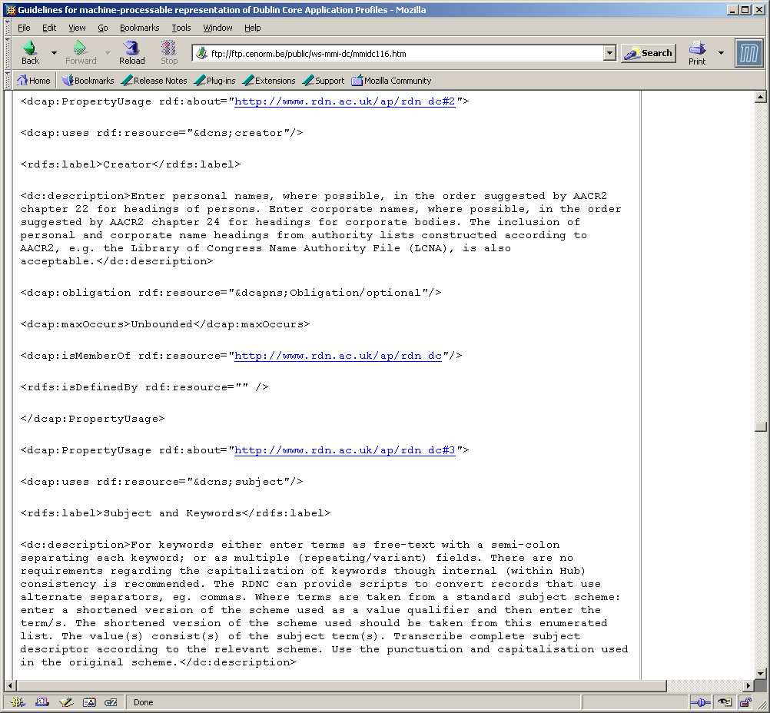

Slide 14
Precise, machine- processable statements!
Information declared (redundantly) in a Metadata Vocabulary is not included
Only includes information which is particular to the Application Profile
Use of formal schema language supports resolution of cross-references and merging of data

Slide 15
DCMI Abstract Model
Draft of the DCMI Architecture Working Group
Seeks to make explicit the data model which has emerged in DCMI
Formal model against which different methods for “encoding” DC metadata can be compared

Slide 16
is instantiated
as
record
is grouped
into
description
set
description
description
description
has one
or more
statement
statement
statement
has one
property
has one
value string
value
is a
OR
is represented
by one or more
representation
rich value
representation
representation
is a
OR
is a
related
description

Slide 17
Model summary
record (encoded as XHTML, XML or RDF/XML)
description set
description (about a resource (URI))
statement
vocabulary encoding scheme (URI)
property (URI)
value (URI)
representation
syntax encoding
scheme (URI)
value string
language
(e.g. en-GB)
OR rich value
OR related description

Slide 18
is instantiated
as
record
is grouped
into
description
set
description
description
description
Which Properties are used
in an application
has one
or more
statement
statement
statement
has one
property
has one
value string
value
is a
OR
is represented
by one or more
representation
rich value
representation
representation
is a
OR
is a
related
description

Slide 19
is instantiated
as
record
is grouped
into
description
set
description
description
description
Which Properties are used
in an application...
has one
or more
statement
statement
statement
has one
property
...and how values are constrained...
has one
value string
value
is a
OR
is represented
by one or more
representation
rich value
representation
representation
is a
OR
is a
related
description

Slide 20
is instantiated
as
record
is grouped
into
description
set
...in the description sets.
description
description
description
Which Properties are used
in an application...
has one
or more
statement
statement
statement
has one
property
...and how values are constrained...
has one
value string
value
is a
OR
is represented
by one or more
representation
rich value
representation
representation
is a
OR
is a
related
description

