Slide 1
Diverse vocabularies in a common model:
Dublin Core at 10 years
Thomas Baker
DC-2005: Vocabularies in Practice
Madrid, 12 September 2005

Slide 2
1994: The Need
Web had arrived: WWW conference, Chicago
Clear: librarians would not “scale” to what was coming…
“We need a simple template for describing Web pages”
Librarians and IT people met in Dublin, Ohio…

Slide 3
1995: “The Dublin Core”
Title, Date, Creator, Subject…
Simple enough for non-experts to understand
Seen as “library catalog card” for Web objects

Slide 4
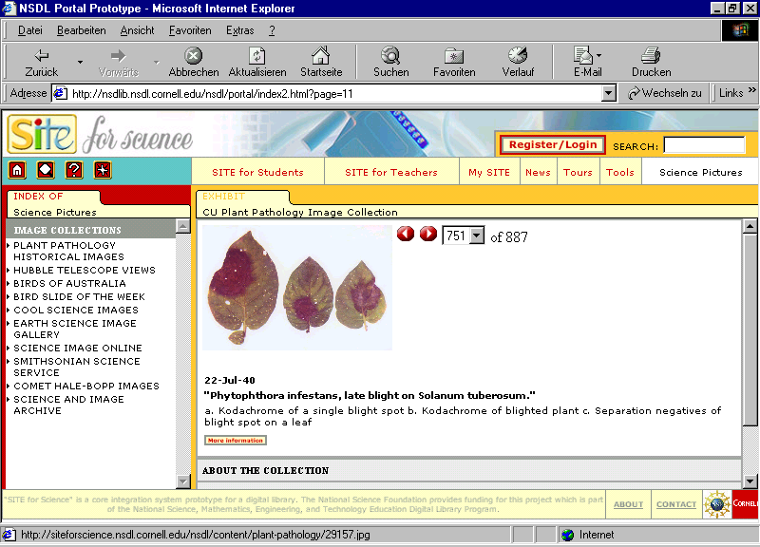

Slide 5
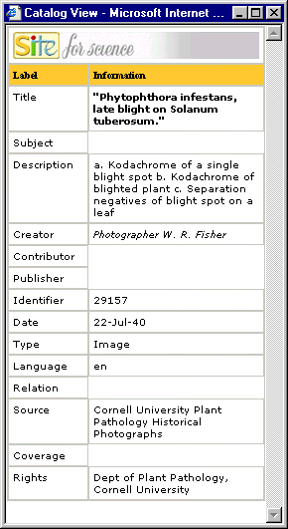

Slide 6
1996: Modular metadata
Not: “One size fits all”.
Rather: many ways to describe one object:
  MARC: complete, for library items
  DC: simple, for helping people find things
  Terms and conditions: who allowed to use it?
Recognized need: General framework for different types of metadata

Slide 7
1996: Putting DC in a context
Diverse “packages” (Warwick Framework idea)
Container
Package
Dublin Core
Package
MARC record
Package
Indirect Reference
URI
Package
Terms and Conditions
Work starts on general framework for metadata:
Resource Description Framework (RDF), Semantic Web

Slide 8
1997: Simple, but also precise
Not just any Date, but Date Created
Not just any Subject, but Library of Congress heading
Dumb-down: ignore extra details to see just a “core” description

Slide 9
1998: DC elements in Web space
http://purl.org/dc/elements/1.1/title: identifiers rooted in Web infrastructure
New assumptions
  How can machines and software process this automatically?
Work on the underlying data model…

Slide 10
1999-2000: Application profiles
Customized implementations
  DC alone is too small – more terms
  More precision for specialized purposes
  Local rules and guidelines
Application profile provides documentation so that others can follow
Not “take it or leave it”, but “take what you want, create what you need”

Slide 11
1999-2000: Growing the vocabulary
Elements
Refinements
Encodings
Types
Identifier
Title
Creator
Contributor
Publisher
Subject
Description
Coverage
Format
Type
Date
Relation
Source
Rights
Language
Abstract
Access rights
Alternative
Audience
Available
Bibliographic citation
Conforms to
Created
Date accepted
Date copyrighted
Date submitted
Education level
Extent
Has format
Has part
Has version
Is format of
Is part of
Is referenced by
Is replaced by
Is required by
Issued
Is version of
License
Mediator
Medium
Modified
Provenance
References
Replaces
Requires
Rights holder
Spatial
Table of contents
Temporal
Valid
Box
DCMIType
DDC
IMT
ISO3166
ISO639-2
LCC
LCSH
MESH
Period
Point
RFC1766
RFC3066
TGN
UDC
URI
W3CTDF
Collection
Dataset
Event
Image
Interactive
Resource
Moving Image
Physical Object
Service
Software
Sound
Still Image
Text

Slide 12
2001: Usage Board
Editorial reviewers to grow vocabulary
Balance bottom-up with top-down
New terms from working groups and projects approved as DCMI terms

Slide 13
2003-2005: Abstract Model
Formal modeling basis for Dublin Core metadata
Like a “grammar” for Dublin Core
Strong link with parallel development of Resource Description Framework

Slide 14
Basic model
Resource with properties
The Play has the title “Antony and Cleopatra”, was written
In 1606 by William Shakespeare, and is about “Roman history”.
Antony and Cleopatra
1606
Title
Date
Play
createdBy
Subject
William Shakespeare
Roman history

Slide 15
…related to other resources
One-to-one
Principle
Description 2
Collected Works of
William Shakespeare
Description 1
Title
Collection
Antony and Cleopatra
1606
isPartOf
William Shakespeare
Title
Description 3
Date
Name
Play
createdBy
Playwright
Subject
Birthplace
Roman history
Stratford

Slide 16
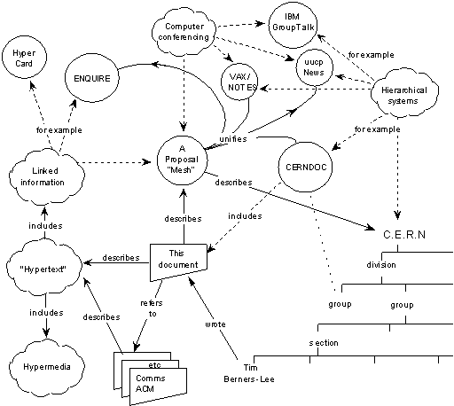
Same as Semantic Web model

Slide 17
is instantiated
as
record
is grouped
into
description
set
A record consists of descriptions,
using properties and values.
A value can be a string or a pointer
to another description.
description
description
description
has one
or more
statement
statement
statement
has one
property
has one
value string
value
is a
OR
is represented
by one or more
representation
rich value
representation
representation
is a
OR
is a
related
description

Slide 18
record (encoded as XHTML, XML or RDF/XML)
description set
description (about a resource (URI))
statement
property (URI)
value (URI)
value string
rich value
related description

Slide 19
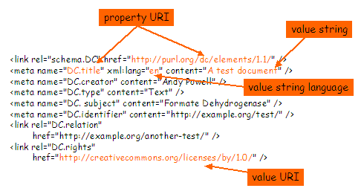
A basis for comparing syntax options
Example of Simple Dublin Core in XHTML

Slide 20
One model, many ways to implement
Choose what’s best for you
  HTML, XML, XHTML, Databases…: appropriate for different contexts
Interoperability depends on shared model
  Evolving guidelines for Dublin Core in HTML, XML, XHTML…

Slide 21
DCMI Model today
Core semantics
  The Dublin Core and related vocabularies
Data model
  Abstract Model a DCMI Recommendation since March 2005
Application Profiles
  Use core semantics
  Based on the Abstract Model
  Customize for specific purposes

Slide 22
Three legs of Interoperability
Shared semantics
  Everyone understands a Core
Shared model (independent of syntax)
  DCMI Abstract Model
Content-level agreement
  Same way to write a date (“2005-09-12”), a name (“Baker, Thomas”)…

Slide 23
Like a language
Small vocabulary (like a pidgin)
  Without shared words, no understanding
Basic grammar
  Without Subject – Verb – Object, no sentences
Jargons and styles
  Emerging agreement within communities

Slide 24
DCMI Today
Core elements for describing information
  Find, share, manage information
Formal framework for interoperability
  The “grammar” of metadata language
Support for communities
  Community usage in application profiles
  Documentation for usage in different areas
  Platforms for people to come together to share experiences.

Slide 25
Looking ahead
How to make Application Profiles
Shift in DCMI emphasis from underlying vocabularies to application profiles
  Learn by example
  Profiles reviewed for conformance to the Abstract Model
  Can be emulated or used by others
Emphasis on guidelines for “how to make an application profile”

Slide 26
DC2005 – Madrid
Vocabularies in Practice
Controlled vocabularies
  Shigeo Sugimoto: core subject vocabularies tailored to communities
  Alistair Miles: SKOS – a vocabulary of thesaurus relations between concepts
  NKOS Special Session: “Enhancing the understanding of meaning”…
  Ron Daniel tutorial

Slide 27
DC2005 – Madrid
Vocabularies in Practice
Models and interoperability
  Eric Miller, W3C, keynote “The Semantic Web in Practice”
  Johannes Keizer, FAO, keynote on coherence and interoperability in global systems
  Special session, IEEE/LOM
  Meetings of DCMI Architecture Working Group, Registries working group

Slide 28
DC2005 – Madrid
Vocabularies in Practice
Application profiles
  Working group meetings on Education, Corporate, Accessibility and Adaptability…
  Working-group profiles for Collection Description, Libraries, Government…
  Tutorials
  Lots of papers!

Slide 29
DC2005 – Madrid
Vocabularies in Practice
Practice
  Keynote Ricardo Baeza-Yates “From user queries to metadata”
  Many papers
  Exhibitors
  Most important…
  the people you will meet!

Slide 30
baker@sub.uni-goettingen.de

