Slide 1
DC-2006 – International Conference on Dublin Core and Metadata Applications
3-6 October 2006
Thomas Baker
Dublin Core Metadata Initiative

Slide 2
The original idea (1994)
After 2nd World-Wide Web conference, workshops for a “core” set of descriptors for Web pages
Generic description method
  For all types of resources
  In all domains
  Simple but can be customized
  “Making it easier to find information”

Slide 3
Dublin Core Metadata Initiative today
Core elements (ISO 15836)
Interoperability framework
  Essential building block for semantic Web applications
Support for communities
  Technical working groups
  Communities developing application profiles
  Since 1995, workshops and conferences in USA, UK, Australia, Finland, Germany, Japan, Italy, China, Spain, Mexico

Slide 4
Core Elements
The Dublin Core
Standard, generic elements
Can be extended and customized using other vocabularies
Information Model
DCMI Abstract Model
Shared framework provides basis for interoperability
Like a grammar for the vocabulary
Application Profile
Customized for specific needs and communities
Basis for modularization and reuse (“mix and match”)
+
=

Slide 5
Core Elements
The Dublin Core
Standard, generic elements
Can be extended and customized using other vocabularies
Information Model
DCMI Abstract Model
Shared framework provides basis for interoperability
Like a grammar for the vocabulary
Application Profile
Customized and optimized for specific needs and purposes
Basis for modularization and reuse (“mix and match”)
+
=

Slide 6
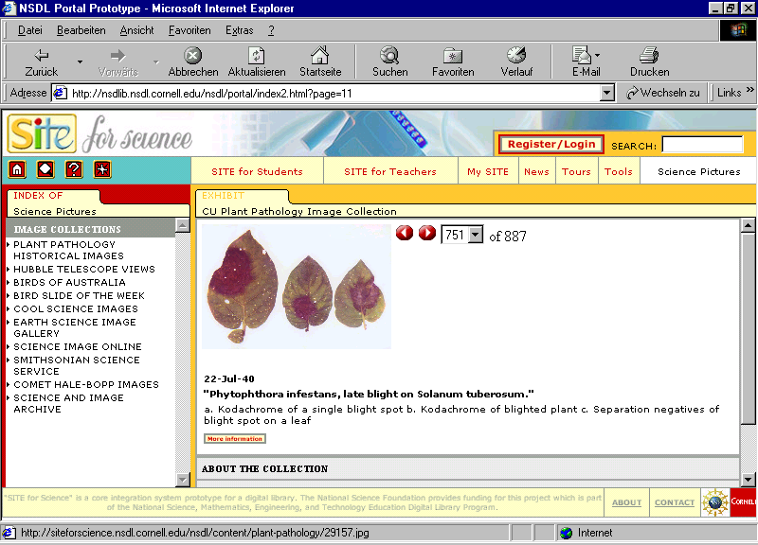

Slide 7
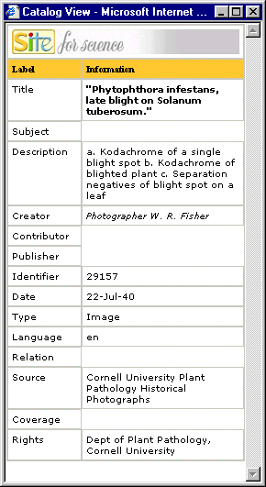

Slide 8




Dublin Core
MARC Relator Terms
SKOS Core
Complementary vocabularies,
sharing a common model

Slide 9
DC-2006 in Manzanillo
Tutorials
  Every morning, 8:30 to 10:00
  “The Basics” for newcomers:
    Semantics (what the elements mean)
    Syntax (the “angle brackets”)
    Controlled vocabularies
    Application profiles

Slide 10
DC-2006 in Manzanillo
Controlled Vocabularies
  Plenary paper session (Wed)
    SKOS Core – describing concept structures (thesauri)
    Registries – Web portals for vocabularies
  Tutorial on vocabularies (Thu)
  DCMI Registry Working Group (Fri)

Slide 11
Core Elements
The Dublin Core
Standard, generic elements
Can be extended and customized using other vocabularies
Information Model
DCMI Abstract Model
Shared framework provides basis for interoperability
Like a grammar for the vocabulary
Application Profile
Customized and optimized for specific needs and purposes
Basis for modularization and reuse (“mix and match”)
+
=

Slide 12
record (encoded as XHTML, XML or RDF/XML)
description set
description (about a resource (URI))
statement
property (URI)
value (URI)
value string
rich value
related description

Slide 13
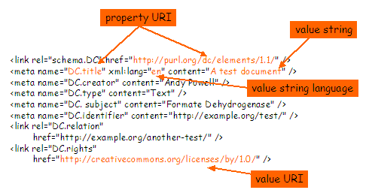
A basis for comparing syntax options
Example of Simple Dublin Core in XHTML

Slide 14
“One model, many ways to implement”
Choose what’s best for you
  HTML, XML, XHTML, Databases…: appropriate for different contexts
Interoperability depends on a shared model
  Expressing Dublin Core in HTML, XML, XHTML…

Slide 15
DC-2006 in Manzanillo
The DCMI Model
  This afternoon is “Architecture Day”
    Plenary paper session on metadata models
    Plenary meeting of DCMI Architecture Working Group
      Part 1: Summary of recent developments
      Part 2: Open issues

Slide 16
Core Elements
The Dublin Core
Standard, generic elements
Can be extended and customized using other vocabularies
Information Model
DCMI Abstract Model
Shared framework provides basis for interoperability
Like a grammar for the vocabulary
Application Profile
Customized for specific needs and communities
Basis for modularization and reuse (“mix and match”)
+
=

Slide 17
DC-2006 in Manzanillo
Education
  Plenary on metadata and vocabularies (Tue)
  “Reports from the field” (Tue)
  Dublin Core and IEEE/LOM (Fri)
  Michael Crandall keynote (Fri)

Slide 18
DC-2006 in Manzanillo
Application experience
  Application Profiles
    ePrints, Kernel, Collection Description
  Project experiences
    Many papers on implementation and deployment
  Special topics
    Date Working Group
    Social Networks and Tagging
    Describing Agents (people and organizations)
    Metadata and productivity

Slide 19
DC-2006 in Manzanillo
Metadata communities
  Language areas
    Portuguese- and Spanish-language projects (Thu)
    French-language projects (Fri)
    Localization and Internationalization Working Group (Thu)
  User communities
    Global Corporate Circle (Wed)
    DCMI Government Working Group (Wed)
    Libraries Working Group (Thu)
      Special session on Resource Description and Access (cataloguing rules) (Wed)

Slide 20
DC-2006 in Manzanillo
And of course the social events!
  Welcome cocktail on Tuesday
  Forklore in Colima on Wednesday
  Closing dinner on Thursday
  You will learn the most from people you meet!
  Have fun!

Slide 21
tbaker@tbaker.de

