Slide 1


Slide 2
Toward a Collection-based
Metadata Maintenance Model
Martin Kurth, Jim LeBlanc
Cornell University Library Technical Services
DC-2006 Manzanillo, 3 October 2006

Slide 3
Overview
Operational context: Metadata maintenance
Metadata maintenance model
Conclusion

Slide 4
Metadata maintenance functions
Accrual
Deletion
Modification
Transformation
Reporting
Export
Mapping
Migration
Exposure
Activation

Slide 5
Metadata maintenance operations
Maintenance
Function
what
Periodicity
when
Contact
who
Documentation
why
Department
where
Script/Service
how

Slide 6
Metadata catalogs & metadata maintenance collection descriptions
Collection A
content objects
cldtype:CollectionXyz
1 dc:type m
1
cld:collectionDescription
m
Collection B, etc.
metadata records
cldtype:Catalogue
dc:type
1
is-described-by
m
Collection
Description
MDM AP
Notes:
Scenario in which a metadata catalog describes a collection and is itself described by a collection description.
To model this scenario we build on the property and vocabularies laid out in the DC Collection Description AP.
Collection A is a collection of content objects represented by the fact that one or more CLDType terms designate it according to the content of the items within it, such as CollectionImage for a collection of images or CollectionPhysicalObject for a collection of physical objects.
Collection A is described by one or more collections (Collection B, etc.) that are catalogs of metadata records, as reflected by the cld:collectionDescription property that relates the metadata catalogs to Collection A and by their CLDType designation of Catalogue. It is the ongoing maintenance of such metadata catalogs that is the focus of the paper. To facilitate that maintenance, we represent in the figure that one or more collection descriptions describe the metadata catalogs for the purposes of metadata maintenance, as reflected by those collection descriptions' adherence to a Metadata Maintenance Application Profile.
The next slide sketches out the rudimentary features of this kind of metadata maintenance collection description.

Slide 7
A metadata maintenance collection description
mdm:MDMCollType
dc:type
Collection
cldtype:Catalogue
mdm:hasSchema
DTD/Schema
1
mdm:followsScheme
mdm:MDMFunctionType
Metadata Scheme
mdm:maintenanceFunction
m
dc:type
1
m
Contact
who
Maintenance
Function
what
mdm:MDMPeriodicity
when
mdm:contact
mdm:maintPeriodicity
1
mdm:administrator
1
dcterms:isReferencedBy
mdm:isEngagedVia
m
m
Department
where
Script/Service
how
Documentation
why
Notes:
This model encompasses two clusters of properties: First, at the top, there are properties that are attributes of a metadata catalog, that is, a Collection of cldtype:Catalogue, which was Collection B in the previous slide. And, second, across the bottom are properties that are attributes of one or more Maintenance Functions that operate on the metadata catalog.
At the upper left we propose that the catalog has a dc:type property that would adhere to an MDMCollType encoding scheme. An MDMCollType vocabulary would enable metadata maintenance administrators to declare that metadata catalogs were of types such as Legacy, Storage, or Delivery.
At the upper right we declare that the metadata catalog is validated by a particular locally-modified XML DTD or schema. This allows administrators to identify all metadata catalogs adhering to a particular DTD or schema. Below that, we indicate that the DTD or schema follows a particular metadata scheme, DC, whatever, by declaring that it has a followsScheme property whose value would be the name or identifier of the scheme. The model provisionally provides for these hasSchema and followsScheme properties, but we need to do more research to determine whether properties from existing schemas would work.
Then in the center of the figure is the relationship between a metadata catalog and the one or more Maintenance Functions that operate on it. Each Maintenance Function is an instance of one or more metadata maintenance function types, which would be controlled by a MDMFunctionType vocabulary. Possible values for the MDMFunctionType scheme are the ten metadata maintenance functions we showed earlier. [Using the logic of the DC CD AP, you can see the maintenanceFunction property that relates a metadata catalog to a Maintenance Function as an expansion of the accrualMethod property. The DC CD AP is only interested in accrual as a means of modifying a collection, our model wants to see collection modification more broadly so we’ve proposed maintenanceFunction as a generic property that relates collections to all types of maintenance operations.]
Maintenance Function serves as a resource with properties of its own, bringing together the other five metadata maintenance entities in our metadata maintenance operations model: Periodicity, Documentation, Script/Service, Department, and Contact. We think rendering these entities as properties of Maintenance Function is justified because administrators typically regard staffing, procedures, tools, and task frequency in terms of the maintenance functions they support. And, grouping Periodicity, Documentation, Script/Service, Department, and Contact by Maintenance Function serves as a de facto categorization of them.
Off to the right, we base our maintPeriodicity property and MDMPeriodicity encoding-scheme on the parallel periodicity-related accrualPeriodicity property and DCCDAccrual Periodicity encoding scheme in the DC CD AP. We think it makes sense to differentiate a "maintenance periodicity" property from Accrual Periodicity, but don’t think it makes sense to define a specific "metadata maintenance periodicity" encoding scheme. What would help here is to rename the DCCDAccrualPeriodicity scheme and define it more broadly so it could be used with additional properties like the maintPeriodicity property we are proposing here.
Our treatment of the remaining metadata maintenance entities of Documentation, Script/Service, Department, and Contact should be self-explanatory. [One or more piece of Documentation relates to a Maintenance Function via the isReferencedby property, an isEngagedVia property relates one or more Scripts or Services to a Maintenance Function, last, in the lower left, we propose administrator and contact properties to relate a Department and Contact to a Maintenance Function.]
So, this slide depicts the metadata maintenance collection description entities and properties and the next slide summarizes all the entities and properties we’ve treated in the last two slides.

Slide 8
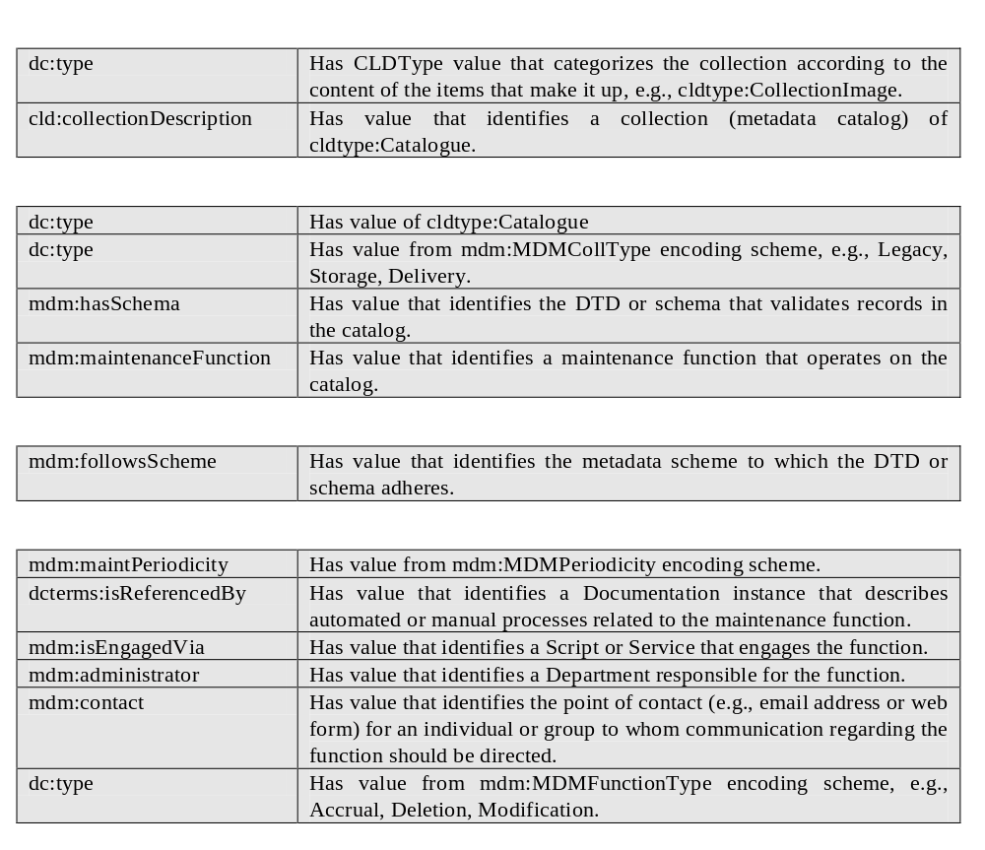
Properties of primary entities
Notes:
This table allows us to break out the properties by the entities to which they apply: collections of content objects, metadata catalogs, XML DTDs or schemas, and metadata maintenance functions.
We know we need to do more work to define properties, value types, and encoding schemes, and to develop the model described here into a Metadata Maintenance Application Profile.
Jim will conclude by talking about some of the areas we want to develop or study further.

Slide 9
Conclusion
Relationship to other data models
Adaptation for maintenance of collections of content objects
Operational applications

Slide 10
Questions?
Or please send follow-up questions to
Marty {MK168@cornell.edu}
or
Jim {JDL8@cornell.edu}

