Slide 1
The NSDL Registry
Jon Phipps Stuart Sutton
Diane Hillmann Ryan Laundry
Cornell U. U. of Washington

Slide 2
What is the NSDL?
National Science Digital Library (NSDL) is a project funded by the National Science Foundation (US)
Consists of:
  a Core Infrastructure group, responsible for the management of common services
  several large-scale projects responsible for specific topical or community coordination
  many small, research-based projects

Slide 3
NSDL Interest in Registries
NSDL projects are required to submit metadata to the NSDL Metadata Repository
Some participants had developed their own vocabularies, others were looking for vocabularies to re-use
NSDL CI had brought participants together in 2004 to develop some broader, education-based vocabularies

Slide 4
Why Aren’t There More Registries?
Most registry projects (including DC) began by registering metadata schemas
Development of registries has assumed that users will register for the “common good”
NSDL registry goes beyond the “common good” by providing services for owners and users

Slide 5
Registries for Active Maintenance
Registration cannot be the last step, after the creation of human-readable documentation, and unconnected to it
Rather the registry should be the central piece, enabling machine-based interaction as well as human-readable documentation
Until registries can support this range of functions, they will necessarily be an afterthought, and cannot perform the roles we envision for them

Slide 6
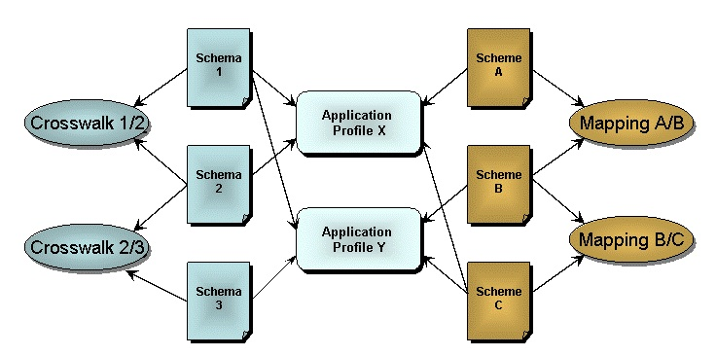

Slide 7
Starting With Vocabularies
Development of Simple Knowledge Organisation System (SKOS) well underway
Able to build on the “top level vocabulary registration” envisioned by the UB some years ago
NSDL community in need of method for developing and re-using small vocabularies, particularly in education

Slide 8
“Typical User” Use Cases
Looking for vocabulary or vocabularies to apply to a particular project
Exploring the use of particular terms or concepts across the registry
Developing an application profile requiring vocabularies with URIs
Searching for sustainable automated methods to update instance data, particularly the value vocabularies

Slide 9
“Vocabulary Owner” Use Case
Owner has an interest in knowing who is using a vocabulary (assists in finding funding support, developing community processes)
Owners can manage terms within the registry, and update their websites and applications using registry outputs
Vocabulary development capabilities assist in community review of new terms

Slide 10
Development Issues
Managing change
  Concepts (and URIs)
  History and “versioning”
The NSDL Registry as a node in a distribution system
  “non-hosted” vocabularies
  relationships between vocabularies

Slide 11
Development Issues (2)
Notifications, outputs, interactions
  Essential for administrative functions
  Basic to all services
Coordination with SKOS development
  Versioning
  Mapping

Slide 12
Where we are: Beta+
Vocabularies registered so far
User registration
URI Assignments enabled
Change management issues defined and basic strategies chosen
Next steps defined

Slide 13
Vocabularies Registered
Selected GEM vocabularies
NSDL Education Level and Learning Resource Type
Registry-specific vocabularies
  Registry administrative properties
  Schema properties
  Application profile properties

Slide 14
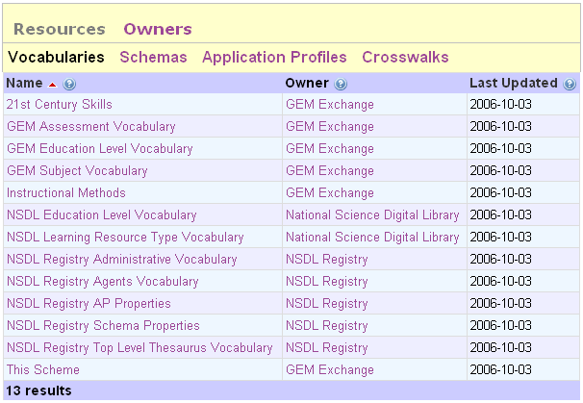
Registered Vocabularies

Slide 15
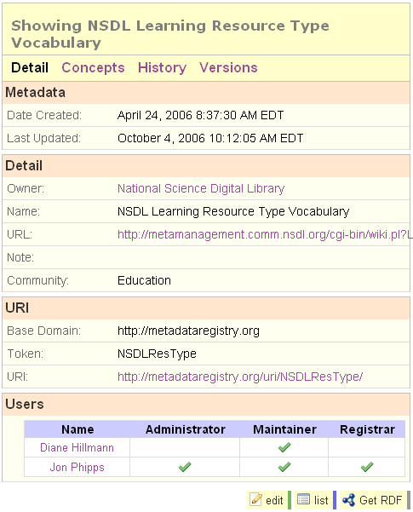
Vocabulary detail

Slide 16
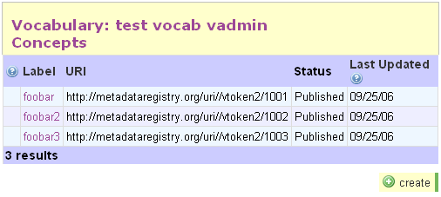
Concepts

Slide 17
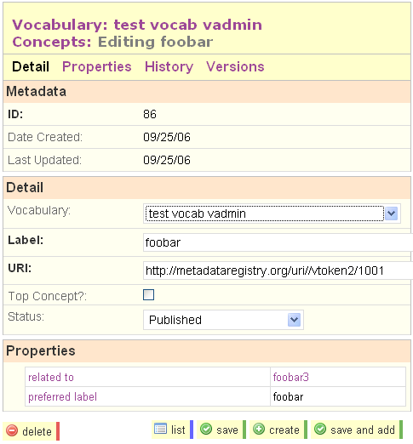
Concept
Detail

Slide 18
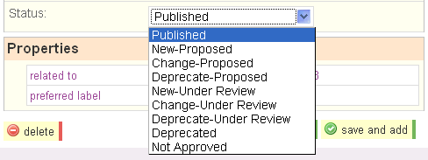
Concept
Status

Slide 19
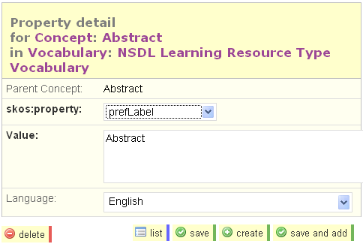
Property
Detail

Slide 20
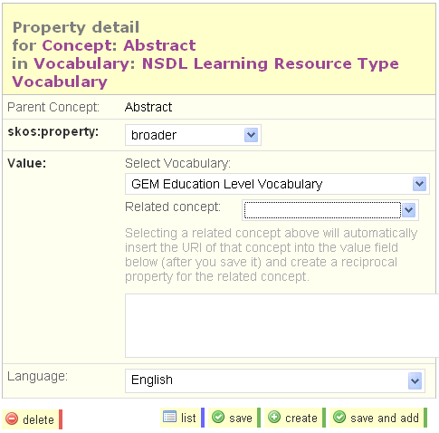
Property
Relationships

Slide 21
User Registration
Agents for Vocabularies
  Organizations or persons “owning” and managing vocabularies
  Maintainers with permissions to perform specific functions
Users of Vocabularies
  Primarily consumers of information
  Enabled to search and browse
  Will be able to subscribe to or request notification and output for specific vocabularies of interest

Slide 22
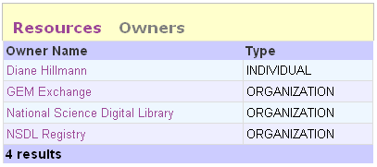
Resource Owners (Agents)

Slide 23
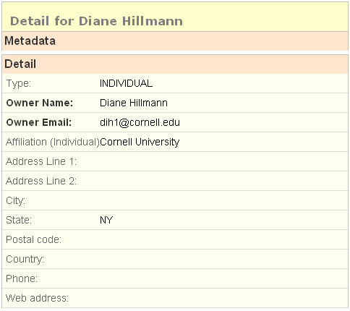
Agent Detail

Slide 24
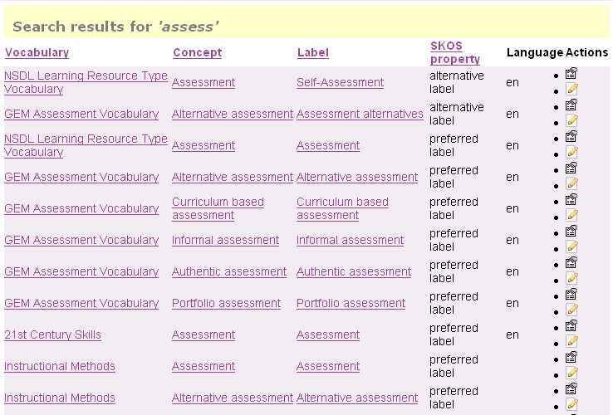
Concept Search

Slide 25
URI Assignments
Assignment an aggregation of:
  agentDomain (specified by owner or defaulted to the Registry domain)
  vocabularyToken (based on the abandoned DC-UB conception)
  conceptIdentifier (preference for numerics, carrying no semantic meaning)
Already extant URIs can be registered if they exist or the owner prefers

Slide 26
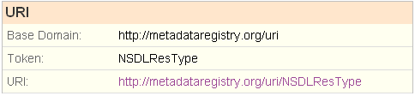
URI Assignment
Vocabulary
Concept

Slide 27
Content Negotiation
Implementing “the Cookbook”
  Active content negotiation
  Serves RDF when RDF requested (primarily for machines)
  Serves HTML when HTML requested (primarily for humans)

Slide 28
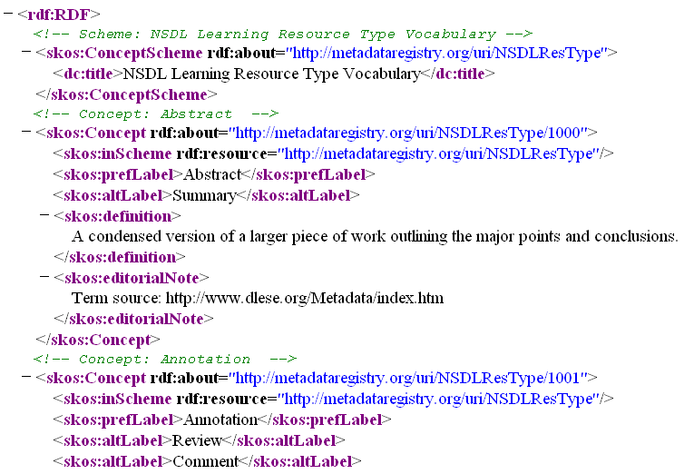
RDF

Slide 29
Managing Change: Basic Strategies
Tracking all changes as “instances”
Defining semantic significance
Snapshots and history will be available for terms and vocabularies
Versioning policy in process
Supporting vocabulary review processes
  Automated validation and error detection
  Assisted error resolution

Slide 30
From here ...
Schemas
  Both registered (hosted) and non-hosted interactions
Application Profiles
  “The Middle Kingdom”--where registered properties are matched with registered vocabularies
File import and output
Administration, notifications, etc.

Slide 31
Documentation available
Functional requirements and planning documents are available:
http://metadataregistry.org/wiki/index.php/Working_Notes_and_Documentation
The Registry Blog: http://eg2.ischool.washington.edu/registry/registryblog
Development site: http://metadataregistry.org/trac/registry/

Slide 32
Take a Look!
http://metadataregistry.org

