Slide 1

DC-Education:
Product, Process and People
International Conference on Dublin Core and Metadata Applications, 3 - 6 October 2006
Colima, Mexico
Mike Crandall
University of Washington
Information School

Slide 2
Agenda
Where we are
What’s been done
Where do we go now?
Product, process and people

Slide 3
Where We Are

Slide 4
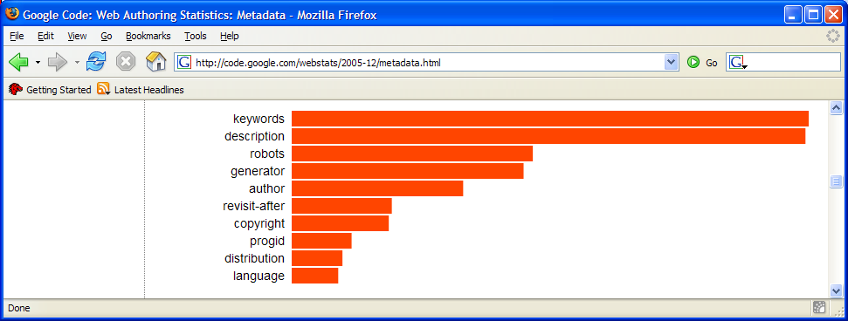
Google Metadata Statistics
<meta name="">
“In December 2005 we did an analysis of a sample of slightly over a billion documents, extracting information about popular class names, elements, attributes, and related metadata.”
http://code.google.com/webstats/2005-12/metadata.html

Slide 5
Google Metadata Statistics
The Dublin Core people can take some comfort from the fact that although their keywords didn't appear in the top ten chart above, they were quite well featured in the next few dozen. Here are the ten most used dc.foo values, most popular first:
  dc.title
  dc.language
  dc.creator
  dc.subject
  dc.publisher
  dc.description
  dc.identifier
  dc.date
  dc.format
  dc.rights
In fact the order maps relatively closely to the frequency of similar metadata in other constructs, like class names or rel values. Nice to know people are consistent!
http://code.google.com/webstats/2005-12/metadata.html

Slide 6
DC Metadata Occurrence Frequency
(% of total) on Google Pages
dc.title | 1.674
dc.language | 1.099
dc.creator | 1.015
dc.subject | 0.870
dc.publisher | 0.841
dc.description | 0.751
dc.identifier | 0.560
dc.date | 0.521
dc.format | 0.405
dc.rights | 0.399
dc.type | 0.376
dc.date.created | 0.274
dc.date.modified | 0.226
dc.coverage | 0.179
dc.source | 0.163
dc.contributor | 0.157
dc.keywords | 0.083
dc.relation | 0.078
dc.coverage.placename | 0.073
dc.date.issued | 0.045
dc.coverage.spatial | 0.042
dc.rights.copyright | 0.040
dc.creator.name | 0.034
dcterms.abstract | 0.034
dc.audience | 0.032
dc.creator.personalname | 0.026
dc.date.valid | 0.026
dcterms.issued | 0.026

Slide 7
More Mysteries
“The <head profile=""> values:
  http://dublincore.org/documents/dcq-html/
  http://purl.org/metadata/dublin_core
  http://purl.org/dc/
  http://purl.org/metadata/dublin_core/
...were, in total, found on about 0.045% of pages (which is a lot less than the number of pages that saw dc.title, sadly -- indicating that most pages with Dublin Core metadata don't actually, technically, have any metadata on them, since they don't declare a profile).”
“In terms of other metadata, <link rel="next"> is used on about 2% of pages, whereas <link rel="schema.dc"> is used on about 0.3% and <link rel="schema.dcterms"> is used on about 0.05% of pages. (In both this is more than the number of pages that declare the Dublin Core metadata is in use, so there are a lot of bogus pages out there.)”
http://code.google.com/webstats/2005-12/metadata.html

Slide 8
What Does This Tell Us?
A quick search for "dublin core" on Google shows about 6,310,000 records
  But only about .045% of all pages are correctly tagged with DC values
  Clearly people know DC exists, but don’t seem to be using it effectively
But, is this the right place to be looking?
And, does this mean Dublin Core is worthless?
Or, is Cory Doctorow right?

Slide 9
Metacrap: Putting the torch to seven straw-men of the meta-utopia
People lie
People are lazy
People are stupid
Mission: Impossible- know thyself
Schemas aren’t neutral
Metrics influence results
There’s more than one way to describe something
Cory Doctorow, August 2001 http://www.well.com/~doctorow/metacrap.htm
Notes:
People lie- true in wide world, less true in internal business or partnership situations. Perhaps not intentional, but still happens
People are lazy- not lazy but busy. Even in best of cases, adding metadata is a chore, and if not trained, won’t be done right (see next bullet). Trick is to make it easy, by embedding in process- Boeing EVS example
People are stupid- not stupid but untrained and focused. Dream of end-user metadata generation has pushed lots of tools- reality is trained and dedicated people or automated solutions work, otherwise not
Mission Impossible- old news, Cranfield studies in 60s of inter-indexer consistency showed low repeatability even in same person. But automated tools haven’t done much better so far either. Helps to have trained outsiders but won’t be nirvana
Schemas aren’t neutral- that’s why they need to be explicit. And why people need to understand why and how they got their information. Build this into your system
Metrics influence results- yes, that’s why good metadata is self-reinforcing. But you have to have checks on this- MSWeb best bets example
More than one way- again explicit descriptions are important, definitions so people are on same page.

Slide 10
My Answers–
Your Mileage May Vary
People don’t lie, aren’t lazy, and are not stupid
But they may need education!!
Metadata is valuable, but we might be expecting it to accomplish the impossible
Looking at the World Wide Web for usage data is misguided– we need to look at specific applications where metadata can provide value
But to gain that value, it is important to have a clear foundation to build on, one that provides interoperability and extensibility

Slide 11
The Dublin Core Advantage
Metadata Standard
Information Model
+
Dublin Core Metadata Element Set
Dublin Core Abstract Model
Simple, but can be flexibly extended and customized
Facilitates interoperability and supports modularization
Supports the ability to create simple, flexible metadata records that can be customized, modularized and are interoperable

Slide 12
What’s Been Done

Slide 13
DC Education
Let’s start with the DC Education working group, first formed in 1999
Driven by the need to provide additional properties necessary for the description of learning objects
Bottom up discovery process involved many people, and from an early stage, cooperation with IMS (later IEEE/LOM)

Slide 14
Current Projects
DC Education Application Profile
  Goal is to set out property usage for the DCMI properties including the use of value spaces and best practices within the context of education and training
  http://dublincore.org/educationwiki/DC_2dEducation_20Application_20Profile
Joint DCMI/IEEE LTSC Taskforce
  Recommendation for using IEEE LOM Elements in Dublin Core Metadata
  http://dublincore.org/educationwiki/DCMIIEEELTSCTaskforce

Slide 15
Challenges
Continuing engagement of stakeholders in process; what is the best communication method for those interested in the problem?
Moving to the next layer (an Application Profile)
  Defining authorized term sets (Controlled Vocabularies) for elements and properties
  Finding hosts to expose and maintain this terminology
  Compliance with the DCMI Abstract Model
Cross-national agreements on common Controlled Vocabularies (e.g. educational levels)
Engagement of vendors in the problem

Slide 16
In Spite of All That
Adoption of IEEE/LOM by the SCORM community has given Learning Management Systems a minimum level of interoperability
Examples such as the MIT Open Courseware project, work done in the UK, and others show the power of bottom up adoption when a standard is in place
The DCMI Abstract Model, along with the core element set, is providing a rigor to future development that was not possible before

Slide 17
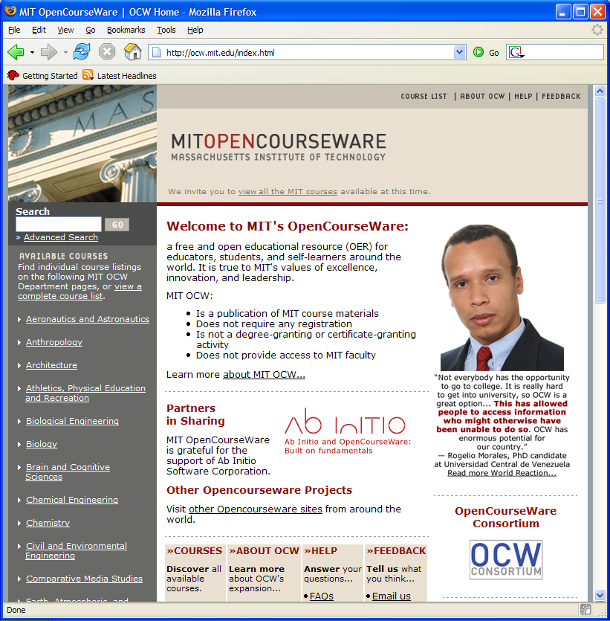
MIT Open Courseware
1,400 courses published as of May 1, 2006
Dependent on open metadata for sharing and sustainability– SCORM compliant
Example of best practice of bottom up release

Slide 18
Lessons
Product is what makes it tangible– basis for much of the content metadata in SCORM (Shareable Content Object Reference Model), which moves theory into practice
Process was critical
  Early (and continuing) cooperation with IMS (IEEE/LOM) meant that efforts weren’t split
  Inclusive approach means parallel efforts stay aligned
People were key– Stuart Sutton, Jon Mason, and Diane Hillman as Working Group Chairs kept the ball rolling, many others are making it reality
Although Education was the subject, it was also the key element in driving progress, by bringing everyone up to the same level of knowledge

Slide 19
Some Personal Examples
Let me shift gears here for a moment, and try to translate some of this into my own personal experience working with Dublin Core since the late 1990s
Each of these examples shows the value of having:
  Products that can take advantage of metadata quickly
  A process for using established metadata standards
  Engagement of the right people
  The value of education across all three of these

Slide 20
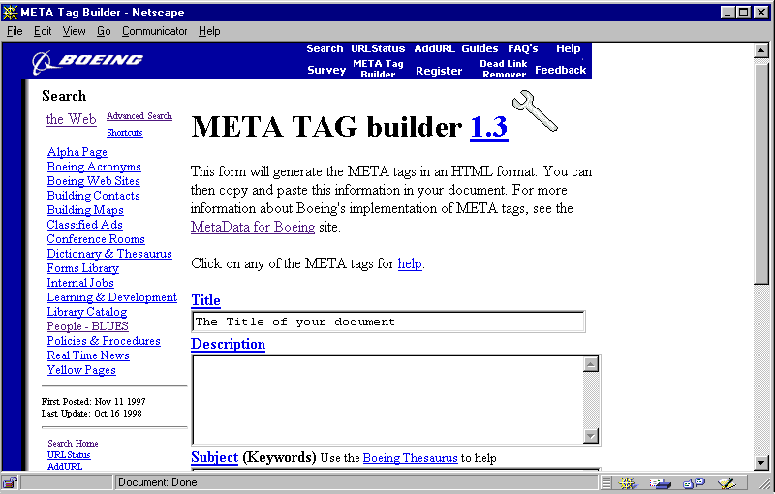
The Boeing Web
Adopted seven metadata tags as standard, based on DC elements, early in 1997 for use on intranet content
Achieved 20% tagging rate in early years
Cross-company effort, involving the right people to build a process for a simple product

Slide 21
MSWeb-2000
MSWeb built a metadata-enabled search service (precursor to SharePoint), again based on DC
Key was the engagement of the right people, along with a process and product
ElementID | CollectionID | LinkedElementID | LinkedCollectionID | RelationType
Author | MSW | root | MSW | N
Contact Alias | MSW | root | MSW | N
Date | MSW | root | MSW | N
Description | MSW | root | MSW | N
Geography | MSW | root | MSW | N
Keywords | MSW | root | MSW | N
Language | MSW | root | MSW | N
Products | MSW | root | MSW | N
Source | MSW | root | MSW | N
Title | MSW | root | MSW | N

Slide 22
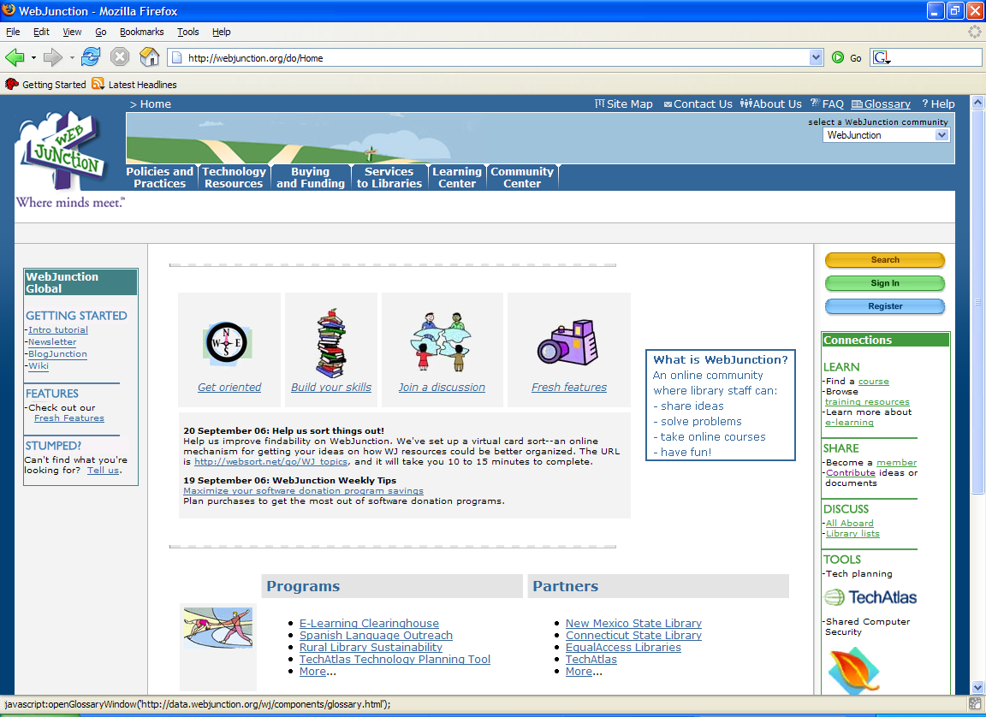
WebJunction
Basic metadata schema developed by OCLC using DC and SCORM
Initial content migration from Gates Foundation managed through a DC-based content inventory
Learning center uses SCORM for course management

Slide 23
Other Examples of Success
Some of the best examples of effective use of Product, Process and People can be seen in the results of the DCMI Working Groups
Each of these has used people who are knowledgeable and interested in their area of expertise together, to educate others working in that area
Two examples…..

Slide 24
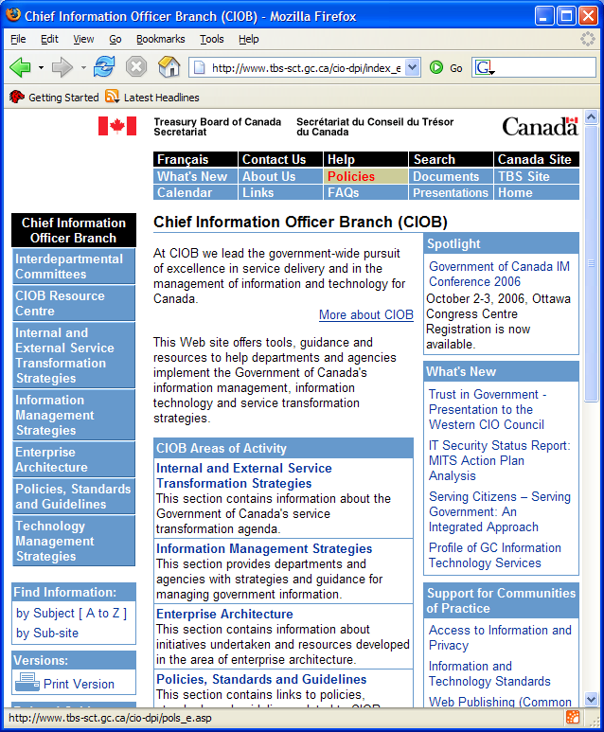
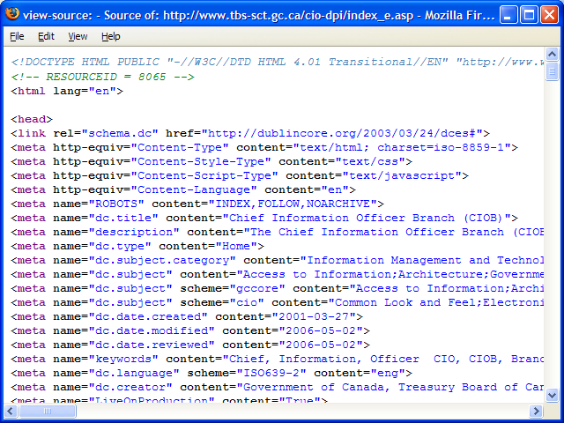
In Government

Slide 25
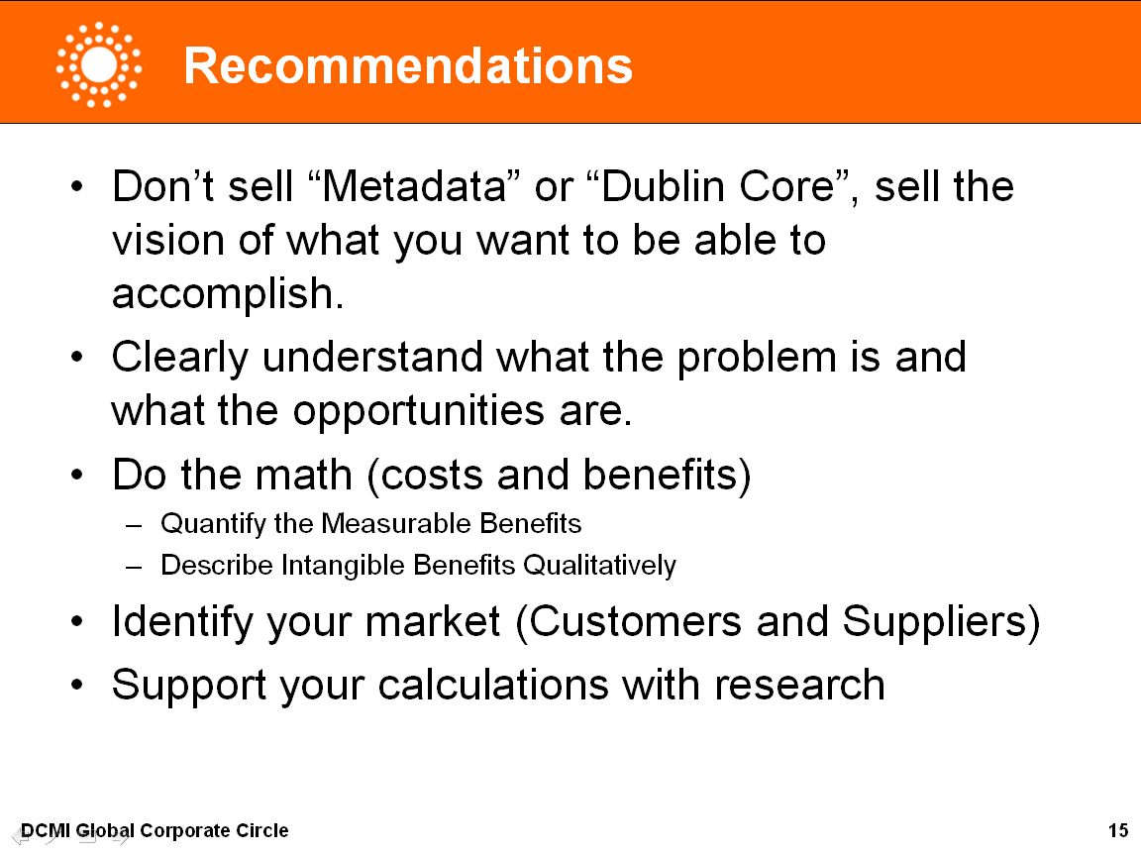
Global Corporate Circle
Developed a series of case studies of existing DC implementations in corporate settings
Drafted a sample presentation for use in convincing stakeholders of metadata value in enterprise settings
Organized workshops at last four DCMI annual conferences to discuss issues in corporate settings

Slide 26
Where Do We Go Now?

Slide 27
Stages of Education
Metadata readiness
  Prerequisite for interest in DCMI
Metadata design
  Understanding the high-level requirements and building a solution that works; DC Education’s and other Working Groups’ mission
Metadata implementation
  The nuts and bolts, what DCMI has focused on
Metadata maintenance
  Often ignored, but a critical part of the process for ongoing success

Slide 28
Shift of Focus
Tom Baker described at DC-2005 a:
  “Shift in DCMI emphasis from underlying vocabularies to application profiles
    Learn by example
    Profiles reviewed for conformance to the Abstract Model
    Can be emulated or used by others
  Emphasis on guidelines for “how to make an application profile””
Implies recognition of a new audience

Slide 29
New Types of Education
With a shift to non-technical audiences, it becomes much more difficult to educate stakeholders on the value of DCMI
While work such as I have described earlier will continue to be critical to success, there are other avenues that will need to be explored to get to metadata readiness
  At the organizational level, DCMI will need to pay more attention to consumers of metadata
  At the individual and group level, more direct education of non-technical audiences by DCMI members will need to occur—in their language, not ours (e.g., the Corporate Circle presentation)

Slide 30
DCMI Efforts
From the start, DCMI has focused on making efforts visible, through many avenues, including
  Website
  Conferences
  Standards
  Liaisons with other groups
DCMI is now shifting focus to produce educational materials targeted at non-technical audiences

Slide 31
Other Avenues
Formal education of professional students in the use and application of metadata in their environments
  University of Washington has a professional masters program in Information Management
  Capstone projects provide a chance to apply learning in a real setting, under academic guidance

Slide 32
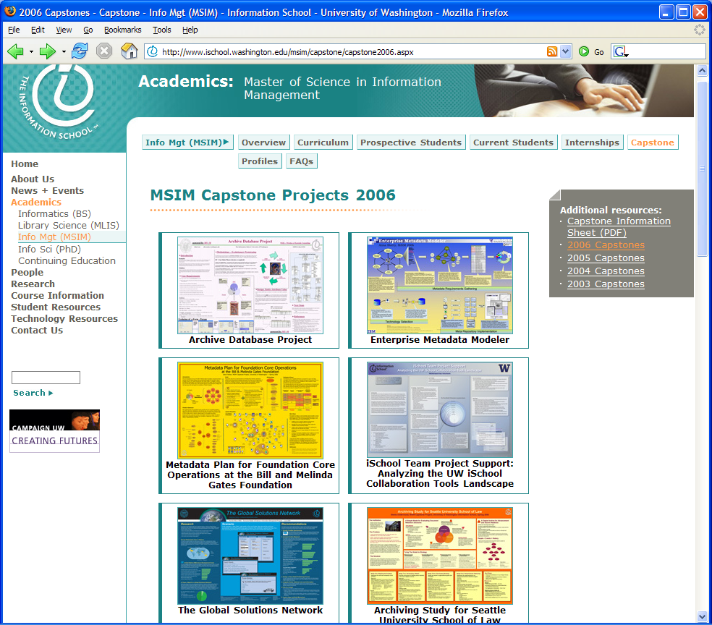
MSIM Capstones
Projects in many settings, from non-profit to government to corporate
Students become educated advocates

Slide 33
Metadata Schema
The following set of metadata attributes is proposed for use by the Gates Foundation Core Operations group to achieve the goals of this project. This set uses elements from the Dublin Core metadata set when possible to utilize standards for improved interoperability.
The metadata elements have been grouped into classifications of purpose (how they are used within the Core Operations group), source (how the values for each element should be captured), and taxonomy architecture (the type of taxonomy best suited to manage the terms of the element).
Identification/
Distinction
Search &
Browse
Use Management/
Workflow
Document
Management/
Retention
Created
Audience
Rights
Date Effective
Human
Capture
Modified
Coverage
Creator
Date Expires
Date
Subject
Owner
Is Replaced By
Programmatic
Capture
Submitted
Description
Title
Role
Relation
Inherit from
System
Identifier
Status
Replaces
Source
Type
Rights Holder
Parker, JD (2006). Metadata Plan for Foundation Core Operations
at the Bill & Melinda Gates Foundation. University of Washington
Flat
Taxonomy
Hierarchical
Taxonomy
Faceted
Taxonomy
Network
Taxonomy

Slide 34
Stages of Education
Metadata readiness
  Prerequisite for interest in DCMI
Metadata design
  Understanding the high-level requirements and building a solution that works; DC Education’s and other Working Groups’ mission
Metadata implementation
  The nuts and bolts, what DCMI has focused on
Metadata maintenance
  Often ignored, but a critical part of the process for ongoing success

Slide 35
Challenges
Educating people, not only at the technical level, but about why, how, and when metadata is important
  Embedding understanding of metadata readiness in the educational core for IS and IM programs
  Evangelizing effective use of metadata at all levels within different sectors
Continuing collaborative work with parallel initiatives to ensure that processes are effective
  IEEE/LOM in education, others in other sectors
Maintenance!!! The constant challenge facing all of us no matter what we’re working on
  Will become even more important as Application Profiles are developed and deployed (the products of our labors)

Slide 36
Product, Process and People

Slide 37
Many Dimensions
Although we tend to focus on products as the visible manifestations of our work, it is clear that the processes and people involved are equally critical at all levels of education
Over the past 10 years, the DCMI community has made great progress in extending DC for use in many sectors
More work remains to be done, but it’s time for all of us to join in educational efforts focused on metadata readiness, no matter what our current roles

Slide 38
Moving From Abstract to Concrete
Most of what I have talked about is at a high level, avoiding the details
Before I end, I want to emphasize that the details are fundamental to success
Work on the Abstract Model and application profiles provide the foundation
But we have to recognize that the audience that will use our work needs to be educated as well, in a different way– that’s everyone’s challenge going forward

Slide 39
The Dublin Core Advantage
Metadata Standard
Information Model
+
Dublin Core Metadata Element Set
Dublin Core Abstract Model
Simple, but can be flexibly extended and customized
Facilitates interoperability and supports modularization
Supports the ability to create simple, flexible metadata records that can be customized, modularized and are interoperable

Slide 40
What Can You Do?
Let people know what and why DCMI is doing– educate them!!
Build processes in your organization to utilize metadata effectively and teach others about how and why to use it
Work to embed DC into tools and products dealing with metadata so that others can use it
Then we can demonstrate why Google and Doctorow missed the mark in their analyses

Slide 41
Have Fun!!!

