Slide 1



Analysis & Predictive Modeling of Home Rental Prices
based on U.S. residential rent data provided within the
Zillow Observed Rent Index (ZORI)
https://www.zillow.com/research/methodology-zori-repeat-rent-27092/
created by David Nick
https://github.com/dcnarch
https://www.linkedin.com/in/davidcnick/

Slide 2
Why did I choose this subject & dataset?
Personal relevance
Been renting for over 20 years in the L.A./Southern California area, difficult to find data targeted to renters.
Methodology of the dataset seems of high quality
Weighted to factor for: variations in home sizes, availability, asking vs. actual prices, all homes in the zip code (not just those listed for rent) and structure age.
Rents are given a 3-month exponentially weighted moving average, then the mean of the middle 20% (the 40-to-60 percentile) is used to calculate each month.
“Middle quintile” usage reduces effect of variance due to minor changes or noise in the data.

Slide 3

Data Analysis
Let’s see what we have!!!

Slide 4
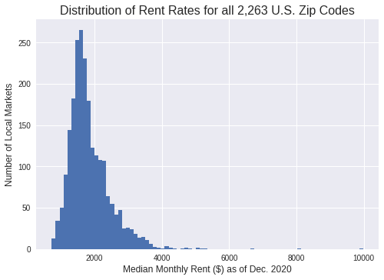
2014-2020 (7 yrs)
Dataset comprised of the 100 largest metro markets in the U.S.
2,263 of the most populated zip codes in total.
Seems to have a divide just below $2,000/month

Slide 5
As of the end of 2020, what is the most expensive rental market in the U.S.?
$9,986/month in 90265 Malibu, CA (no surprise there)
And what is the least expensive rental market in the U.S.?
$727/month in 44052 Lorain, OH (a Cleveland suburb)
Just for Fun...

Slide 6
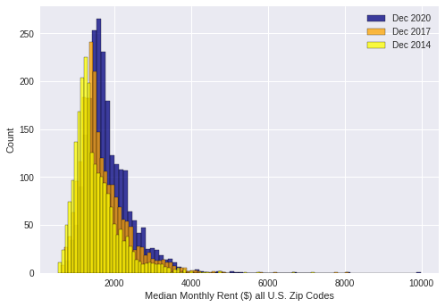
Historic data
2014
to
2017
to
2020

Slide 7
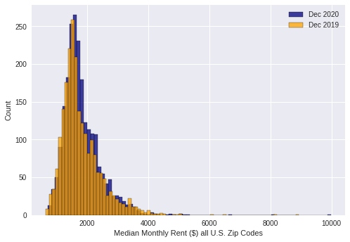
Comparing 2019
to 2020
Surprised?
I expected 2020 to be about the same, not higher
1.7% average increase in 2020
3.6% median increase in 2020

Slide 8
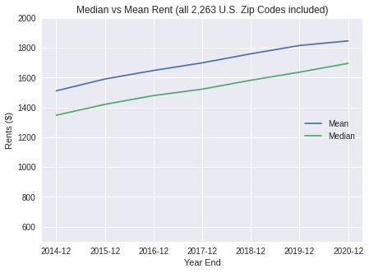
Median or Mean?
We’ll look at medians going forward to reduce the impact of a few high-priced outliers.
We’ll compare the Top 3 metro markets (most zip codes) vs. the entire U.S. next

Slide 9
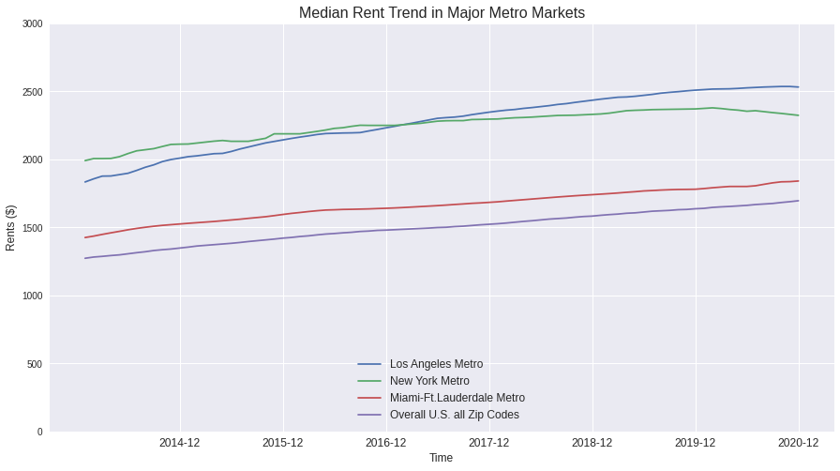

Slide 10

Unsupervised ML Modeling
Given that this specific ZORI dataset has:
Numeric trends over time
No specific target
Then it is well suited for unsupervised machine learning.
The plan was to examine some clustering methods first (KMeans, KMeans w/ PCA, Hierarchical Clustering and DBSCAN).

Slide 11
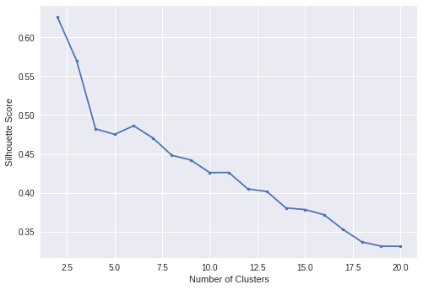
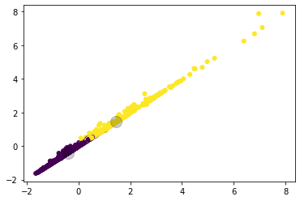
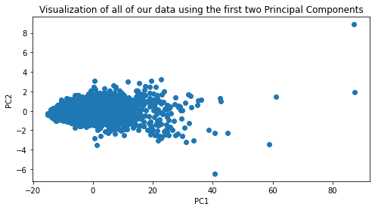
KMeans Clustering (only 2) seemed to give the best relevancy compared to other clustering methods, but I didn’t feel like this was showing much.

Slide 12
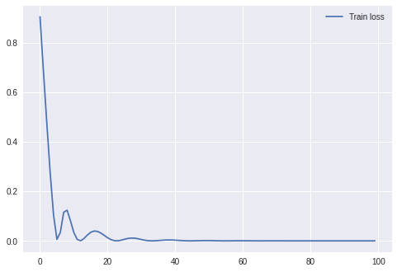
For this specific dataset RNN (Recurrent Neural Networks) in Keras is ideal.
Below is a graph of the loss calculation from fitting a model with RNN:
(The closer it gets to 0, the better!)

Slide 13
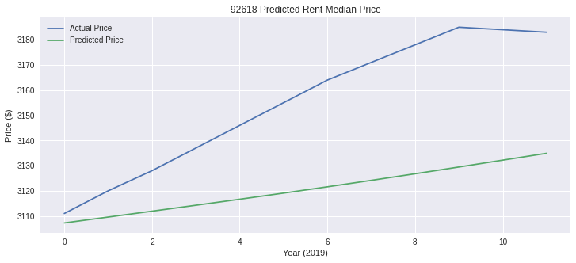
Using 2014-2018 as the training data, I modeled time-series prediction with RNN.
I started with a sample zip code in the LA market, tested w/ actual data from 2019.
Eventually my goal is to apply this predictive modeling based on the median data of all 2,263 zip codes, as well as for all Top 10 markets, to get larger sample sizes.

Slide 14
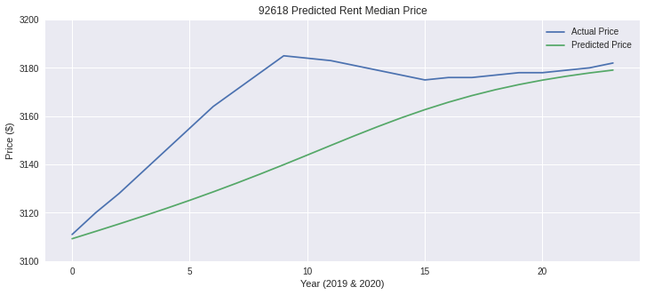
We need to increase the sample of testing data, so let’s include 2020 after all.
Sweet!!! This prediction ends 2020 extremely close to the actual!

Slide 15

Final Thoughts & Takeaways
Zillow. It’s not just for ogling your friends’ home price history or daydreaming about buying a house you can’t afford.
bfill and ffill limitations
Transpose difficulty with dtypes
This dataset is pretty massive, so you could go a number of directions as to what/how you want to analyze or derive ML modeling from it.
THANK YOU!

Slide 16
This presentation has concluded for the day.
Stay tuned for more data science wonderment.

