Slide 1
> USAG WIESBADEN CYBER SUMMIT - CYBER DEFENSE WORKSHOP
Cyber Defense with KQL
in Azure Data Explorer (ADX)
Investigate a live intrusion the way a Defender XDR analyst does — by writing queries against real telemetry, together.
> ./start --workshop cyber-defense-kql --time 2h --mode instructor-led
CYBER DEFENSE WORKSHOP · KQL → XDR
INSTRUCTORS: LORENZO IRELAND & ISAAC SANTIAGO
01 / 29

Slide 2
> WHOAMI
Your instructor for this workshop.
WHY I'M HERE TODAY
This is a hands-on, basic course — no prior KQL required.
We investigate one real-world-style intrusion end to end.
Hopefully, you leave able to orient on telemetry and follow the kill chain w/ KQL.
The goal isn't the answer — it's the method to reach it.
Lorenzo J. Ireland
Sr Cloud Solution Architect (AI+Security)
Microsoft (European AOR)
Advanced Persistent DEfender
$ focus --areas
› Cloud & hybrid identity (Entra ID)
› Microsoft Defender XDR & MDE
› KQL threat hunting & detection
› Security architecture for gov
HOW WE'LL WORK
Instructor-led — we run every query together, live.
You watch, then you type. Break things freely — ADX tells you where.
Fall behind? The story still makes sense at the next step.
Questions are the point. Interrupt early and often.
CYBER DEFENSE WORKSHOP · KQL → XDR
02 / 29

Slide 3
> TODAY // 120 MINUTES
One operating rhythm: train on the tool, then use it to find, fix, and finish the adversary.
01
FRAME
KQL mental model, the lab, the kill chain, and the threat actor.
10m
02
CLOUD & IDENTITY
Acts 2-5: phish, device code, risky sign-in, OAuth consent, Graph.
40m
03
ENDPOINT
Acts 6-7: land on the host, watch the credential-access playbook.
30m
04
PIVOT & CORRELATE
Acts 8-12: Kerberoast, hybrid pivot, cloud exfil, threat intel, XDR.
35m
05
DEBRIEF & NEXT
What was decisive → SOAR, detection engineering, enhanced defense.
5m
CYBER DEFENSE WORKSHOP · KQL → XDR
03 / 29

Slide 4
> OBJECTIVES
By the end of the hour, you can do these five things unaided.
READ KQL
› Navigate Defender & Entra tables in ADX — filter, project, summarize, join.
CORRELATE TELEMETRY
› Connect endpoint, identity, cloud, Graph, and alert evidence across tables.
PIVOT AN INVESTIGATION
› Anchor on user / IP / time and chase the attacker through the data.
MAP TO FRAMEWORKS
› Place each finding on the Cyber Kill Chain and MITRE ATT&CK.
BUILD A TIMELINE
› Assemble a defensible incident narrative from first signal to impact.
THE ONE HABIT
“Start broad, project narrow, summarize, join, build the timeline.”
CYBER DEFENSE WORKSHOP · KQL → XDR
04 / 29

Slide 5
> KQL 101 // THE MENTAL MODEL
Data flows through a pipeline, one operator at a time — like Linux pipes.
● ● ● the 5 operators you use most
SYNTAX YOU NEED
|
== exactly equals (case-sensitive)
=~ equals, case-insensitive
has | contains: contains the whole word
in~ ("a","b") in this list, any case
let name a query and reuse it
DeviceProcessEvents 1 start with a table
| where FileName == "mimikatz.exe" 2 filter rows
| project Timestamp, DeviceName, AccountName 3 pick cols
| summarize Count = count() by DeviceName 4 aggregate
| order by Count desc 5 sort
THE MODEL
› A table is a giant list of rows (DeviceProcessEvents is a table).
› A pipe | hands all rows from one step to the next.
› An operator transforms them: where (filter), project (columns), summarize (count), order by (sort).
› ADX is forgiving — a typo tells you exactly what's wrong and where. Don't be afraid to break things.
CYBER DEFENSE WORKSHOP · KQL → XDR
05 / 29

Slide 6
> THE TERRAIN // LAB ENVIRONMENT
Synthetic Microsoft security telemetry — a realistic hybrid estate, no production risk.
1
Entra Connect server
Identity Tier 0
10
Windows 11 25H2
endpoints · MDE
5
Ubuntu servers
endpoints · MDE
Hybrid
Entra ID
cloud + on-prem
2
Domain Controllers
MDI · AssetValue High
THE CROWN JEWELS
Domain Controllers (×2) — can mint any Kerberos ticket.
AADCONNECT01 — the Entra Connect server. It syncs passwords
to the cloud, so owning it bridges on-prem AD and Entra ID.
Nothing in this lab is internet-facing — verify that yourself (Stretch).
Everything else (workstations, Linux) is a stepping stone to these.
TABLE FAMILIES YOU'LL EMPLOY
› EmailEvents / EmailUrlInfo / UrlClickEvents — Defender for Office
› DeviceProcessEvents / DeviceLogonEvents / SecurityEvent — endpoint
› SigninLogs / EntraIdSignInEvents / IdentityQueryEvents — identity
› CloudAppEvents / GraphAPIAuditEvents / AzureActivity — cloud & Graph
› ThreatIntelIndicators / SecurityIncident / AlertEvidence — TI & cases
CYBER DEFENSE WORKSHOP · KQL → XDR
06 / 29

Slide 7
> THE KILL CHAIN
Lockheed Martin's 7 stages — our map for where the attacker is, and where we hunt next.
1 RECON
2 WEAPONIZE
3 DELIVERY
4 EXPLOIT
5 INSTALL
6 C2
7 ACTIONS
Target USAG Cyber, pick Victor
›
Malicious OAuth app built
›
Phishing → risky sign-in
›
Compromised token / session
›
OAuth consent + SP credential
›
Graph API via app identity
›
Creds → Kerberoast → pivot
READ IT LEFT TO RIGHT — BUT WE HUNT RIGHT TO LEFT
In the cloud, identity is the new perimeter — the identity provider (Entra ID) sees the attacker
first, before any endpoint does. So our investigation starts at Delivery/Exploitation (the risky sign-in)
and works outward: cloud → identity → endpoint → back to identity (Kerberoast) → hybrid pivot → XDR.
CYBER DEFENSE WORKSHOP · KQL → XDR
07 / 29

Slide 8
> THREAT ACTOR // MIDNIGHT BLIZZARD
APT29 / Cozy Bear — attributed to Russia's SVR. Emulated tradecraft, synthetic data.
THE SCENARIO, IN ONE BREATH
Victor Alvarez receives a device-code phishing email. The lure
carries the genuine microsoft.com/devicelogin URL, so no mail
filter blocks it. He completes real MFA and hands the attacker an
already-authenticated token. They consent a malicious OAuth app,
enumerate Graph, pivot to WIN11-04 for a credential-access
playbook, Kerberoast, reach the Entra Connect server, and finish
by listing storage keys and reading mail.
ANCHOR IDENTIFIERS — WRITE THESE DOWN
User: victor.alvarez@usag-cyber.local
IP: 185.225.73.18
Host: WIN11-04.usag-cyber.local
Target: AADCONNECT01 (Entra Connect)
Benign twin: alice.weber 198.51.100.50
THE SIGNATURE PATTERN
› device-code phish → token theft → OAuth consent
› → Graph enumeration → hybrid pivot → cloud exfiltration
› MFA was satisfied. OAuth persistence survives a password
› reset. That is why identity-first response matters.
CYBER DEFENSE WORKSHOP · KQL → XDR
08 / 29

Slide 9
> THE METHOD
The analyst's first habit: anchor on identifiers, then let the data pull you forward.
START BROAD
Inventory what telemetry exists before chasing anything.
PROJECT NARROW
Show only the columns that matter for triage — never project *.
SUMMARIZE
Collapse rows into counts and sets to see the shape.
PIVOT WITH let
Capture an identifier (IP, user) and filter other tables by it.
BUILD THE TIMELINE
order by time asc — read the story in the order it happened.
CYBER DEFENSE WORKSHOP · KQL → XDR
09 / 29

Slide 10
> ACT 0 // ARE WE CONNECTED?
Before anything else — confirm you can see all ten tables. Run it together.
● ● ● KQL
WHAT YOU'LL SEE
Fourteen rows back — one per table,
each with a row count. The database
holds 79 tables in total.
Zero rows or an error? Raise your hand.
union withsource=TableName
EmailEvents, UrlClickEvents, SigninLogs, EntraIdSignInEvents,
CloudAppEvents, GraphAPIAuditEvents, DeviceProcessEvents,
SecurityEvent, IdentityQueryEvents, AzureActivity,
ThreatIntelIndicators, SecurityIncident, AlertInfo, AlertEvidence
| summarize Rows = count() by TableName
| order by TableName asc
MENTOR MOMENT
› union stacks tables; withsource tags each row's origin.
› Then we count by table to inventory the estate.
KC: PREP
—
79 tables
CYBER DEFENSE WORKSHOP · KQL → XDR
10 / 29

Slide 11
> ACT 1 // KNOW YOUR TERRAIN
Where do hosts live? What's high value? Understand the cyber terrain before we maneuver through information.
● ● ● KQL
WHAT YOU'LL SEE
2 DCs + 1 Entra Connect = crown
jewels (AssetValue High / Tier 0).
10 Win11 workstations, 5 Ubuntu.
DeviceInfo
| summarize Hosts = dcount(DeviceId),
Devices = make_set(DeviceName, 100)
by OSPlatform, DeviceType, MachineGroup, AssetValue
| order by AssetValue desc, Hosts desc
MENTOR MOMENT
› You can’t defend what you don’t see (Asset Inventory)
› dcount = distinct count (unique, not total).
› make_set collects the actual names, not just a number.
KC: RECON
—
DeviceInfo
CYBER DEFENSE WORKSHOP · KQL → XDR
11 / 29

Slide 12
> ACT 2 // THE DEVICE-CODE PHISH
Before the sign-in there was an email. This is the delivery mechanism — and the URL you cannot block.
● ● ● KQL
WHAT YOU'LL SEE
Two URLs in one lure. One is the
attacker's portal. The other is the
genuine microsoft.com/devicelogin.
let PhishId = toscalar(
EmailEvents
| where RecipientEmailAddress startswith "victor.alvarez"
and Subject has "verify your device"
| top 1 by Timestamp asc
| project NetworkMessageId);
EmailUrlInfo
| where NetworkMessageId == PhishId
| project Timestamp, Url, UrlDomain
MENTOR MOMENT
› You cannot block the Microsoft URL — that is why this works.
› ZAP quarantines the mail, but only after the token is issued.
KC: DELIVERY
T1566
EmailEvents
EmailUrlInfo
CYBER DEFENSE WORKSHOP · KQL → XDR
12 / 29

Slide 13
> ACT 3 // FIND THE SUSPICIOUS SIGN-IN
The intrusion starts in the cloud. Identity sees the attacker first — so we start there.
● ● ● KQL
WHAT YOU'LL SEE
One row: victor.alvarez@usag-cyber.local from 185.225.73.18,
risk level: HIGH.
SigninLogs
| where IsRisky == true
or RiskLevelDuringSignIn in~ ("high", "medium")
| project TimeGenerated, UserPrincipalName, IPAddress,
AppDisplayName, RiskLevelDuringSignIn, RiskState, UserAgent
| order by TimeGenerated asc
MENTOR MOMENT
› Entra ID P2 Identity Protection flags risky sign-ins for us — we just ask the telemetry.
› Anchor on user + IP + time. Every next query starts here.
KC: DELIVERY
T1078.004
T1110.003
SigninLogs
CYBER DEFENSE WORKSHOP · KQL → XDR
13 / 29

Slide 14
> ACT 4 // THE BENIGN TWIN
Two device-code sign-ins, same technique, minutes apart. Only one is an attack. Prove which.
● ● ● KQL
WHAT YOU'LL SEE
alice.weber — compliant, Azure AD
joined, risk none. Benign.
victor.alvarez — unmanaged, risk
high, from 185.225.73.18.
EntraIdSignInEvents
| where LogonType =~ "deviceCode"
| extend RiskLevel = case(RiskLevelAggregated >= 100, "high",
RiskLevelAggregated >= 50, "medium",
RiskLevelAggregated >= 10, "low", "none")
| project Timestamp, AccountUpn, IPAddress, Country,
DeviceTrustType, IsCompliant, RiskLevel
| order by Timestamp asc
MENTOR MOMENT
› Alerting on the protocol alone flags Alice too.
› Defender stores risk as ints: 0, 10, 50, 100.
› Evidence decides the verdict, not the technique.
KC: EXPLOIT
T1078.004
T1550.001
EntraIdSignInEvents
CYBER DEFENSE WORKSHOP · KQL → XDR
14 / 29

Slide 15
> ACT 5 // FOLLOW THE IP → OAUTH CONSENT
The same IP did more than sign in. Capture it with let, then hunt OAuth consent.
● ● ● KQL
WHAT YOU'LL SEE
OAuthAppConsentGranted for
“USAG Cyber Sync Helper” — scopes
Mail.Read, Files.Read.All, offline_access.
let suspiciousIp =
SigninLogs
| where IsRisky == true
| top 1 by TimeGenerated asc
| project IPAddress;
CloudAppEvents
| where IPAddress in (suspiciousIp)
| project Timestamp, AccountDisplayName, ActionType,
ObjectName, OAuthAppId
| order by Timestamp asc
MENTOR MOMENT
› let pivots without hard-coding the IP.
› OAuthApp doesn't require user delegation.
› This backdoor app survives a password reset.
KC: INSTALL
T1528
T1098.001
CloudAppEvents
CYBER DEFENSE WORKSHOP · KQL → XDR
15 / 29

Slide 16
> ACT 5 // GRAPH + PERSISTENCE
What did the app touch, and how did it become durable? Reuse suspiciousIp to find out.
● ● ● two queries · run in sequence
WHAT YOU'LL SEE
The app reads Victor's mailbox,
OneDrive root, and the tenant user list.
Then a new SP credential is added —
app-only access, no human needed.
// Graph calls from the same IP
GraphAPIAuditEvents
| where IpAddress in (suspiciousIp)
| project Timestamp, RequestMethod, RequestUri, Scopes,
ResponseStatusCode
| order by Timestamp asc
// Prove the service-principal credential add
AuditLogs
| where OperationName has_any ("Consent to application",
"service principal credentials")
MENTOR MOMENT
› OAuth consent → SP credential = persistence
› the attacker keeps even after a reset.
KC: C2 / COLLECT
T1114.002
T1550.001
GraphAPIAuditEvents
AuditLogs
CYBER DEFENSE WORKSHOP · KQL → XDR
16 / 29

Slide 17
> ACT 6 // LAND ON THE ENDPOINT
Cloud access became a foothold. What did Victor's workstation actually run?
● ● ● KQL
WHAT YOU'LL SEE
Tooling staged under
C:\ProgramData\wrstage,
then execution begins on the host.
DeviceProcessEvents
| where DeviceName has "WIN11-04"
| project Timestamp, AccountName, FileName,
ProcessCommandLine, InitiatingProcessFileName
| order by Timestamp asc
MENTOR MOMENT
› Cloud identity compromise just became
› endpoint execution — MDE is now our lens.
KC: ACTIONS
T1105
T1059.001
DeviceProcessEvents
CYBER DEFENSE WORKSHOP · KQL → XDR
17 / 29

Slide 18
> ACT 7 // THE CREDENTIAL-ACCESS CHAIN
This is the heart of it — watch the classic credential-theft playbook unfold in order.
● ● ● KQL
WHAT YOU'LL SEE
Registry & SAM hive, LSASS memory
dump, browser + password stores,
then Mimikatz — in sequence.
DeviceProcessEvents
| where DeviceName has "WIN11-04"
| where AccountName contains 'victor'
| project Timestamp, FileName, ProcessCommandLine, AccountName, AccountObjectId
| order by Timestamp asc
MENTOR MOMENT
› Each tool = a different credential store.
› Technique matters more than tool name.
KC: ACTIONS
T1003.002
T1555
T1003.001
DeviceProcessEvents
CYBER DEFENSE WORKSHOP · KQL → XDR
18 / 29

Slide 19
> ACT 8 // KERBEROASTING
Endpoint telemetry cannot explain service-account targeting. Identity and Windows auditing can.
● ● ● KQL
WHAT YOU'LL SEE
LDAP queries enumerating service
principal names, then a burst of
4769 service-ticket requests for
the same accounts.
union
(IdentityQueryEvents
| where Query has "servicePrincipalName"
| extend Src = "MDI"),
(SecurityEvent
| where EventID in (4768, 4769)
| extend Timestamp = TimeGenerated, Src = "Windows")
| project Timestamp, Src, AccountName, ServiceName
| order by Timestamp asc
MENTOR MOMENT
› Two independent sources agreeing beats one alone.
› Many service tickets, one account, short window.
› That burst is the behavioural signature.
KC: ACTIONS
T1558.003
IdentityQueryEvents
CYBER DEFENSE WORKSHOP · KQL → XDR
19 / 29

Slide 20
> ACT 9 // HYBRID IDENTITY PIVOT
The cracked service-account hash reaches the crown jewel. This is the dangerous move.
● ● ● KQL
WHAT YOU'LL SEE
svc_sql logs on to AADCONNECT01
from WIN11-04 — into the Entra
Connect synchronization tier.
DeviceLogonEvents
| where DeviceName has "AADCONNECT01"
| where AccountName has "svc_sql"
| where LogonType in ("RemoteInteractive", "Network")
| project Timestamp, DeviceName, AccountName, ActionType, Protocol,
LogonType, RemoteDeviceName, RemoteIP
| order by Timestamp asc
MENTOR MOMENT
› Owning the sync server bridges on-prem
› AD and Entra ID. Blast radius = the tenant.
KC: ACTIONS
T1078.002
T1021.006
DeviceLogonEvents
CYBER DEFENSE WORKSHOP · KQL → XDR
20 / 29

Slide 21
> ACT 10 // CLOUD COLLECTION & EXFIL
Credential theft is not the impact. This is what actually left the tenant.
● ● ● three queries · run in sequence
WHAT YOU'LL SEE
Storage keys listed from the
attacker IP, then a bulk azcopy
read burst against the data
account, and mail read in Exchange.
// 1. Storage account keys listed
AzureActivity
| where OperationNameValue has "LISTKEYS"
| project TimeGenerated, Caller, CallerIpAddress
// 2. Bulk blob read burst
CloudStorageAggregatedEvents
| where UserAgentHeader has "azcopy"
// 3. Mailbox items accessed
OfficeActivity | where Operation == "MailItemsAccessed"
MENTOR MOMENT
› Most students stop at credential access.
› Impact is what left, not what was stolen.
KC: EXFIL
T1530
T1114.002
AzureActivity
OfficeActivity
CYBER DEFENSE WORKSHOP · KQL → XDR
21 / 29

Slide 22
> ACT 11 // THREAT INTELLIGENCE
Everything you found by hand is already an indicator. Join TI to telemetry instead of reading it in another portal.
● ● ● KQL
WHAT YOU'LL SEE
The attacker IP and the C2 host,
both already present as high-
confidence indicators.
ThreatIntelIndicators
| where ObservableValue in ("185.225.73.18",
"203.0.113.77", "cdn.update-check.example")
| summarize arg_max(TimeGenerated, Confidence, Tags)
by ObservableValue, ObservableKey
| order by Confidence desc
MENTOR MOMENT
› Threat intel is a join, not a separate portal.
› Confidence and TLP should drive the response.
KC: C2
Enrichment
ThreatIntelIndicators
—
CYBER DEFENSE WORKSHOP · KQL → XDR
22 / 29

Slide 23
> ACT 12 // CORRELATE IN XDR
Twelve acts of scattered signals — now let XDR group them into one analyst-friendly case.
● ● ● KQL
WHAT YOU'LL SEE
One incident expands into every
alert — OAuth, LSASS, Kerberoast,
Mimikatz, the hybrid pivot — with
entities attached.
AlertInfo
| join kind=inner (
AlertEvidence
) on AlertId
| where AccountName in (“victor.alvarez”, “svc_sql”)
MENTOR MOMENT
› Opaque AlertIds (not “MIDNIGHT-*”) mirror
› Real SOC conditions. Join = the full story.
› Predictive Shielding – Attack Disruption / Containment
KC: CORRELATE
Multiple
SecurityIncident
AlertEvidence
CYBER DEFENSE WORKSHOP · KQL → XDR
23 / 29

Slide 24
> THE ANATOMY OF ATTACK TIMELINE
Every signal in order, relative to the intrusion anchor T — absolute times shift on every regeneration.
T-49
Device-code phishing email delivered
Lure carries the genuine microsoft.com/devicelogin
T1566
T-44
T1566
Lure clicked from 185.225.73.18
Safe Links allowed the click through
T-38
Device code redeemed
Real MFA satisfied · unmanaged, non-compliant device
T1078.004 · T1550.001
T-30
ZAP quarantines the mail
Too late — the token was already issued
Response
T+6
OAuth service-principal persistence
USAG Cyber Sync Helper consented + credentialed
T1528 · T1098.001
T+35
Kerberoasting
SPN enumeration, then a service-ticket burst
T1558.003
T+50
LSASS dump through Mimikatz
procdump, LaZagne, gsecdump under \wrstage
T1003.001 · T1555
T+82
Hybrid pivot and cloud exfiltration
svc_sql → AADCONNECT01, storage keys, azcopy, mail
T1078.002 · T1530
CYBER DEFENSE WORKSHOP · KQL → XDR
24 / 29

Slide 25
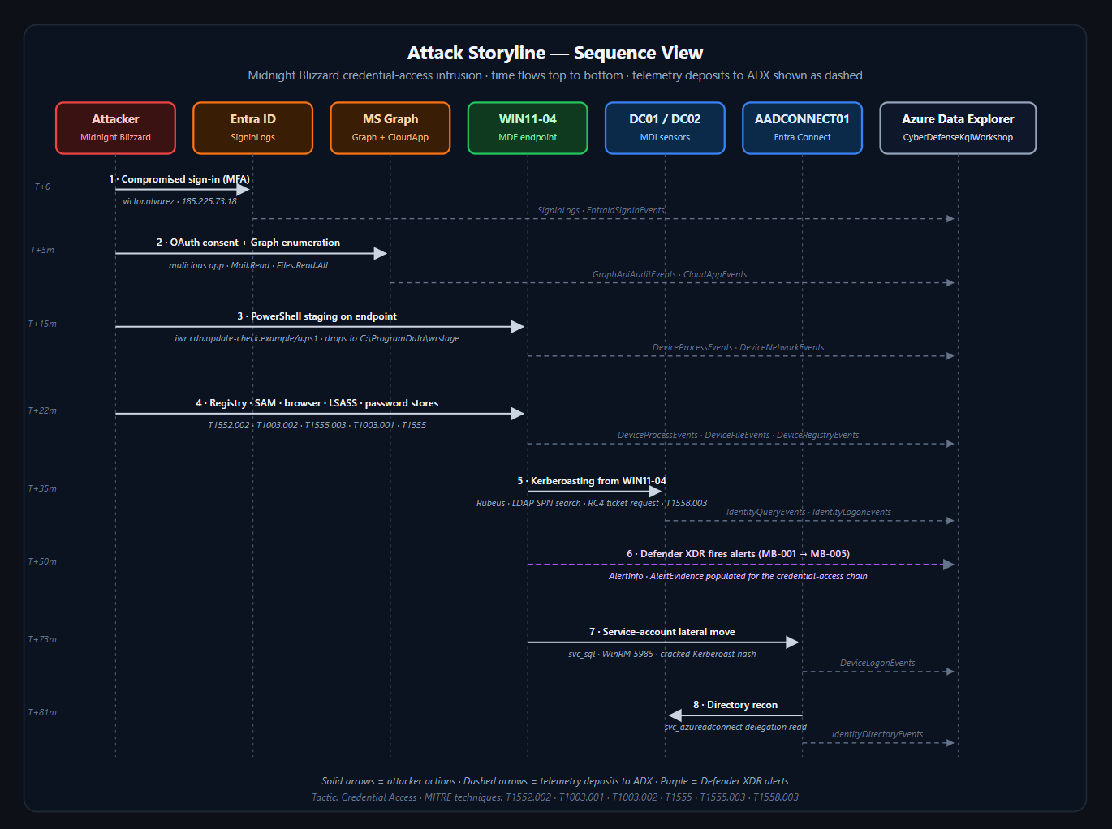
> THE FULL CYBER KILL CHAIN
Every stage of this intrusion, end to end.
CYBER DEFENSE WORKSHOP · KQL → XDR
25 / 29

Slide 26
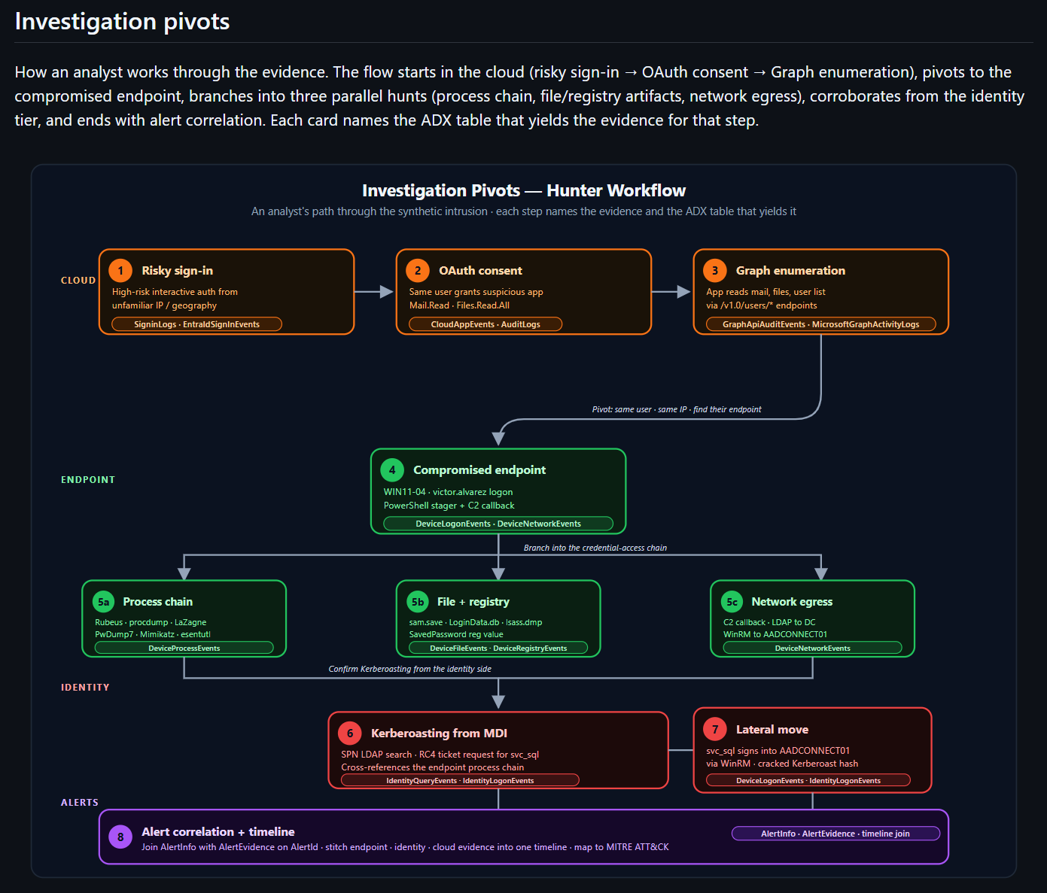
> DEFENDER XDR CORRELATION
CYBER DEFENSE WORKSHOP · KQL → XDR
26 / 29

Slide 27
> DEBRIEF
Close the loop — turn what we saw into what we'd keep. Discuss together.
WHAT TELEMETRY WAS DECISIVE?
› EmailEvents + UrlClickEvents — the delivery nobody saw.
› EntraIdSignInEvents — separated the twin from the attack.
› CloudAppEvents — caught the OAuth backdoor.
› AzureActivity — proved data actually left.
WHAT DETECTIONS WOULD YOU KEEP?
› Device code from a non-compliant, unmanaged device.
› Risky sign-in + new OAuth consent, correlated.
› SP credential add on a freshly consented app.
› Storage key listing followed by a bulk read burst.
WHAT CONTROLS REDUCE IMPACT?
› Block device-code flow via Conditional Access.
› Admin consent workflow — no user OAuth consent.
› Require compliant device, phishing-resistant MFA.
› Tier-0 isolation for AADCONNECT01.
CYBER DEFENSE WORKSHOP · KQL → XDR
27 / 29

Slide 28
> WHERE THIS LEADS
Today was the foundation. Reading telemetry is step one — here's the bigger picture.
DETECTION ENGINEERING
Turn each decisive query into a durable, tested
analytics rule. Version it, tune out false
positives, measure coverage against ATT&CK.
Query → detection → measurable coverage.
SOAR
Automate the response you just did by hand:
revoke sessions, disable the OAuth app,
isolate the host, open the case — in seconds,
not hours.
Playbooks act on your detections.
ENHANCED DEFENSE
Feed it forward: threat-informed defense,
proactive hunting, purple-team validation,
and identity-first Zero Trust hardening.
Assume breach — shrink dwell time and
blast radius, continuously.
THE THROUGH-LINE
Kill chain tells you WHERE the attacker is · KQL tells you WHAT the data proves · XDR tells you HOW it all connects and PROACTIVELY disrupts the attacker lifecycle.
CYBER DEFENSE WORKSHOP · KQL → XDR
28 / 29

Slide 29
> DEFENDERS | USAG WIESBADEN CYBER SUMMIT - CYBER DEFENSE WORKSHOP
Thank you.
You observed the telemetry, fixed on the attacker, severed the kill chain & imposed cost on the adversary!
> next: turn these queries into detections!
CYBER DEFENSE WORKSHOP · KQL → XDR
29 / 29

