Slide 1
> USAG WIESBADEN CYBER SUMMIT - CYBER DEFENSE WORKSHOP
Cyber Defense with KQL
in Azure Data Explorer (ADX)
Investigate a live intrusion the way a Defender XDR analyst does — by writing queries against real telemetry, together.
> ./start --workshop cyber-defense-kql --time 2h --mode instructor-led
CYBER DEFENSE WORKSHOP · KQL → XDR
INSTRUCTORS: LORENZO IRELAND & ISAAC SANTIAGO
01 / 25

Slide 2
> WHOAMI
Your instructor for this workshop.
WHY I'M HERE TODAY
This is a hands-on, basic course — no prior KQL required.
We investigate one real-world-style intrusion end to end.
Hopefully, you leave able to orient on telemetry and follow the kill chain w/ KQL.
The goal isn't the answer — it's the method to reach it.
Lorenzo J. Ireland
Sr Cloud Solution Architect (AI+Security)
Microsoft (European AOR)
Advanced Persistent DEfender
$ focus --areas
› Cloud & hybrid identity (Entra ID)
› Microsoft Defender XDR & MDE
› KQL threat hunting & detection
› Security architecture for gov
HOW WE'LL WORK
Instructor-led — we run every query together, live.
You watch, then you type. Break things freely — ADX tells you where.
Fall behind? The story still makes sense at the next step.
Questions are the point. Interrupt early and often.
CYBER DEFENSE WORKSHOP · KQL → XDR
02 / 25

Slide 3
> TODAY // 60 MINUTES
One operating rhythm: train on the tool, then use it to find, fix, and finish the adversary.
01
FRAME
KQL mental model, the lab, the kill chain, and the threat actor.
10m
02
CLOUD & IDENTITY
Acts 0–3: risky sign-in, OAuth consent, Graph, persistence.
15m
03
ENDPOINT
Acts 4–5: land on the host, watch the credential-access playbook.
15m
04
PIVOT & CORRELATE
Acts 6–8: Kerberoasting, hybrid pivot, XDR incident timeline.
15m
05
DEBRIEF & NEXT
What was decisive → SOAR, detection engineering, enhanced defense.
5m
CYBER DEFENSE WORKSHOP · KQL → XDR
03 / 25

Slide 4
> OBJECTIVES
By the end of the hour, you can do these five things unaided.
READ KQL
› Navigate Defender & Entra tables in ADX — filter, project, summarize, join.
CORRELATE TELEMETRY
› Connect endpoint, identity, cloud, Graph, and alert evidence across tables.
PIVOT AN INVESTIGATION
› Anchor on user / IP / time and chase the attacker through the data.
MAP TO FRAMEWORKS
› Place each finding on the Cyber Kill Chain and MITRE ATT&CK.
BUILD A TIMELINE
› Assemble a defensible incident narrative from first signal to impact.
THE ONE HABIT
“Start broad, project narrow, summarize, join, build the timeline.”
CYBER DEFENSE WORKSHOP · KQL → XDR
04 / 25

Slide 5
> KQL 101 // THE MENTAL MODEL
Data flows through a pipeline, one operator at a time — like Linux pipes.
● ● ● the 5 operators you use most
SYNTAX YOU NEED
|
== exactly equals (case-sensitive)
=~ equals, case-insensitive
has | contains: contains the whole word
in~ ("a","b") in this list, any case
let name a query and reuse it
DeviceProcessEvents 1 start with a table
| where FileName == "mimikatz.exe" 2 filter rows
| project Timestamp, DeviceName, AccountName 3 pick cols
| summarize Count = count() by DeviceName 4 aggregate
| order by Count desc 5 sort
THE MODEL
› A table is a giant list of rows (DeviceProcessEvents is a table).
› A pipe | hands all rows from one step to the next.
› An operator transforms them: where (filter), project (columns), summarize (count), order by (sort).
› ADX is forgiving — a typo tells you exactly what's wrong and where. Don't be afraid to break things.
CYBER DEFENSE WORKSHOP · KQL → XDR
05 / 25

Slide 6
> THE TERRAIN // LAB ENVIRONMENT
Synthetic Microsoft security telemetry — a realistic hybrid estate, no production risk.
1
Entra Connect server
Identity Tier 0
10
Windows 11 25H2
endpoints · MDE
5
Ubuntu servers
endpoints · MDE
Hybrid
Entra ID
cloud + on-prem
2
Domain Controllers
MDI · AssetValue High
THE CROWN JEWELS
Domain Controllers (×2) — can mint any Kerberos ticket.
AADCONNECT01 — the Entra Connect server. It syncs passwords
to the cloud, so owning it bridges on-prem AD and Entra ID.
Nothing in this lab is internet-facing — verify that yourself (Stretch).
Everything else (workstations, Linux) is a stepping stone to these.
TABLE FAMILIES YOU'LL EMPLOY
› DeviceInfo / DeviceProcessEvents / DeviceLogonEvents — MDE endpoint
› IdentityInfo / IdentityQueryEvents — MDI on-prem identity
› SigninLogs / AADServicePrincipalSignInLogs — Entra ID
› CloudAppEvents / GraphApiAuditEvents / AuditLogs — Cloud & Graph
› SecurityIncident / AlertInfo / AlertEvidence — XDR case mgmt
CYBER DEFENSE WORKSHOP · KQL → XDR
06 / 25

Slide 7
> THE KILL CHAIN
Lockheed Martin's 7 stages — our map for where the attacker is, and where we hunt next.
1 RECON
2 WEAPONIZE
3 DELIVERY
4 EXPLOIT
5 INSTALL
6 C2
7 ACTIONS
Target USAG Cyber, pick Victor
›
Malicious OAuth app built
›
Phishing → risky sign-in
›
Compromised token / session
›
OAuth consent + SP credential
›
Graph API via app identity
›
Creds → Kerberoast → pivot
READ IT LEFT TO RIGHT — BUT WE HUNT RIGHT TO LEFT
In the cloud, identity is the new perimeter — the identity provider (Entra ID) sees the attacker
first, before any endpoint does. So our investigation starts at Delivery/Exploitation (the risky sign-in)
and works outward: cloud → identity → endpoint → back to identity (Kerberoast) → hybrid pivot → XDR.
CYBER DEFENSE WORKSHOP · KQL → XDR
07 / 25

Slide 8
> THREAT ACTOR // MIDNIGHT BLIZZARD
APT29 / Cozy Bear — attributed to Russia's SVR. Emulated tradecraft, synthetic data.
THE SCENARIO, IN ONE BREATH
Victor Alvarez's account is compromised by an attacker emulating
Midnight Blizzard tradecraft. They sign in from an unfamiliar IP,
grant themselves mailbox & file access via a malicious OAuth app,
then pivot to Victor's workstation WIN11-04. There they run a
credential-access playbook — registry, SAM hive, browser creds,
LSASS dump, Kerberoasting, Mimikatz. They crack a service-account
hash and use it to reach AADCONNECT01, the Entra Connect server.
This echoes the real 2023–2024 Microsoft & HPE breaches.
ANCHOR IDENTIFIERS — WRITE THESE DOWN
User: victor.alvarez@usag-cyber.local
IP: 185.225.73.18
Host: WIN11-04.usag-cyber.local
Target: AADCONNECT01 (Entra Connect)
Window: 2026-05-01 10:30–12:00 UTC
THE SIGNATURE PATTERN
› risky sign-in → malicious OAuth consent
› → Graph enumeration → hybrid identity pivot
› OAuth persistence survives a password reset — the app keeps its
› own identity. That's why identity-first response matters.
CYBER DEFENSE WORKSHOP · KQL → XDR
08 / 25

Slide 9
> THE METHOD
The analyst's first habit: anchor on identifiers, then let the data pull you forward.
START BROAD
Inventory what telemetry exists before chasing anything.
PROJECT NARROW
Show only the columns that matter for triage — never project *.
SUMMARIZE
Collapse rows into counts and sets to see the shape.
PIVOT WITH let
Capture an identifier (IP, user) and filter other tables by it.
BUILD THE TIMELINE
order by time asc — read the story in the order it happened.
CYBER DEFENSE WORKSHOP · KQL → XDR
09 / 25

Slide 10
> ACT 0 // ARE WE CONNECTED?
Before anything else — confirm you can see all ten tables. Run it together.
● ● ● KQL
WHAT YOU'LL SEE
Ten rows back — one per table, each
with a row count.
Zero rows or an error? Raise your hand.
union withsource=TableName
DeviceInfo, IdentityInfo, SigninLogs, CloudAppEvents,
GraphApiAuditEvents, DeviceProcessEvents, IdentityQueryEvents,
SecurityIncident, AlertInfo, AlertEvidence
| summarize Rows = count() by TableName
| order by TableName asc
MENTOR MOMENT
› union stacks tables; withsource tags each row's origin.
› Then we count by table to inventory the estate.
KC: PREP
—
10 tables
CYBER DEFENSE WORKSHOP · KQL → XDR
10 / 25

Slide 11
> ACT 1 // KNOW YOUR TERRAIN
Where do hosts live? What's high value? Understand the cyber terrain before we maneuver through information.
● ● ● KQL
WHAT YOU'LL SEE
2 DCs + 1 Entra Connect = crown
jewels (AssetValue High / Tier 0).
10 Win11 workstations, 5 Ubuntu.
DeviceInfo
| summarize Hosts = dcount(DeviceId),
Devices = make_set(DeviceName, 100)
by OSPlatform, DeviceType, MachineGroup, AssetValue
| order by AssetValue desc, Hosts desc
MENTOR MOMENT
› You can’t defend what you don’t see (Asset Inventory)
› dcount = distinct count (unique, not total).
› make_set collects the actual names, not just a number.
KC: RECON
—
DeviceInfo
CYBER DEFENSE WORKSHOP · KQL → XDR
11 / 25

Slide 12
> ACT 2 // FIND THE SUSPICIOUS SIGN-IN
The intrusion starts in the cloud. Identity sees the attacker first — so we start there.
● ● ● KQL
WHAT YOU'LL SEE
One row: victor.alvarez@usag-cyber.local from 185.225.73.18,
risk level: HIGH.
SigninLogs
| where IsRisky == true
or RiskLevelDuringSignIn in~ ("high", "medium")
| project TimeGenerated, UserPrincipalName, IPAddress,
AppDisplayName, RiskLevelDuringSignIn, RiskState, UserAgent
| order by TimeGenerated asc
MENTOR MOMENT
› Entra ID P2 Identity Protection flags risky sign-ins for us — we just ask the telemetry.
› Anchor on user + IP + time. Every next query starts here.
KC: DELIVERY
T1078.004
T1110.003
SigninLogs
CYBER DEFENSE WORKSHOP · KQL → XDR
12 / 25

Slide 13
> ACT 3 // FOLLOW THE IP → OAUTH CONSENT
The same IP did more than sign in. Capture it with let, then hunt OAuth consent.
● ● ● KQL
WHAT YOU'LL SEE
OAuthAppConsentGranted for
“USAG Cyber Sync Helper” — scopes
Mail.Read, Files.Read.All, offline_access.
let suspiciousIp =
SigninLogs
| where IsRisky == true
| top 1 by TimeGenerated asc
| project IPAddress;
CloudAppEvents
| where IPAddress in (suspiciousIp)
| project Timestamp, AccountDisplayName, ActionType,
ObjectName, OAuthAppId
| order by Timestamp asc
MENTOR MOMENT
› let pivots without hard-coding the IP.
› OAuthApp doesn't require user delegation.
› This backdoor app survives a password reset.
KC: INSTALL
T1528
T1098.001
CloudAppEvents
CYBER DEFENSE WORKSHOP · KQL → XDR
13 / 25

Slide 14
> ACT 3 // GRAPH + PERSISTENCE
What did the app touch, and how did it become durable? Reuse suspiciousIp to find out.
● ● ● two queries · run in sequence
WHAT YOU'LL SEE
The app reads Victor's mailbox,
OneDrive root, and the tenant user list.
Then a new SP credential is added —
app-only access, no human needed.
// Graph calls from the same IP
GraphApiAuditEvents
| where IpAddress in (suspiciousIp)
| project Timestamp, RequestMethod, RequestUri, Scopes,
ResponseStatusCode
| order by Timestamp asc
// Prove the service-principal credential add
AuditLogs
| where OperationName has_any ("Consent to application",
"service principal credentials")
| project TimeGenerated, OperationName, InitiatedBy, Result
MENTOR MOMENT
› OAuth consent → SP credential = persistence
› the attacker keeps even after a reset.
KC: C2 / COLLECT
T1114.002
T1550.001
GraphApiAuditEvents
AuditLogs
CYBER DEFENSE WORKSHOP · KQL → XDR
14 / 25

Slide 15
> ACT 4 // LAND ON THE ENDPOINT
Cloud access became a foothold. What did Victor's workstation actually run?
● ● ● KQL
WHAT YOU'LL SEE
Tooling staged under
C:\ProgramData\wrstage,
then execution begins on the host.
DeviceProcessEvents
| where DeviceName has "WIN11-04"
| project Timestamp, AccountName, FileName,
ProcessCommandLine, InitiatingProcessFileName
| order by Timestamp asc
MENTOR MOMENT
› Cloud identity compromise just became
› endpoint execution — MDE is now our lens.
KC: ACTIONS
T1105
T1059.001
DeviceProcessEvents
CYBER DEFENSE WORKSHOP · KQL → XDR
15 / 25

Slide 16
> ACT 5 // THE CREDENTIAL-ACCESS CHAIN
This is the heart of it — watch the classic credential-theft playbook unfold in order.
● ● ● KQL
WHAT YOU'LL SEE
Registry & SAM hive, LSASS memory
dump, browser + password stores,
then Mimikatz — in sequence.
DeviceProcessEvents
| where DeviceName has "WIN11-04"
| where AccountName contains 'victor'
| project Timestamp, FileName, ProcessCommandLine, AccountName, AccountObjectId
| order by Timestamp asc
MENTOR MOMENT
› Each tool = a different credential store.
› Technique matters more than tool name.
KC: ACTIONS
T1003.002
T1555
T1003.001
DeviceProcessEvents
CYBER DEFENSE WORKSHOP · KQL → XDR
16 / 25

Slide 17
> ACT 6 // KERBEROASTING
Endpoint telemetry can't explain service-account targeting. Identity telemetry (MDI) can.
● ● ● KQL
WHAT YOU'LL SEE
LDAP queries enumerating service
principal names — the setup for
Kerberoasting a crackable hash.
IdentityQueryEvents
| where QueryType =~ "SPN"
or Query has "servicePrincipalName"
| project Timestamp, DeviceName, AccountName,
QueryType, Query, Protocol
| order by Timestamp asc
MENTOR MOMENT
› MDI sees on-prem identity activity that endpoint logs alone would never reveal.
› XDR combines the telemetry of these security solutions to give you deep insights, control, and protections.
KC: ACTIONS
T1558.003
IdentityQueryEvents
CYBER DEFENSE WORKSHOP · KQL → XDR
17 / 25

Slide 18
> ACT 7 // HYBRID IDENTITY PIVOT
The cracked service-account hash reaches the crown jewel. This is the dangerous move.
● ● ● KQL
WHAT YOU'LL SEE
svc_sql logs on to AADCONNECT01
from WIN11-04 — into the Entra
Connect synchronization tier.
DeviceLogonEvents
| where DeviceName has "AADCONNECT01"
| where AccountName has "svc_sql"
| where LogonType in ("RemoteInteractive", "Network")
| project Timestamp, DeviceName, AccountName, ActionType, Protocol,
LogonType, RemoteDeviceName, RemoteIP
| order by Timestamp asc
MENTOR MOMENT
› Owning the sync server bridges on-prem
› AD and Entra ID. Blast radius = the tenant.
KC: ACTIONS
T1078.002
T1021.006
DeviceLogonEvents
CYBER DEFENSE WORKSHOP · KQL → XDR
18 / 25

Slide 19
> ACT 8 // CORRELATE IN XDR
Nine acts of scattered signals — now let XDR group them into one analyst-friendly case.
● ● ● KQL
WHAT YOU'LL SEE
One incident expands into every
alert — OAuth, LSASS, Kerberoast,
Mimikatz, the hybrid pivot — with
entities attached.
AlertInfo
| join kind=inner (
) on AlertId
| where AccountName in (“victor.alvarez”, “svc_sql”)
MENTOR MOMENT
› Opaque AlertIds (not “MIDNIGHT-*”) mirror
› Real SOC conditions. Join = the full story.
› Predictive Shielding – Attack Disruption / Containment
KC: CORRELATE
Multiple
SecurityIncident
AlertEvidence
CYBER DEFENSE WORKSHOP · KQL → XDR
19 / 25

Slide 20
> THE ANATOMY OF ATTACK TIMELINE
Every signal, in order — 2026-05-01 UTC. This is the defensible narrative you just built.
10:30
Spear Phishing - AtRisk Successful Logon
USAG Cyber Office 365 Exchange Online - consented SMS+ credentialed
T1528 · T1098.001
10:36
T1528 · T1098.001
OAuth service-principal persistence
USAG Cyber Sync Helper consented + credentialed
10:45
PowerShell credential discovery
First endpoint credential activity on WIN11-04
T1552.002
11:05
Kerberoasting
SPN enumeration → service-ticket request
T1558.003
11:20
Credential dumping from LSASS
procdump against LSASS memory
T1003.001
11:35
Password-store harvesting
LaZagne / gsecdump under \wrstage
T1555
11:43
Mimikatz credential dumping
Final Windows credential-theft tool
T1003.001
11:52
Hybrid identity lateral movement
svc_sql → AADCONNECT01 (Entra Connect)
T1078.002 · T1021.006
CYBER DEFENSE WORKSHOP · KQL → XDR
20 / 25

Slide 21
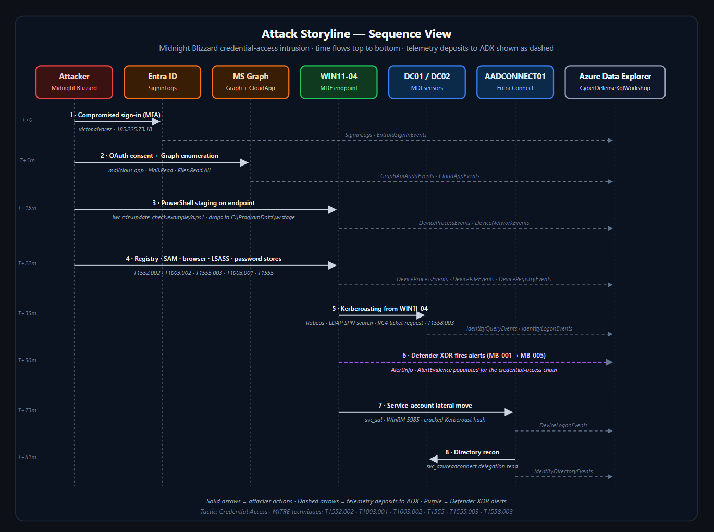
> THE FULL CYBER KILL CHAIN
Every stage of this intrusion, end to end.
CYBER DEFENSE WORKSHOP · KQL → XDR
21 / 25

Slide 22
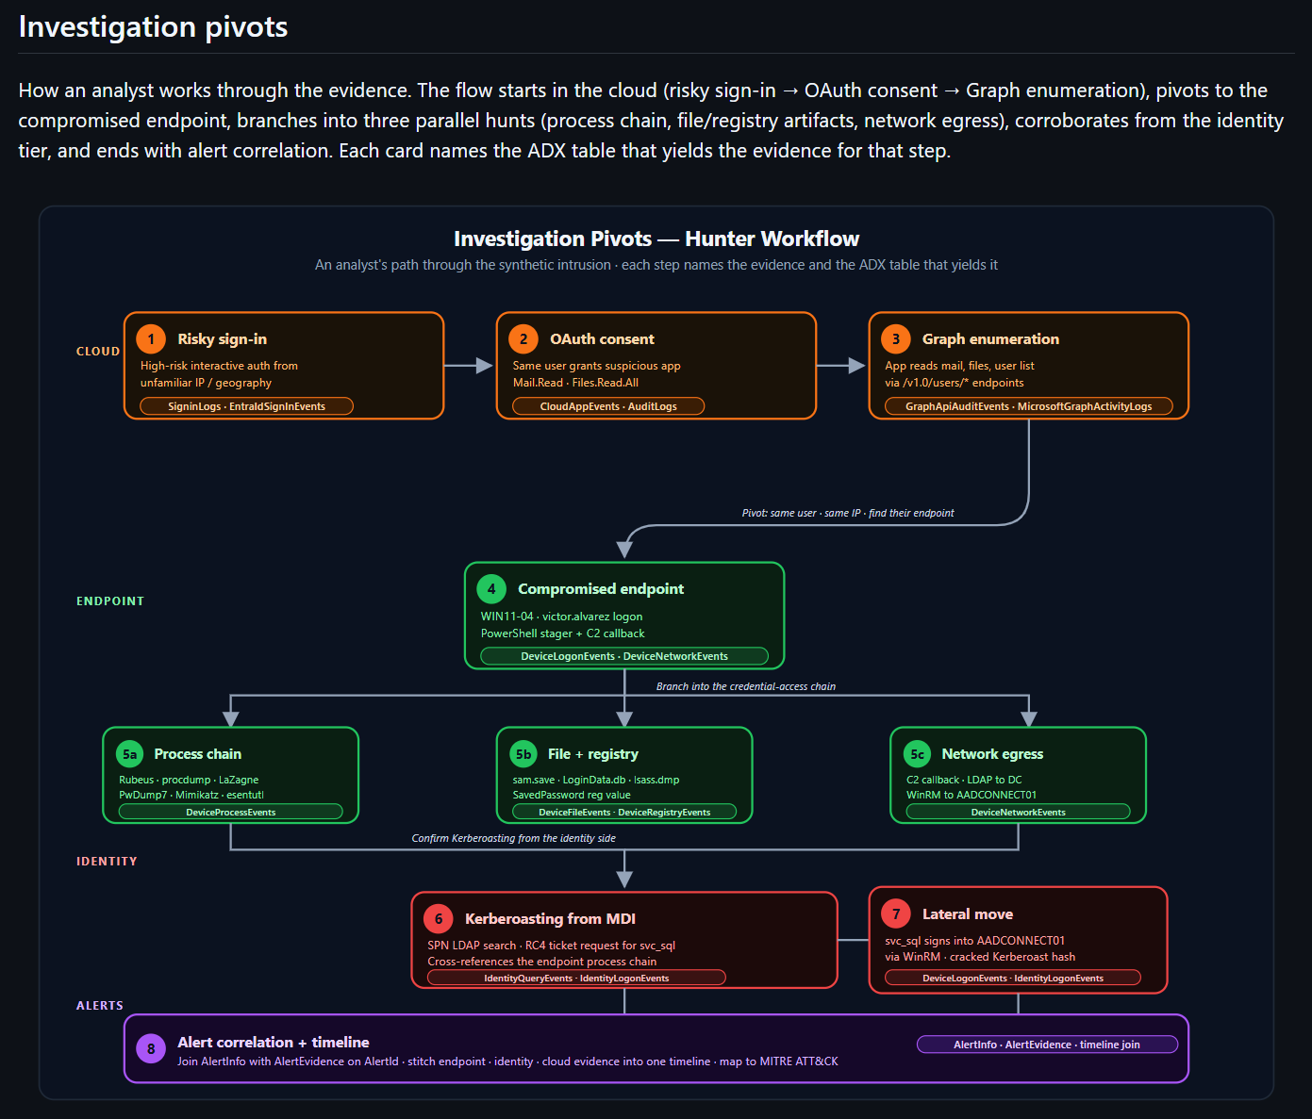
> DEFENDER XDR CORRELATION
CYBER DEFENSE WORKSHOP · KQL → XDR
22 / 25

Slide 23
> DEBRIEF
Close the loop — turn what we saw into what we'd keep. Discuss together.
WHAT TELEMETRY WAS DECISIVE?
› Entra risky sign-in — the first and earliest signal.
› CloudAppEvents — caught the OAuth backdoor.
› IdentityQueryEvents — the only proof of Kerberoasting.
› AlertEvidence — tied entities to the case.
WHAT DETECTIONS WOULD YOU KEEP?
› Risky sign-in + new OAuth consent, correlated.
› SP credential add on a freshly consented app.
› LSASS access + Kerberoast on one host in a window.
› Service-account interactive logon to Tier 0.
WHAT CONTROLS REDUCE IMPACT?
› Admin consent workflow — block user OAuth consent.
› Conditional Access + phishing-resistant MFA.
› Tier-0 isolation for AADCONNECT01.
› gMSA + long random service-account passwords.
CYBER DEFENSE WORKSHOP · KQL → XDR
23 / 25

Slide 24
> WHERE THIS LEADS
Today was the foundation. Reading telemetry is step one — here's the bigger picture.
DETECTION ENGINEERING
Turn each decisive query into a durable, tested
analytics rule. Version it, tune out false
positives, measure coverage against ATT&CK.
Query → detection → measurable coverage.
SOAR
Automate the response you just did by hand:
revoke sessions, disable the OAuth app,
isolate the host, open the case — in seconds,
not hours.
Playbooks act on your detections.
ENHANCED DEFENSE
Feed it forward: threat-informed defense,
proactive hunting, purple-team validation,
and identity-first Zero Trust hardening.
Assume breach — shrink dwell time and
blast radius, continuously.
THE THROUGH-LINE
Kill chain tells you WHERE the attacker is · KQL tells you WHAT the data proves · XDR tells you HOW it all connects and PROACTIVELY disrupts the attacker lifecycle.
CYBER DEFENSE WORKSHOP · KQL → XDR
24 / 25

Slide 25
> DEFENDERS | USAG WIESBADEN CYBER SUMMIT - CYBER DEFENSE WORKSHOP
Thank you.
You observed the telemetry, fixed on the attacker, severed the kill chain & imposed cost on the adversary!
> next: turn these queries into detections!
CYBER DEFENSE WORKSHOP · KQL → XDR
25 / 25

