Slide 1
Aspect Ratios
Notes:
Today has two halves. The first is where boards came from, fast, because it explains why the job exists.
The second is the shape of the frame, which is the actual subject and which walks straight into your first assignment.
This is an important class - By the end of this session you will build a storyboard template which you will use for many of your future assignments.

Slide 2
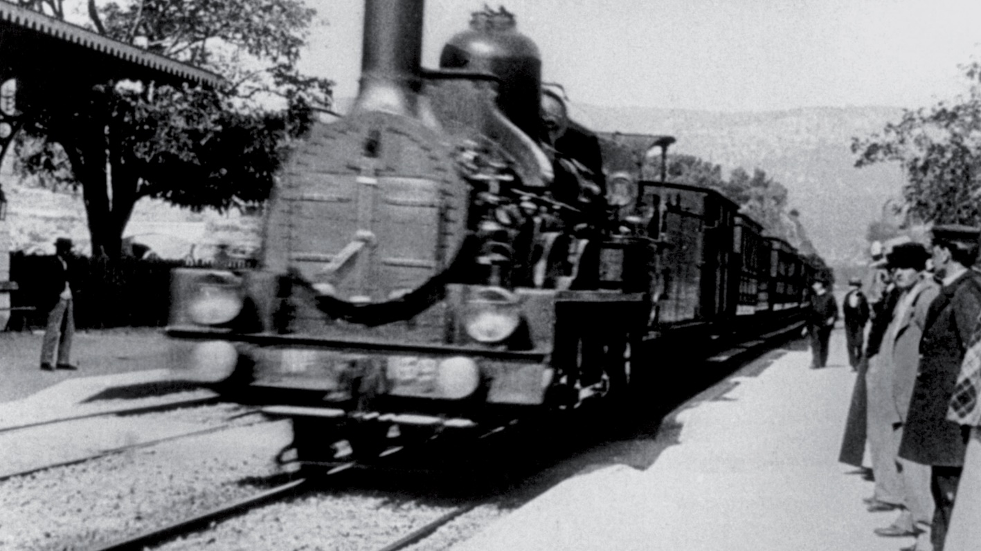
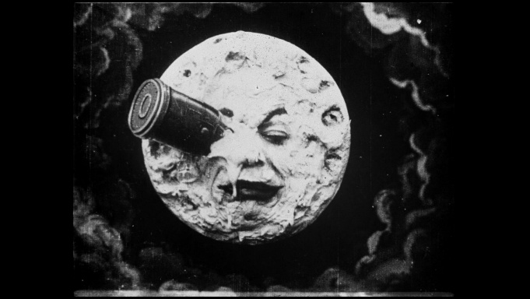
Before There Was Planning
The Lumiere Bros, 1895 - film as record. Workers leaving a factory. A train pulling in.
Georges Melies, 1902 - film as invention. A Trip to the Moon.
A stage magician by trade. He used a camera to tell a lie on purpose.
Notes:
The origins of the cinematic language that we take for granted today didn’t come from just one place. A number of people contributed to its development by looking at it from different angles.
In the beginning the nature of photography and film was to document reality.
The Lumiere brothers screened workers leaving their factory and a train arriving at a station. Audiences were astonished, but what they were astonished by was the recording – and seeing pictures come to life and move before their eyes. The Lumieres themselves thought of it as a scientific instrument.
Georges Melies was a stage magician who owned a theatre. He looked at the same technique and saw a way to entertain and tell stories. A Trip to the Moon, 1902, is a made-up story with built sets and effects.
Instead of recording reality, Melies sought to show a new one. Instead of capturing what was in front of him, he thought of a story and planned how it would be presented, much in the same way that he’d present his magic tricks.

Slide 3
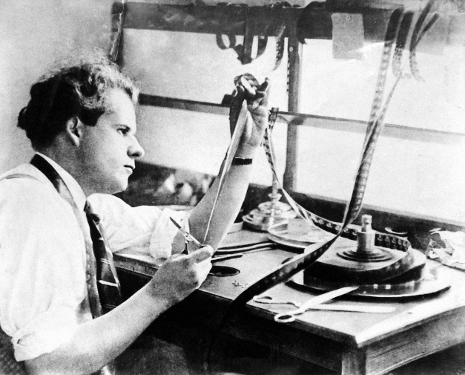
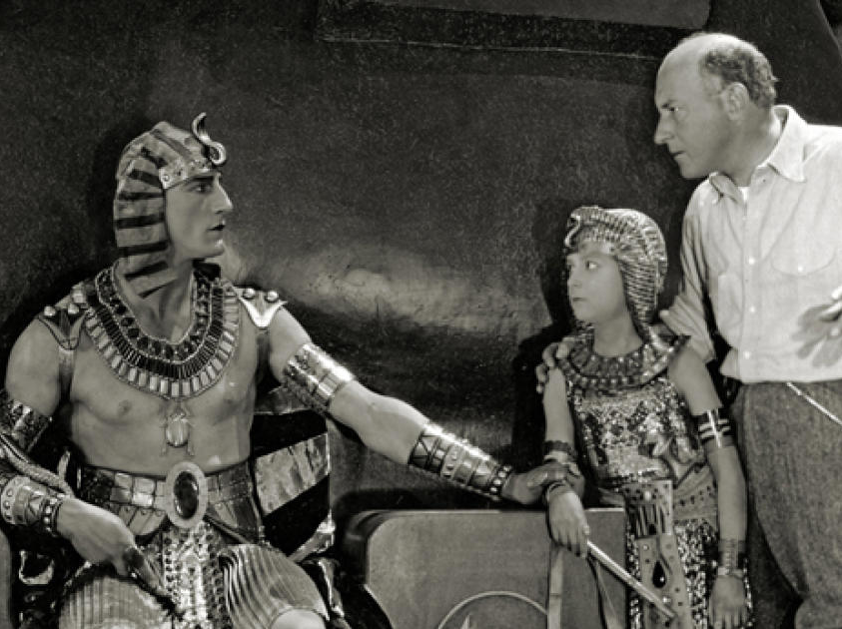
Directors Who Drew First
Sergei Eisenstein sketched sequences before shooting Battleship Potemkin (1925).
Cecil B. DeMille used artist Dan Sayre Groesbeck to visualise The Ten Commandments (1923).
The practice existed well before the word did.
Notes:
During this initial phase of the development of film, directors like Sergei Eisenstein drew his own sketches to work out how action would move inside a frame and across a cut. DeMille hired an illustrator to show him what a sequence would look like before he committed a budget to it. Neither of these men had the word storyboard. Both were doing a version of the thing.
The practice of storyboarding existed before the word for it did. Which tells you the job was invented because somebody needed it, not because somebody theorised it. As you can start to see, the language of film came from many different places, but in working with it, people found similar ways of solving many problems in the way they told stories. That’s what this is – Problem Solving, and that’s what we’re here to do as artists and creatives in general.

Slide 4
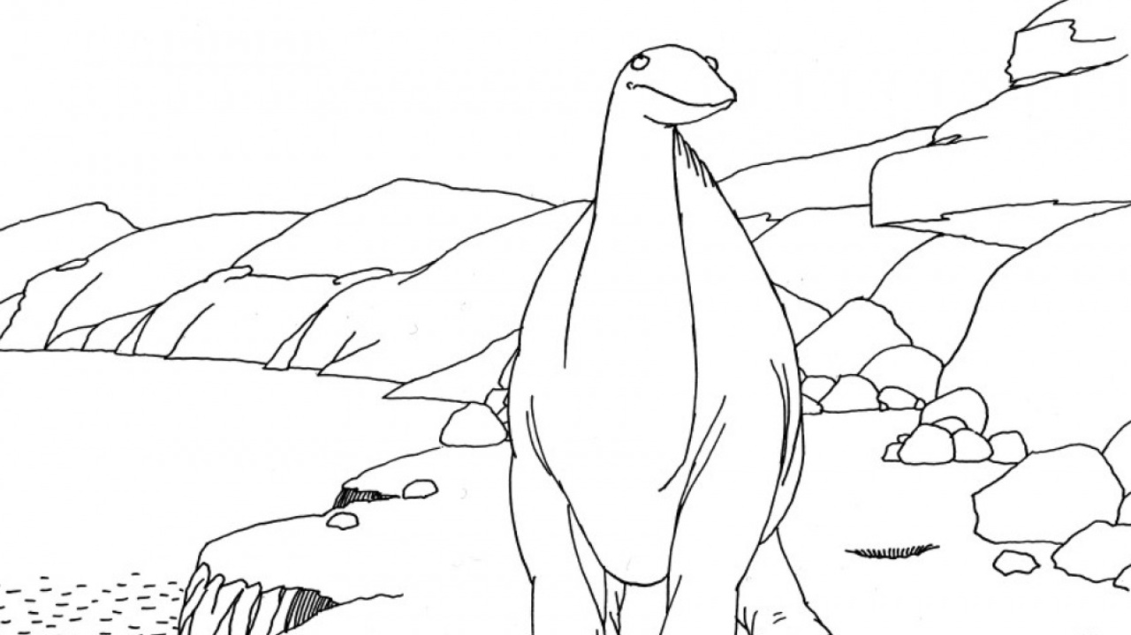
McCay and Gertie
Gertie the Dinosaur, 1914. Around 10,000 drawings, on rice paper, by hand.
McCay stood beside the screen in evening dress with a bullwhip, spoke to her, and she answered.
McCay was a cartoonist, working with the simple format of “beginning, middle, and end”.
Notes:
Winsor McCay was already known at the time for his newspaper strip “Little Nemo in Slumberland”. A friend of McCay’s had placed a bet with him on whether he could bring his character “Gertie the Dinosaur” to life.
Much like Georges Melies, I just mentioned, Gertie was a stage act. McCay stood at the front of the stage in a tuxedo holding a bullwhip like an animal trainer, did an introduction to the audience, and introduced the only dinosaur in captivity. Then he gave her instructions which she appeared to obey. At the end he appears to walk into the frame and ride off on her.
I think a key takeaway here is also the nature of how this person thought about telling this story. This man drew comics for a newspaper. Usually these are very condensed “to the point stories” contained in maybe 3 panels – a beginning, a middle and an end. This is more important than it initially sounds, but this practice eventually makes its way into other animations and films.

Slide 5
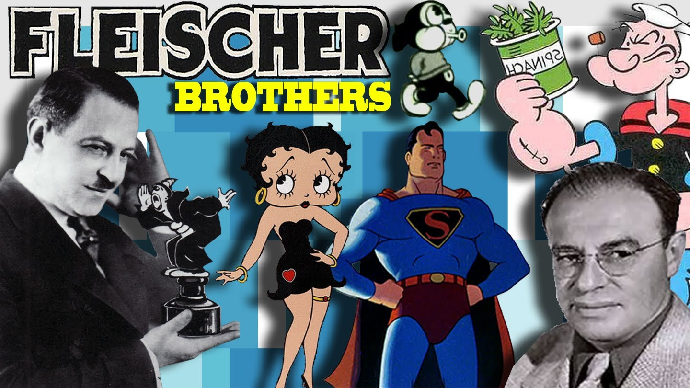
The Counterexample: Fleischer
Max and Dave Fleischer - Koko the Clown, Betty Boop.
No script. No story department. Nothing written down. Improvised as they went.
Practice still used today as “Dailies”.
Dave walked the room every morning and collected gags from the animators.
Notes:
Two of these people that were influenced by this thinking were the Fleischer brothers. They were not a minor studio. In the 1920s they were arguably the most successful animation house in America, and they ran with no written plan of any kind.
They too approached it like a comic strip in a way. There was no script. There was no story department. Dave Fleischer would come around each morning, to monitor the progress of each animation, and make suggestions as it developed. * (This practice is alive and well today still, known as “Dailies”, and practiced in VFX and animation studios all over)
There was not a rigid structure in place, or much of a defined plan. But it worked. It worked for five-minute shorts built out of gags, where nothing has to pay off later because there is no later. What happens though when the gag has to pay off for a much longer story?
- What happens when the film is eighty minutes long and a thing in reel one has to pay off in reel six? That is the question that produces the storyboard, and it gets answered on the next slide.

Slide 6
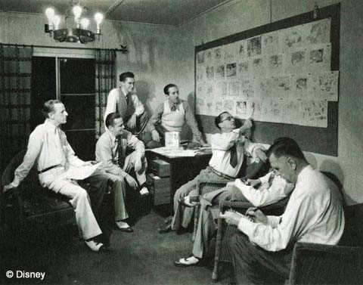
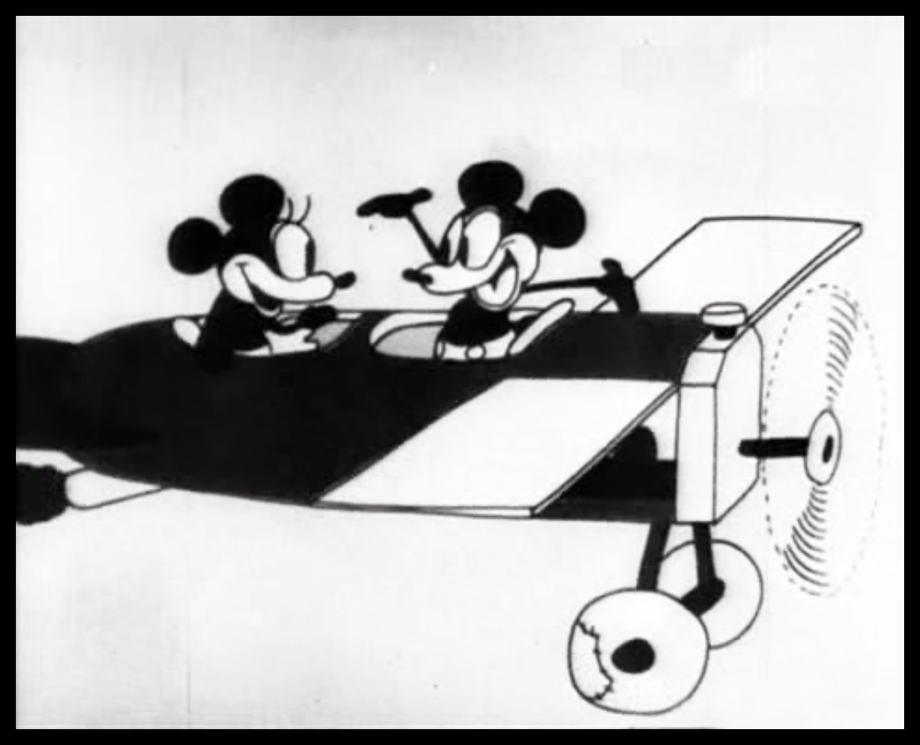
Webb Smith Pins It to a Wall
Disney's story department, early 1930s, under Ted Sears.
Too many sketches to hold in your head at once.
Story man Webb Smith pinned them up in order and reworked the order until the continuity held.
First cartoon built this way: Three Little Pigs, 1933.
Notes:
(continued from last slide – “That’s where this guy comes in”) Walt Disney was one of the most influential and visionary figures in the development of animation and sequential storytelling in general – for many reasons. One of his first moves was to separate the two jobs of the animators. They’d been both generating stories and animating them; As the stories became more complex, Disney split story development into its own department (under Ted Sears), liberating animators to focus purely on the art of animation.
But the sketches piled up faster than anyone could follow. Webb Smith's solution was very simple: pin every sketch to the wall, in order, beginning to end. Then to take a step back and look at the “big picture”, the whole thing at once. If it didn’t work, they would rearrange the drawings until they made sense.
This was one early contribution of Disney’s that is still around today, practiced even at computer animated studios such as Pixar or Dreamworks.
Disney introduced a way of seeing a sequence all at once, laid out in space, so you can rearrange it before you have spent money on it. Everything since is a refinement of that one idea, including the software you will use.
The image on the right is a page of story sketches from Plane Crazy, 1928 - the first Mickey cartoon
- which was already being built from sketches that looked like a comic strip, with the action described on separate sheets.

Slide 7
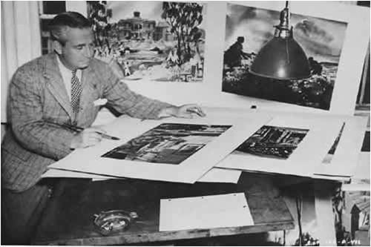
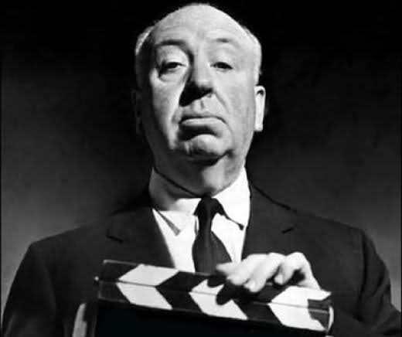
Live Action Takes Notice
Citizen Kane (1941) boarded its complex sequences in advance.
Hitchcock called his films storyboards come to life.
Saul Bass drew 48 panels for the Psycho shower scene.
Notes:
After years of production, the long awaited release of Disney’s Snow White finally established the storyboard as a successful practice. Full feature length animation simply had not been done yet, and it was planning and coordination that made this possible. Once the animation studios proved it, live action took it up - but selectively. For decades, live-action films only boarded the expensive parts: effects, stunts, complex action.
Citizen Kane was one of the famous early cases.
Hitchcock adopted storyboards early on. He even said that “he found the actual shooting boring because the film was already finished in his head and on paper”.
In “Psycho”, one of his most well known movies made famous by the famous shower/murder scene. For that scene, his storyboard artist, Saul Bass drew 48 storyboard panels. The finished scene is usually counted at around 78 camera setups and about 52 cuts, and it runs roughly 45 seconds. That is a lot of decisions for 45 seconds, and every one of them was made on paper first.

Slide 8
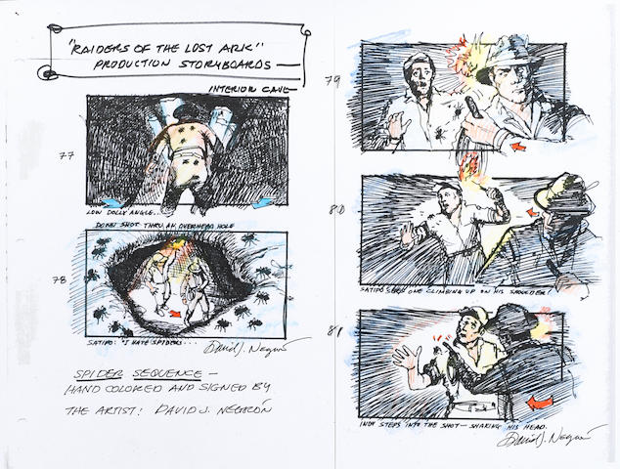
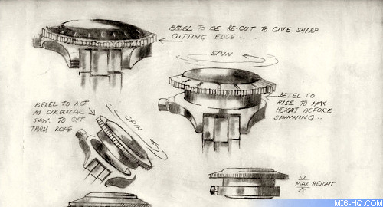
Why the Industry Actually Adopted It
James Bond, Star Wars, Indiana Jones (Raiders of the Lost Ark).
Multiple units, shooting different things in different countries, all cutting into one film.
Not because boards are beautiful. Because they are cheaper, and because they keep two hundred people making the same movie.
Notes:
Boards did not spread through the industry because they are an art form.
They spread because a big film has several units shooting simultaneously in different places,
and somebody has to guarantee that the footage will cut together.
A board is the cheapest available guarantee - not because it is beautiful.
Because it is cheaper than fixing it later, and because it keeps multiple people on the same page. As you’ll see in either your animation or film programs – production is expensive. Storyboards are one of the safe places to test out ideas before studios invest in them – MISTAKES are EXPENSIVE.

Slide 9
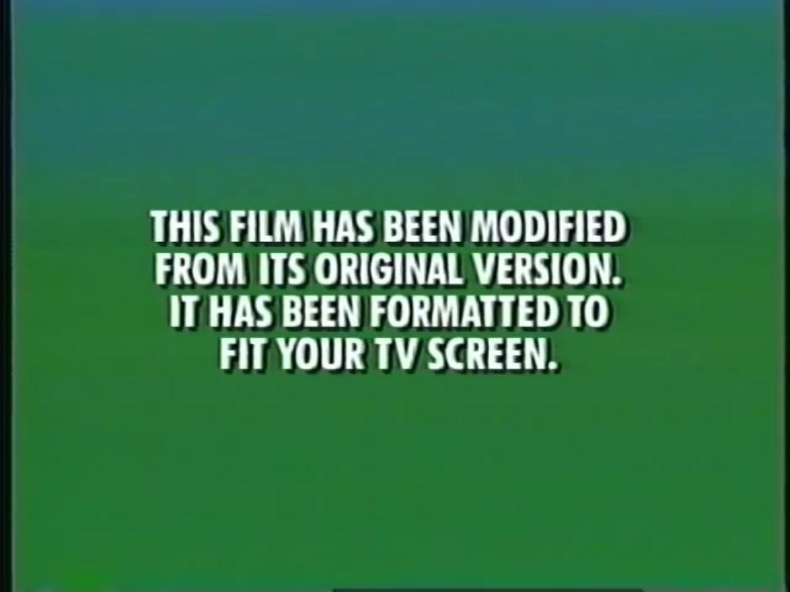
Modified From Its Original Format
You have read this card a hundred times.
Modified how? From what? Into what?
By the end of today you will know - and know why it is closer to an apology than a disclaimer.
Notes:
Many of you might have seen this card before a movie - saying the film was modified. But how was it modified?
The answer is that the shape was changed, and to change the shape somebody had to discard part of the frame so it would fit on the smaller screen. Let’s take a look at how it got there.

Slide 10
The Shape of the Screen
The size relationship between width and height.
First number: width, relative to a height of 1.
1.85:1 means 1.85 units across for every 1 unit tall.
It is a shape, not a size. A 1.85:1 frame is the same shape on a phone and on an IMAX screen.
1.85 : 1
Notes:
An aspect ratio is a proportion. The first number is the width, the second is the height, and the height is almost always normalised to 1. So 1.85:1 is a rectangle 1.85 units wide and 1 unit tall.
It is a SHAPE, not a SIZE. Scaling a frame up or down does not change its aspect ratio. A 1.85:1 image is the same shape on a phone as it is on an IMAX screen,
and a panel you draw at four inches tall is the same shape as the projected image.
This is really important before starting your storyboards – know the size of the media that it’s going to be shot/animated in.
You are not drawing at the size of the film. You are drawing at the shape of it.

Slide 11
Why You Care, Specifically
The ratio is the first decision on a board.
Before composition. Before staging. Before a single line goes down.
You cannot compose for a shape you have not chosen.
Artists need to understand the compositional space.
Notes:
Every compositional decision you make is a decision about a relationship between something and an edge. Headroom is a relationship to the top edge. Lead room is a relationship to the leading edge. A rule-of-thirds intersection is a point defined entirely by where the edges are.
Change the shape and every one of those relationships moves. So if you draw twenty panels and then discover the ratio was wrong, you have not made a small error - you have composed twenty frames for a rectangle that does not exist.
You cannot compose for a shape you have not chosen. It’s important for the artist to understand the compositional space they have to work with.

Slide 12
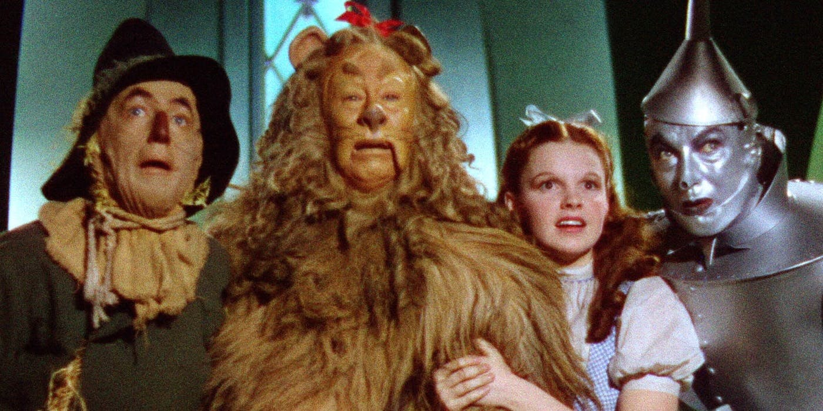
1.33 : 1 - Where It Started
The native ratio of 35mm film.
Four units wide by three tall. Also written 4:3.
Cinema's default from the 1890s until sound arrived.
Notes:
*Note – this slide is not the 1.33 aspect ratio, but the film is. 1.33:1 is not a designed choice. When film appeared it assumed the aspect ratio of the 35mm camera. It was what existed, and people just adopted it.
The shape of nearly every film for thirty-five years was determined by a piece of hardware.
Four wide by three tall - which is why you will also see it written 4:3, and why it is the same shape as an old television and an old computer monitor.
This ratio is the one television is going to take.

Slide 13
1.37 : 1 - The Academy Ratio
Sound arrives. The optical soundtrack needs room on the film strip.
The image gets squeezed to about 1.19:1 - almost square, and it looked wrong.
In 1932 the Academy fixes it at 1.37:1 by adjusting the aperture.
The Wizard of Oz - Gone with the Wind - Citizen Kane - Casablanca
Notes:
When sound came into films, the soundtrack was printed optically down the side of the film. It had to go somewhere, and where it went was into the picture. That narrowed the image and left a frame of roughly 1.19:1 - nearly square. People thought it looked bad.
So in 1932 the Academy standardised a fix: shave the frame height, restore a sensible proportion, and call it 1.37:1.
Close enough to the old 1.33 that it didn’t require too much adaptation.
What’s interesting to point out here: The shape of every film for the next twenty years was set by where they decided to put the audio. (much in the same way that the original aspec ratio was inherited from the still camera) A storytelling format changed because of an engineering constraint. If you’re working with media, this is going to happen a lot. It is happening right now with your phones.

Slide 14

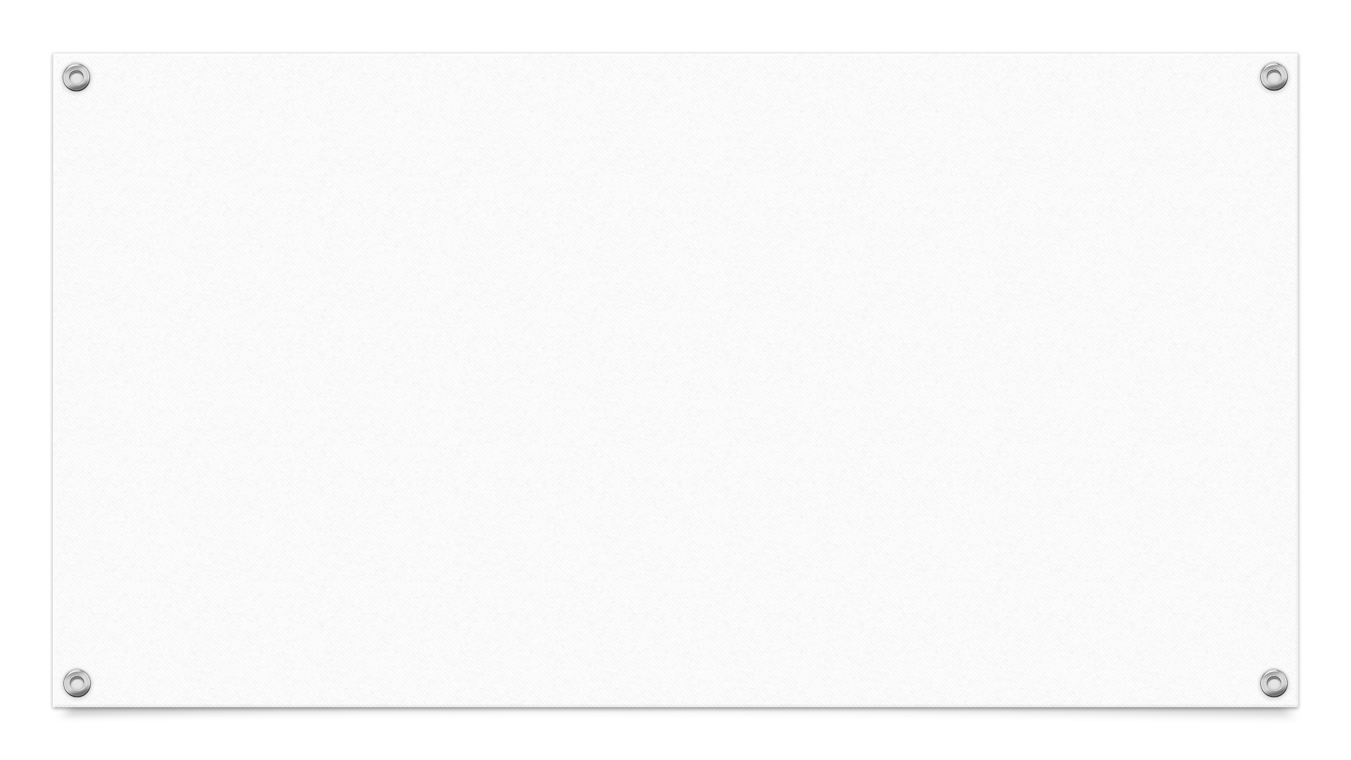
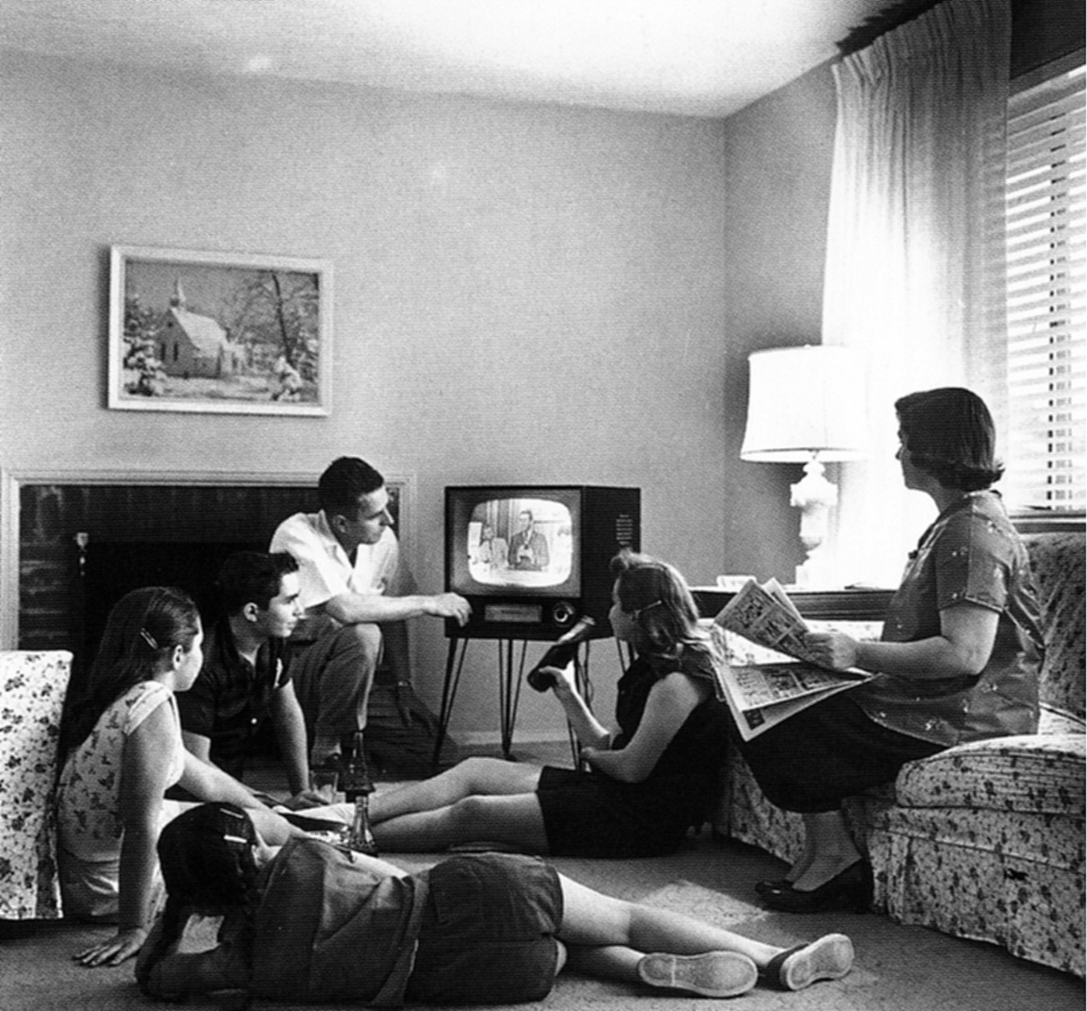
The Peak
1929-30: around 100 million tickets a week.
The population of the United States was about 123 million.
The average American went to the pictures roughly once a week - some weeks, most of the country was in a cinema.
Notes:
In the 1930’s there was a culture of going to movies. (cite the Captain America / Bucky scene from first film if you want)
around 100 million tickets a week at the end of the 1920s, in a country of about 123 million people.
That is not a hobby, it is a habit - closer to what television became than to what cinema is now.
Attendance stayed enormous through the war - about 90 million a week in 1946. Then something arrives in the living room.

Slide 15
Then Television - At the Same Ratio
Television adopts 1.33:1.
The identical rectangle. In your house. For free.
Not a different product competing with cinema. The same shape, delivered to the sofa.
Notes:
In the same way that film got its aspect ratio from the 35mm camera, so did Television when it came around, adopting the format of theater films.
TV did not compete with the movies on content, at least not at first - early TV was mostly cheap and live. It competed on convenience, and, crucially, it competed in the identical shape. A broadcast picture was 1.33:1, the same rectangle audiences had been watching in theatres since the 1890s.
So in other words, you’re getting the same experience you’re getting in the theater at home – for free…
So naturally, this is going to have a big effect on the industry and what happens afterwards.
Hollywood could not compete on price and it could not compete on convenience. So they had to build bigger, better.

Slide 16
The Collapse
1946: about 90 million a week.
1950: about 60 million.
Mid-1950s: about 45 million.
1970: about 20 million.
By 1960 there was a television in roughly 90% of American homes.
Notes:
So it started at 100 million a week, then 90, then 60, then 45, then 20. Eighty percent of the audience gone in forty years.
By 1960 there is a television in about nine out of ten American homes. That is close to total saturation inside a single generation.
Hollywood needed desperately to offer something a television cannot do.

Slide 17
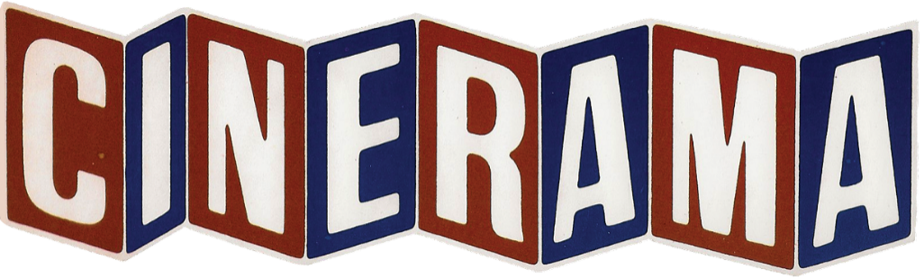
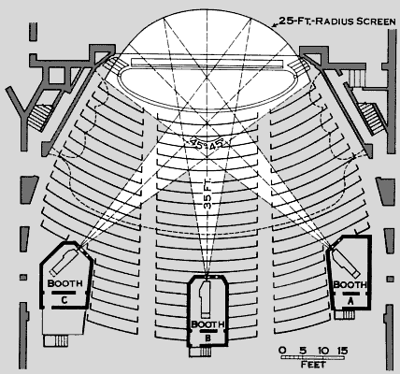
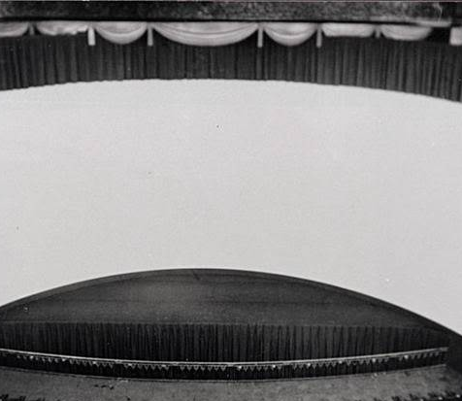
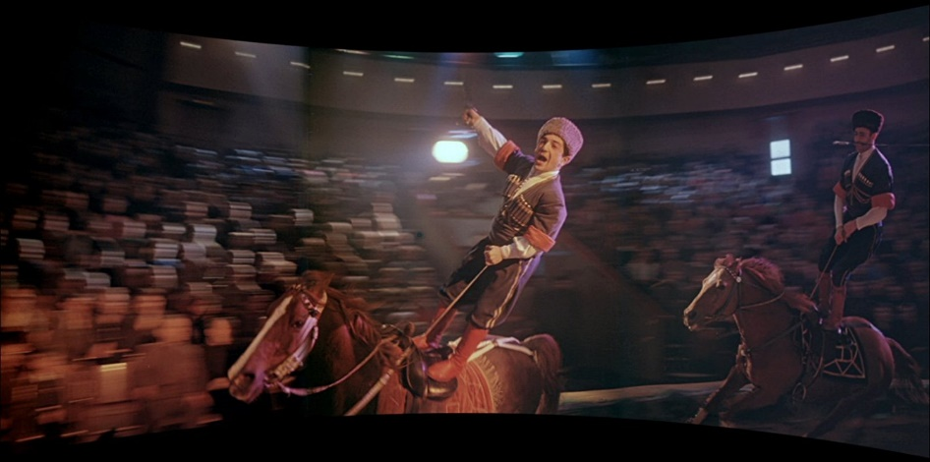
Cinerama (1952) - 2.60 : 1
Three cameras, three projectors, one deeply curved screen.
This Is Cinerama opened 30 September 1952. The first thing the audience saw was a roller coaster.
Abandoned - the cost of re-fitting a theatre was ruinous, and the seams between the three panels showed.
Notes:
Cinerama is the maximalist answer: if a television cannot be wide, be enormously wide.
Three synchronised cameras shooting side by side, three projectors throwing onto a deeply curved screen that wrapped past the edge of your peripheral vision. About 2.6:1 overall.
The opening film was not a story. It was a demonstration, and the first sequence was a roller coaster shot from the front car. People screamed and some of them were sick. That was the selling point: your television cannot do this to you. (much like some of the VR that’s being pushed today)
It died of economics. Every theatre needed three projectors, three operators in sync, and a new screen. And you could see the two vertical seams where the panels met.
The technically spectacular format loses to the cheap one that is nearly as good. It happens again with 3D, twice.

Slide 18
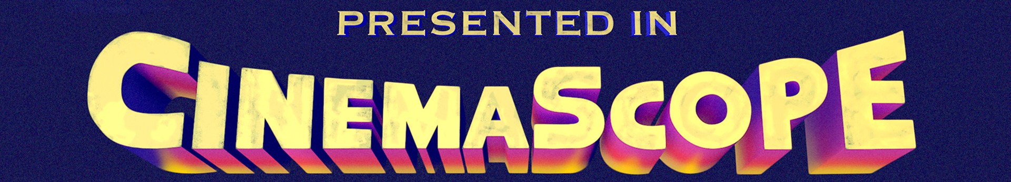
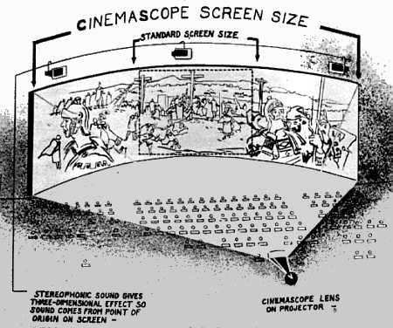
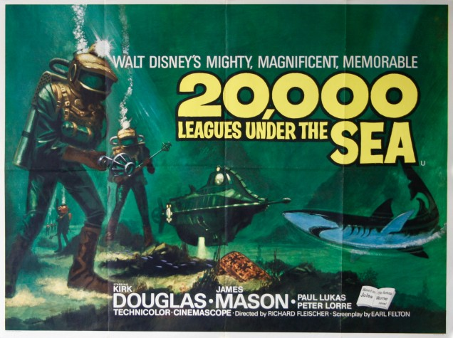
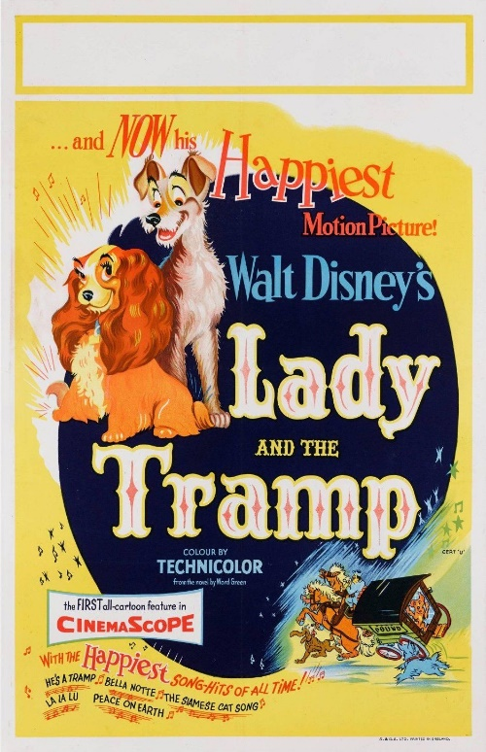
CinemaScope (1953)
20th Century Fox. An anamorphic lens squeezes a wide image onto ordinary 35mm film; a second lens on the projector unsqueezes it.
2.66:1 at launch, settling to 2.55:1.
20,000 Leagues Under the Sea - Lady and the Tramp, the first animated feature in the format.
Notes:
Cinerama needed new cameras, new projectors and a new screen. CinemaScope needed two pieces of glass. An anamorphic lens optically squeezes a wide field of view onto a standard 35mm frame - everything looks tall and thin on the negative. A matching lens on the projector stretches it back out.
Same film stock. Same projector body. Same theatre. Two lenses.
That is the difference between a format that dies in five years and a format that is still in use seventy years later.
The Robe was the first feature out, in 1953. Lady and the Tramp is the one worth naming for this room - the first animated feature made in the format, which meant Disney's board artists had to learn to compose for a shape more than twice as wide as tall, having spent twenty years in 1.37.

Slide 19

Panavision
Late 1950s. Fixed CinemaScope's distortion problems and became the industry standard.
2.39:1* and 1.85:1 - still the two shapes you will actually work in.
* Originally 2.35:1, but later modified to this format.
Notes:
CinemaScope's lenses had real problems. Faces near the edge of frame stretched, and there was a focus artefact bad enough that cinematographers called it the CinemaScope mumps.
Panavision built better anamorphics, licensed them, and took the market. The name survives as a rental house that is still supplying anamorphic lenses today.
The anamorphic standard was 2.35:1 until 1970, when a change to the projection aperture made it 2.39:1. Films from before 1970 are genuinely 2.35; films after are 2.39. Almost everyone in the industry still says two-three-five for both. If you write 2.39 on a modern project you are correct, and if a supervisor says 2.35 they mean the same thing.

Slide 20
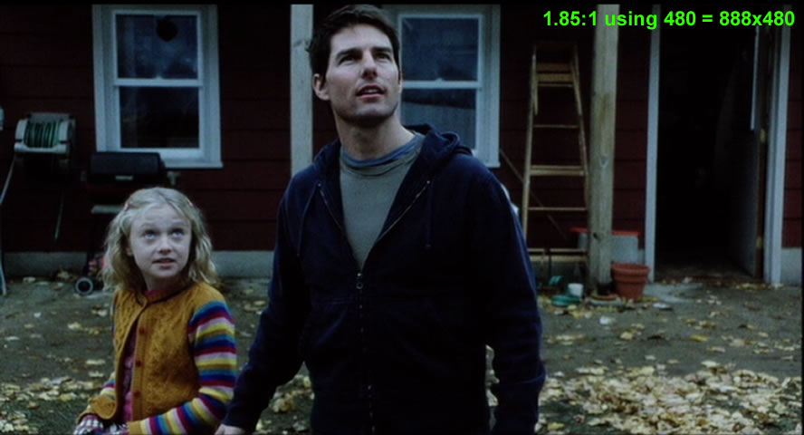
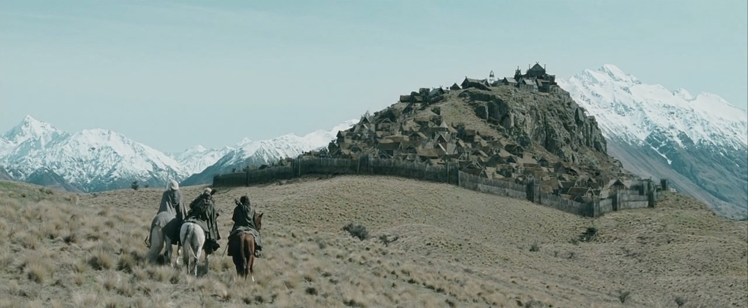
The Two Ratios You'll Actually Use
1.85 : 1 - comedy, drama, most animated features. The default.
2.39 : 1 - the epic one. Gladiator, The Lord of the Rings, Braveheart.
Same story, different shape - and the shape changes what you can put in frame at once.
Notes:
The two images in this slide are the same height and different widths, which is the entire point.
1.85 is the most widely used in films. Comedy, drama, most animated features, most of what you will ever be asked to board.
2.39 is the wider format. It changes what is possible in a single frame. It is great for stretching out landscapes and making things look epic. 2.39 is not so good with tall things - staircases, towers, anyone standing up quickly.

Slide 21
The Mismatch
A cinema frame is far wider relative to its height than a 1.33:1 television.
Show a 2.39:1 film on a 1.33:1 screen unaltered and most of the picture has nowhere to go.
Something has to give. The question is what, and who decides.
Notes:
What happens when we want to watch a wide screen movie on a smaller screen?
You have an image that is much wider than the screen it now has to live on. There are two ways you can adapt them. You can throw away the parts that do not fit, or you can scale down the whole image until it does, and accept empty space above and below.

Slide 22
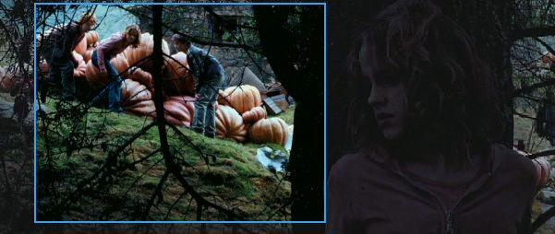
Pan & Scan
20th Century Fox, early 1960s.
Crop the wide frame down to 1.33:1, and pan within the original image to follow whatever a technician judges to be the subject.
Every frame of the film gets re-composed by somebody who was not there.
Notes:
Pan and scan works exactly as described: an operator watches the film, decides where the important thing is in each shot, and crops a smaller format’s window around it. When the important thing moves, or when the film cuts between two people at opposite edges, the window slides across - which invents a camera move that was never shot.
Pan and scan can add camera movement to a locked-off shot. It can turn a single composition holding two actors into what looks like a cut between them.
It was not done out of malice. It filled the screen, and audiences at home preferred a full screen. But the person making those decisions was a technician on a deadline, not the director, and they were making a compositional decision in every single shot of the film.

Slide 23
What Pan & Scan Costs You
A 1.85:1 frame cropped to 1.33:1 loses about 28% of its width.
A 2.35:1 frame loses about 43% - close to half the image.
Two characters at opposite edges of a composition: now you can only have one.
Notes:
Going from 1.85 to 1.33 you keep 1.33 of 1.85 - about 72%, so you lose 28 percent of the width. From 2.35 you keep 1.33 of 2.35, which is 57%: you lose 43 percent. Nearly half the picture.
Someone composed that frame on purpose and somebody else re-composed it later, for a rectangle it was never made for.

Slide 24
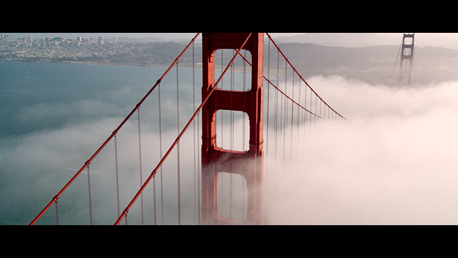
Letterboxing
The other answer: keep the whole frame, shrink it, and accept black bars.
Directors pushed for it. Audiences complained the picture was smaller.
Nothing is thrown away and nobody re-composes anything.
Notes:
Letterboxing is the opposite trade. Instead of discarding picture to fill the screen, you preserve the whole picture and give up screen.
It was unpopular for years. People had paid for a big television and felt cheated by the empty strips. Video labels who released letterboxed editions had to put explanations on the packaging.
Directors pushed hard for it anyway, and eventually won –
helped enormously by widescreen sets arriving, which made the bars smaller and the argument easier.
The bars are not a defect and they are not a border. With Letterboxing, you get the whole picture as the director intended, just scaled down.

Slide 25
Why This History Still Matters
Every fight on the last four slides is the same fight:
a mismatch between the shape something was made in and the shape it gets watched in.
That fight never ended. It moved.
Notes:
Cinema invents a shape. Television takes it. Cinema changes shape to escape. Television takes that shape too, eventually. At every step, somebody is deciding what happens to a picture composed for a different rectangle.
This process never ended, it is still evolving. The screen your work gets watched on now is a phone held vertically, or a laptop, or an ultrawide monitor, or a television twice the size of the ones in this story. Your composition will be re-cropped by an algorithm instead of a technician.

Slide 26
Today's Actual Landscape
16:9 (1.78:1) - streaming and broadcast default
2.39:1 - features, and anything that wants to feel like one
9:16 vertical - phones and short form. A genuinely new shape.
4:3 revived deliberately, as a period or claustrophobia cue
IMAX sequences that change ratio partway through a film
4:3 - 1.33:1
16:9 - 1.78:1
2.39:1
9:16 vertical
Horizontals drawn to a common height.
Notes:
16:9 is the negotiated settlement - close enough to 1.85 that a feature loses almost nothing, wide enough that television stopped being square.
It is not a natural shape. Nothing about it is natural. It is a compromise between two industries.
The genuinely new item on this list is vertical. 9:16 is not a crop of anything; it is a native delivery format with real money behind it, and it inverts almost every assumption in the shot vocabulary you are about to learn. You lose the horizontal, which means you lose most two-shots and most establishing shots. You gain stacking - foreground and background become the axis you compose along.
Your generation is the first to grow up composing for a vertical frame, and almost everything written about composition assumes you are not.

Slide 27
Games Don't Get to Pick
The same game runs on a 16:9 laptop, a 21:9 ultrawide, a 4:3 projector and a phone.
The frame is variable, and the composition has to survive all of it.
Which means composing for a range of shapes rather than a shape.
Notes:
This is the case where the mismatch problem is permanent rather than occasional.
A film is finished in one ratio and then adapted. A game ships into a hardware landscape where the player's aspect ratio is genuinely unknown and can change mid-session when they plug into a television.
So games solve it structurally: safe areas for anything that must be readable, interface anchored to the edges rather than laid out for one rectangle, cameras that adjust field of view by ratio. Cinematics get the film treatment; gameplay does not.
We will come back to this properly in the games (or a future) session. But for now, I just want to leave you with the takeaway that it is the same problem from 1953, but instead of a technician cropping the film, it’s now an algorithm.

Slide 28
So the Question Isn't What's Correct
The question is: what shape is this being watched in?
And: did I compose for that shape, or for a different one?
That card from the start of the session was a warning about exactly this. It applies to your work now.
Notes:
Aspect Ratios are a matter of aesthetic choice – there is no correct one.

Slide 29
Two Directions of the Same Arithmetic
Either you know the ratio and need the frame size,
or you know the frame size and need the ratio.
One multiplication and one division. That is the whole of it.
Notes:
There are two directions.
Going out from a ratio to a size, you multiply.
Going from a size back to a ratio, you divide.

Slide 30
Ratio to Frame Size
Pick the height you want to draw at. Multiply by the ratio. That is your width.
4 inches tall x 1.85 = 7.4 inches wide
4 inches tall x 2.39 = 9.56 inches wide
Pick the height first, because height is what limits how many panels fit on a page.

Slide 31
Frame Size to Ratio
Divide the width by the height.
6 inches wide / 4 inches tall = 1.5 -> 1.5:1
Useful when you are handed a template, or measuring a frame off an existing production.
Notes:
The reverse direction, and the one you use when somebody hands you something and does not tell you what it is.
Measure the width, measure the height, divide. Width divided by height, always in that order - if you get a number below 1 you have done it upside down, unless the frame really is taller than it is wide, which now genuinely happens with vertical.
Worth mentioning: this is how you check a template you have been given rather than trusting its label. On a real production the label is sometimes wrong.

Slide 32
Worked Table
Frame height x aspect ratio = frame width.
Ratio
At 3" tall
At 4" tall
At 5" tall
1.33:1
4.00"
5.32"
6.65"
1.78:1 (16:9)
5.34"
7.12"
8.90"
1.85:1
5.55"
7.40"
9.25"
2.39:1
7.17"
9.56"
11.95"
You do not need to memorise this - you need to produce any row of it with a calculator in ten seconds.
2.39:1 at 5" tall is nearly 12" wide. It will not fit on a page with margins, which is why you choose height first.
Notes:
This table is a reference, not something to memorise. Say that explicitly or somebody will try to learn it.
What they need is the ability to produce any row of it with a calculator in about ten seconds. The table is here so that during the build they can check themselves without putting a hand up.
Two things to point out. First, look down the 2.39 column - at five inches tall it is nearly twelve inches wide, which does not fit on a sheet of paper with any margin. That is a real constraint and it is why panel height gets chosen first. Second, notice 1.78 and 1.85 are almost the same number. They are not the same shape, and on a real production using one where the other was specified is a genuine error, but they are close enough that eyeballing will not catch it. Which is the argument for calculating.

Slide 33
Common Student Mistakes on this Assignment
Eyeballing the panel instead of calculating it.
Panels that do not match each other down the page.
A frame that is not the ratio the sequence is actually in.
Working so small that you cannot draw comfortably inside the box.
All four are avoidable in about a minute of arithmetic. That is why the numbers are graded.

Slide 34
Hand-off: Build the Template
Template Build
Panels at the assigned ratio, on a page, with room under each for panel number, shot number, action and camera notation.
Deliver 3 images in the correct aspect ratio. See your assignment on Canvas for details.

Slide 35
One Line to Leave With
The shape of the frame is the first decision,
And it determines how the story will play out inside that space for the rest of the film.

