Slide 1
The Principles of Design
Notes:
The Principles of Design
The reason I wanted to show you these visual examples, is that as designers and multimedia authors in general, you will quite often be looking critically at work like this.
It will be your job to understand how this all works. There is so much you can learn from analyzing work critically. If this sort of thing interests you, I’d recommend you take a look or do some further reading on Semiotics.
Could you see with some of those examples how it relates to structuring an essay?
Just as text authors, visual designers have to choose how to weigh the information they want to present.
The designer is constantly directing the attention of the viewer to what is important that they notice.

Slide 2
The Principals of Design
ELEMENT: A separate piece of a composition.
LINE the mark between two points.
SHAPE a self contained defined area of geometric or organic form.
DIRECTION
All lines have direction - Horizontal, Vertical or Oblique.
SIZE
TEXTURE: the surface quality of a shape - rough, smooth, soft hard glossy etc.
COLOR
VALUE: the lightness or darkness of a color, also called TONE.
Notes:
An element is a piece of a composition that contributes to the whole. Think of it as the “particles” of design, these are the bits that make up the entire piece.
Specifically, we have some common types of elements such as:
LINE- which is the mark between two points.
SHAPE - self contained defined area of geometric or organic form.
DIRECTION
All lines have direction - Horizontal, Vertical or Oblique. Many artists use this to direct the viewer’s attention, which can be very powerful for design.
SIZE - Size is simply the relationship of the area occupied by one shape to that of another.
TEXTURE- the surface quality of a shape - rough, smooth, soft hard glossy etc.
COLOR
VALUE - Value is the lightness or darkness of a color. Value is also called Tone

Slide 3
Elements
ELEMENT: A separate piece of a composition.
LINE the mark between two points.
SHAPE a self contained defined area of geometric or organic form.
DIRECTION
All lines have direction - Horizontal, Vertical or Oblique.
SIZE
TEXTURE: the surface quality of a shape - rough, smooth, soft hard glossy etc.
COLOR
VALUE: the lightness or darkness of a color, also called TONE.
Notes:
An element is a piece of a composition that contributes to the whole. Think of it as the “particles” of design, these are the bits that make up the entire piece.
Specifically, we have some common types of elements such as:
LINE- which is the mark between two points.
SHAPE - self contained defined area of geometric or organic form.
DIRECTION
All lines have direction - Horizontal, Vertical or Oblique. Many artists use this to direct the viewer’s attention, which can be very powerful for design.
SIZE - Size is simply the relationship of the area occupied by one shape to that of another.
TEXTURE- the surface quality of a shape - rough, smooth, soft hard glossy etc.
COLOR
VALUE - Value is the lightness or darkness of a color. Value is also called Tone

Slide 4
Lines
The connection between two points.
They can be used in the composition to:
Lead or direct the eye,
evoke movement
divide the space

Slide 5
Lines
Horizontal Lines – As the name suggests, Can be used to communicate a vastness of a landscape or the “horizon”. Also suggests stability, quietness or restfulness.

Slide 6
Lines
Vertical Lines – Tend to be stronger and more active than horizontal lines.
Can be used to draw the viewer’s attention to something on the screen.

Slide 7
Lines
Diagonal Lines – Imply movement, may be used to suggest action, violence or energy. Can convey instability (as in the idea of a canted shot/dutch angle). General feel is tense and uncomfortable.

Slide 8
Lines
Curved Lines – Imply natural, sensual or soothing quality. May be used to suggest harmony.
“S” curves can be used to take the viewer through a landscape.

Slide 9
Lines
Jagged Lines – A combination of multiple lines.
Tend to convey sense of restlessness or aggressiveness.

Slide 10
Shapes
Outlines of objects that are defined by their height and width.
Square
Circle
Triangle

Slide 11
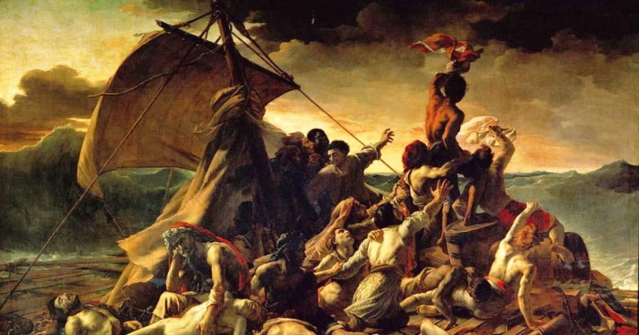
Shapes
Triangular compositions – tends to put one person/subject at the apex of the composition.

Slide 12
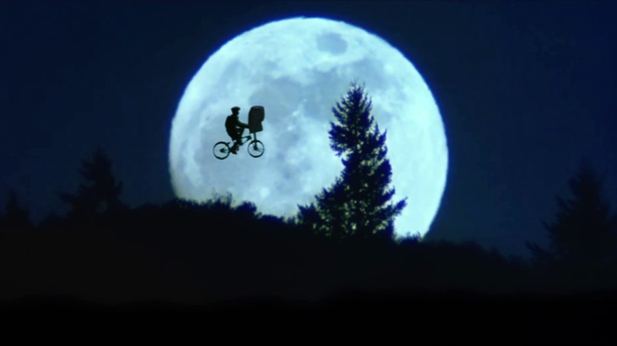
Shapes
Circular and Arch compositions – Draws the viewer and the subject together into a more intimate image.

Slide 13
BALANCE
Results from comparing images to our ideas of physical structure
Symmetrical
Assymetrical
Notes:
Balance is an equilibrium that results from looking at images and judging them against our ideas of physical structure
(such as mass, gravity or the sides of a page).
It is the arrangement of the objects in a given design as it relates to their visual weight within a composition.
Balance usually comes in two forms: SYMMETRICAL and ASYMMETRICAL.

Slide 14




BALANCE
Results from comparing images to our ideas of physical structure
Symmetrical
Assymetrical
Horizontal
Symmetry
Approximate
Horizontal Symmetry
Radial
Symmetry
Assymetry
Notes:
Symmetrical
Symmetrical balance occurs when the weight of a composition is evenly distributed around a central vertical or horizontal axis.
Under normal circumstances it assumes identical forms on both sides of the axis.
When symmetry occurs with similar, but not identical, forms it is called approximate symmetry.
In addition, it is possible to build a composition equally around a central point resulting in radial symmetry 1. Symmetrical balance is also known as formal balance.
Asymmetrical
Asymmetrical balance occurs when the weight of a composition is not evenly distributed around a central axis.
It involves the arranging of objects of differing size in a composition such that they balance one another with their respective visual weights.
Often there is one dominant form that is offset by many smaller forms. In general, asymmetrical compositions tend to have a greater sense of visual tension.
Asymmetrical balance is also known as informal balance.

Slide 15
BALANCE
Results from comparing images to our ideas of physical structure
Symmetrical
Assymetrical
Horizontal
Symmetry
Approximate
Horizontal Symmetry
Radial
Symmetry
Assymetry
Notes:
Symmetrical
Symmetrical balance occurs when the weight of a composition is evenly distributed around a central vertical or horizontal axis.
Under normal circumstances it assumes identical forms on both sides of the axis.
When symmetry occurs with similar, but not identical, forms it is called approximate symmetry.
In addition, it is possible to build a composition equally around a central point resulting in radial symmetry.
Asymmetrical
Asymmetrical balance occurs when the weight of a composition is not evenly distributed around a central axis.
It involves the arranging of objects of differing size in a composition such that they balance one another with their respective visual weights.
Often there is one dominant form that is offset by many smaller forms. In general, asymmetrical compositions tend to have a greater sense of visual tension.

Slide 16



RHYTHM
Results from comparing images to our ideas of physical structure
Regular Rhythm
Flowing Rhythm
Progressive Rhythm
Notes:
Rhythm
Just as in music, visual arts also can have rhythm. Rhythm is the repetition or alternation of elements, often with defined intervals between them.
Rhythm can create a sense of movement, and can establish pattern and texture. There are many different kinds of rhythm, often defined by the feeling it evokes when looking at it.
Regular: A regular rhythm occurs when the intervals between the elements, and often the elements themselves, are similar in size or length.
Flowing: A flowing rhythm gives a sense of movement, and is often more organic in nature.
Progressive: A progressive rhythm shows a sequence of forms through a progression of steps.

Slide 17


PROPORTION
Notes:
Proportion
Proportion is the comparison of dimensions or distribution of forms. It is the relationship in scale between one element and another, or between a whole object and one of its parts. Differing proportions within a composition can relate to different kinds of balance or symmetry, and can help establish visual weight and depth.
In the examples on the slide, notice how the smaller elements seem to recede into the background while the larger elements come to the front.

Slide 18
DOMINANCE
Dominant
Sub-dominant
Subordinate
Notes:
Dominance
Dominance relates to varying degrees of emphasis in design.
It determines the visual weight of a composition, establishes space and perspective, and often resolves where the eye goes first when looking at a design.
There are three stages of dominance, each relating to the weight of a particular object within a composition.
Dominant: The object given the most visual weight, the element of primary emphasis that advances to the foreground in the composition.
Sub-dominant: The element of secondary emphasis, the elements in the middle ground of the composition.
Subordinate: The object given the least visual weight, the element of tertiary emphasis that recedes to the background of the composition.

Slide 19
UNITY
The relationship of the elements and how they react together as a whole.
Unity can be achieved by:
Proximity
Repetition/Similarity
Continuation
Notes:
Unity
The concept of unity describes the relationship between the individual parts, or the individual elements and the whole of a composition.
It describes the bits of a given design that are necessary to tie the composition together, to give it a sense of wholeness, or to break it apart and give it a sense of variety.
The concept of Unity is typically achieved through proximity, repetition or continuation:

Slide 20
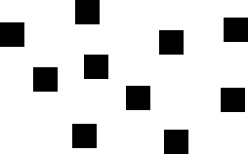

UNITY
The relationship of the elements and how they react together as a whole.
Unity can be achieved by:
Proximity
Repetition/Similarity
Continuation
Notes:
PROXIMITY: The simplest method of making objects appear to belong together is to group them closely together. This allows us to see a pattern.

Slide 21

UNITY
The relationship of the elements and how they react together as a whole.
Unity can be achieved by:
Proximity
Repetition/Similarity
Continuation
Notes:
REPETITION or SIMILARITY: Another method often used to promote unity is the use of repetition. Repetition of color, shape, texture or object can be used to tie a work together.
These repeated triangles form a pattern around the eagle head. When the eagle’s head actually interrupt the pattern, it is perceived as just three more triangles around the circle.

Slide 22

UNITY
The relationship of the elements and how they react together as a whole.
Unity can be achieved by:
Proximity
Repetition
Continuation
Notes:
CONTINUATION: A much more subtle method of unifying a work involves the continuation of line, edge or direction from one area to another.
Continuation is often used in books and magazines to tie the elements of a page together with the use of rules, and by lining up edges of copy, headlines and graphics.

Slide 23
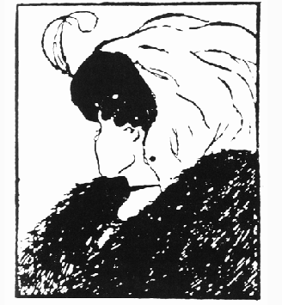
RELATED CONCEPTS:
GESTALT: "The whole is greater than the sum of the parts."
Notes:
I wanted to quickly introduce some other concepts.
A lot of concepts, especially from Unity are built around Gestalt theory.
Gestalt is a concept from psychology, that basically states that the entirety of an object is made up of it’s parts.
The whole idea of gestalt applies more to human perception than it does specifically to visual arts, but this is precisely why it is interesting to designers as well.
Some of the principles described here have their base on this.
Many of you have probably seen this image. What is it you see?
It really depends on the way you look at it, doesn’t it? It depends on what part you focus on.

Slide 24


CLOSURE
How the brain fills in missing information.
Notes:
CLOSURE
Closure is the idea that the brain tends to fill in missing information when it perceives an object is missing some of its pieces.
Objects can be deconstructed into groups of smaller parts, and when some of these parts are missing the brain tends to add information about an object to achieve closure.
In the example, we compulsively fill in the missing information to create shape.

Slide 25
CONTRAST and SIMILARITY

Slide 26
Texture

Slide 27
Patterns

Slide 28
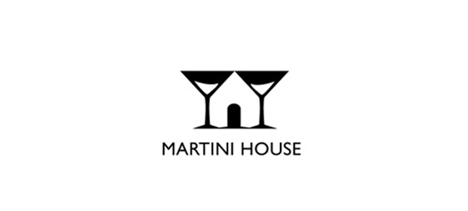
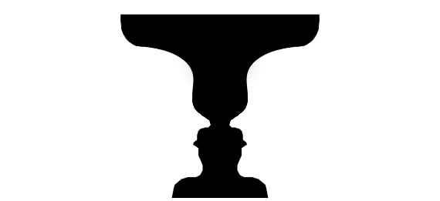
POSITIVE/NEGATIVE SPACE
Positive space – occupied by dominant elements
Negative space - “White Space” or “Unused Space”
Notes:
Positive and Negative Space
Positive and negative space refers to the juxtaposition of figure and ground in a composition.
The objects in the environment represent the positive space, and the environment itself is the negative space.
Positive space is basically the space occupied by the dominant elemetnt, while negative space can be thought as white space.

Slide 29
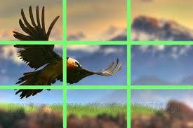
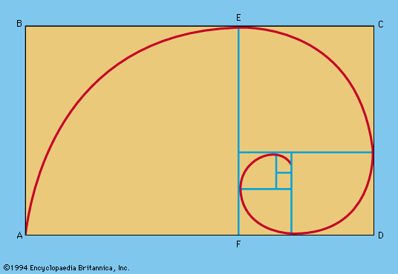
RULE OF THIRDS
A compositional concept that places the subject slightly off center.
Notes:
RULE OF THIRDS
A long time ago, someone came up with the idea of the rule of thirds, that is sometimes also referred to as the golden rectangle.
The rule of thirds is a compositional tool that makes use of the notion that the most interesting compositions are those in which the primary element is off center. Basically, take any frame of reference and divide it into thirds placing the elements of the composition on the lines in between.

