Slide 1
Animatics
Notes:
_

Slide 2
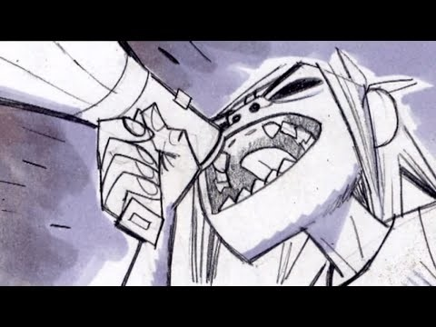
Animatics
Notes:
For a long time in the history of film storyboards have been a great tool to emphasize character blocking, camera placement and action.
With the development of the language of film and animation as visual media, film makers came to realize that while a traditional storyboard is quite useful in organizing the shots and action, there are certain times when film-makers need to have a sense of timing. That’s where an Animatic is especially helpful.

Slide 3
Animatics
Animatics are a “moving storyboard” that helps a production understand how scenes flow together.
Notes:
An animatic is a moving storyboard that helps the director of a production determine how scenes flow together.

Slide 4
Animatics
Begins with script, that is translated to storyboard and then timed in an animatic.
Individual panels are brought into computer or editing software.
By using stopwatch or cutting together footage, the animatic artist can decide how long each movement, dialogue or action will take.
Sound can also be used in an animatic, to give the viewer a sense of the dialogue in the scene, or the emotional buildup when matched to the music.
Notes:
An animatic begins with the script, which is then translated into storyboards.
The individual storyboard Panels are then shot with a camera, or scanned into a computer, and edited together in time to a dialogue track.
By cutting together live footage, or using a stopwatch to time storyboards, the animatic artist has a guide for how long each movement, dialogue, and action will take. Sound can also be used in an animatic, to give the viewer a sense of the dialogue in the scene, or the emotional buildup when matched to the music.

Slide 5
Animatics
There is no set rule for how animatics should be done.
Artists may want creative license to emphasize action or emotion.
Without animatics, production time and the expense could be greatly increased.
Notes:
Although these two examples of timing are often used to produce an animatic, the artist should never stick to them religiously. Sometimes the animatic artist may want creative license to emphasize an emotion or an action, in which case the pre timed sequence would not be completely accurate.
Nonetheless, without a well-timed animatic, production time for a shot could take three to four times longer to build, causing the studio to lose thousands of dollars and valuable production time.

Slide 6
Animatics
Animatics help coordinate productions by ensuring everyone is following the same vision:
Directors use animatics to help them visualize a scene.
Animators can use it to block out timing for a scene.
Notes:
Almost everyone involved in a production can benefit from using an animatic.
Animators use the animatic as a template for the scene setup and basic timing.
Directors use the animatic to help them visualize scenes.

Slide 7
Animatics
Animatics help coordinate productions by ensuring everyone is following the same vision:
Actors may use animatics when interacting with CG characters that aren’t there.
Special effects artists can use the animatic to clearly identify timing issues.
Voice actors or sound effects artists can also use the animatic for visualization.
Notes:
The animatic helps actors who are working with computer animated characters or objects, to act and react to images that are not there.
Special effects artist use the animatic for clearly identifying timing issues.
The animatic may also be used in the sound booth to help voice actors get a feel for the action that they are dubbing over.
Again, There is no set rule for the number of uses for the animatic. Most studios that use the animatic for pre-production have their own rules governing its uses and functions.

Slide 8
Types of Animatics
Hand-Drawn Animatics
Motion Tests
Videomatics
3D Animatics
Notes:
There are several different types of animatics that a director may request to help previsualize shot.
The four most common types include hand drawn animatics , motion test, videomatics, and 3d animatics.

Slide 9
Types of Animatics
Hand drawn animatics
Basically “timed storyboards”.
The storyboards themselves are hand drawn sketches that are animated to show how is seen should flow.
Often times can be simpler to produce, and help director communicate complex action scenes.
Notes:
Hand drawn animatics
Hand drawn animatics are timed storyboards.
The storyboards themselves are hand drawn sketches that are animated to show how is seen should flow.
Such animatics help the director communicate complex action scenes.

Slide 10
Types of Animatics
Pencil Tests
Pencil tests are commonly found in cel animation.
The purpose of a pencil test is to preview the motion of characters or objects.
Once pencil tests are analyzed, they are cleaned up by the artist.
Notes:
Pencil tests are commonly found in cel animation. The purpose of a pencil test is to preview the motion of characters or objects. Once pencil test are analyzed they are cleaned up by the artist.

Slide 11
Types of Animatics
Motion Previews
Camera movement
Character placement
Timing
Pacing
Notes:
Motion preview, on the other hand, explores various issues including camera movement, character placement, timing, and pacing.
For example, George Lucas previewed what a battle sequence of to spaceships would look like by cutting together existing World War II camera footage of planes in aerial combat.

Slide 12
Types of Animatics
Videomatic
A Videomatic is a rough videotaped version of a scene that uses actors or production staff to assist in blocking the action, actor placement, timing, and camera angles.
Videomatics are usually shot on or near the studio lot, using existing equipment.
Usually shot against bluescreen.
Notes:
A videomatic is a rough videotaped version of a scene that uses actors or production staff to assist in blocking the action, actor placement, timing, and camera angles.
Videomatics are usually shot on or near the studio lot, using existing equipment.
For example, the director’s car might serve as a space vehicle, or a picnic table might be used as a ledge that overlooks a deadly Gorge.
A member of the production staff usually sits in front of an actor, and is shot against a bluescreen.

Slide 13
Types of Animatics
Videomatic
A Videomatic is a rough videotaped version of a scene that uses actors or production staff to assist in blocking the action, actor placement, timing, and camera angles.
Videomatics are usually shot on or near the studio lot, using existing equipment.
Usually shot against bluescreen.
Notes:
A videomatic is a rough videotaped version of a scene that uses actors or production staff to assist in blocking the action, actor placement, timing, and camera angles.
Videomatics are usually shot on or near the studio lot, using existing equipment.
For example, the director’s car might serve as a space vehicle, or a picnic table might be used as a ledge that overlooks a deadly Gorge.
A member of the production staff usually sits in front of an actor, and is shot against a bluescreen.

Slide 14
Types of Animatics
Videomatic
Blue background is then removed and replaced with new background.
Usually directing is minimal, and cinematography style is simple.
The idea is to test out the script, timing and feel of the shot.
Notes:
The blue background is then removed, and replaced with a new background that makes it appear as if the character is actually 16 stories high.
Usually the directing is minimal and cinematography simple. The idea is to test out the script, timing, and feel of the shot.

Slide 15
Types of Animatics
3D Animatic
Some will prefer to create animatics from computer generated material rather than hand-drawn storyboards.
This can give the artist and the team the ability to easily adapt the storyboard to a production that has a lot of changes.
Notes:
Some companies opt to make their animatics from computer-generated material rather than hand drawn storyboards.

Slide 16
Types of Animatics
3D Animatic
3D Artist will create “proxy model”, of characters and props. These will be updated later.
A “layout” animation is created to get a sense of the action.
Allows the production team to experiment with different camera positions, blocking movements, and camera framing, which are difficult to explore with storyboard panels.
Notes:
3D artist create low-resolution models , also known as proxy models , of the set characters and props .
It is understood that these proxy models will be replaced later with the real thing.
The 3D artist then animate each shot, applying the basic rules of storyboarding such as blocking movements and camera framing

Slide 17
Rough-Cut
Rough cut is a well-developed animatic that is constantly updated as the film or animation develops.
This is very useful to visualize the progress of a film.
Just as with any animatic, it also helps the production understand how the different pieces flow together as a story.
Notes:
A rough cut is a well-developed animatic that is constantly updated with near completed animation or finished shots.
The rough cut is a great way to give a director, or a production a way of visualizing the development of a film while ensuring that all these parts flow together as a story.

Slide 18
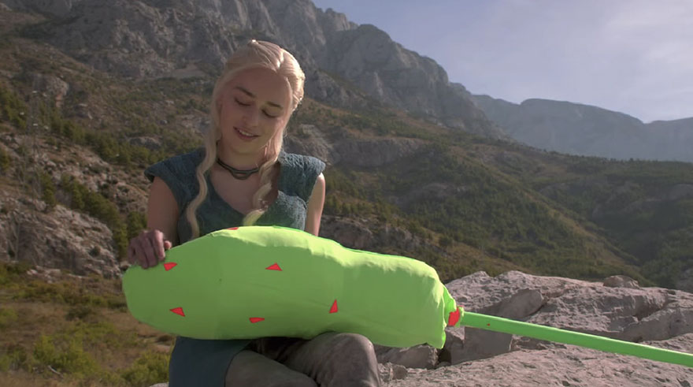
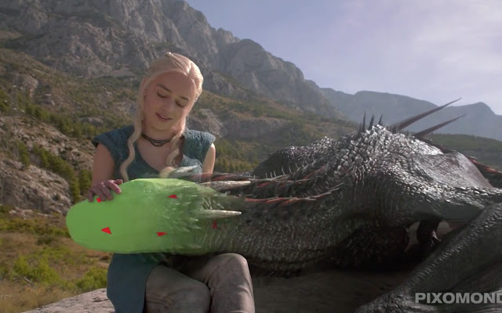
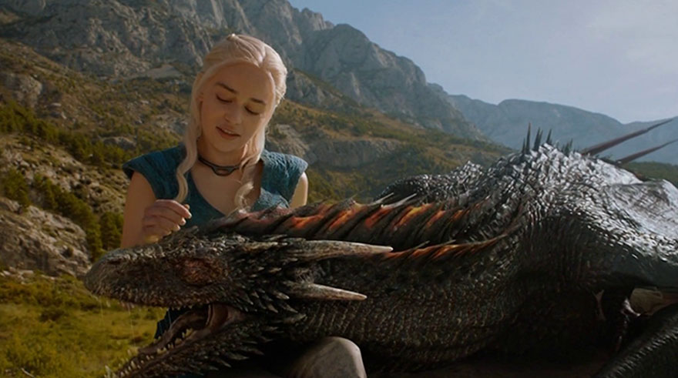
Rough-Cut
Once a shot is ready for review, the artist replaces the existing animatic shot with the actual final footage.
The updated rough-cut is then presented to the director or department head for approval.
The rough cut animatic should reflect the tools and techniques needed to create each scene.
If a shot requires special effect, the rough cut should have that same, or a proximate, special
effect in it.
Notes:
Once a shot is ready for review, the artist replaces the existing animatic shot with the actual final footage.
The updated rough-cut is then presented to the director or department head for approval.
The rough cut animatic should reflect the tools and techniques needed to create each scene.
If a shot requires special effect, the rough cut should have that same, or a proximate, special effect in it.
For example if alive actor picks up a computer-generated object, the rough cut should show the actor picking up the 3D model or in an approximation of the CG object.

Slide 19
Software
Every animatic artist uses software to either produce images or to load hand-drawn shots into the computer and manipulate them.
Among many other things, Photoshop and After Effects are often chosen to prepare storyboards and animatics.
Both have compatible features
Each specializes in different areas: Photoshop for stills and manipulation, After Effects is very similar, but deals more with motion.
Ideal workflow tends to be a combination of both.
Notes:
Every animatic artist works with software to load the hand-drawn or film shots into the computer and manipulate them.
There are several storyboard software programs on the market.
Amongst many other things Photoshop and after effects are often used to prepare storyboards and animatics.
Both have many compatible features, but specialize in different areas, with photoshop more dedicated to traditional composition, and After Effects dedicated to motion.
An Ideal workflow is the combination of each.

Slide 20
Software
Storyboard Pro
Frameforge
Storyboard Quick
Shot Master
Notes:
Remember though, storyboards are not about software, but stories.
Technology is only the means for articulating and executing the director artist's vision.
Other Software include Storyboard Quick, FrameForge 3d studio and shot master.

Slide 21
Software
Remember though, storyboards are not about software, but stories.
Technology is only the means for articulating and executing the director artist's vision.
Notes:
Remember though, storyboards are not about software, but stories.
Technology is only the means for articulating and executing the director artist's vision.

Slide 22
Scanning
Scanners are often used to bring in hand drawn artwork into a computer.
When scanning storyboards, you need to set the resolution.
Television resolution for PCs is 72 dpi at 720 x 480 pixels, and Mac 72 dpi at 640 x 480.
Notes:
Scanners are often used to bring in hand drawn artwork into a computer.
When scanning storyboards, you need to set the resolution.
Television resolution for PCs is 72 DPI at 720 x 480 pixels, and Mac 72 dpi at 640 x 480.
Depending on which platform you use, either PC or Mac, these will be your choices for the basic composition size of the animatic.

Slide 23
Still Shots and Moving Shots
Scanners are often used to bring in hand drawn artwork into a computer.
When scanning storyboards, you need to set the resolution.
Television resolution for PCs is 72 dpi at 720 x 480 pixels, and Mac 72 dpi at 640 x 480.
Notes:
The basic rule of thumb is to always scan larger than you need. It is easier to take away then to add.
Although television resolution is 72 DPI, you never know when the director will ask you to change a still shot to show movement.
Having a little foresight could save you a few headaches down the road.
As a rule of thumb it's a good idea to scan your images at 150 dpi

Slide 24
Still Shots
Still shots should be scanned at 72 DPI, 720 x 480 minimum size.
Notes:
Still shots should be scanned at 72 DPI, 720 x 480 minimum size.

Slide 25
Pan Shots
The only consideration you must think about here is the length of a pan.
Does a camera pan a full 360 Degrees?
Can you fit your panning sketch into the scanner?
Notes:
The only consideration you must think about here is the length of a pan.
Does a camera pan a full 360 Degrees?
Can you fit your panning sketch into the scanner?

Slide 26
Zoom Shots
As a rule of thumb zoomed should be scanned at 300 dpi.
If you want to be exact you should figure out how close you are going to get in on the frame.
Notes:
As a rule of thumb zoomed should be scanned at 300 dpi.
If you want to be exact you should figure out how close you are going to get in on the frame.
For example, if you are going to move in on the frame twice, scan at twice the base resolution (72 dpi x 2 zooms = 144 dpi)

Slide 27
Zoom Shots
Save the raw scanned images in Photoshop as either TGA or Tiff format.
Both of these formats are lossless (file type does not use any type of compression to store the data within the image).
Formats such as .gif, jpeg and .bmp are used to compress data with repeated use (opening, saving, closing. These are called “lossy” because of the loss of detail in favor of file size and compression.
Notes:
Save the raw scanned images in Photoshop as either TGA or Tiff format.
Both of these formats are lossless (file type does not use any type of compression to store the data within the image).
Lossy types of Algorithms to compress the data and with repeated use (opening, saving, closing), the data can be loaded overtime.
Other formats that are lossy are jpeg, gif , and BMP.

Slide 28
Cleanup
It is faster to scan everything all at once rather than going back and forth between the scanning software and Photoshop.
Save each file in Photoshop then start cleaning them up for use in programs such as After Effects.
It is wise to save the original raw image and work with a copy.
Notes:
It is faster to scan everything all at once rather than going back and forth between the scanning software and Photoshop.
Save each file in Photoshop then start cleaning them up for use in programs such as After Effects.
It is wise to save the original raw image and work with a copy.

Slide 29
Preparing Storyboards for Animatic
It is faster to scan everything all at once rather than going back and forth between the scanning software and Photoshop.
Save each file in Photoshop then start cleaning them up for use in programs such as After Effects.
It is wise to save the original raw image and work with a copy.
Notes:
It is faster to scan everything all at once rather than going back and forth between the scanning software and Photoshop.
Save each file in Photoshop then start cleaning them up for use in programs such as After Effects.
It is wise to save the original raw image and work with a copy.

Slide 30
Image Cleanup
Straight lines, dots, fuzzy pixels and so forth should be removed.
Adjust the contrast as needed. Keep white paper white, and black lines black.
Objective should be clarity. What is the main point the drawing is supposed to show?
Most scanning software allows you to adjust the contrast, or you can fix it in Photoshop by adjusting the contrast.
Notes:
Straight lines, dots, fuzzies and so forth should be removed. Adjust the contrast as needed. Keep white paper white, and black lines black. Nothing is more distracting than yellowish paper with gray lines that are supposed to represent your storyboards. Most scanning software allows you to adjust the contrast, or you can fix it in Photoshop by adjusting the contrast.

Slide 31
Movement
As you decide what to animate, it might be necessary to move body parts or objects separately.
To do this, cut the part out , and put it on its own layer.
There are several tools with in Photoshop that you can use for such editing purposes.
All of these methods are usable within After Effects.
Notes:
As you decide what to animate, it might be necessary to move body parts, such as an arm waving up and down for timing purposes.
To do this, you would cut the arm out , and put it on its own layer.
There are several tools with in Photoshop that you can use for such editing purposes

Slide 32
Selection Tools
The Marquee tools are good for selecting large rectangular or elliptical areas.
Magic Wand tool selects large areas. It is useful for removing the background color from an image.
Lasso tools that you can choose from.
The Pen tool can also be used as a very flexible selection tool by converting the path to selection.
Notes:
The Marquee tools are good for selecting large rectangular or elliptical areas.
The magic wand tool selects large areas. It is useful for removing the background color from an image.
There are several lasso tools that you can choose from. The lasso is free hand selection tool.

Slide 33
Timing
Each production has a specified length, whether it is a 30-second television spot or a two-hour feature film.
The mood and pace of our production is determined by the cutting and motion of every scene.
Acting effects the timing of each shot.
Bad timing sticks out like a sore thumb in any medium and any format.
Notes:
There are three key elements to keep in mind when considering timing.
First, each production has a specified length, whether it is a 30-second television spot or a two-hour feature film.
Second, the mood and pace of our production is determined by the cutting and motion of every scene.
And third, acting effects the timing of each shot.
Bad timing sticks out like a sore thumb in any medium and any format.

Slide 34
Developing a sense for Timing
Timing is important. Just as in music, where it gives meaning to the notes. Timing in storyboards does the same for the visual elements.
If a shot is too long, it may slow down the pace and make it boring.
If the shot is too short, it may seem ambiguous and confusing.
Trial-and-error perfect or timing skills.
Notes:
Time is often a complicated issue.
If a shot is too long, it may slow down the pace and make it boring.
On the other hand, if the shot is too short, it may seem ambiguous and confusing.
Trial-and-error perfect or timing skills.

Slide 35
Developing a sense for Timing
If you don't know how long a shot should be, make an educated guess.
Remember, the animatic is created to block out the timing.
Using a nonlinear software to edit and the animatic makes it easy for animators to add or subtract frames from a shot.
Notes:
If you don't know how long a shot should be, make an educated guess.
Remember, the animatic is created to block out the timing.
Using a nonlinear software to edit and the animatic makes it easy for animators to add or subtract frames from a shot.

Slide 36
Developing a sense for Timing
The single most important thing to remember when blocking out your timing is the FPS or framerate.
FPS or “Frames per Second” is your guiding rule. This is how many frames equal one second of actual, real-world time.
Frame count, blocking the animation, dialogue tracks, and specific shot movements are also main factors used in determining the timing of the animatic.
Notes:
Developing good timing in the atomatic helps animators with their workload.
The single most important thing to remember when blocking out your timing is the FPS or framerate.
FPS or “Frames per Second” is your guiding rule. This is how many frames equal one second of actual, real-world time.
Frame count, blocking the animation, and dialogue tracks, and specific shot movements are the main factors used in determining the timing of the animatic.

Slide 37
Developing a sense for Timing
Film speed is 24 frames per second and television is 30 fps.
Some games and different media use other frame rates.
Some modern cameras have a very high framerate that allows the animator/director to slow down time when needed.
Knowing the frames per second for a project can save you time when creating an animatic.
Notes:
Film speed is 24 frames per second and television is 30 fps.
Some games and different media use other frame rates.
Some modern cameras have a very high framerate that allows the animator/director to slow down time when needed.
Knowing the frames per second for a project can save you time when creating an animatic.

Slide 38
Developing a sense for Timing
Timing is a difficult skill to acquire. While some have a natural sense, most of us acquire it with practice.
Use a timing device such as a stopwatch to get a sense of how long actions take.
Observe how other artists treat timing in their films.
Observe real life to get a sense of how long real movements should last.
Notes:
Some people are naturals at timing, but most of us are not.
For those of us who do not have this natural talent, we need plenty of practice.
Every animator, whether they are 2D or 3D animatic artist, should own a stopwatch.
The hardest part 4 animatic artists to learn is how to use a stopwatch!
This may sound simple, but many animators by a stopwatch and never use it because they think they already know how long it takes to perform a task.
Using a stopwatch or some sort of timing will give you a real-world reference of how long an action takes.
Another way to sharpen up your sense of timing is to Simply watch others.
Watch to see how other artists have dealt with time in situations similar to your own.

Slide 39
Developing a sense for Timing
Observing the real world is also a great way to get a sense of timing.
Video reference is often times a crucial tool when it comes to animation.
Long before motion capture technology was ever invented, animators would use film reference to get a good sense of timing and natural poses.
Notes:
Observing the real world is also a great way to get a sense of timing.
Video reference is often times a crucial tool when it comes to animation.
Long before motion capture technology was ever invented, animators would use film reference to get a good sense of timing and natural poses.

Slide 40
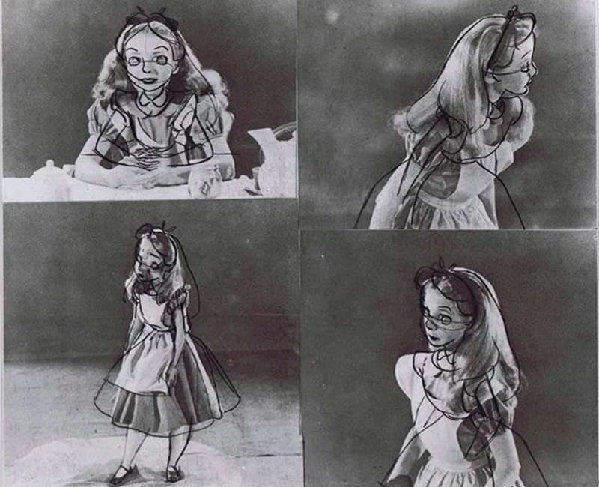
Developing a sense for Timing
No matter the skill level of an artist, reference can only make your work better.
Disney pioneered using test footage to create a new high quality standard of animation at the time.
The footage not only captured the subtlety of the natural gestures and the timing, but more importantly, the relationship between the two.
Notes:
No matter the skill level of an artist, reference can only make your work better.
Disney pioneered using test footage to create a new high quality standard of animation at the time.
The footage not only captured the subtlety of the natural gestures and the timing, but more importantly, the relationship between the two.

