Slide 1
Aspect Ratios

Slide 2
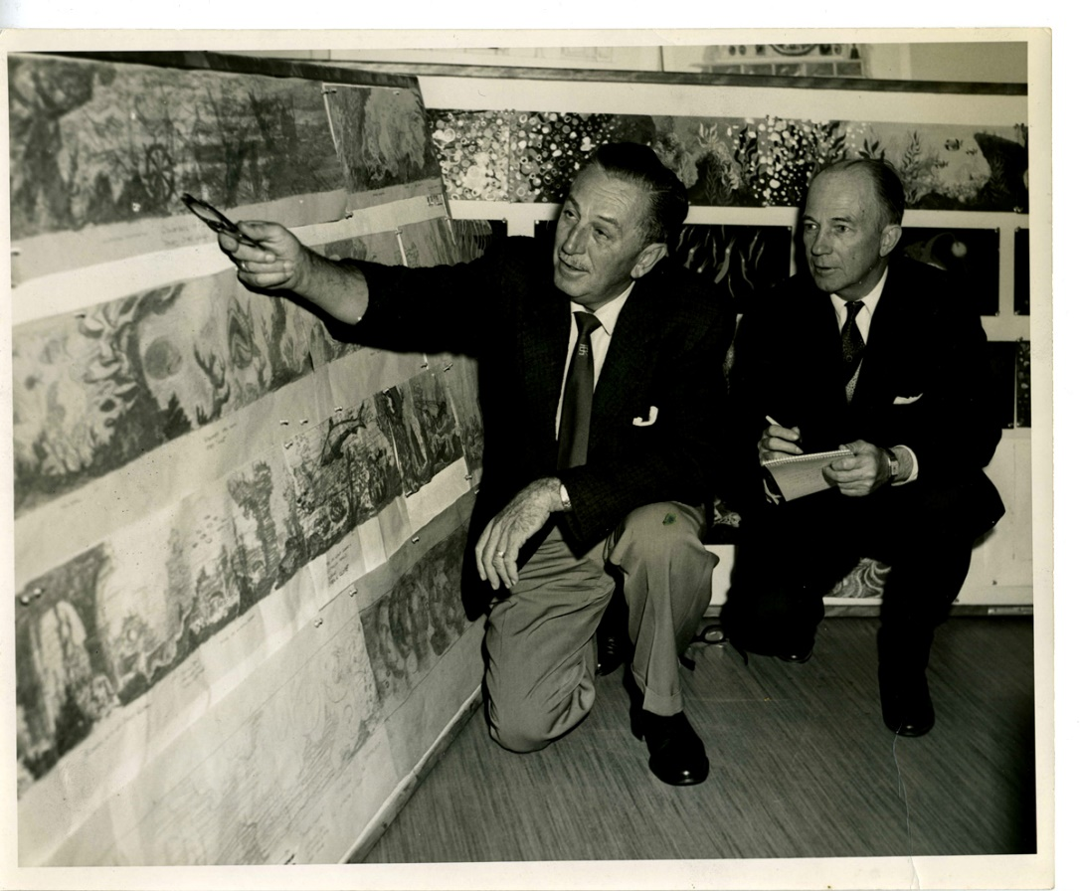
Storyboarding and Aspect Ratios
Disney studios first conceived of storyboards in the early 1930s, with rise of animated shorts.
Directors also relied on storyboard panels that were the same size, or aspect ratio of the movie screen.
Similar experiments by Edward Muybridge and others tied to photography.
Notes:
Visual storytelling has been around for thousands of years, but the technique of storyboarding is a relatively new Concept.
Disney Studios first conceived of storyboards with the rise of animated short in the early 1930s.
Soon afterwards, film directors were planning complex sequences by sketching how they envision particular seems to unfold.
Directors also relied on storyboard panels that were the same size, or aspect ratio of the movie screen.
Aspect ratios changed over the years as new technologies, such as television, were introduced.

Slide 3
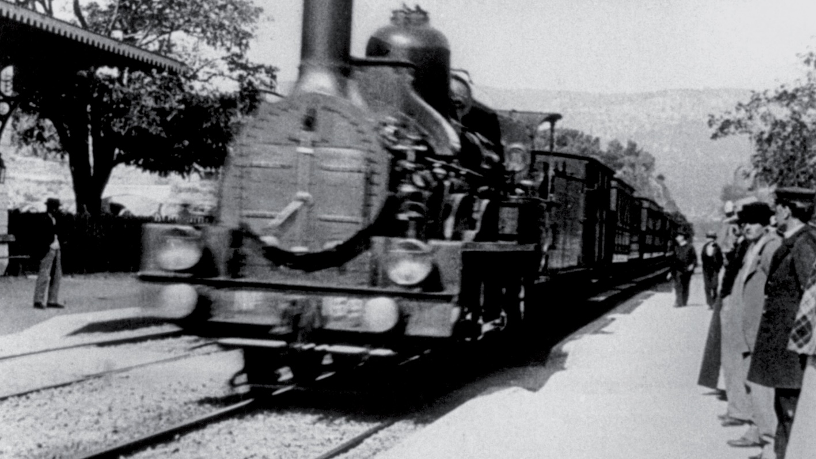
Early History of the Storyboard
Lumiere Brothers were credited with the first cinematic screening in 1895
Considered recordings scientific observation.
Similar experiments by Edward Muybridge and others tied to photography.
Notes:
The birth of the Cinematic image was a spectacle as audiences watched first pictures flicker across the screen.
The Lumiere brothers were credited with the first cinematic screening in 1895 of workers at The Lumiere Factory strolling through the front gate.
Audiences were awed as they watched every day events, such as a train pulling into station and the baby eating.
Although the public was fascinated, the Lumieres considered their many recordings as a purely scientific method to record reality,
and so no real future for this new innovation.

Slide 4
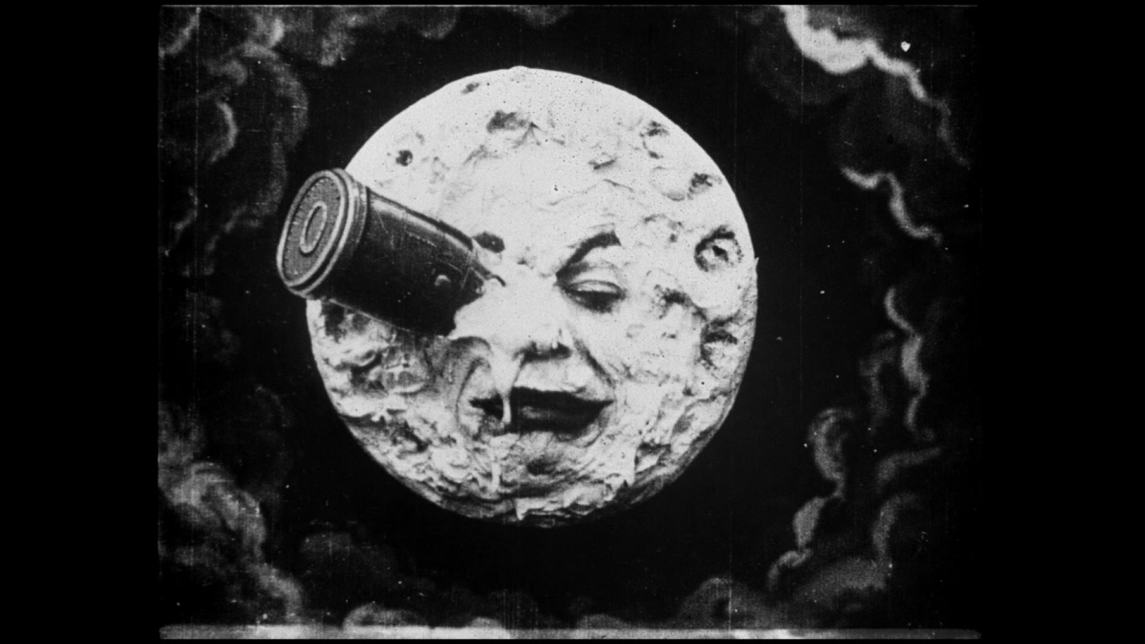
Early History of the Storyboard
George Melies, magician by trade used film to document his magic tricks.
1902 film “A Trip to the Moon”
Film does not document, but tells fictional story about explorers landing on moon.
One of first uses of film as art.
Notes:
In stark contrast to the loom years was George Melies , who was a magician by trade.
He used the camera not to record everyday occurrences, but to document his own magic tricks.
He created stylized sets for his elaborate film narratives.
His best-known work is in the 1902 film a trip to the moon, which is a tale of Space Explorers who land on the Moon.

Slide 5
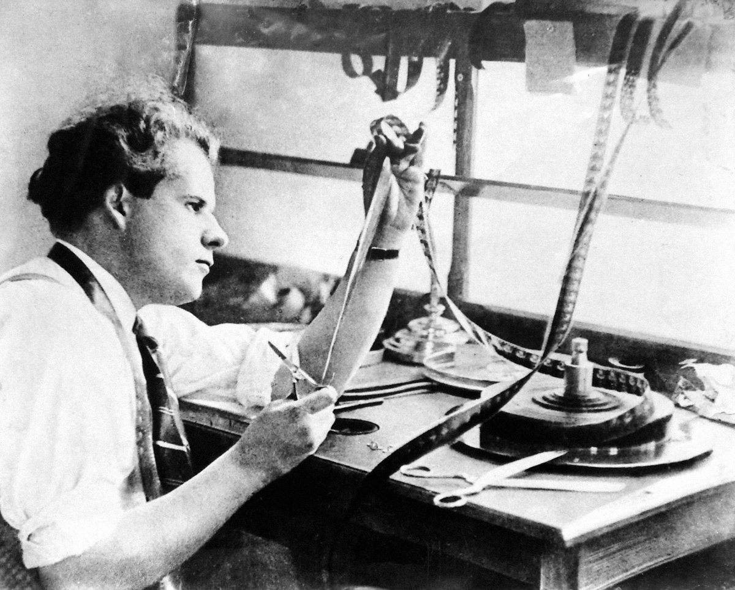
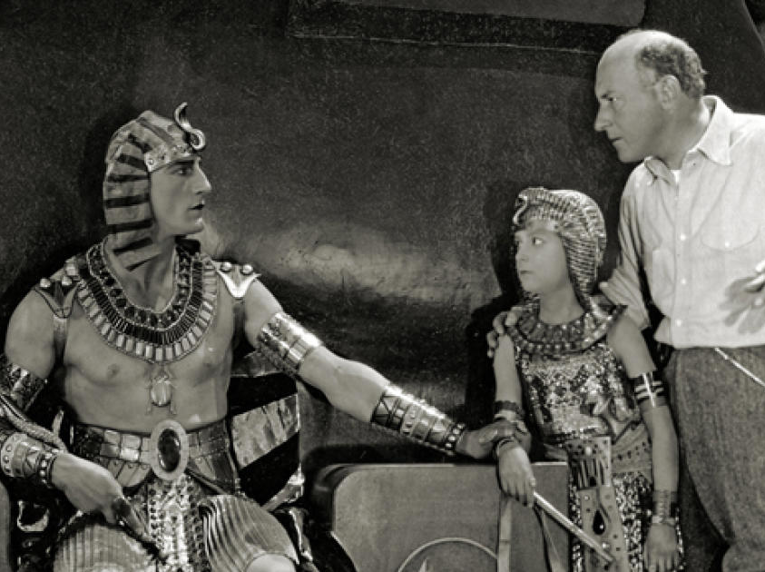
Early History of the Storyboard
Sergei Eisenstein
Cecil B. DeMille
used artist sketches to develop story ideas.
Notes:
With the evolution of film came more elaborate stories and sophisticated camera techniques.
Although the modern storyboard was still years away during cinemas early history, directors such as Sergei Eisenstein and Cecil B DeMille relied on an artist sketches to help develop story ideas.

Slide 6
Early History of the Storyboard
Sergei Eisenstein
Created several of his own sketches before making Battleship Potemkin (1925)
Notes:
Eisenstein created a multitude of his own sketches before undertaking the 1925 film the battleship Potemkin and later the 1931 film black Majesty .
These sketches guided him for how the action would move within each scene.

Slide 7
Early History of the Storyboard
Cecil B. DeMille
Dan Sayre Groesbeck helped DeMille visualize sequences for The Ten Commandments (1923)
Notes:
Cecil B Demille the famed Hollywood director use the talents of artist Dan Sayre Groesbeck to assist him in visualizing the dramatic scenes for his 1923 film The Ten Commandments.

Slide 8
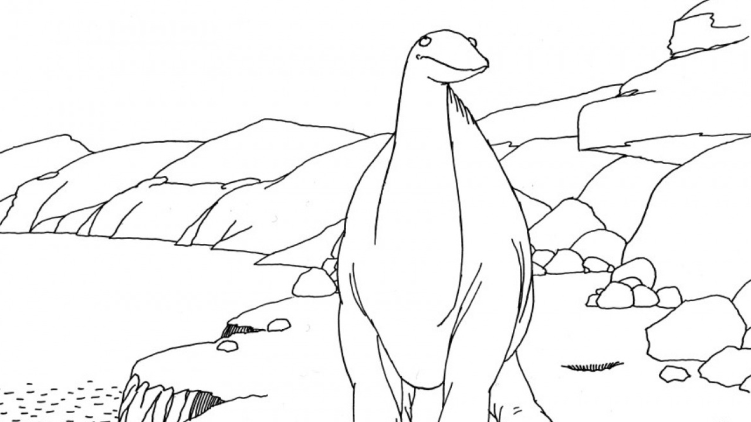
Early History of the Storyboard
Modern Storyboards evolved more through animation.
In beginning, animation studios relied purely on their artists to generate story ideas.
Notes:
Real strides towards the birth of modern storyboard took place not in film, but in animation.
During animations infancy, Studios rely solely on their artists to generate story ideas.

Slide 9
Early History of the Storyboard
Animators were responsible for cartoons, which were simple gags and jokes that revolved around the theme.
Winsor McCay helped popularize animation by turning his newspaper strip, essentially a short gag, into a moving animation.
Notes:
Animators were responsible for cartoons, which were often no more than simple gags and jokes strung together around the theme.
Early animation such as crazy cat and Bobby bumps were five minute cartoons with no storyline.
This was how Winsor McCay, who is considered the father of Animation got his start. McKay's first animation was based on his popular newspaper strip Little Nemo in Slumberland.

Slide 10
Early History of the Storyboard
Cartoonist friend Ed McMahon bet McKay that he could not “bring a dinosaur to life”.
Gertie like so many animations to follow was an experiment in motion rather than a fully-formed story with a beginning, middle, and end.
Notes:
It was not until cartoonist Ed McMahon wagered McKay that he could not “bring a dinosaur to life”, that the public became aware of this new technology.
As a result of the bet, McKay created a series of drawings for his 1914 animation Gertie the dinosaur.
McKay animated Gertie almost single-handedly, creating over 10,000 sketches which he then hand colored frame by frame.
Gertie like so many animations to follow was an experiment in motion rather than a fully-formed story with a beginning, middle, and end.

Slide 11
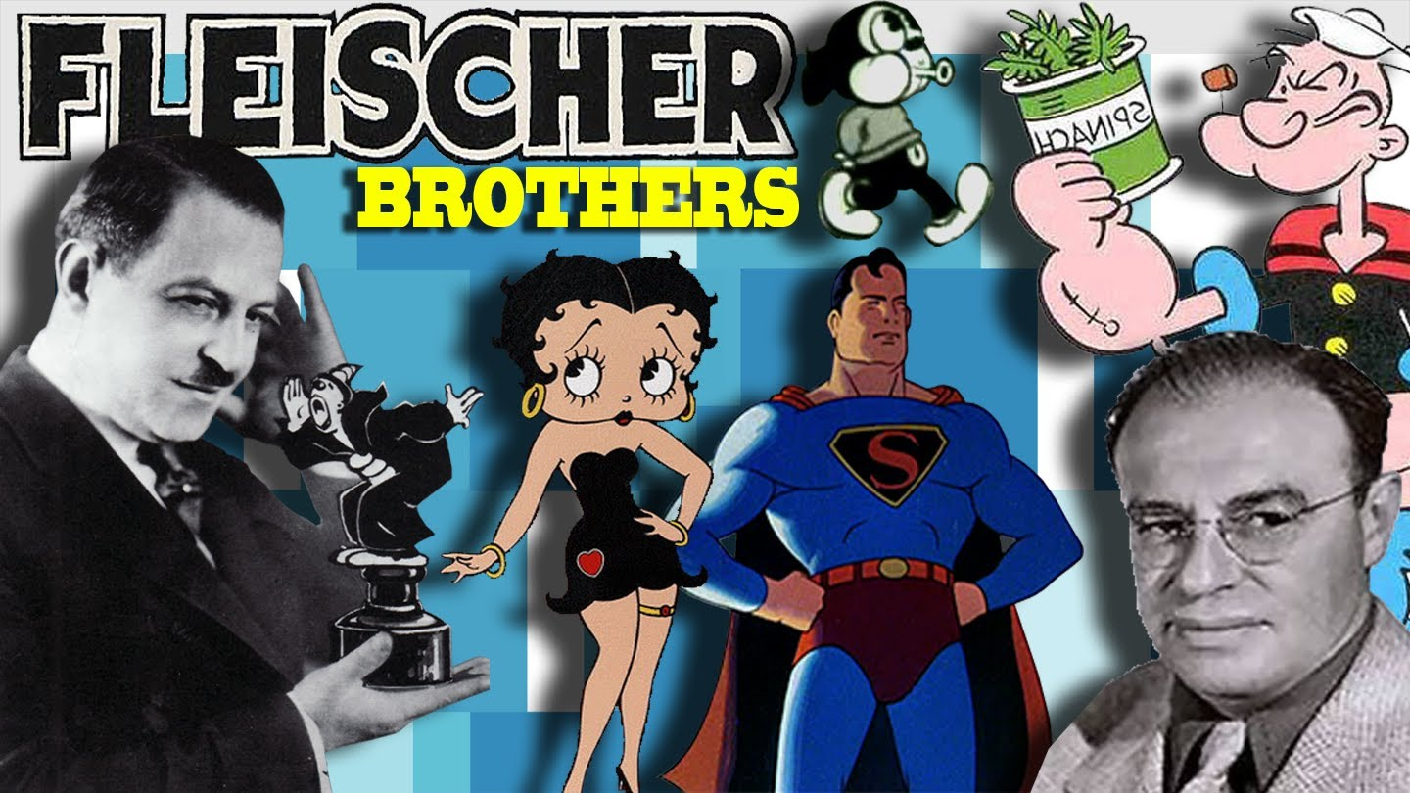
Early History of the Storyboard
Max and Dave Fleischer – creators of Betty Boop, were among the most successful of these early animators in the 20s and 30s.
Fleischers did not use script. Ideas were added through suggestion of gags every morning.
Notes:
Arguably, the most successful and influential of these early animators were Max and Dave Fleischer , creators of Koko the Clown and Betty Boop cartoons.
In the 1920s and early 1930s, Fleischer Studios had no story department and often relied on their animators to generate stories based on gags.
The Fleischer gave their animators ideas for scenes but nothing was ever written down on paper.
There was no script. Rather, Dave Fleischer would make the rounds every morning among the animators and suggest where more gags should be added.
This practice is commonly known in the animation and effects industry as “dailies”.

Slide 12
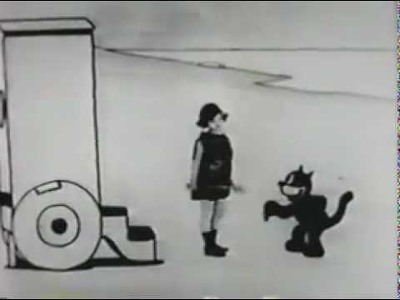
Early History of the Storyboard
Walt Disney was influenced by Fleischer and McCay.
Also influenced by live action such as Charlie Chaplin and Buster Keaton.
Disney studied the camera angles, camera movement, and timing from these films.
Notes:
In the beginning of his career, Walt Disney imitated the style of Fleischer and McKay with his animated short Alice in cartoonland.
But his interest in live action film peaked, so did his motivation to think beyond the scope of presenting cartoons as a series of uncomplicated sight gags. Disney and his small crew started sketching out ideas for stories after studying the films of Charlie Chaplin and Buster Keaton.
They studied the camera angles, camera movement, and timing. Over time, their work paid off.

Slide 13
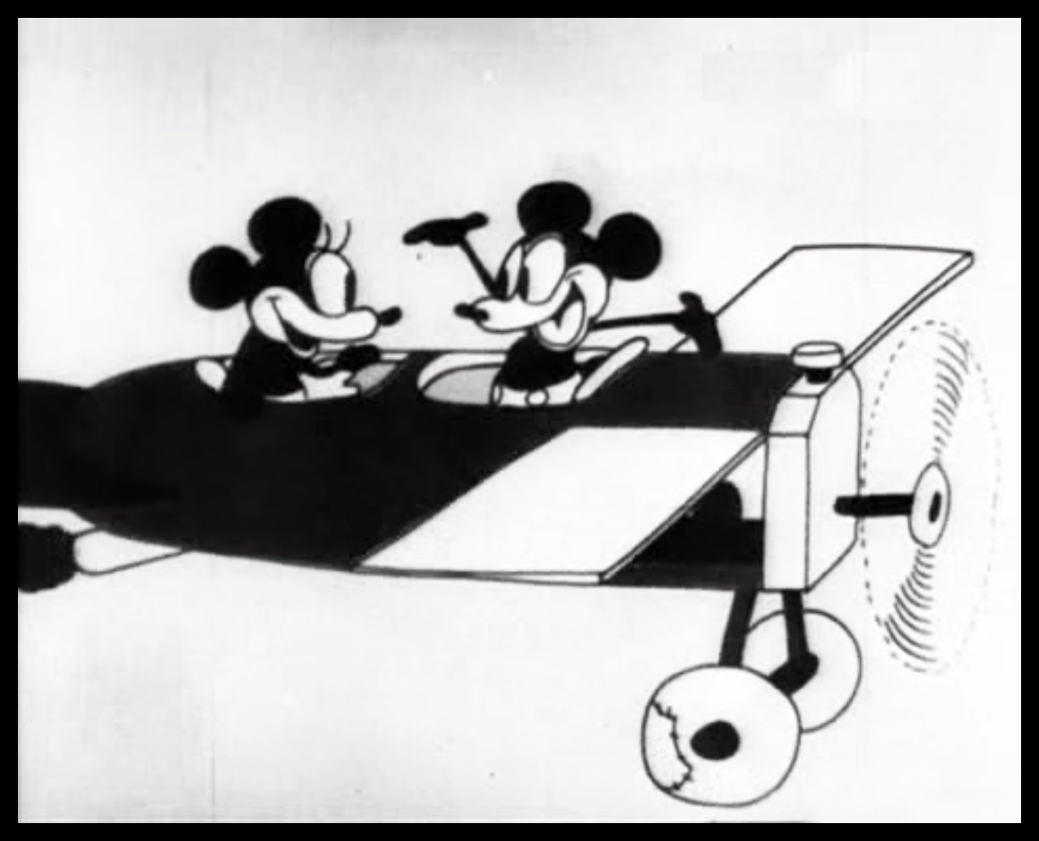
Early History of the Storyboard
Plane Crazy features sketches that looked similar to comic strip.
The story sketches included Dynamic Camera Angles, Framing, and character action.
With the sketches were action descriptions for each scene, written out on separate piece of paper.
Notes:
In 1928 Disney released Plane Crazy, the first Mickey Mouse cartoon.
Plane crazy was meticulously crafted from story sketches that looked similar to a comic strip.
The story sketches included Dynamic camera angles, Framing, and character action.
With the sketches were action descriptions for each scene, written out on separate piece of paper.

Slide 14
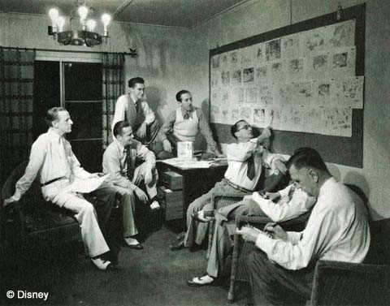
Early History of the Storyboard
Disney animators did both animation and gag development
Disney soon realized need for separate story department.
Instituting a story department changed the way the company wrote and developed story ideas, letting animators focus on animation.
Notes:
Disney animators worked as both Gag-men and animators, but as they experimented with story sketches, Walt realized the need for a separate story Department with its own writers.
Ted Sears, who began his career as a gag man for Disney, was appointed head up This newly-formed department in the early 1930s.
From this point forward, animators were no longer responsible for both the story and the art.
Instead, they worked with writers who developed the story ideas.

Slide 15
Early History of the Storyboard
With dedicated story department, stories became more complex and difficult to develop.
Storyman Webb Smith had idea of pinning sketches do dialogue wall to show sequence.
Smith would rework the sequence until continuity was achieved.
Notes:
Before too long, the number of sketches that each project generated grew to the extent that understanding is stories logical flow and content became increasingly a difficult task.
Story Man Webb Smith had a solution: he pinned all the sketches and dialogue to the wall in a sequence from beginning to end.
Smith then we work the sequence of shots Until he felt that a story continuity was achieved.
The first cartoon recognized for using Smith's method of storyboarding was the 1933 cartoon the three little pigs.

Slide 16
Early History of the Storyboard
Early Disney storyboards were collaborative process between animator and writer, and had a lot of editing.
Snow White used thousands of sketches in the storyboard, and used actors to aid with animation reference.
Notes:
Early Disney storyboards were a collaborative process between the writer and animator, making it easy to visualize ideas by shifting scenes, and adding and deleting drawings.
Over time, the process was streamlined so that eventually all ideas submitted for review to Walt Disney World on storyboards.
If approved by Disney, the boards were used to coordinate production.
One of the earliest most well-known uses of the modern storyboard was for the animated feature film Snow White and the Seven Dwarves.
Storyboards played an integral role in the development of Snow White with thousands of sketches being generated to bring the story to life.
Disney had the story board panels pinned to a wall and then he acted out the scenes of the movie to the crew working on production (as visual reference).

Slide 17
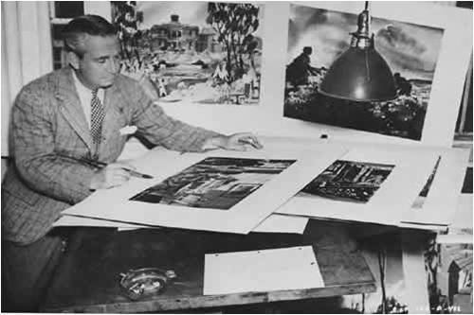
Early History of the Storyboard
Film studios soon took notice of storyboarding methods to plan film.
Citizen Kane used storyboards for complex sequences.
William Cameron Menzies helped storyboard many popular films such as Gone With the Wind, focusing on framing, camera movement and composition.
Notes:
As storyboard usage became more common, and Animation Studios flourished, live action directors took notice.
Film directors began to pre-plan their films, storyboarding elaborate action sequences and special effect.
For Citizen Kane, Orson Welles storyboarded complex lighting sequences and scenes used “deep-focus” cinematography.
Producer David O Selznick, whose films include Gone With the Wind and Duel in the Sun, worked with illustrator William Cameron Menzies , who storyboarded many early films.
Menzies was credited with a visual design of Gone With The Wind, in which he created hundreds of drawings that encompassed framing, composition, and camera movement.

Slide 18
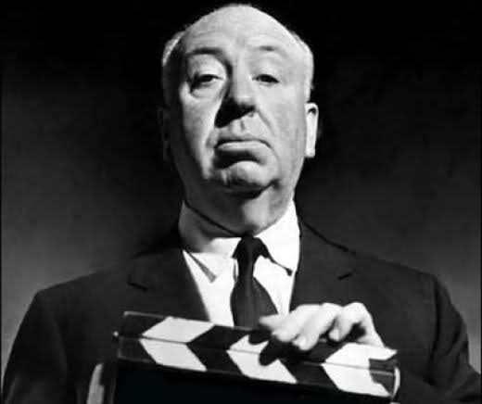
Early History of the Storyboard
Alfred Hitchcock considered his films storyboards come to life, having even drawn some of his own storyboards.
Hitchcock enlisted Saul Bass to assist him in creating the storyboard for the shower sequence of Psycho, which contained 75 different camera setups.
Notes:
Alfred Hitchcock, the director of such films as vertigo, rear window, and psycho, considered his films as storyboards come to life.
Hitchcock Drew many of his own storyboards, as well as Enlisted the help of famous title designer Saul bass, who storyboarded the intricate shower sequence in Psycho, which included over 75 camera setups.
Hitchcock referred to Bases storyboards as a guideline For setting up the murder.

Slide 19
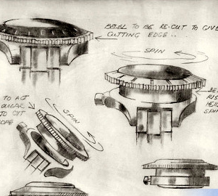
Early History of the Storyboard
From 1930s-1970s, many used storyboards to plan out special effects and complex action shots.
Syd Cain choreographed action sequences in many James Bond Films.
Notes:
From the 1930s through the 1970s many live-action directors only storyboarded special effects and complex action sequences.
This was the case with many James Bond films that were created during the 1960's and 1970’s.
Artist Syd Cain choreographed the storyboards for the key action sequences for the film From Russia with Love.
He later went on to create both concept art and storyboards for such Bond films as Live and Let Die, on Her Majesty's Secret Service, and GoldenEye.
On the film Live and Let Die came created detailed story boards for three intricate action sequences that had never been tried before.
Storyboarding such scenes allowed the director to visualize on paper what would work without going through the expense of having to shoot different variations of the scene.
As films became more expensive to create, many directors took note of the efficiency that storyboards provided.
The storyboard process became particularly important to directors who had several units involved in shooting different scenes.
For big budget films, such as Raiders of the Lost Ark, the creation of storyboards ensured that all units involved in staging scenes were on the same page.

Slide 20
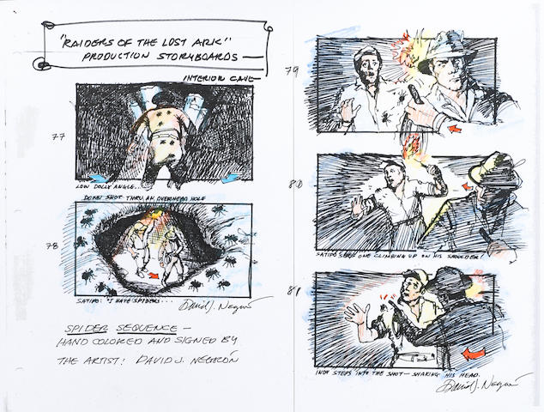
Early History of the Storyboard
Storyboards were used because of the efficiency that they provided directors.
Large films such as Star Wars and Raiders of the Lost Ark used storyboards extensively to ensure that the entire crew/production was on the same page.
Even with digital technology, these methods are still popular today.
Notes:
As films became more expensive to create, many directors took note of the efficiency that storyboards provided.
The storyboard process became particularly important to directors who had several units involved in shooting different scenes.
For big budget films, such as Raiders of the Lost Ark, the creation of storyboards ensured that all units involved in staging scenes were on the same page.

Slide 21
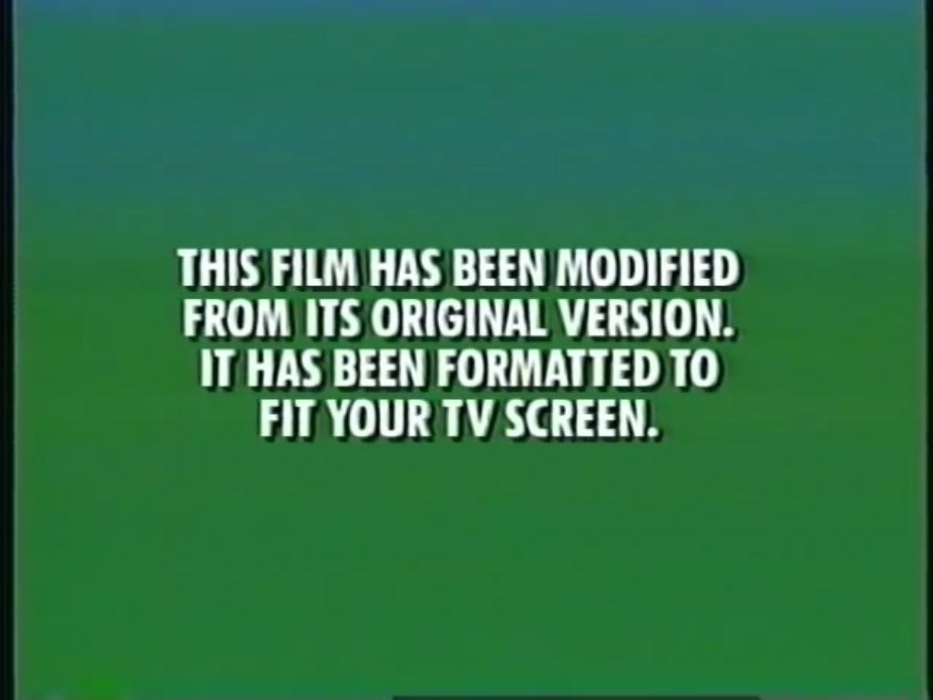
What are Aspect Ratios
shape of the screen
size relationship between its width and height.
Since there are many different aspect ratios in use for film, the image has to be modified to fit the television screen
Notes:
Have you ever watched a film on television and, just before the movie starts, the words this film has been modified from its original format appear.
If you're like many people , you probably thought what original format?
This format refers to the shape of the screen, or size relationship between its width and height. Since there are many different aspect ratios in use for film, the image has to be modified to fit the television screen.

Slide 22
What are Aspect Ratios
First number represents width in relation to the height
Second number represents height in relation to width.
1.5:1
Notes:
The first number in an aspect ratio indicate the frames width, Relative to its height.
For example , 1.5:1 Is an aspect ratio.
The first number, 1.5, represents the width of the frame , whereas the second number, 1, stands for the height.
The 1.5:1 ratio tells us that for every one unit of height, there are 1.5 units of width .

Slide 23
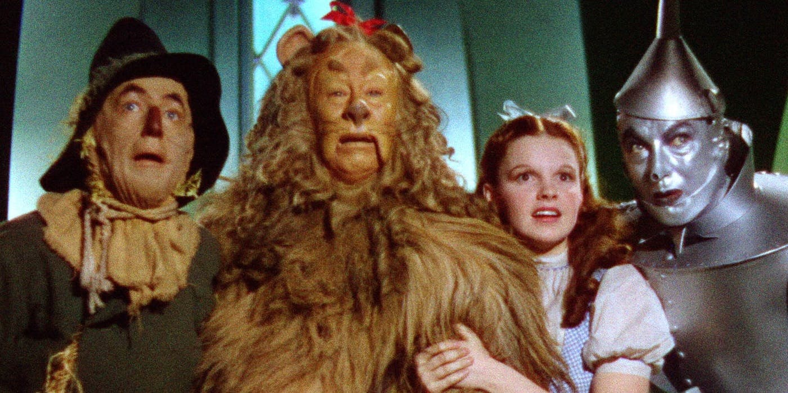
History of Aspect Ratios
1.33:1 was the format used during the early days of film production.
This format is the ratio of the 35 mm film camera.
Notes:
In the early days of Film Production, movies were created using an aspect ratio of 1.33:1 ,
which is the ratio for 35 millimeter film.

Slide 24
History of Aspect Ratios
1.37:1 was created to fit the soundtrack on the film.
Became known as “Academy Ratio”
Was used on films like Gone With the Wind, Wizard of Oz, Citizen Kane and Casablanca.
These films do not need additional formatting to fit on a standard TV.
Notes:
When sound was Incorporated into Motion Pictures, the aspect ratio was adjusted to 1.37:1 to make room for an optical soundtrack on the film.
This new ratio became known throughout the industry as the academy ratio.
Films produced in a 1.37:1 aspect ratio include The Wizard of Oz, Gone With the Wind, Citizen Kane, and Casablanca.
When these films are shown today, there is no need for additional formatting to play on a standard television set.

Slide 25
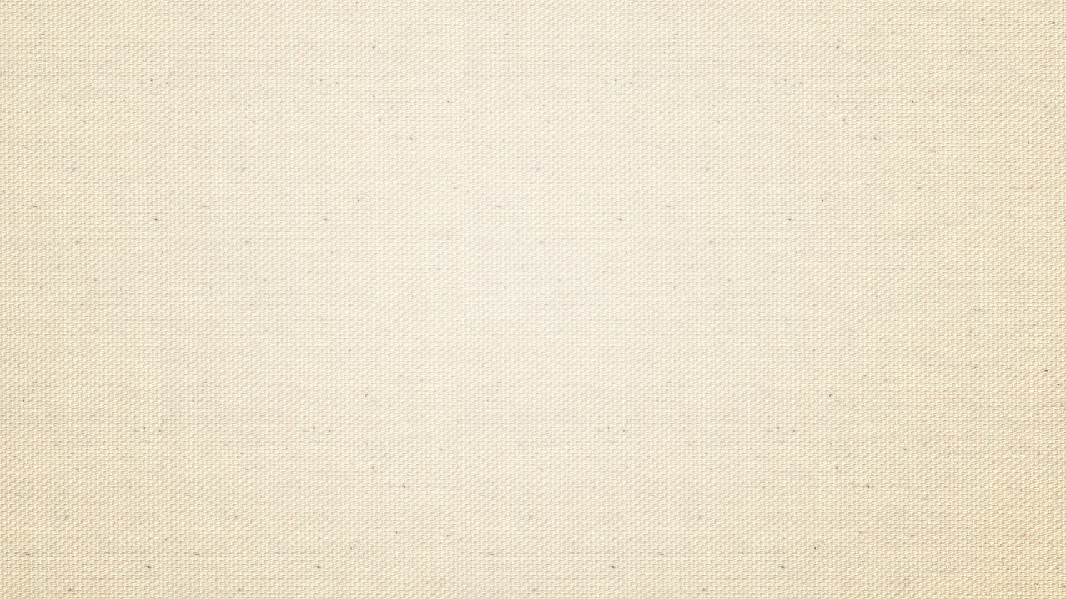
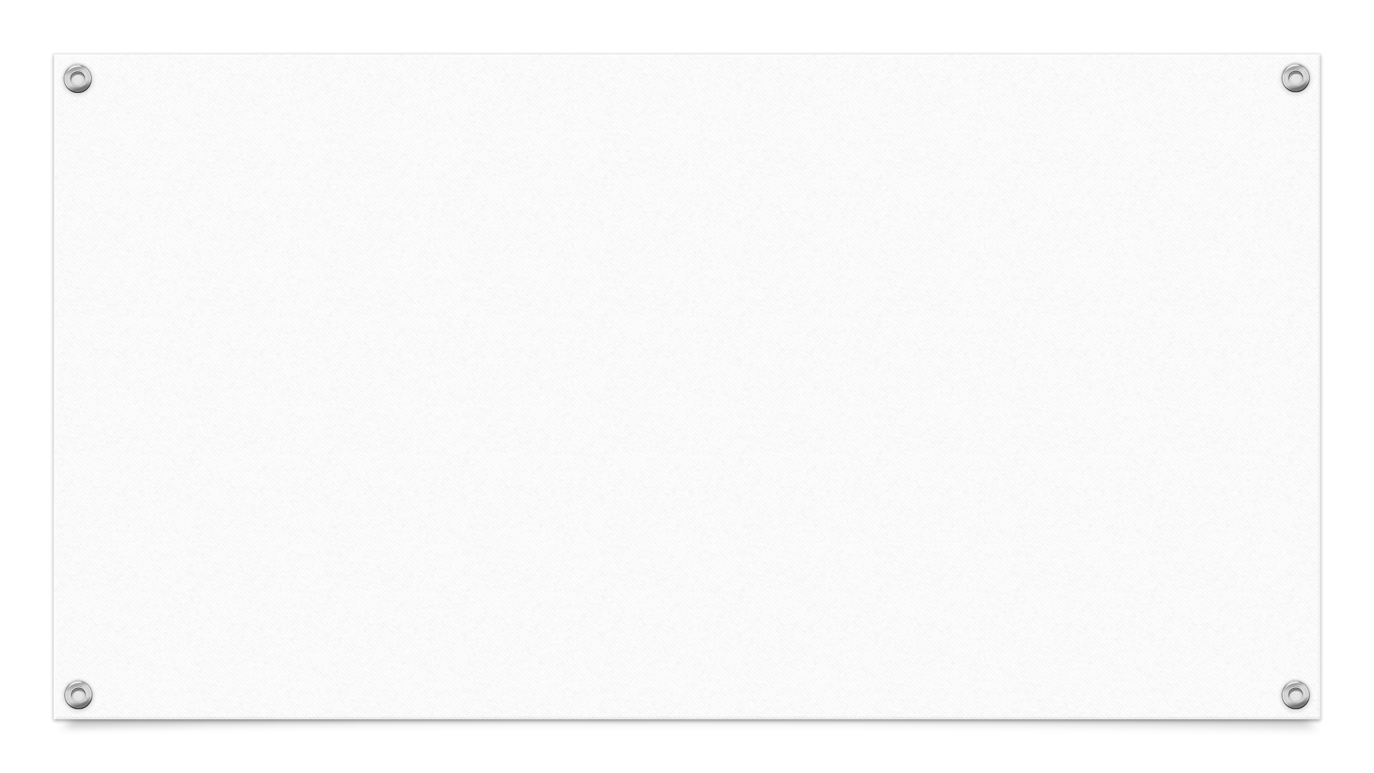
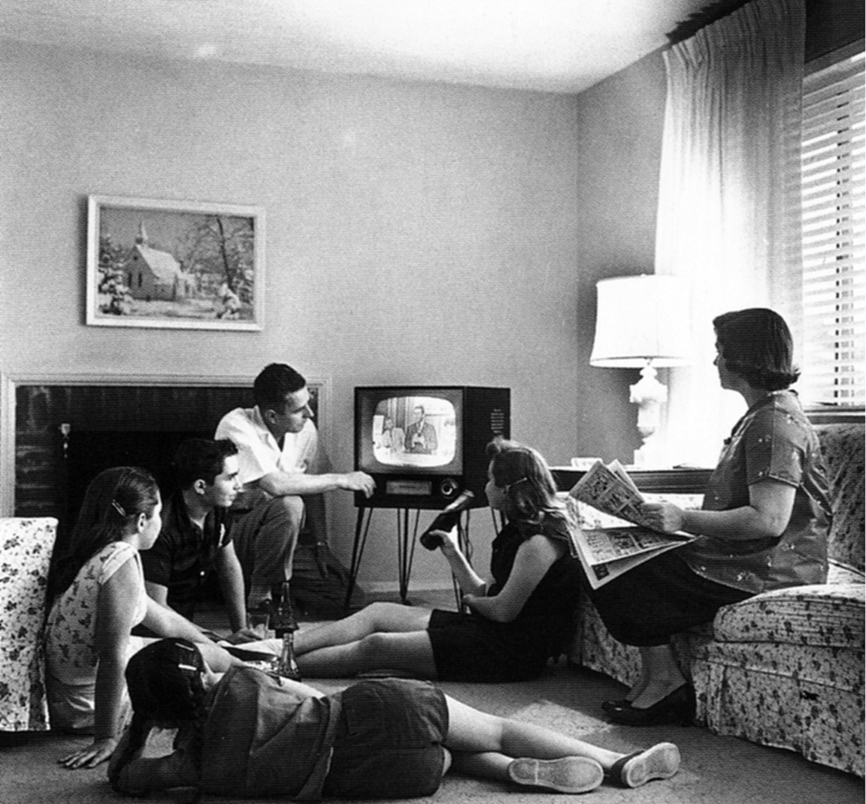
History of Aspect Ratios
At height of film’s popularity in 1930s, an estimated 95 million people attended the theater.
Families went 3 – 4 times a week to movies.
When Television was introduced it incorporated the same 1.33:1 aspect ratio.
In other words, the same exact experience – at home. For free.
Notes:
At the height of film popularity in the 1930s, an estimated 95 million people attended the theater.
Families would frequent the movies three or four times a Week, and kids would go every Saturday morning.
That all changed when television was introduced, which adopted the same 1.33:1 aspect ratio in the film industry.
By mid-1950s, the number of people attending decreased to 45 million. Movie attendance dropped further 220 million in the late 1960s, as television penetrated over 90% of homes. By 1970, Hollywood needed to provide audiences with an entertainment experience they could not get at home. What they gave them was wider screen movies, which translated into bigger left-to-right Dimension than the square shape of a television screen. A wider image feels more of or peripheral vision and, as a result, Is more intense and realistic because the effect imitates the way we actually see the world. Studios began to compose their films in various widescreen ratios including Cinerama, cinescope , and Panavision.

Slide 26
History of Aspect Ratios
By 1950s number of movie goers had decreased to 45 million.
By 1960s, 90% of homes had TVs.
By 1970s Hollywood needed to create an experience their audience could not get at home. Something to entice them into going to the theater.
Notes:
By mid-1950s, the number of people attending decreased to 45 million. Movie attendance dropped further 220 million in the late 1960s, as television penetrated over 90% of homes. By 1970, Hollywood needed to provide audiences with an entertainment experience they could not get at home.

Slide 27
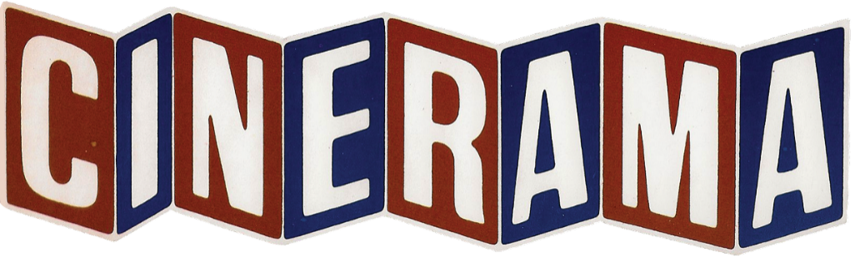
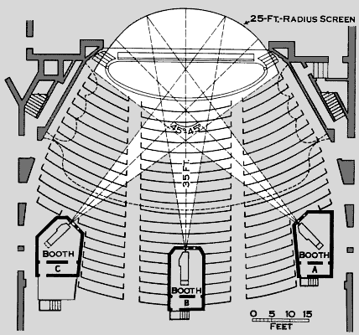
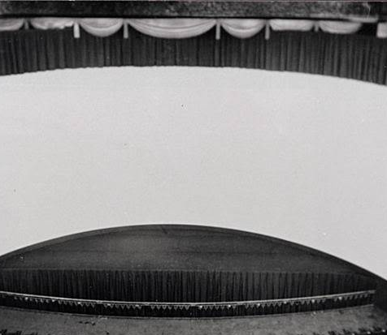
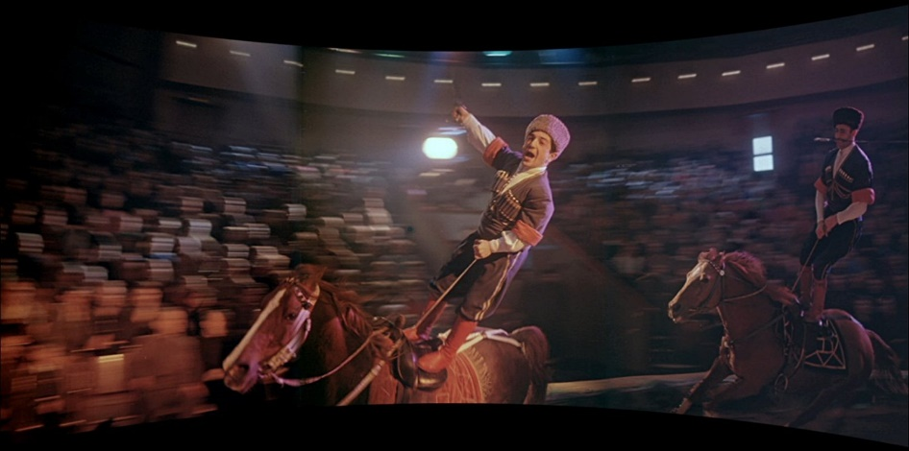
This format, introduced in 1952 had an aspect ratio of 2.6:1.
Used 3 cameras, and 3 projectors transmitted onto curved screen.
Notes:
The movie industry was in a quandary after television adopted the same aspect ratio.
One of the ways the film industry fought back was with the introduction of Cinerama, with an aspect ratio of 2.60:1.
The widescreen technique was introduced in New York in the 1952 show entitled this is Cinerama.
The Cinerama experience was it 3 camera, 3 projector setup that transmitted the film image onto a curved screen.

Slide 28
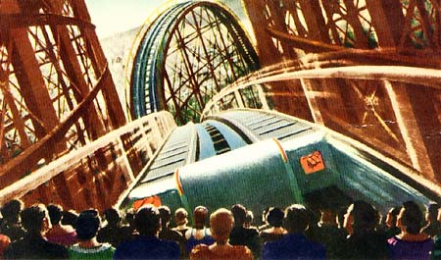
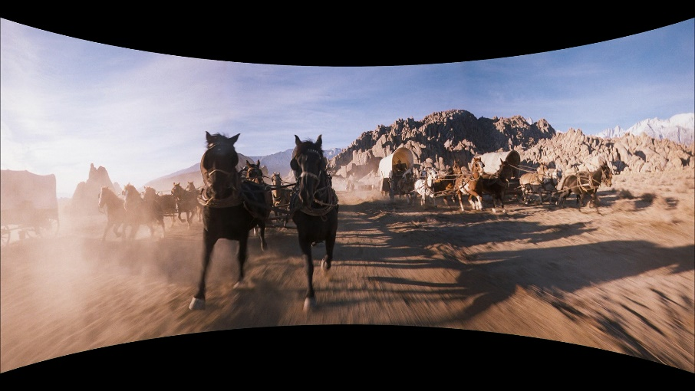
First images were from a roller coaster ride, “Atom Smasher” in 1952.
Other movies included “How the West was Won”, “South Seas Adventure”, and “Seven Wonders of the World”
Cinerama’s high cost led to it being abandoned.
Notes:
The first Cinerama images were a roller coaster ride. The viewers felt as if they were in the first car as It sped up, down, and around the tracks.
There were seven movies released under the Cinerama moniker, including How the West Was Won, South Seas adventure, and seven wonders of the world.
Cinerama ultimately was abandoned because of high cost of outfitting theaters with multiple cameras and projectors.

Slide 29
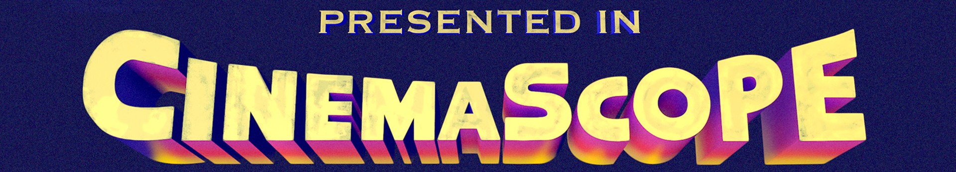
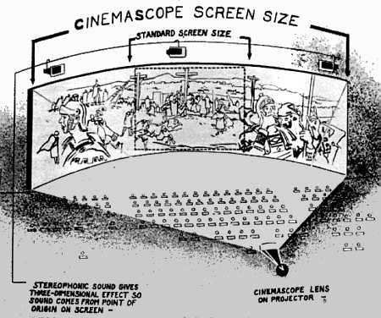
20th Century Fox introduced cinemascope one year after Cinerama.
Process required outfitting cameras with an anamorphic lens, which captures image and then compresses it.
Another anamorphic lens is used to uncompress the image.
Notes:
20th Century Fox introduce cinemascope one year after Cinerama made it to entrance at the widescreen experience. The cinemascope process required outfitting cameras with an anamorphic lens, which photographs the film image and then compresses it. When the image is ready to be screened, another anamorphic lens is used to uncompress the footage.

Slide 30
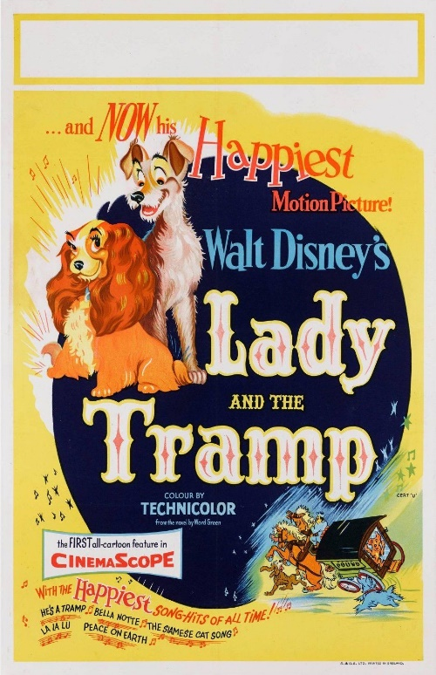
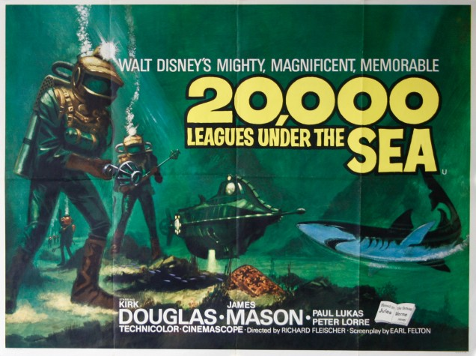
Began as 2.66:1 aspect ratio, when introduced, but was reduced to 2.55:1
Films produced in Cinescope include Disney's 20000 Leagues Under the Sea and Lady and the Tramp.
Process lasted until late 1960s.
Notes:
When first introduced, the aspect ratio for cinescope was 2.66:1, But ultimately was reduced to 2.55:1.
Films produced in Cinescope include Disney's 20000 Leagues Under the Sea, Lady and the Tramp, In Like Flint, and rope. This process lasted until the late 1960s .

Slide 31
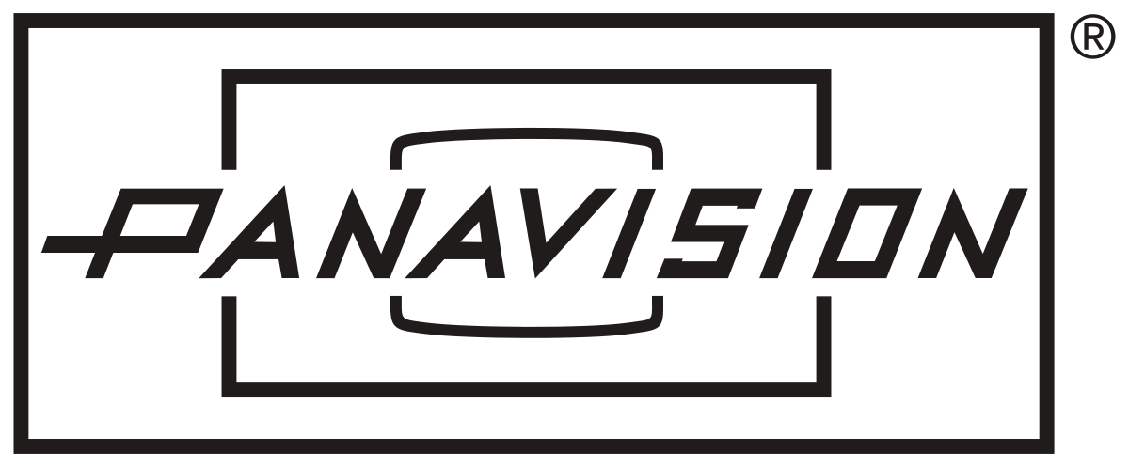
Following Cinemascope, Panavision created their anamorphic lenses in the late 1950s.
Reduced some of the issues Cinemascope had with compression, which made it a new standard of choice within the industry.
Aspect ratios for Panavision are 2.35:1 and 1.85:1, which are the current film standards.
Notes:
Panavision followed on the heels of cinemascope by creating anamorphic lenses in the late 1950s.
Panavision reduced some of the issues that cinemascope was having with compression, which ultimately lead to it becoming the standard Choice within the industry The aspect ratios for Panavision are 2.35:1 and 1.85:1, which are the current film standards.

Slide 32
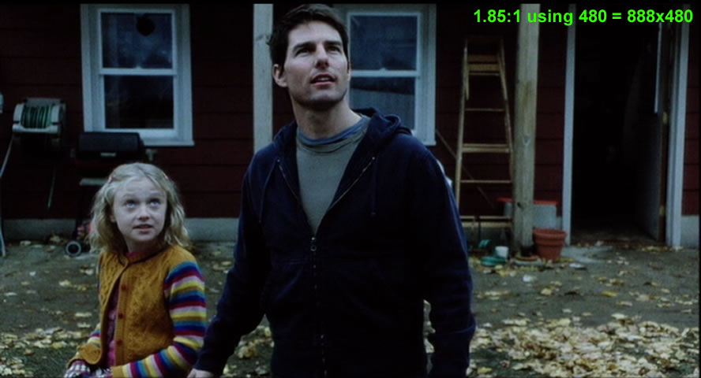
Common Aspect Ratio Formats
Most films today are shot in either 1.85 :1 or 2:35:1 aspect ratio.
1.85:1 is the most common aspect ratio.
Films shot in 1.85:1 ratio include comedy, drama and many animated films.
Notes:
Most films today are shot in either 1.85 :1 or 2:35:1 aspect ratio. The most common aspect ratio for Motion Pictures is 1.85:1, or standardized, non anamorphic films. Films produced in the 1.85:1 aspect ratio are personal films that include comedy, drama, and many animated films .

Slide 33
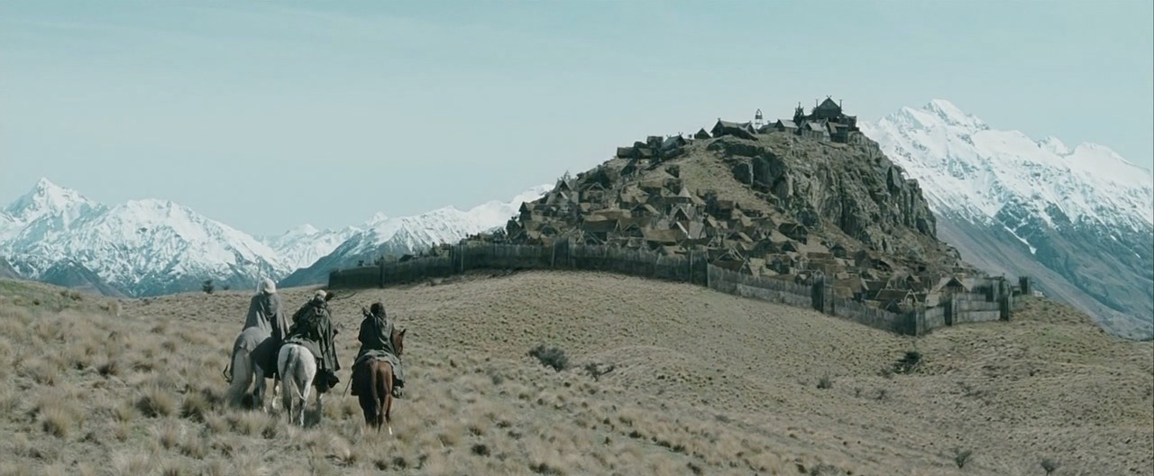
Common Aspect Ratio Formats
2:35:1 aspect ratio is usually used for films that are often described as “epic” or monumental.
Such films include “Gladiator”, “Lord of the Rings”, and Braveheart.
2:35:1 aspect ratio
Notes:
If someone were to describe a film as “epic" or monumental, chances are the film was shot using a 2.35:1 aspect ratio, which included Panavision and other anamorphic films. Some films shot using the 2.35:1 aspect ratio include Gladiator, the Lord of the Rings, and Braveheart .

Slide 34
Common Aspect Ratio Formats
A standard television screen has a 1.33 to 1 aspect ratio
The 1.78:1 or 16:9 aspect ratio was introduced to televisions due to a higher demand.
Since the 16:9 Aspect ratio is closer to the theatrical screen ratio of 1.85 to 1, when cropped for widescreen television, the theatrical aspect ratio of 1.85 to 1 does not lose noticeable picture information.
Notes:
A standard television screen has a 1.33 to 1 aspect ratio , but many televisions being manufactured today have a wider aspect ratio of 1.78 to 1 (commonly referred to as 16:9 ratio).
This new standard was introduced into the broadcast Market because of consumer preferences for a wider screen . A 16 to 9 screen contains more of the images content and enhances the movie experience.
Since the 16:9 Aspect ratio is closer to the theatrical screen ratio of 1.85 to 1, when cropped for widescreen television, the theatrical aspect ratio of 1.85 to 1 does not lose noticeable picture information.

Slide 35
Common Aspect Ratio Formats
The difference between the width and the height of the movie screen is much greater than the difference between the width and the height of a standard television screen.
For example, if you were to show Gladiator on a conventional television screen without altering the image, you would lose about 20% of the image on each end.
Fortunately there are techniques that can adjust the proportional difference between motion picture images and television screens.
Notes:
The difference between the width and the height of the movie screen is much greater than the difference between the width and the height of a standard television screen. For example, if you were to show Gladiator on a conventional television screen without altering the image, you would lose about 20% of the image on each end. Fortunately there are techniques that can adjust the proportional difference between motion picture images and television screens.

Slide 36
Pan & Scan
The introduction on video once again presented a challenge to the film industry, in which film had to be cropped from the original size to fit the 1.33:1 screen shape of the television.
20th Century Fox developed the Pan & Scan process to resize widescreen movies so that they fit a 1.33:1 aspect ratio.
Notes:
The industry was once again in predicament when their movies sold to television and home video, and had to be cropped from their original size to fit the 1.33:1 screen shape of the television.
In the early 1960s, 20th Century Fox developed the pan-and-scan process that resizes widescreen movies to fit a 1.33 to one aspect ratio.
The pan and scan process locates the center of interest of an image and fits it into the space available for standard television.

Slide 37
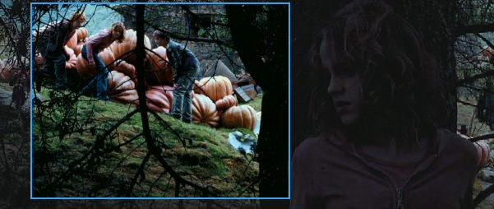
Pan & Scan
Image is “cropped”, “resized” or zoomed in to capture main focus of film, often sacrificing some screen space.
Using pan-and-scan, a video technician will adjust the shot by either cutting back and forth between a conversation to follow the action, or by cropping the image according to the center of Interest.
Notes:
For example, if you have two characters at either end of a shot within a widescreen version, one or both characters will be lost when it is displayed in a standard 4:3 frame.
Using pan-and-scan, a video technician will reset it the shot by either cutting back and forth between a conversation to follow the action, or by cropping the image according to the center of Interest.

Slide 38
Pan & Scan
A drawback to pan-and-scan is that audiences only see a portion of the image on their television sets, which alters the way the director intended audiences to view the film.
Notes:
A drawback to pan-and-scan is that audiences only see a portion of the image on there television sets, which Alters the way the director intended audiences to view the film. For instance, a 1.85 to one aspect ratio will lose about 25% of the film image, Whereas a 2.35 to one aspect ratio loses almost 45 to 50%.

Slide 39
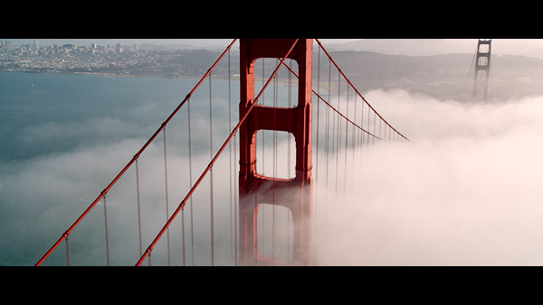
Letterboxing
Pan & Scan was not a viable option for some directors in getting their films onto television.
Many opted instead for letterboxing in order to maintain original movie as seen in theater.
Notes:
For most directors, pan-and-scan was not viable alternative to showcasing their films on television.
Many banded together to ensure their compositions would not be manipulated under pan-and-scan.
Instead, directors opted for letterboxing which maintains a film's original aspect ratio, reserving the image as it was originally seen in a movie theater.

Slide 40
Letterboxing
Letterboxed images, do not fill the entire screen.
Picture is centered along the horizontal plane and shrunk to fit the shape of a television screen.
Notes:
Letterboxed images, however, do not fill the entire screen.
Rather, the picture is centered along the horizontal plane and shrunk to fit the shape of a television screen.
This results in empty space above and below the image.

Slide 41
Calculating Aspect Ratios for Storyboards
When working on a Storyboard, one of the first things to define is the aspect ratio.
First decide on height of frame. (For example 4”)
Next multiply by the aspect ratio. (For example 4 x 1.84 = 7.4”)
Notes:
When working on a project, you will need to calculate storyboard frames in proportion to the aspect ratio for the film.
Let's say for example, the aspect ratio for a film is 1.85 to 1.
First, you must decide at what height you want to render your storyboards.
Determining frame height is based on either the preference of the director, or how many frames you work best on a page. Once the frame height is chosen, calculate its width. If, in case, you have decided on a frame height of 4 inch, you would multiply 1.85 by 4 to obtain a film frame width of 7.4 inches.

Slide 42
Calculating Aspect Ratios for Storyboards
You may also calculate the aspect ratio for a film or animation if you already know the height and width of the screen.
Divide the screens with by its height to calculate the aspect ratio.
( For example, a screen width of 4 is divided by a screen height of 3 is equal to an aspect ratio of 1.33:1. )
Notes:
You may also calculate the aspect ratio for a film or animation if you already know the height and width of the screen.
Divide the screens with by its height to calculate the aspect ratio.
For example, a screen width of 4 is divided by a screen height of 3 is equal to an aspect ratio of 1.33 to 1 .

Slide 43
In Summary
Modern storyboards got started from animation such as Disney Studios.
Early filmmakers soon adopted the practice for their films.
Notes:
The modern storyboard arose out of Disney Studios, but early filmmakers such a Sergi Eisenstein, and Cecil B Demille were creating detailed sketches to help determine the staging of scenes and Camera placement. The real need for the storyboard came from the animation industry.

Slide 44
In Summary
In early animation, there was no story department. The studios relied on animators to come up with jokes and visual gags.
Disney formed their first story department in the 1930s.
Directors such as Alfred Hitchcock and Orson Welles adopted storyboards soon after, to plan out complex shots.
Notes:
In animations infancy, there were no story departments.
Rather, the Studio's relied on their animators to generate stories based on gags. This changed when Disney formed the first story Department in the 1930s, which was led by Ted Sears. Gagmen and artists would work together, sketching out story ideas for upcoming cartoons. The first animation to use the modern storyboard was the short The Three Little Pigs. Live-action directors who adapted storyboards to their projects included Alfred Hitchcock and Orson Welles.

Slide 45
In Summary
In the early years of film, The aspect ratio was 1.33:1 which is a mostly square-like shape.
Competition from television drove movie industry to develop widescreen formats that offered a bigger picture, using more of the viewer's peripheral vision.
Cinerama and Cinescope were two popular widescreen formats in the 1950s. These gave way to Panavision, and the standard aspect ratios of 1.85:1 and 2.35:1.
Notes:
In the early years of film, The aspect ratio was 1.33:1 which is a square shape. As film matured, and received competition from television, the aspect ratio was adjusted to reflect wider screens. Two popular widescreen formats in the 1950s were Cinerama and Cinescope. These two formats eventually gave way to Panavision, and standard aspect ratios of 1.85 to 1 and 2.35 to 1.

Slide 46
In Summary
Widescreen formats had to be formatted for TV screens when films began to be shown there.
The industry came up with the technique of Pan & Scan, which resizes the picture by finding the center of interest and cutting out around it.
The letterbox technique offered an alternative that adapted the size of the original image to fit the screen without losing any part of the image.
Notes:
The widescreen format had some trouble when films began to be shown on television.
The difference between the width and height in an average movie image is much greater than the difference between the width and height of a standard television screen. The industry came up with a technique of pan-and-scan, which resizes the image by finding the center of interest and cropping. The more favorable letterbox technique shrinks the image to fit the screen rather than losing any parts of the image.

Slide 47
In Summary
Before determining anything else in the storyboard, a storyboard artist must establish the shape of the panel.
Many choose the aspect ratio to be used in the film.
This refers to the relation between the width and height.
Notes:
Before determining compositional elements of the storyboard frame, an artist must establish the shape of storyboard panel. Many artists work within the aspect ratio used to photograph a film. The aspect ratio for a film or animation refers to the height and width of a screen.

