Slide 1
Drawing in Perspective
Notes:
Sdg sdf adsf awer q4j

Slide 2
Intro to Perspective
Perspective is a thing we take for granted, in everything we see, that is part of the way we see the world.
Perspective conveys information to us about depth and distance
Perspective changes the appearance of things based on where you are looking from.
The translation of the real 3d world onto 2d media such as a screen or a drawing, reduces depth to an illusion, or a simple “interpretation”.
Notes:
We see the world in three dimensions, but when that world is recorded on to film or video, depth becomes illusion. The concept of perspective is based on the way the human eye sees the world.
Our eyes are constantly in motion, scanning objects and the environment.
We View the world from different positions that alter the way objects appear.
If we look out the window from the 6th floor of an apartment complex, for instance, the environment looks much different than if we were on the ground looking up.

Slide 3
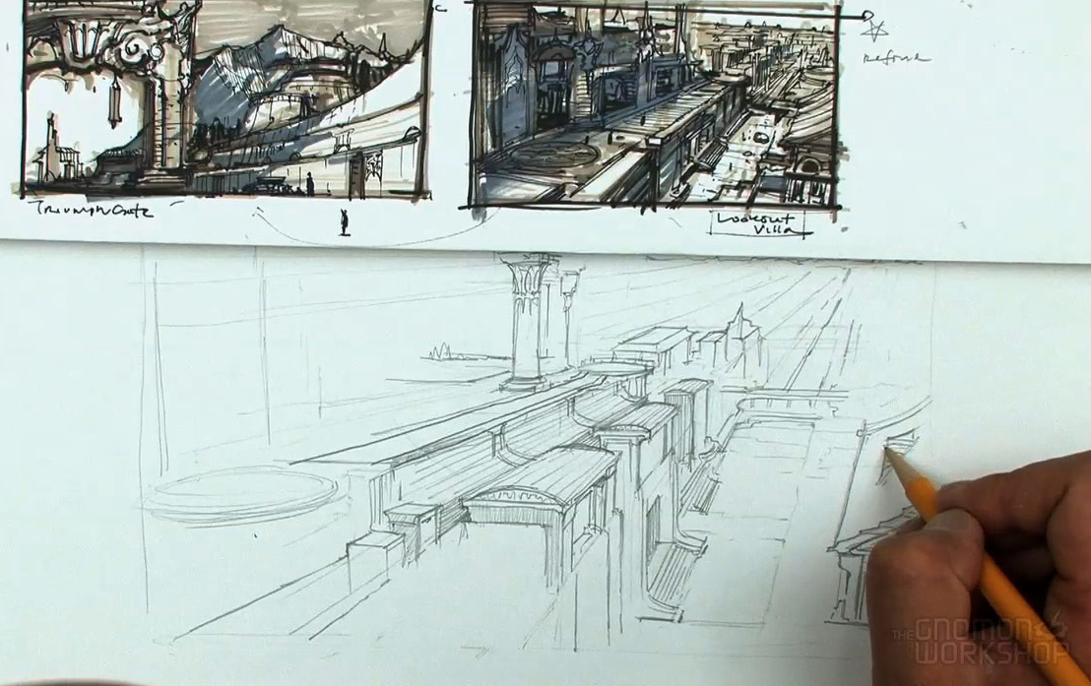
Intro to Perspective
Artists, especially storyboard artists need to understand laws of visual perspective to convey dimension and distance.
Perspective allows artist to consider different viewpoints of a shot.
Notes:
So what happens when you want to convey a feeling of depth, but the material you are working with is essentially flat, and two dimensional?
As a storyboard artist, you need to have a firm grasp on the laws of visual perspective to make objects appear to have Dimension and distance.
Understanding perspective allows you to consider different viewpoints of a shot.

Slide 4
Intro to Perspective
Linear perspective is most regarded system of representation
Distance between camera and subject as well as the choice of lens is critical to Linear Perspective
Perspective changes any time a camera is rearranged. Essentially, when a camera is moved, you are re-framing a shot.
Other important cues include overlapping texture, spacing, size, and foreshortening.
Notes:
The most regarded system of representation is linear perspective.
Critical to linear perspective is lens choice, and the distance between the camera and the subject.
Perspective will change anytime the lens or camera position is rearranged.
Other important cues include overlapping texture, spacing, size, and foreshortening.
A basic understanding of perspective is vital to creating dynamic and understandable storyboards.

Slide 5
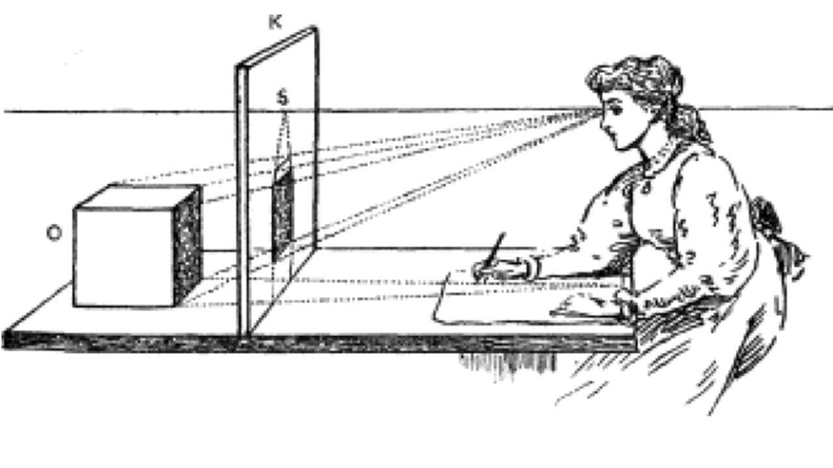
Picture Plane
Similar to window (canvas or monitor) in which we see the subject projected in 2d.
To view an object, viewer must direct gaze in the direction of the object (line of sight or eye line)
Notes:
The picture plane is similar to an actual window.
As we look out of a window, we can draw exactly what we see on the surface.
In order to view an object, you must direct the gaze in the direction of the object in question, which is referred to as the line of sight or eye line.
If your eye line shifts, the window needs to shift as well, otherwise the scene outside will move out of alignment.
That is Because the imaginary picture plane follows or every move. It moves wherever or eyes move.
For instance, if we shift or line of sight up or down, the picture plane also goes up or down.
If we look left or right, so will the picture plane.
As you plan your storyboards, think of your drawing paper as the picture plane through which you view locations in objects from different Vantage points.

Slide 6

Horizon Line and Vanishing Point
Where the “sky” and ground-plane disappear.
Imaginary line that is always at eye level.
Object relationship with a horizon line shows whether it is a low-angle, high-angle, or normal view.
Notes:
Standing at the foot of this shoreline shown here, looking out toward the ocean, it appears that the ocean meets the sky.
This is called The Horizon, which is the same as the horizon line, an imaginary line that is always at or eye level.
An object relationship with a horizon line shows whether it is a low-angle, high-angle, or normal view.

Slide 7

Horizon Line and Vanishing Point
Vanishing point is a point on the horizon line where the parallel lines of an object proceed to the Horizon.
Objects that are different angles have their own vanishing point.
Notes:
The vanishing point is a point on the horizon line where the parallel lines of an object proceed to the Horizon.
Objects that are parallel to one another have the same vanishing point.
Objects that are different angles have their own vanishing point.
The simplest method for understanding the relationship between the Horizon and the vanishing point is to imagine yourself standing between two train tracks.
When you look toward the Horizon, it appears that the parallel tracks actually converge at a point in the distance.

Slide 8
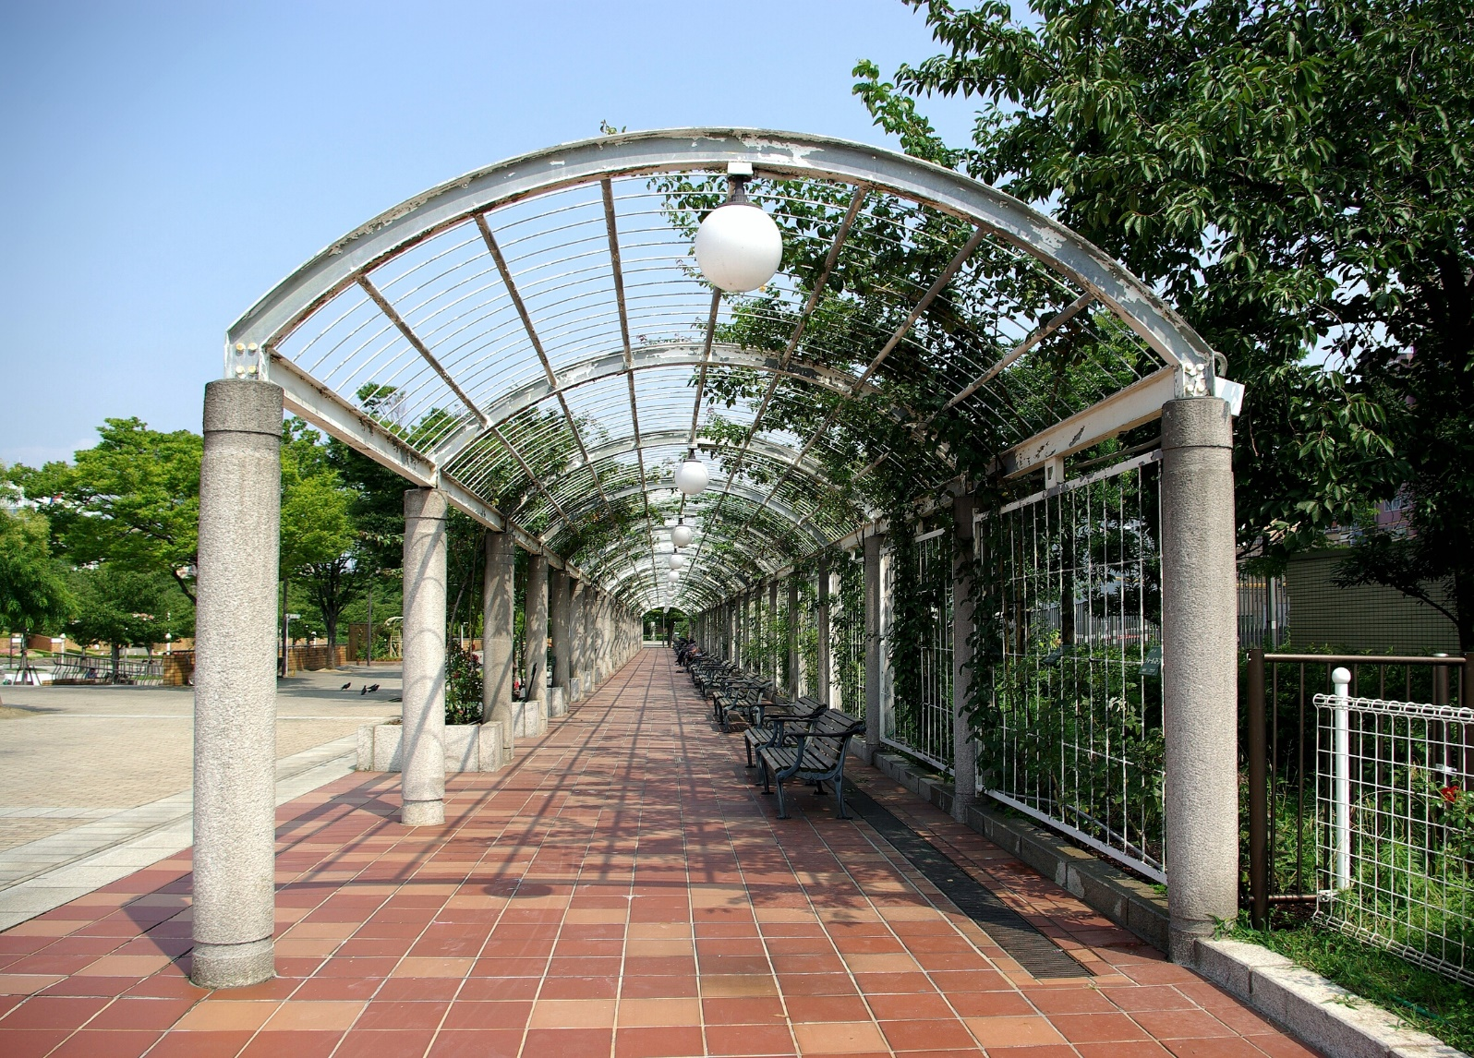
One Point Perspective
Most common system used to render three-dimensional objects and environments on two-dimensional surfaces.
In one point perspective, there is only one vanishing point.
There are three types of lines used in one point perspective: vertical lines, horizontal lines, and orthogonal lines.
Notes:
One-point perspective is the most common system used to render three-dimensional objects and environments on two-dimensional surfaces.
In one point perspective, there is only one vanishing point.
In the picture in this slide, we are looking straight down the middle of this passage way. All the lines lead us to that vanishing point.
There are generally three types of lines used in one point perspective: vertical lines, horizontal lines, and orthogonal lines.
All the curves you see here can also be projected onto this system. Even the crossed wire on the top of the structure gives us a good idea of how this all fits into this system.

Slide 9
One Point Perspective
Vertical Lines are perpendicular to the horizon line and the bottom of your panel.
Horizontal lines go from left to right and are parallel to the bottom edge of the panel.
Orthogonal lines are parallel lines that recede to the vanishing point.
Notes:
Vertical lines are perpendicular to the horizon line and the bottom of your panel.
Horizontal lines go from left to right and are parallel to the bottom edge of the panel.
Orthogonal lines are parallel lines that recede to the vanishing point.
In this example here, the orthogonal lines, would be the beams connecting the pillars that go all the way back to the vanishing point.
Objects that contain parallel lines may be drawn in one point perspective, such as room interiors, tables and chairs.

Slide 10
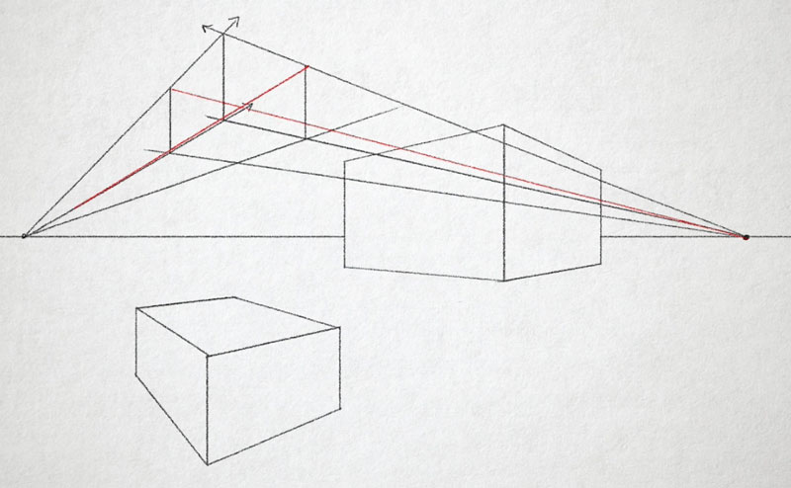
Two Point Perspective
Two point perspective helps draw objects from different angles.
Opens up the image so the viewer does not have to look at a wall from straight on or down a passageway to a single point.
Notes:
Applying two point perspective to your storyboard will help you to draw environments and objects from different angles.
Shots drawn in 2 point perspective open up the image so the viewer does not have to look at a wall from straight on or down a passageway to a single point.

Slide 11
Two Point Perspective
Three sets of lines in two-point perspective:
Lines that converge on Left of Vanishing Point.
Lines that converge on Right of Vanishing Point.
Vertical Lines
Notes:
There are three sets of lines in 2 point perspective drawings:
a set of lines that Converge on the left of a vanishing point,
a set of lines that converge on the right at a vanishing point,
and vertical lines.

Slide 12
Two Point Perspective
Lines form a square corner.
If the locations of the vanishing point change, the angle of the object may change, which causes change in the object’s appearance.
Notes:
These lines form a square Corner.
If the locations of the vanishing points change, the angle of the object may change, which causes a change in the object's appearance.

Slide 13
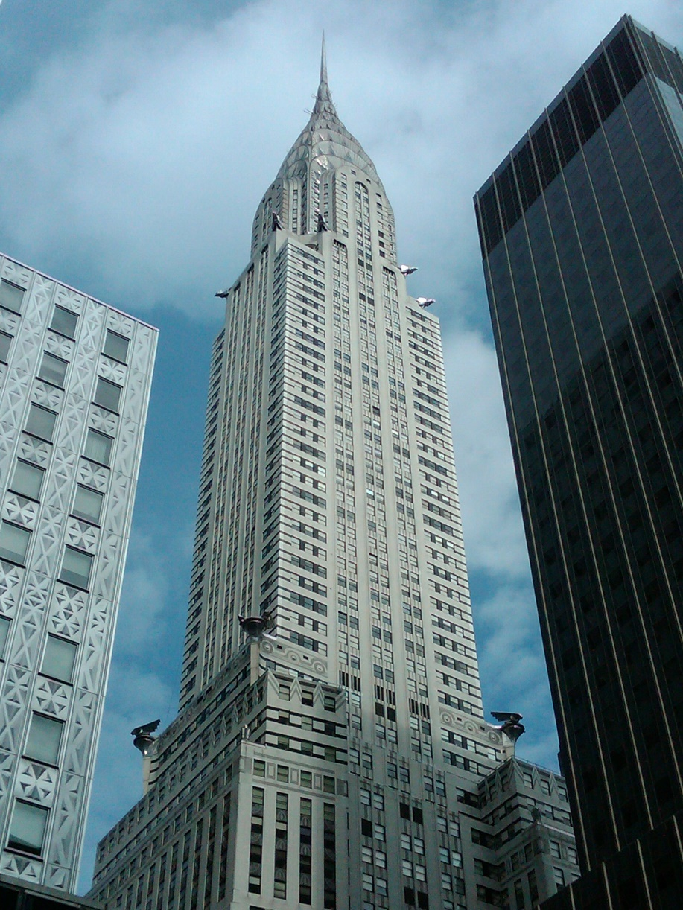
Three Point perspective
Great for dramatic perspective
Typically involve viewers looking up or down at a scene.
All lines recede to one of the three vanishing points.
Usually, two vanishing point are located on horizon line, while another is above or below.
Notes:
Three-point perspective drawings typically involve viewers looking up or down at a scene.
Many times, when drawing on paper, it is quite natural to relate to, as many artists tend to draw their own lines (regardless of paper orientation).
All lines in 3 point perspective drawing to recede to one of three vanishing points.

Slide 14
Three Point perspective
Great for dramatic perspective
Typically involve viewers looking up or down at a scene.
All lines recede to one of the three vanishing points.
Usually, two vanishing point are located on horizon line, while another is above or below.
Notes:
Two of these vanishing point rest somewhere on the horizon line, while the third is set either well below, or above, the eye line.
The vanishing point that is above the horizon line gives the impression of a low-angle view.
When observing a building from this low angle, it is necessary to tilt the picture plane upward.
When the vanishing point is below the horizon line, it creates the illusion of a bird's eye view.
You words tend to feel farther away from what they are looking at if it's a bird's eye view.

Slide 15
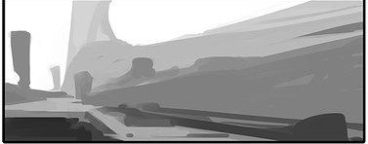
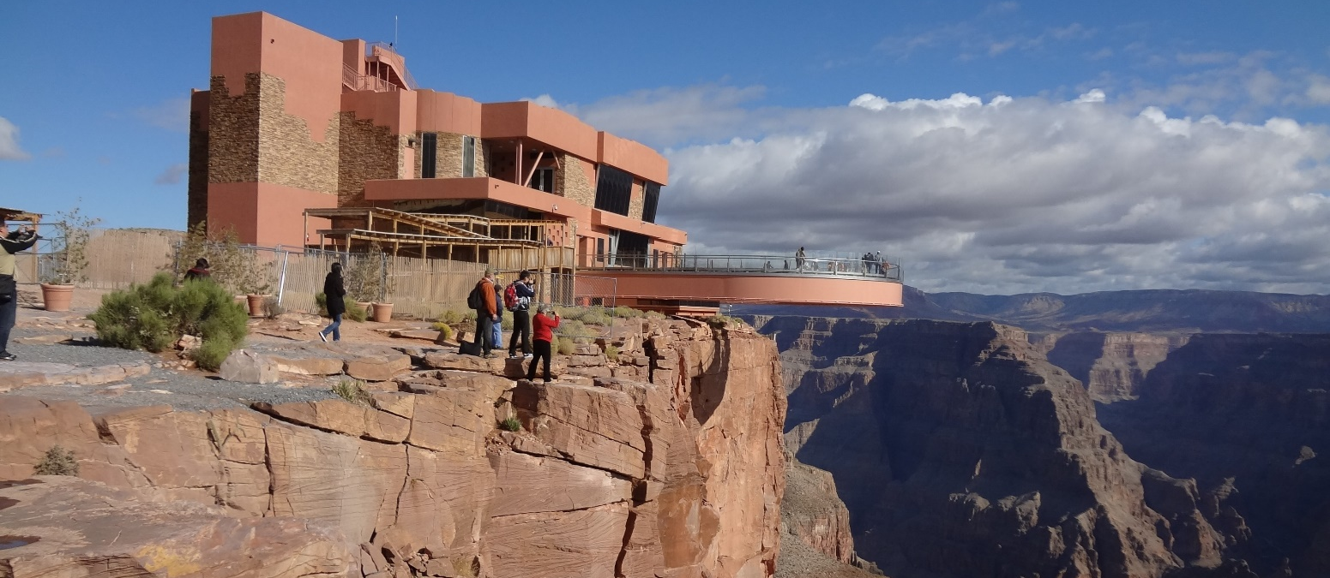
Atmospheric Perspective
Objects close to viewer have more contrast.
Objects further away recede into the background.
Gives the impression of depth
Notes:
Observing objects in the distance is often difficult because of particles in the air such as dust and moisture.
Objects that are further away tend to be a little hazy urine sometimes cast of bluish tint to achieve this effect in storyboard panels, color saturation is decreased and background objects are blurred.
This gives the impression of depth when contrasted with objects in the foreground.

Slide 16
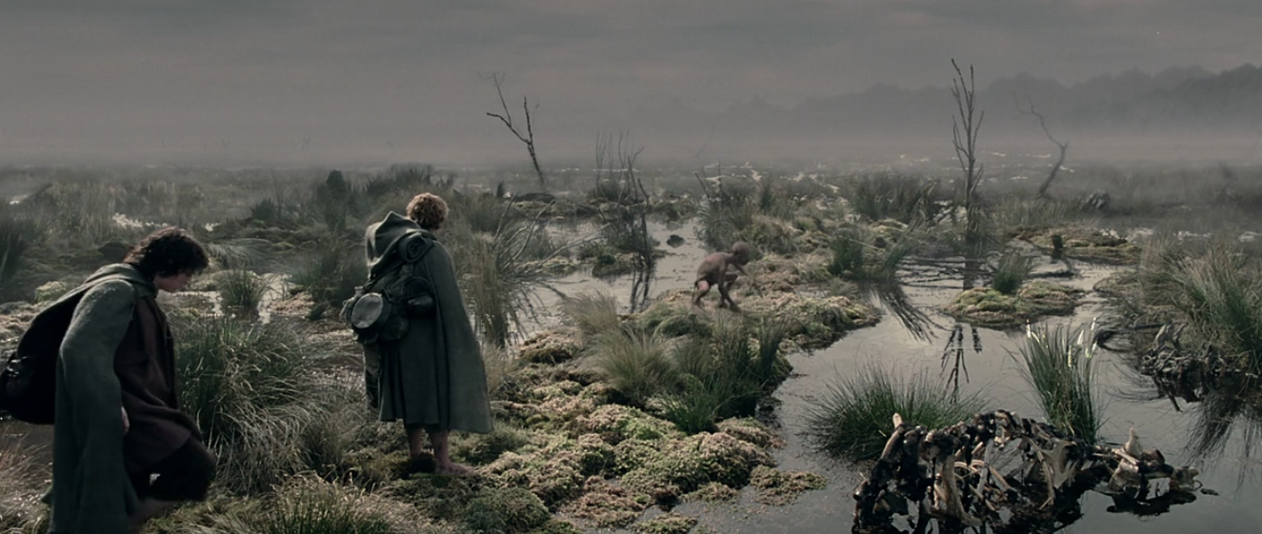
Atmospheric Perspective
Notes:
The Lord of the Rings: the Twin Towers is full of shots of atmospheric perspective as Frodo and Sam cross the dead marshes on their Journey.
According to the Director of Photography Andrew Lesney, anyone who walks through the dead marshes is prone to fall under influence of the trapped souls, which Frodo does briefly. He therefore depicted the marshes as a misty, unnatural environment, with sunlight weakened by the atmosphere.

Slide 17
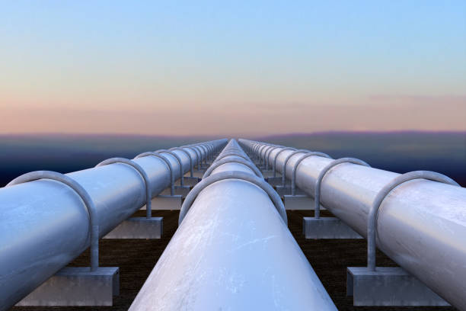
Foreshortening
The process of applying perspective to objects and figures.
Foreshortening an object makes one part appear closer to viewer than other parts.
Notes:
Foreshortening is the process of applying perspective to objects and figures.
When you foreshorten an object, you make one part appear closer to you than other parts.
Let's say you have a long Pipeline on its side.
As the pipe turns towards you, we see less of its side until ultimately the only part visible is the circle on the top of the pipe.
This is often done to create a sort of dramatic effect to the shot.

Slide 18
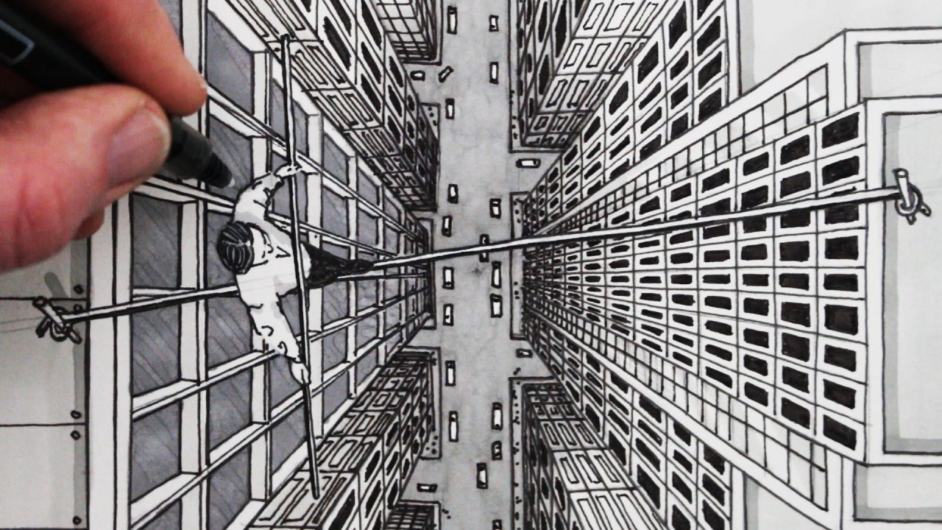
Foreshortening
This view shows less of the sides of the building than if you were to view it from the side.
The parts closer to the camera seem exaggerated.
Notes:
For example, if you are drawing a bird's eye view of a building, you will see less of its sides than if you drew a low angle shot.

Slide 19
Foreshortening
Foreshortening tricks the eye into giving the viewer at the illusion of depth
Notes:
Foreshortening tricks the eye into giving the viewer at the illusion of depth.
Simple objects such as books, rulers, ladders and so forth are relatively easy to draw as foreshortened.
However more complex shapes, such as the human figure and animals, are more difficult to reconstruct on paper.
When drawing objects, you must train your eye to see three dimensional objects in 2D.

Slide 20

Overlap
Overlapping objects creates the illusion of space.
When one object is placed over a second object, the first object appears closer than the second one.
This rule applies across any distance, and contributes to the illusion of depth.
Notes:
Overlapping objects creates the illusion of space.
When one object is placed over a second object, the first object appears closer than the second one.
This rule applies across any distance, and contributes to the illusion of depth.
For example, the sun appear smaller when it sets behind the mountains.
When blocking a shot, you should overlap characters and objects to create depth.

Slide 21
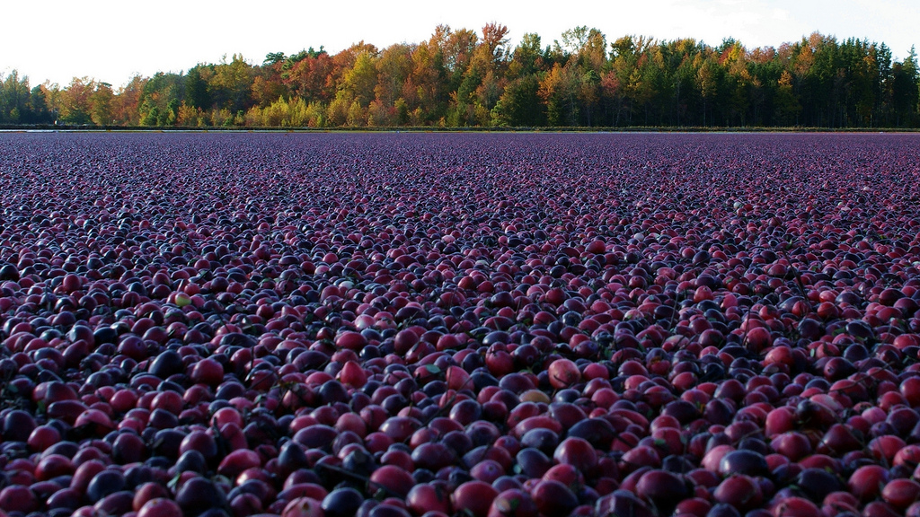
Texture Gradient
Most surfaces have some sort of texture on them.
The closer you are to the object, the more of this texture you can see.
From further away, texture gets finer and appears smoother.
Notes:
Most surfaces, such as walls, buildings, Fields, And Roads, have texture.
The closer the object is, the more detail we can see.
As the surface gets farther away from us, the texture gets finer and appears smoother.

Slide 22
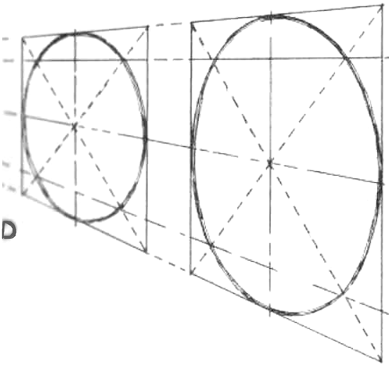

Circles in Perspective
Just like anything else, circles also follow the rules of perspective.
Circles or ellipses that are near the horizon line are seeing straight on and drawn as straight lines while ellipses farther from the horizon are drawn bigger.
Notes:
Automobiles, tables, plates, lamps, and many other objects are made up of circles. To create three-dimensional objects, rules of perspective must apply.
Circles or ellipses that are near the horizon line are seeing straight on and drawn as straight lines while ellipses farther from the horizon are drawn bigger.

Slide 23
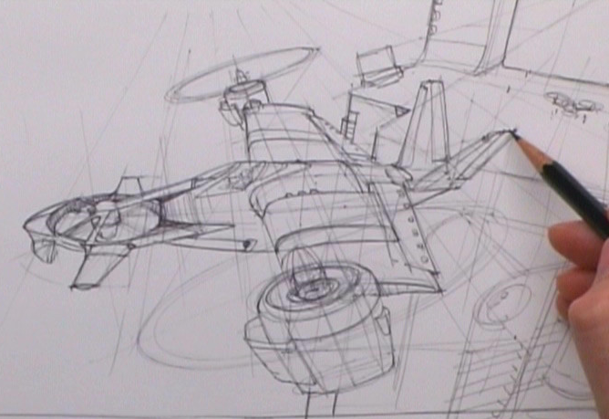
Circles in Perspective
The best method to draw a circle in perspective is to draw it inside a square, in perspective.
The sides of the circle should touch the sides of the square.
By using this system you can project any sort of curve or arc across different perspectives.
Notes:
The best method to draw a circle in perspective is to draw it inside a square, in perspective.
The circle is intersected with to access lines, which creates four quadrants.
The point where the two lines cross within the circle creates at.
Whether you are drawing a perfectly round circle or an elongated Circle, the relationship of the two lines stays the same.
The diagonal lines assist in finding the position of each Arc of the circle.

Slide 24
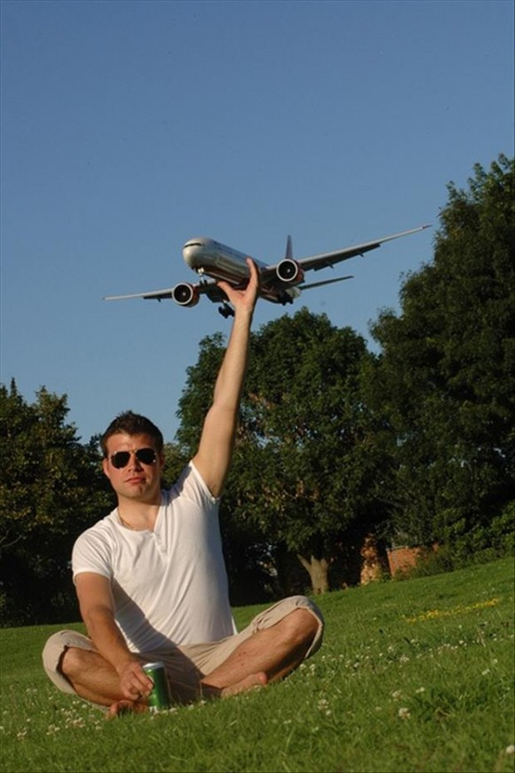
Size Perspective
Perspective basically establishes that objects closer to the viewer are bigger, and objects further away are smaller.
Scale helps the viewer determine the actual size or relative size of the object in the picture.
Notes:
When flying an airplane everything on the ground looks miniature.
The illusion of small houses, swimming pools, and cars speckle the ground. If we put our hand to the window, we can cover whole neighborhoods with our Palm.
Obviously we know that house is on the ground or much bigger than our hand but the further away objects are from where went Viewpoint, the smaller they appear.
Size relationship is made up of familiar objects.
When subjects of familiar size are included, they helped establish the scale of a picture or drawing.
Scale helps the viewer determine the actual size or relative size of the object in the picture.

Slide 25
Relative Motion
The camera captures the relative motion of objects, which contributes to the overall depth of a scene.
When we move, images located at different distances seem to move at different speeds.
Close objects seem to move quicker than objects that are farther away, such as distant mountain ranges.
Objects that are closer appear to move in the opposite direction to our own movement, whereas object farther away appear to move in the same direction.
Notes:
Relative motion is a considerable depth cue to consider for movies, television, and animation.
The camera captures the relative motion of objects, which contributes to the overall depth of a scene.
When we move, images located at different distances seem to move at different speeds.
Close objects seem to move quicker than objects that are farther away, such as distant mountain ranges.
Also, objects that are closer appear to move in the opposite direction to our own movement, whereas object farther away appear to move in the same direction.
For instance, if your focus is on a character in The foreground and the background is out of focus, this is considered shallow depth of field.
In such situations our eyes tend to naturally go to the object or individual that is in focus.

Slide 26
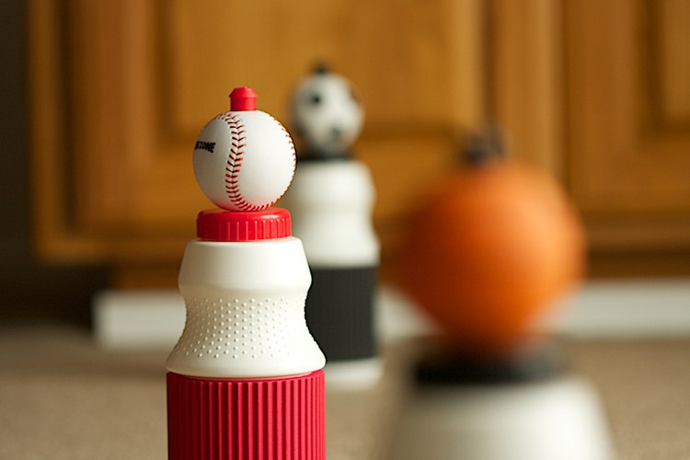
Depth of Field
Depth of field is created when the camera focuses on something.
Different camera lenses have different ways to deal with depth of field.
Notes:
Depth of field, which refers to how much of the frame is in Focus, both in front and behind an object, is another effect used to create death in your images.
If you were to view a long road that is a line telephone poles, for example, the polls in the distance look much smaller than those close to you.
If you focus your attention on the telephone poles that are close to you, the ones in the distance will appear out of focus.
This effect is often used in film and animations to direct the audience's attention to certain Details within the shot.
For instance, if your focus is on a character in The foreground and the background is out of focus, this is considered shallow depth of field. In such situations arise tend to naturally go to the object or individual that is in focus.

Slide 27
Depth of Field
If both the foreground and the background are in focus this is considered wide depth of field.
Deep focus refers to a strategy that keeps the foreground, middle-ground, and background in focus, given each plane equal importance.
Notes:
If both the foreground and the background are in focus this is considered wide depth of field.
Orson Welles and cinematographer Greg Toland popularized A technique called the deep-focus cinematography in the classic film Citizen Kane.
Deep focus refers to a strategy that keeps the foreground, middle-ground, and background in Focus, given each plane equal importance.
Depth is also created through lens type, and the amount that a lens is opened to let in light, also known as a preacher.
If the aperture for a lens is small, less light is let in, which results in Greater depth of field. A wider average her let's in more light, which results in a shallow depth of field.

Slide 28
Depth of Field
Depth is also created through lens type, and the amount that a lens is opened to let in light, also known as a preacher.
If the aperture for a lens is small, less light is let in, which results in greater depth of field.
A wider aperture lets in more light, which results in a shallow depth of field.
Notes:
If both the foreground and the background are in focus this is considered wide depth of field.
Orson Welles and cinematographer Greg Toland popularized A technique called the deep-focus cinematography in the classic film Citizen Kane.
Deep focus refers to a strategy that keeps the foreground, middle-ground, and background in Focus, given each plane equal importance.
Depth is also created through lens type, and the amount that a lens is opened to let in light, also known as a preacher.
If the aperture for a lens is small, less light is let in, which results in Greater depth of field. A wider aperture lets in more light, which results in a shallow depth of field.

Slide 29
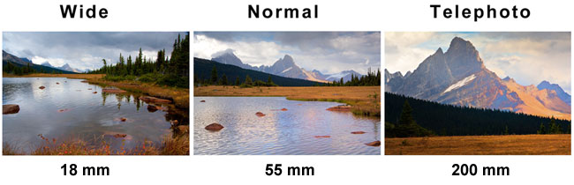
Lenses
Lenses have huge influence in determining depth of field.
Three main lenses are:
Notes:
Camera lenses play an indispensable role in determining depth of field within an image.
Three main lenses are the wide-angle, normal, and telephoto lens.
Each of these lenses tells a story quite differently.

Slide 30
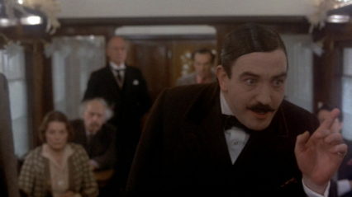
Lenses
Different lenses can have different effects, and can be used to tell a story in different perspective
Such as the flashbacks in Murder on the Orient Express (1974), which used wide angle lenses to make them feel more dramatic.
Notes:
In his book making movies, Sydney Lumet Uses an example from the film murder on the Orient Express to illustrate the power of the lens.
In the film, The Director uses various lenses to tell the story.
During the body of the picture, various scenes take place, which were we told at the end of the movie by Hercule Poirot, the genius detective.
While he described the incidents, the scenes shown earlier where were repeated flashbacks.
The first time the scenes were shot, the director used in normal lens.
When the same scenes were shown in flashback, the director use of very wide angle lens which made the scenes look much more dramatic.

Slide 31
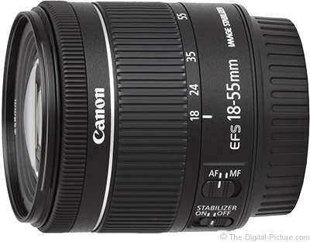
Normal Lenses
Most cameras have a normal lens which mimics the human eye’s perspective.
Viewing an object using a normal lens is similar to viewing an object without a camera.
Figures rendered with normal lens will appear to be normal sized and perspective relative to each other.
Notes:
Every camera usually comes with a normal lens which mirrors the perspective of the human eye.
For instance, viewing an object using a normal lens is similar to viewing an object without a camera.
Figures rendered with normal lens Will appear to be of a normal size and perspective relative to each other.

Slide 32

Wide Angle Lens
A wide-angle lens includes a much larger area than the normal lens.
Exaggerates the space between near and far shots.
Notes:
A wide-angle lens includes a much larger area than the normal lens, exaggerating the space between near and far shots.
This creates a feeling of vastness within an image. Wide-angle lenses have a short focal length, which exaggerated the distance in front of the camera.
Films that have used wide-angle lenses are those that reline panoramic shots such as Dances with Wolves and Message in a Bottle, which opens with a panoramic shot of a boat adrift in the ocean.
Wide-angle lenses are often used for establishing shots of buildings and Landscapes.
When using a wide-angle lens, object in the foreground and background will both be in Focus, enhancing the three-dimensional feeling of the frame.
Quality of the wide-angle lens is that perspective is distorted.
The Wider the lens, the more distorted the image.
When is subject is close to the camera, it exaggerate the size relationship.
For example a wide-angle shot of an individual kicking his foot for the camera will create an illusion of an exaggerated foot in comparison to an undersized body.

Slide 33
Wide Angle Lens
Often used for establishing shots.
Objects in foreground and background tend to both be in focus, enhancing the 3D feel of the frame.
The wider the lens, the more distorted the image.
Notes:
Wide-angle lenses are often used for establishing shots of buildings and Landscapes.
When using a wide-angle lens, object in the foreground and background will both be in Focus, enhancing the three-dimensional feeling of the frame.
Quality of the wide-angle lens is that perspective is distorted.
The Wider the lens, the more distorted the image.
When is subject is close to the camera, it exaggerate the size relationship.
For example a wide-angle shot of an individual kicking his foot for the camera will create an illusion of an exaggerated foot in comparison to an undersized body.

Slide 34
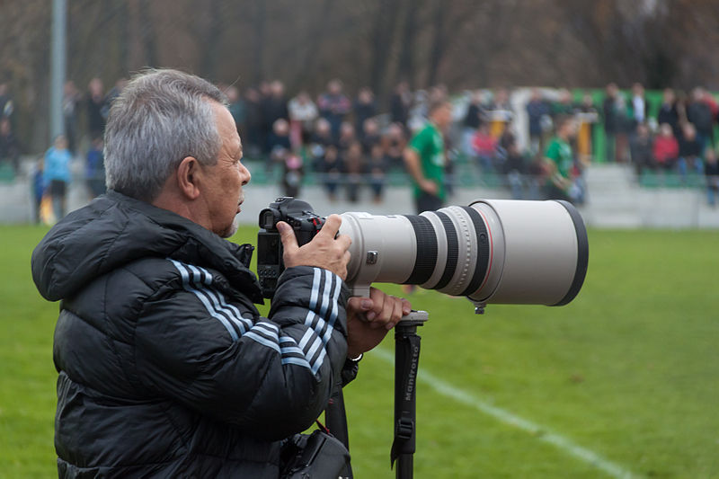
Telephoto Lens
Telephoto lenses have shallow depth of field
Compressing the foreground and background.
This creates the illusion of objects appearing closer together.
Notes:
Telephoto lens
Telephoto lenses have shallow depth of field, compressing the foreground and background.
This creates the illusion of objects appearing closer together.
Any unwanted distractions in an image are thrown out of focus with telephoto lens, making the background appear flat.

Slide 35
In Conclusion
Perspective
Atmospheric perspective
1, 2 and 3 point perspective
Lens choice
Depth of Field
Notes:
Impression of depth within a two-dimensional storyboard design is achieved through various techniques.
To understand perspective, imagine standing in front Of an open window.
Outside your window is to seeing what you were going to draw.
The horizon line runs across your view, and the parallel lines of the objects outside your window up here to meet at some point in the distance, also known as the vanishing point.

Slide 36
In Conclusion
Perspective
Atmospheric perspective
1, 2 and 3 point perspective
Lens choice
Depth of Field
Notes:
These objects are closer to the horizon line appear more distant, where is these objects closer to you appear larger.
Some depth cues include overlap which is when one object is placed in front of the other, and Atmospheric perspective, which is how Haze or fog affect the appearance of objects.
A bird's eye view of helicopter landing on the roof of a building is achieved by applying 3 point perspective, where is drawing one-point perspective allows the viewer to see an object only from straight on.

Slide 37
In Conclusion
Perspective
Atmospheric perspective
1, 2 and 3 point perspective
Lens choice
Depth of Field
Notes:
Lens Choice also creates depth within an image.
Shallow depth of field is when an object is in focus in the foreground, but the background is out of focus.
For wide depth of field both the foreground and background or in focus.

