Slide 1
Continuity
Notes:
_

Slide 2
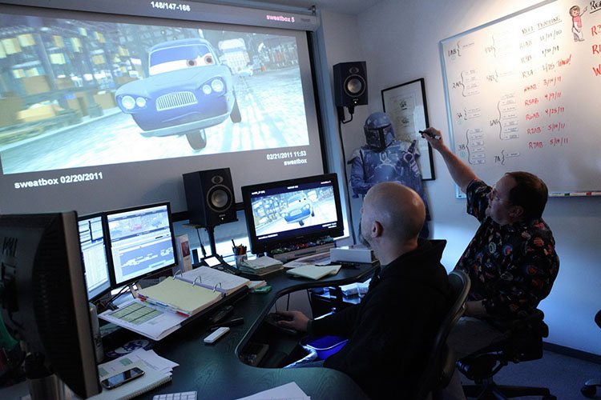
Continuity
Continuity Editing is an editing style used to create visual stories that flow continuously from beginning to end.
Notes:
As a storyboard artist, it is important to understand the editing process, and most importantly, continuity editing, which is an editing style used to create visual stories that flow continuously from beginning to end.

Slide 3
Continuity
Continuity is about splicing together shots of various frame sizes and camera angles.
If an editor is doing his/her job well, the cuts will seem invisible.
Audience will then perceive the story as a whole
If the editor has not achieved continuity, the illusion of seeing consecutive action will be interrupted.
Notes:
This may seem misleading since continuity is about splicing together shots of various frame sizes and camera angles.
There may be as many as a dozen cuts within one minute, however these edits are invisible if the editor does not do his job well.
If continuity is achieved, audiences will not notice the edits but rather will see the story as a continuous whole.
If the editor has not achieved continuity, however, the spectators illusion of seeing consecutive action will be interrupted.

Slide 4
Continuity
A good director or designer will consider continuity at the storyboard/planning phase.
Essential details are considered, including the pacing and transitions, to establish the visual flow of the project.
Notes:
A good director or designer will consider continuity at the storyboard phase.
Each frame that is sketched is evaluated and judged, as the story is composed shot-by-shot.
Essential details are considered, including the pacing and transitions, to establish the visual flow of the project.

Slide 5
Basic Principle of Continuity
To tell a story that develops through the interaction of its characters.
Continuity editing allows the director to create seamless sequences that flow from one shot to the next.
Notes:
The basic principle of continuity is to tell a story that develops through the interaction of its characters.
If you look at most films, you will notice that many are based on continuity editing, which allows the director to create seamless sequences that flow from one shot to the next.

Slide 6
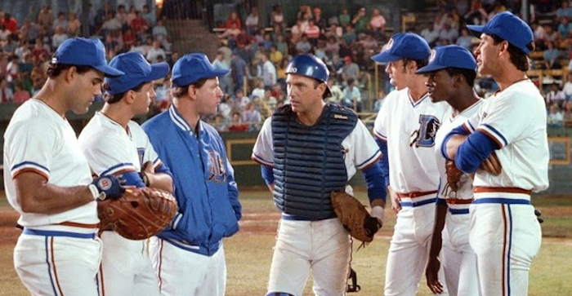
Basic Principle of Continuity
Time in film differs from that of reality.
If a sequence is too fast, the audience might not understand what is happening.
If it is too slow, they can become bored.
Notes:
By focusing in on the parts that are relevant to the story, Editing gives the director a way of controlling time in the story.
The example here shows a game of baseball. Anyone that’s been to a game of baseball can probably tell you it’s usually not a very short game.
In a film, however, the audience can be presented a game that takes place in only a few minutes.
By doing so, the editing can focus in on the parts of the game that were important to the characters or to the story, and leave out the parts that weren’t.
As you develop each scene, you are compressing, or in some instances stretching time.
If a sequence is too fast, the audience will not understand what is happening.
If the story is too slow, audiences will become bored.

Slide 7
Basic Principle of Continuity
If a production achieves continuity the audience will not see the manipulation of time and space.
They will be swept up in the narrative even if the story jumps suddenly to the future or back in time.
Notes:
Creating the illusion of a continuous action in real time can be tricky, especially when dealing with hundreds, if not thousands, of shots that vary in frame size and camera positions.
If a production achieves continuity the audience will not see the manipulation of time and space.
They will be swept up in the narrative even if the story jumps suddenly to the future or back in time.

Slide 8
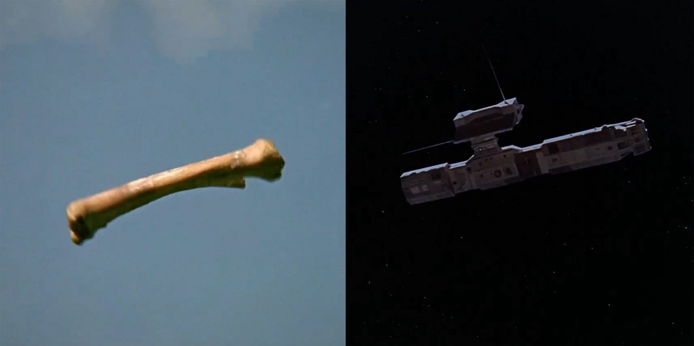
Basic Principle of Continuity
Example. 2001:
Film begins with ape throwing bone into air that transitions to image of space station.
Notes:
One of the most outrageous leaps in time is in the Stanley Kubrick film 2001: A space odyssey.
The film begins with a prehistoric ape throwing a bone into the air and on his descend, it transitions to a space shuttle about to dock at a space station.
Quite a bold leap in time, but it works.

Slide 9
Basic Principle of Continuity
Continuity editing works to join shots together to create dynamic meaning, linking the action of the individual shot to the bigger picture of the story.
Continuity can be used to compress or stretch time, depending on what is best for the narrative.
If an editor has done their job well, the audience will not notice how shots of various frame sizes and angles are spliced together to tell a story.
Notes:
So in summary, continuity editing can be used to link shots together to create a dynamic meaning,
linking the action of the individual shot to the bigger picture of the story.
Continuity can be used to compress or stretch time, depending on what is best for the narrative.
If an editor has done their job well, the audience will not notice how shots of various frame sizes and angles are spliced together to tell a story.

Slide 10
Other techniques that can affect Continuity
Matching eye lines
Matching action
180 degree rule.
Notes:
Several techniques that can be applied to create continuity include proper transitions, matching eye lines and action, and applying the 180-degree rule to your work.

Slide 11
The Line of Action (180 degree rule)
Line of Action (also known as 180 degree rule) helps organize camera angles and movement into consistent screen direction.
Line of Action gives the audience a sense of direction for the scene.
Notes:
The line of action, also known as the 180-degree rule, is one of the most important continuity tools because it helps organize camera angles and movement in a consistent screen direction.
The line of action is an imaginary line that runs through right in front of the camera or the direction the eyes are looking (line of sight), which gives the audience a sense of direction for the scene.

Slide 12
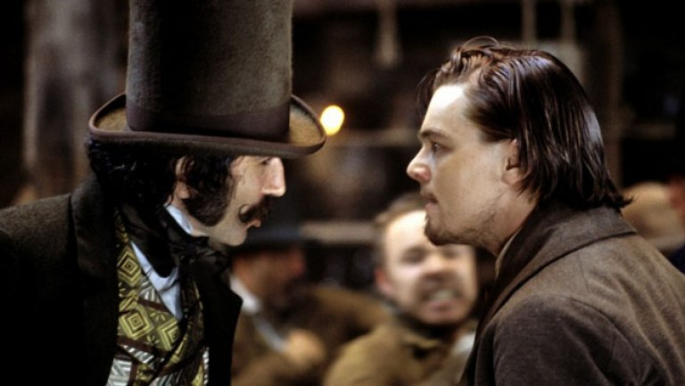
The Line of Action
Example:
Line of Action is drawn between two individuals.
Once line is in place, there is a space of 180 degrees (half circle) where shots can be rendered
Notes:
The easiest way to see how the line of action works is to render a profile shot of two people standing across from each other.
The Line of Action is drawn between two individuals.
Once the line is in place, there is a space of 180 degrees (half circle) where shots can be rendered.

Slide 13
The Line of Action
Example:
Line of Action is drawn between two individuals.
Once line is in place, there is a space of 180 degrees (half circle) where shots can be rendered
Notes:
As an example, the two characters are facing each other in this scene.
This is a somewhat subjective shot, where both characters are seen from a side angle, letting us see the facial expressions of each character.
A line is drawn between them, and the camera is placed on either side of the line to frame that shot.
From here, we may frame a shot emphasizing the expressions of either character.

Slide 14
The Line of Action
Make sure to capture the action of a shot from the same side of a line to maintain consistency.
If the line is crossed, one character might end up looking at the backside of another character's head.
The audience will be confused.
?
Notes:
As an artist, you want to make sure that you capture the action of a shot from the same side of a line to maintain consistency.
If the line is crossed, one character might end up looking at the backside of another character's head.

Slide 15
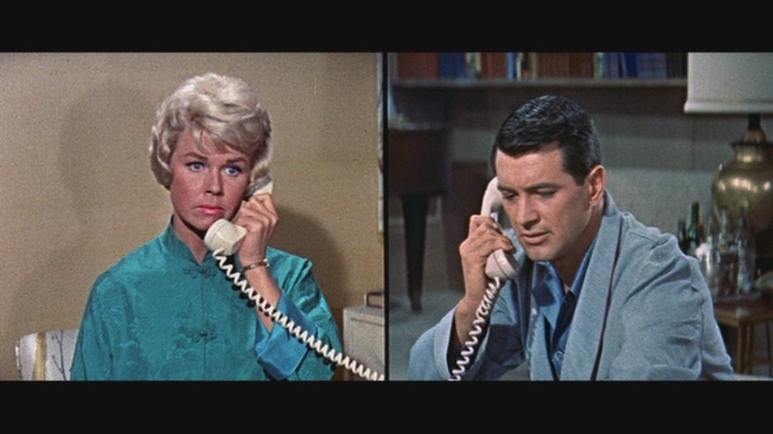
The Line of Action
Situations with distant characters talking to one another still need an imaginary line between the characters.
When cutting from one character to the next, characters should be facing each other, even if they are in separate locations.
Characters are looking at each other’s general direction
Notes:
What if you want to show separate locations of two people talking on the phone with each other?
In such situations, you will still want to establish an imaginary line between the characters.
Therefore, when cutting from one character to the next, the characters should be facing each other, even if they are in separate locations.

Slide 16
Crossing the Line of Action
A dolly or crane shot can move over the established line, as long as the movement is continuous
Notes:
Once the line of action is established, there are several occasions when a character or object may cross the line.
One approach is to keep the camera moving.
A dolly or crane shot can move over the established line, as long as the movement is continuous.

Slide 17
Crossing the Line of Action
If one of these characters were to get up and move, the camera will be reframed.
Once the character has established his eye contact with the seated character, you have established a new line of action.
Notes:
You may also cross the line if an object or person moves across the line.
Let's say these two characters having coffee when one of the characters gets up and moves to a new position.
Once the character has established his eye contact with the seated character, you have established a new line.

Slide 18
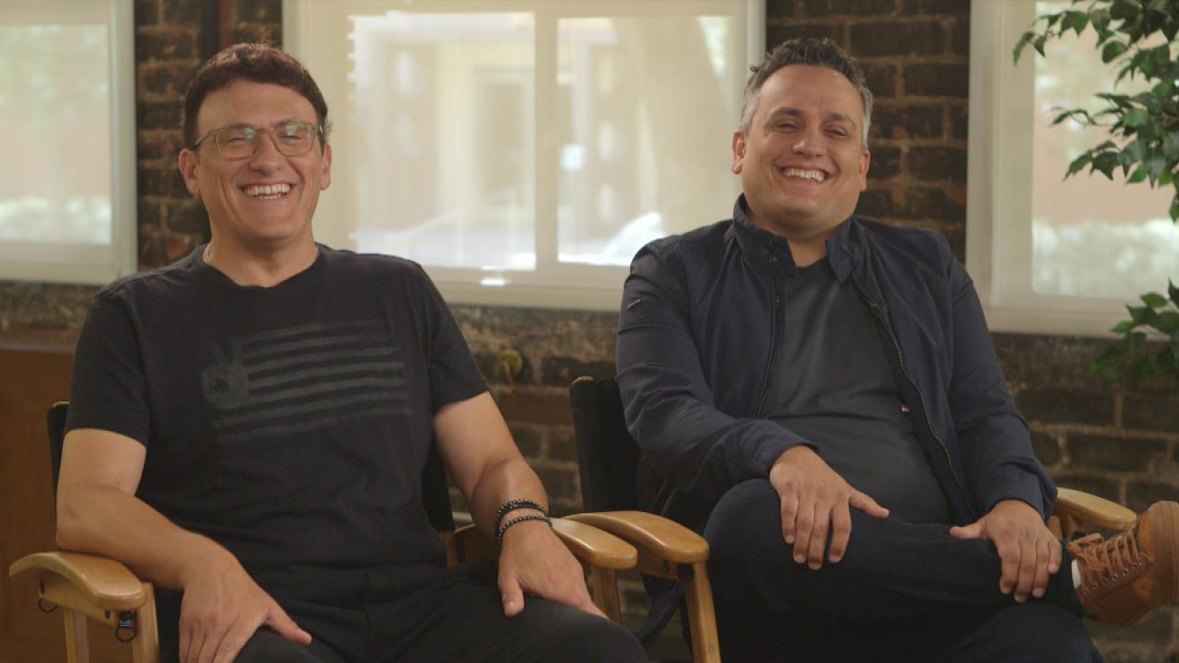
Crossing the Line of Action
If a camera cuts away to a third person entering the room and one of the characters seated turns to acknowledge the third person (establishing a new sight line), you may cross the line and establish a new one.
Notes:
The camera may cross the line of action when an eyesight line for a character is established.
In this picture, these two characters are in the same room, perhaps watching TV or engaged in a conversation with an off-screen character to the right of the screen.
If a camera cuts away to a third person entering the room and one of the characters seated turns to acknowledge the third person (establishing a new sight line), you may cross the line and establish a new one.
In order to preserve this line of action, if there are cuts, showing the character entering the room, the movement should be consistent with this line of sight.

Slide 19
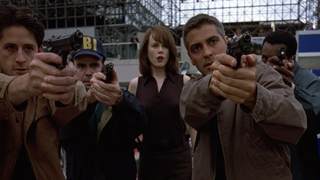
Crossing the Line of Action
Occasionally, the line of action is crossed to convey the character’s confusion. (example: searching for suspect in crowd)
Be aware, however, there is a very fine line convey a character’s confusion and confusing your audience.
Notes:
What if you have a scene where the main character is rushing through a crowd trying to find the bad guy?
In such a situation, you may want to cross the line to establish a frenetic or disorienting chase.
By crossing the line, you will end up with several shots that showcase the main character running back and forth, even though in reality the character is moving in the same direction.
Be aware, however, there is a very fine line conveying a character’s confusion and confusing your audience.

Slide 20
Screen Direction
It is important to plan the direction a person or object moves or looks toward.
Have clarity in intent of scene, especially when multiple shots are used.
A good director will rely on the shot list and storyboards to maintain a consistent screen direction.
Several types of screen direction include neutral, constant, and contrasting direction.
Notes:
When rendering storyboards, it is important to plan the direction a person or object moves or looks toward.
If a character is facing in one direction in the first shot, and the opposite direction in the second shot, continuity will be jeopardized.
This often confuses viewers as to the intent of the scene, especially when there are dozens of shots that make up the scene.
A good director will rely on the shot list and storyboards to maintain a consistent screen Direction.
Several types of screen direction include neutral, constant, and contrasting direction.

Slide 21
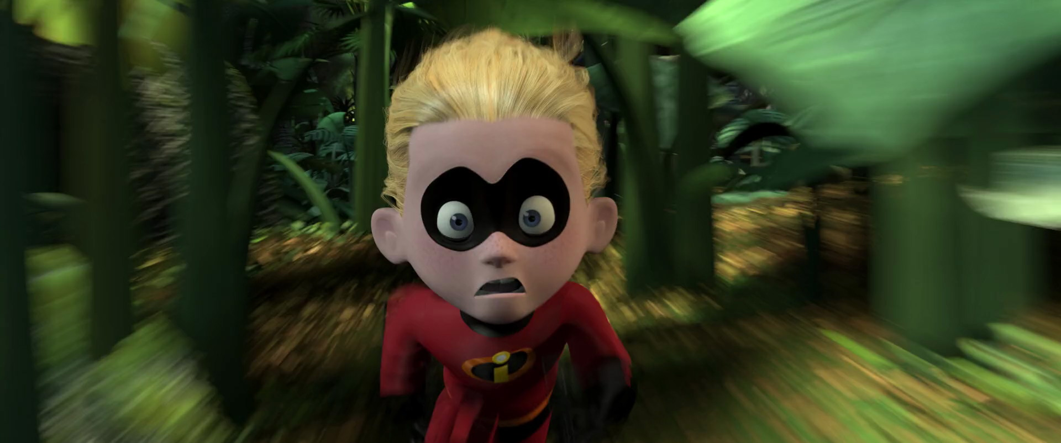
Neutral Screen Direction
movement toward or away from the camera.
shows only the front or back side.
provides impact and is quite dynamic because the character or object appears to increase in size as it moves closer to the camera.
Notes:
Neutral screen direction is movement toward or away from the camera.
It shows only the front or back side of a person or object one of the most common shots we see of a neutral screen direction is when a character walks directly toward the camera and blacks out the lens.
Neutral screen Direction provides impact and is quite dynamic because the character or object appears to increase in size as it moves closer to the camera. For instance, a shot of the bad guy running straight at the camera will often jolt to the audience.

Slide 22
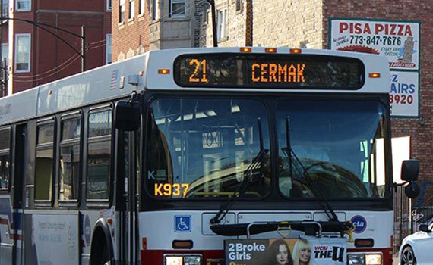
Constant Screen Direction
Constant screen Direction shows movement in one direction only.
You would storyboard the progression of shots of this bus going in the same direction.
Showing the bus going in the opposite direction, this will confuse the audience because the bus appears to be moving back to its starting point.
Notes:
Constant screen Direction shows movement in one direction only.
Let's say a downtown bus is traveling it's daily route through the city.
You would storyboard the progression of shots of the bus going in the same direction.
If you cut to the shot of the same bus traveling in the opposite direction, this will confuse the audience because the bus appears to be moving back to its starting point.

Slide 23
Constant Screen Direction
Subjects should move in the same direction
Once the line and the camera are established, screen direction will be maintained
Notes:
The same can be said of subject answering and exiting a frame.
Subjects should move in the same direction whether they are moving left to right or right to left.
One technique to maintain a consistent screen direction is to establish a line of action and then position the camera to one side of the line. Once the line and the camera are established, screen direction will be maintained.

Slide 24
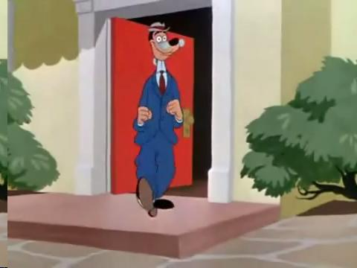
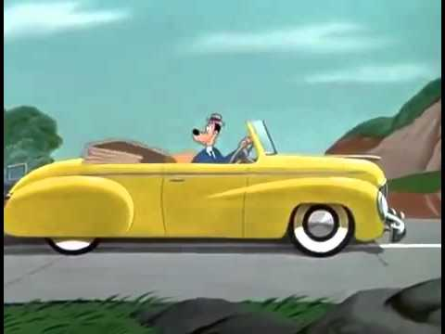
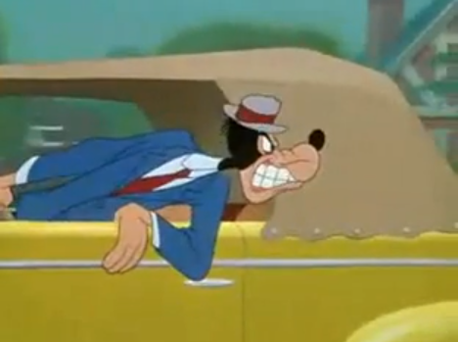
Contrasting Screen Direction
Entering and Exiting frame from opposite directions.
Often called Right or Left and Left to Right movement.
Notes:
Contrasting screen Direction is when a person comes into the frame from one direction and leaves in the opposite direction.
This is often called left to right and right to left movement.
In these example the character leaves his home and walks left to right towards his car to go to work.
Therefore logical movement on his way back from work would be right to left.

Slide 25
Contrasting Screen Direction
Entering and Exiting frame from opposite directions.
Often called Right to Left and Left to Right movement.
Notes:
Opposing screen direction is also established by showing two objects or people moving toward each other.
In this example, the two opposing groups are headed for each other on a collision course.
Two opposing screen directions creates tension, the timing of the shots gets faster, and the shot framing tighter, as the tanks accelerate toward each other until contact.

Slide 26
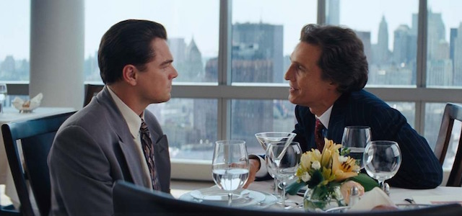
Shot/Reverse Shot
Common technique used to create continuity between two or more characters.
Allows audience to follow the action between characters as camera angles and framing changes.
The simplest form of the short/ reverse shot is staging conversation between two characters.
Notes:
The shot/reverse shot Is a common technique used to create continuity between two or more characters.
It allows the audience to follow the action between characters as camera angles and framing changes.
The simplest form of the short/ reverse shot is staging conversation between two characters.

Slide 27
Shot/Reverse Shot
Common technique used to create continuity between two or more characters.
Allows audience to follow the action between characters as camera angles and framing changes.
The simplest form of the short/ reverse shot is staging conversation between two characters.
Notes:
You may want to set up an initial shot that establishes the location and characters.
Once established, draw the line of action between the two characters.
The imaginary line allows the camera to be positioned anywhere on one side of the line, to capture the conversation between them.
A typical shot/reverse shot frames characters over the shoulder.
So, if the camera is behind the first character, who is looking right at the second, the camera is behind the first character’s shoulder.
And the reverse shot, the camera is behind second character’s right shoulder, as he looks left.

Slide 28
Match on Action
Match on action is the illusion that the action continues uninterrupted even though the camera positions may have changed from one shot to the next.
To create a match on action, everything at the end of the first shot must closely match the action at the beginning of the next shot.
It is generally easier to create a match cut by noticeably changing the size of the frame and cutting on the movement.
Notes:
Match on action is the illusion that the action continues uninterrupted even though the camera positions may have changed from one shot to the next.
To create a match on action, everything at the end of the first shot must closely match the action at the beginning of the next shot.
It is generally easier to create a match cut by noticeably changing the size of the frame and cutting on the movement.
For instance cutting on the movement of the character takes off his glasses, as in the figure below , it appears fluid as the director cuts from a full shot to a medium shot.

Slide 29
Match on Action
When matching action, you should only cut after the audience understands the visual information that is being delivered.
If a shot is too fast, the audience will not have time to absorb the details
If the shot is too long, the audience will be irked.
Notes:
When matching action, you should only cut after the audience understands the visual information that is being delivered.
If a shot is too fast, the audience will not have time to absorb the details, and if the shot is too long, the audience will be irked.

Slide 30
Eyeline Match
Creates order and meaning within the story space by matching eyeline between characters, or what a character might be looking at..
Example: If a person looks off screen, the audience will expect to be shown what that character is looking at in next shot.
By obeying the line of sight, characters will look toward each other, maintiaining eyelines.
Notes:
The eyeline match creates order and meaning within the story space by matching eyeline between characters, or what a character might be looking at.
Put simply, if a person looks off screen in the first frame, the audience will expect to be shown what the character sees in the next shot.
If a character looks screen left at a character off screen, then an imaginary line of sight will be drawn between him and the off screen character. By obeying the line of sight, the characters will look toward each other, maintaining eye lines.

Slide 31
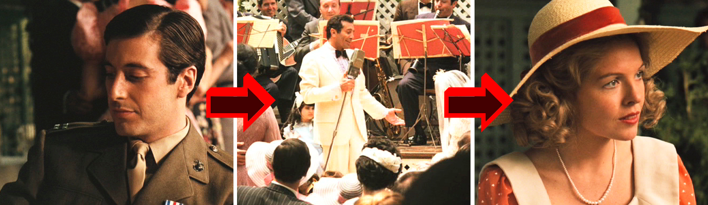
Cutaways
The Cutaway technique is used to manipulate time and space.
The Cutaway should be related to the main action, but not part of it.
The camera cuts away to the singer to complement the main action, which is the conversation between the two characters. In this situation, the cutaway is used to add context to the setting.
Notes:
The Cutaway technique is used to manipulate time and space.
The Cutaway should be related to the main action, but not part of it.
In the example, the camera cuts away to the singer to complement the main action, which is the conversation between the two characters.
In this situation, the cutaway is used to add context to the setting.

Slide 32
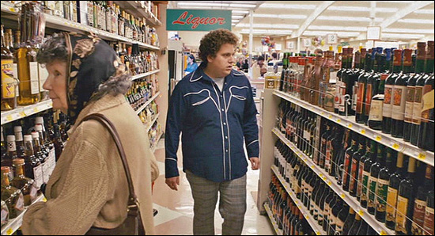
Cutaways
Cutaways allow the director to make minor shifts in time.
Cutaways allow director to build tension or work within the “psychological space” of a character interaction.
By cutting away from the main action, we can focus on only the actions that are important to the story.
Notes:
Cutaways allow the director to make minor shifts in time.

Slide 33
Cut-ins
Cut-ins focus on the primary action of a scene.
Rather than cutting away from the main action, the cut-in shot narrows our view to a smaller portion of the action.
Provides dramatic emphasis.
Notes:
Cut-ins focus on the primary action of a scene.
Rather than cutting away from the main action, the cut in shot narrows our view to a smaller portion of the action, providing dramatic emphasis.
If the main action is a baseball game, a cut in could be a bat connecting to a baseball.
The dramatic action of the bat hitting the ball in the smaller action must match what is being shown in the larger scene.
If it does not match, you will have a jump-cut in which the figure appears to move but the background does not.

Slide 34
Cross-cut
Cross-cutting, also called parallel editing, manipulates both time and space.
Action that is happening at the same time is intercut so that the audience may see a parallel action.
Cross-cutting is often used to intensify the drama and to provide suspense in a film or animation.
Notes:
Cross-cutting, also called parallel editing, manipulates both time and space.
Action that is happening at the same time is intercut so that the audience may see a parallel action.
Cross-cutting is often used to intensify the drama and to provide suspense in a film or animation.
How many times have you witnessed the scenes of the bad guy about to kill his next victim as the hero races to The Hideout
These two independent scenes are added together to keep the audience on the edge of their seats as they Wonder if the hero will make it in time.

Slide 35
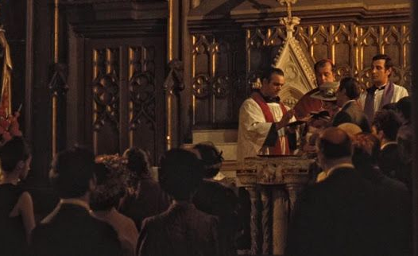
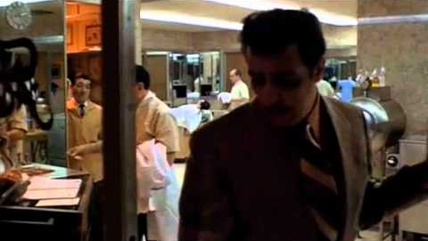
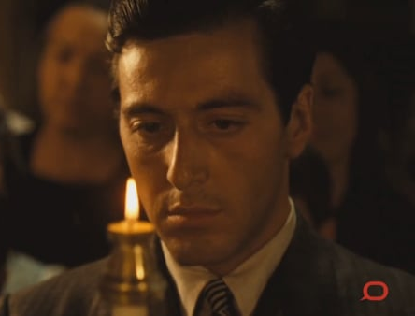
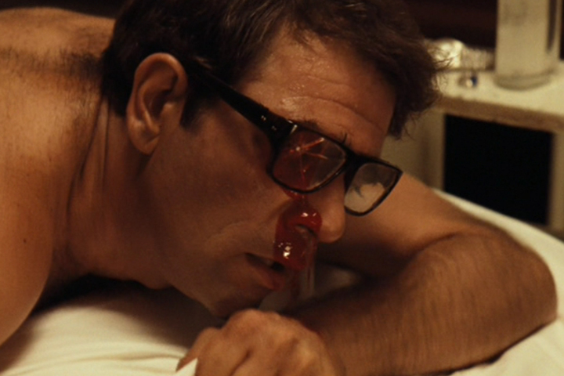
Cross-cut
Example (The Godfather):
The sequence between the baptism of Michael Corleone's nephew cross cuts with the Corleone Mobsters preparing for and ultimately committing murder.
Although the sequence last for 6 minutes, it is fairly fast-paced.
Notes:
An excellent use of cross-cutting is shown in the film Godfather.
The sequence between the baptism of Michael Corleone's nephew cross cuts with the Corleone Mobsters preparing for and ultimately committing murder.
Although the sequence last for 6 minutes, it is fairly fast-paced.

Slide 36
Transitions
Narrative device linking two different shots, that may change in time, place, or focus of characters.
Contributes to the pace of a production, whether it is lyrical or abrupt.
Types of transitions include: Dissolve, Cut, and Fade.
Notes:
A transition is a narrative device that links two different shots that may change in time, place, location, or characters.
Transitions contributed to the pacing of a production, whether it is lyrical or abrupt.
There are several types of transitions, including the dissolve, cut, and fade.

Slide 37
Dissolve
Basically, when a piece of film strip was superimposed onto another, creating an overlapping image.
Can be any length, and are usually employed to show a time lapse or location change.
Notes:
The dissolve is when a piece of film strip is superimposed on to another.
Disolves can be any length and are often used to show either time lapse or location change.
For example in shot number one in the figure below a person is exiting a limousine.
The shot slowly dissolves to shot number two of the character on the train platform.
We assume from the dissolve that the man Waiting on the train platform is the same man that was getting out of the limousine.

Slide 38
Cuts
Over 90% of films use Cuts as a transition to connect two shots together.
Most audiences do not even notice when a program cuts to a different angle or framing within a scene.
The cut is effective for compressing time.
Notes:
The cut is an unobtrusive and frequently used transition in terms of Storytelling.
Over 90% of films use Cuts as a transition to connect two shots together.
Most audiences do not even notice when a program cuts to a different angle or framing within a scene.
llogical cut may include a wide shot of a building that cuts to a full shot of the building door.
The cut is effective for compressing time. Before our wedding, for example, can be compressed to a few minutes by using cuts.

Slide 39
Fades
Used to denote a passage of time and should not be used in the present tense.
Fades are usually very subtle as the screen fades in or out from black. (if it fades to white, it's often called a white out)
A Fade-In is used to ease the audience into a setting by starting in black, and gradually lightening up the setting to full brightness.
A Fade Out is usually the last shot of a scene that gradually disappears into darkness.
Notes:
Fades are used to denote a passage of time and should not be used in the present tense.
Fades are usually very subtle as the screen fades in or out from black. (if it fades to white, it's often called a white out)
A fade-in is used to ease the audience into a setting by starting in black, and gradually lightening up the setting to full brightness. A Fade Out is usually the last shot of a scene that gradually disappears into darkness.

Slide 40
Wipes
Wipes function the same way as the cut, transitioning from one shot to the next, but here it pushes one image off the screen with another image.
This showy technique was quite popular during the 1930s and 40s, but went out of fashion shortly after World War II.
The wipe made a Resurgence in the 1970s with the release of Star Wars, and can be seen in a handful of films today.
Notes:
Wipes function the same way as the cut, transitioning from one shot to the next, but here it pushes one image off the screen with another image. This showy technique was quite popular during the 1930s and 40s, but went out of fashion shortly after World War II. The wipe made a Resurgence in the 1970s with the release of Star Wars, and can be seen in a handful of films today.

Slide 41
Jump Cuts
Jump cuts are the opposite of continuity shots, using abrupt changes in movement to disrupt the illusion of a continuous flow of action .
A jump can be achieved between Shots by maintaining the background and abruptly changing a character's position.
Jump cuts are also achieved when character framing is the same from one shot to the next, but the camera has moved its position.
Notes:
Jump cuts are the opposite of continuity shots, using abrupt changes in movement to disrupt the illusion of a continuous flow of action .
A jump can be achieved between Shots by maintaining the background and abruptly changing a character's position.
In the film dark blue, the character played by Kurt Russell appears to jump from a bed to the window, to a chair, Etc, to communicate the passage of time.
In such situations , the story has jumped over some of the action.
Jump cuts are also achieved when character framing is the same from one shot to the next, but the camera has moved its position.

Slide 42
Montage
Cinematic montage is a series of images that can be juxtaposed to create meaning by evoking an emotional response.
The shots maintained information relating to a single idea or theme. Music videos are often assembled around the Montage sequence of a band or singer.
In such scenarios, the rhythm and pacing of the video depends on the structure of the song.
Notes:
Cinematic montage is a series of images that can be juxtaposed to create meaning by evoking an emotional response.
The shots maintained information relating to a single idea or theme. Music videos are often assembled around the Montage sequence of a band or singer.
In such scenarios, the Rhythm and pacing of the video depends on the structure of the song.

Slide 43
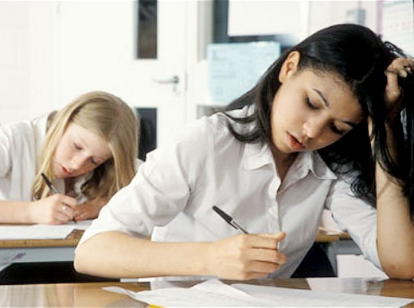

Montage
Notes:
Suppose you have two separate shots.
The first shot, is a group of students languishing over an exam in a classroom.
The second shot is someone sleeping in bed.
The shots are unrelated in both time and space, yet when they're just opposed with one another they create meaning.
The two shots lead the audience to believe that the character in bed has overslept on exam day.

Slide 44
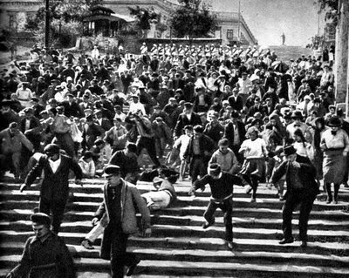
Montage
The Montage Style was developed in the 1920s by Soviet filmmakers such as Sergi Eisenstein and Dziga Vertov.
One of the most famous Montage sequences is the Odessa steps from Einstein's Battleship Potemkin.
Notes:
The Montage Style was developed in the 1920s by Soviet filmmakers such as Sergi eisenstein ablnd Dziga Vertov.
One of the most famous Montage sequences is the Odessa steps from Einstein's Battleship potemkin.
The images include boots of the soldiers stopping down steps, a mother screaming, a baby carriage rolling out of control, a broken umbrella, a woman's bleeding eye, and close-ups of frightened faces. These edits include shots that vary in length to build the rhythm of a sequence, which ultimately climaxes with the massacre and failure of the russian revolution.

Slide 45
Summary
Continuity editing works to join shots together to create dynamic meaning.
If an editor has done their job well, the audience will not notice how shots of various frame sizes and angles are spliced together to tell a story.
Instead the audience will see the story as a continuous whole of uninterrupted action.
That is what we refer to as CONTINUITY.
Notes:
Continuity editing Works to join shots together to create Dynamic meaning.
If an editor has done their job well, the audience will not notice how shots of various frame sizes and angles are spliced together to tell a story. Instead the audience will see the story as a continuous whole of uninterrupted action

