Slide 1
Drawing in Perspective
Notes:
Delete the placeholder notes that were on this slide.
Set expectations immediately, because this is the session most likely to convince a weak draftsman that they cannot pass. It is not a draftsmanship test.
The deck is deliberately ordered so that the five techniques that work regardless of drawing ability come first, and constructed linear perspective comes second. That ordering is the argument: most of the depth in most panels does not come from vanishing points.

Slide 2
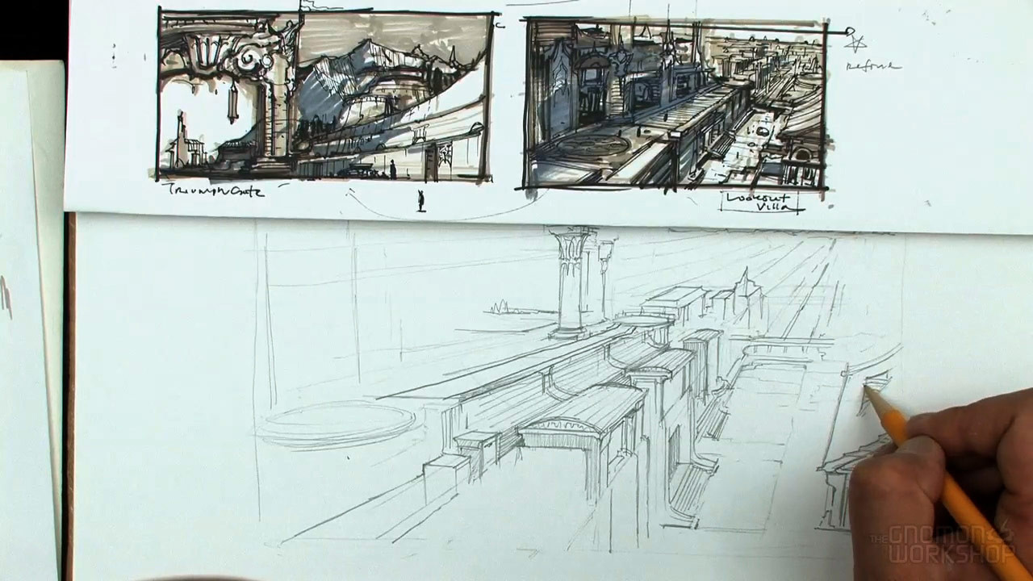
Flat Surface, Dimensional World
We see in three dimensions. Film, video and paper are two.
Depth becomes an illusion, and an illusion is something you construct on purpose.
Perspective is what your eye uses to reconstruct space from a flat image.
Notes:
Depth on a flat surface is always a trick,
it’s a translation from one medium to another.
Your eye reconstructs space from a flat image using a handful of cues:
overlap, relative size, haze, texture, and converging lines.
Those cues are what the next twenty slides are about.
Perspective is something we take for granted, because it is built into our understanding of reality.
You do not have to draw well to use them, you have to know they exist and decide to use them.

Slide 3
You Do Not Need to Be Good at This to Be Good at This
Six ways to create depth.
Five of them work no matter how well you draw.
The sixth, constructed linear perspective, is the only one that requires construction.
We are doing the five first, on purpose.
Notes:
Perspective has a reputation as the gatekeeping skill in drawing,
and that reputation frightens people out of a discipline they would otherwise be good at.
In storyboarding it is simply not the highest-leverage tool.
Overlap, scale, atmosphere, value and texture will give you most of the depth in most panels,
and none of them require you to construct anything.

Slide 4
Perspective Changes Every Time the Camera Moves
Lens choice and camera-to-subject distance are both perspective decisions.
Move the camera and you have re-framed the shot, and changed the perspective in it.
Which means perspective is not a drawing topic. It is a camera topic you happen to execute with a pencil.
Notes:
Linear perspective is not a property of the drawing.
It is a property of where the camera is and what lens is on it.
Change either of these and every convergence in the frame changes with it.
This is a camera topic that you happen to execute with a pencil.
Which means the perspective questions in this session are the same questions as the angle questions from a previous lecture, asked in a different vocabulary. Where is the camera, how high, how far, and how wide is the lens.

Slide 5

Overlap
One object in front of another.
The nearer object is complete. The farther one is interrupted.
Probably the cheapest depth cue there is, and it works at any skill level.
Notes:
Put something in front of something.
The object that is interrupted is behind.
The brain fills the rest instantly, with no construction and no accuracy required.
That’s it - That is the entire technique.
If your panel reads flat, the first question is not "is my perspective wrong," it’s - "is anything in front of anything."
Overlap also survives bad drawing completely intact.
A crude shape in front of another crude shape still reads as depth.

Slide 6
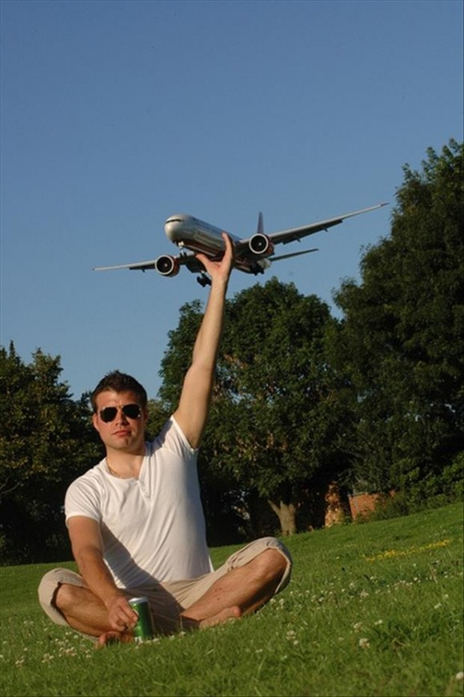
Size and Scale
Closer is bigger. Farther is smaller.
Scale also tells the audience how big the thing itself is: the horse beside the castle.
Two identical shapes at different sizes read as the same object at different distances.
Notes:
Relative size gives you distance:
(Pretty basic stuff) - the same figure drawn small reads as far away.
And a known-size object next to an unknown-size one tells the audience how big the unknown thing is,
which is why the extreme long shot from our previous lecture needs a human-scaled reference in it.
This is why establishing shots often put a person in the frame.
Without one, a mountain and a rock look identical.

Slide 7
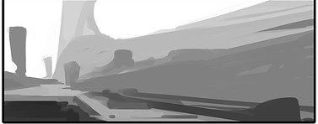
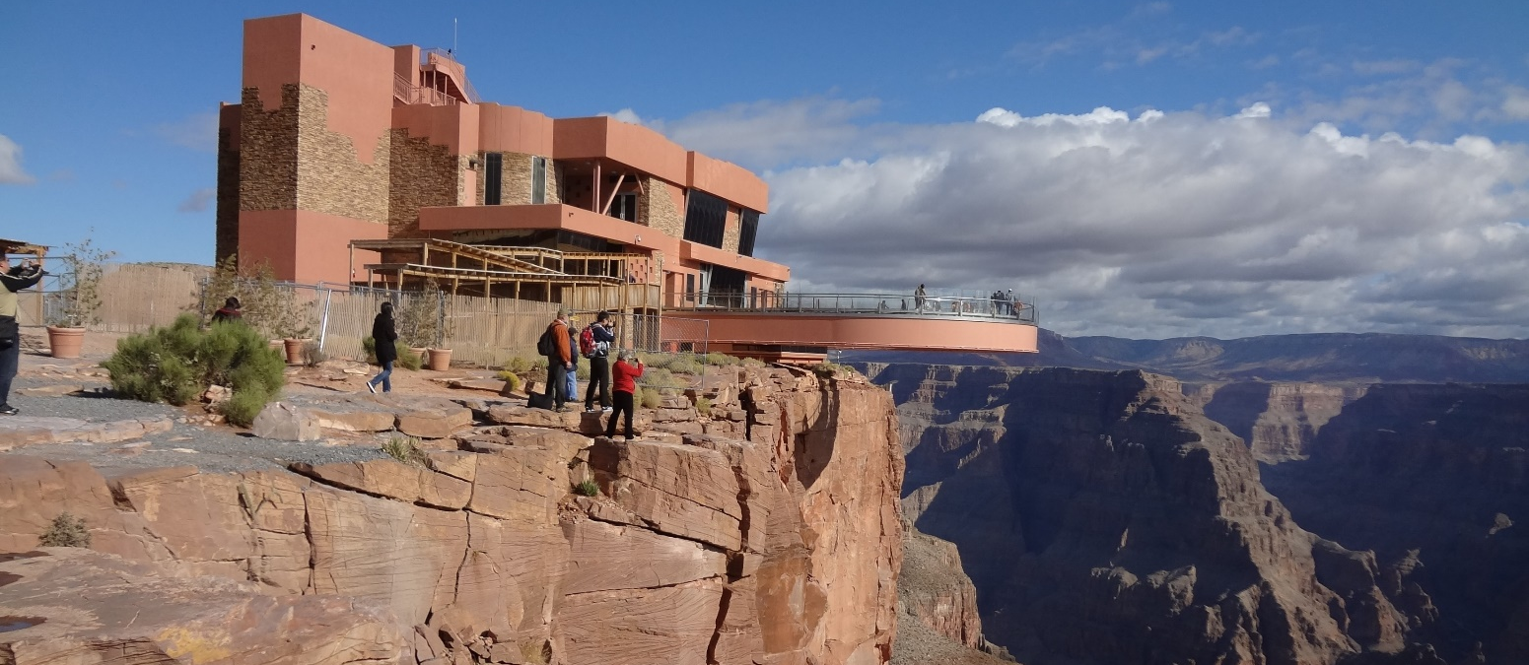
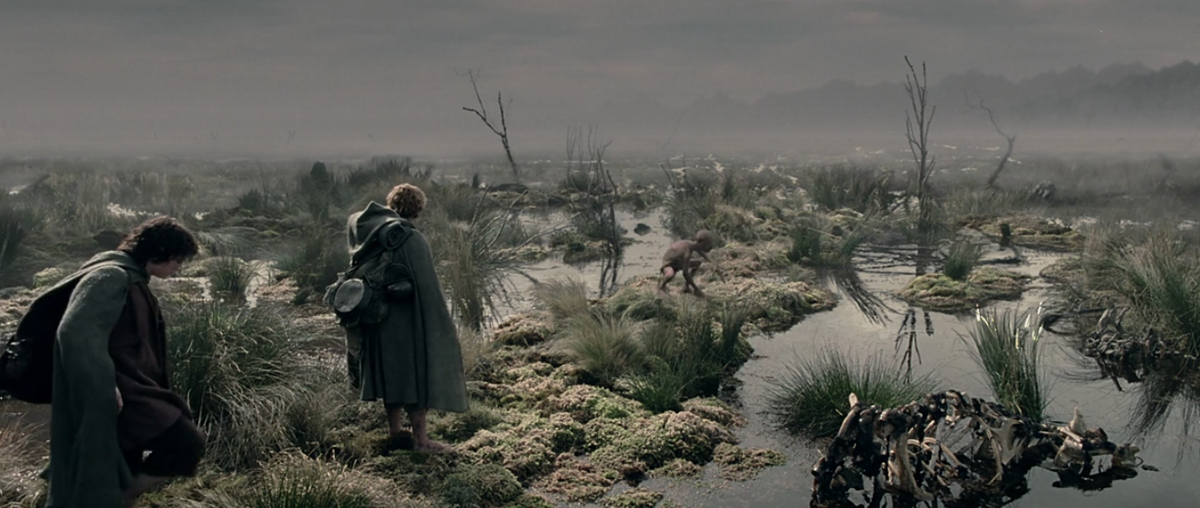
Atmospheric Perspective
Distance means haze: particles of dust and moisture between you and the subject.
Far away: less contrast, lighter value, cooler and bluer.
Near: darker, higher contrast, warmer.
The Lord of the Rings: The Two Towers. The Dead Marshes are built on this.
Notes:
Another really great cue for telling distance is called “Atmospheric Perspective”
And it simply is based on the idea that Air is not transparent.
Dust and moisture scatter light, so distant objects lose contrast, get lighter, and pick up a blue cast.
Paint that and the eye reads distance without any lines converging anywhere.
The reference on the slide is The Two Towers.
The Dead Marshes sequence is a sustained demonstration of atmospheric perspective as a way of illustrating the story of the characters getting lost in those wetlands, without proper reference of where they were going to.
On a black-and-white board you cannot use the color shift,
but you can absolutely use the CONTRAST,
and that is the part that does the work anyway.

Slide 8
Value as Depth
Near: darker, higher contrast.
Far: lighter, lower contrast.
This is the cheapest depth cue you own, and it works even if your perspective is wrong.
Notes:
New slide, lifted directly from the composition lecture
Say it verbatim, because they have heard it before and the repetition is the point: this is the cheapest depth cue you own, and it works even if your perspective is wrong.
Three values. Foreground dark, midground mid, background light. That alone will separate three planes in a panel with no construction whatsoever.
Say: notice this is the same three-value discipline from composition and from lighting. Three sessions, one tool, three different jobs. That is not a coincidence, it is the sign that you are learning a system rather than a list.

Slide 9
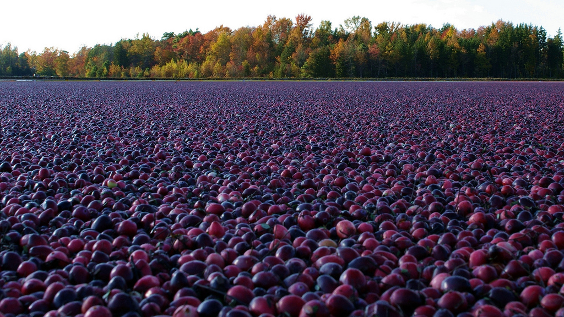
Texture Gradient
Most surfaces have texture: walls, roads, fields, water, crowds.
Close up, the texture is coarse and you can see individual units.
With distance it gets finer and smoother until it disappears into an even tone.
Notes:
Another great way of representing distance is through textures.
Any repeating surface (cobbles, tiles, grass, waves, a crowd) has a texture that compresses with distance.
Draw the near ones big and separated and the far ones small and merged, and the surface recedes.

Slide 10
Foreground, Midground, Background
Three planes is enough. Most student panels use one.
Something near, something at the subject's distance, something far.
Overlap them, separate them by value, and you have depth without a single construction line.
Notes:
Imagine you have three planes.
Put something in the foreground: a branch, a doorframe, a shoulder, a silhouetted edge.
Keep your subject in the midground.
Put something in the background and lighten it.

Slide 11
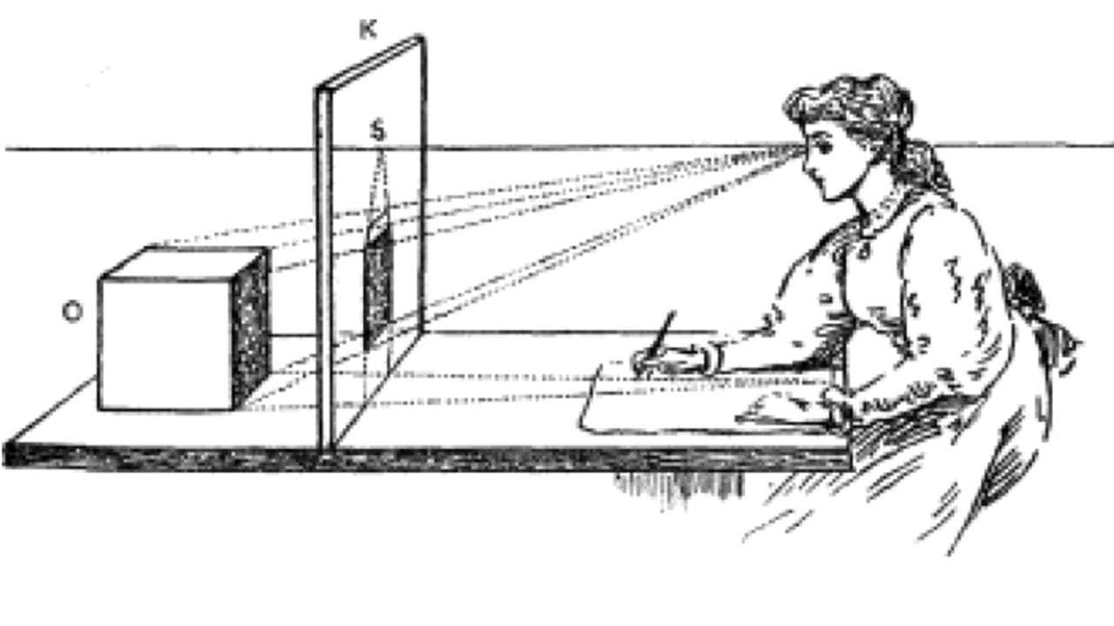
Picture Plane
Think of it as a window between you and the world.
What you draw is what you would trace on that glass.
Your line of sight (your eyeline) points through it at the subject.
Notes:
Now the constructed half, framed as the specialist tool rather than the foundation.
The picture plane is the imaginary sheet of glass between the viewer and the scene.
Everything you draw is a projection onto that glass.
It is a useful mental model because it makes the geometry concrete: you are not drawing objects, you are drawing where they intersect a plane.

Slide 12

Horizon Line = Eye Level
The horizon line is always at the viewer's eye level.
Where an object sits relative to it tells you whether the shot is high, low or neutral.
Move the horizon line and you have moved the camera.
Notes:
The horizon line is your camera height.
That is not a metaphor, it is literally what it encodes.
If the horizon crosses a standing figure at chest level, the camera is at chest level.
Which means you can change the camera angle without drawing anything.
Move the horizon line up and you are looking down. Move it down and you are looking up. You have just executed the high-angle and low-angle shots from Deck 03 with a single line.
Ask them to find the horizon in a still and tell you how tall the camera operator was. It works, and it makes the point permanently.

Slide 13
Vanishing Point
The point on the horizon where parallel lines appear to converge.
Objects parallel to each other share a vanishing point.
Objects at different angles get their own.
Notes:
Parallels converge as they recede, and where they meet is a vanishing point on the horizon line.
A scene can have many vanishing points.
Every set of parallel edges pointing in its own direction gets one.
A street of buildings all facing the same way share one; a building turned at an angle to the street has its own.
This is why a drawing can be "in perspective" and still look wrong.
Usually it means two things that should share a vanishing point do not.

Slide 14
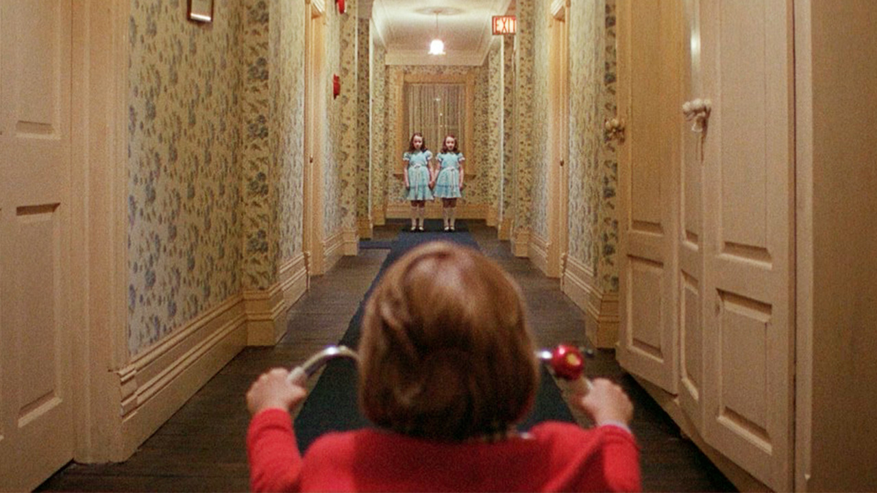
One-Point Perspective
One vanishing point on the horizon.
Three kinds of line: verticals, horizontals, and orthogonals that recede to the point.
Corridors, roads, tunnels, receding rooms: anything you are looking straight down.
Notes:
The simplest construction and the most recognizable.
One vanishing point. Verticals stay vertical, horizontals stay horizontal, and everything receding runs to the single point.
It is also the most conspicuous.
Stanley Kubrick built a career on one-point corridors,
and the reason those shots feel formal and unnerving is that perfect one-point symmetry almost never happens by accident.
Use it when you want the audience to feel the geometry.

Slide 15
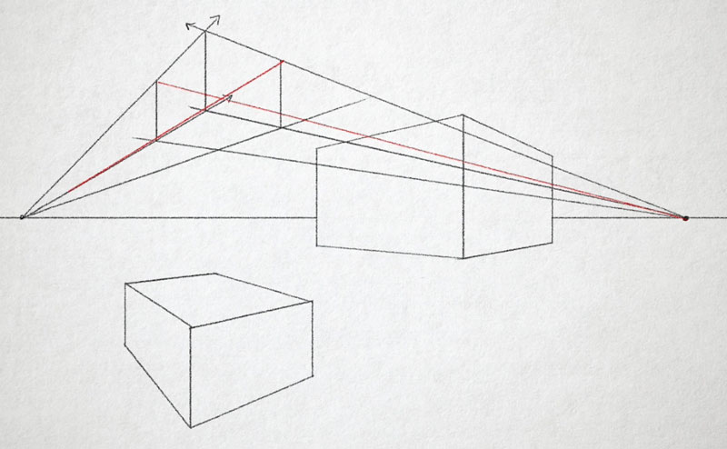
Two-Point Perspective
Two vanishing points, both on the horizon.
Verticals stay vertical; the two sets of receding lines run to their own points.
You are looking at a corner rather than a face. Most exteriors live here.
Notes:
Two points, which means you are looking at an object fome the corner rather than face-on.
It opens the frame up.
Instead of staring down a hallway at a single point,
you get two planes receding in different directions,
which reads as a real place rather than a diagram.
This is the default for most environments,
and it is worth noticing how much less formal it feels than one-point.
Moving the two vanishing points closer together exaggerates the corner and makes the space feel tighter; further apart flattens it out.

Slide 16
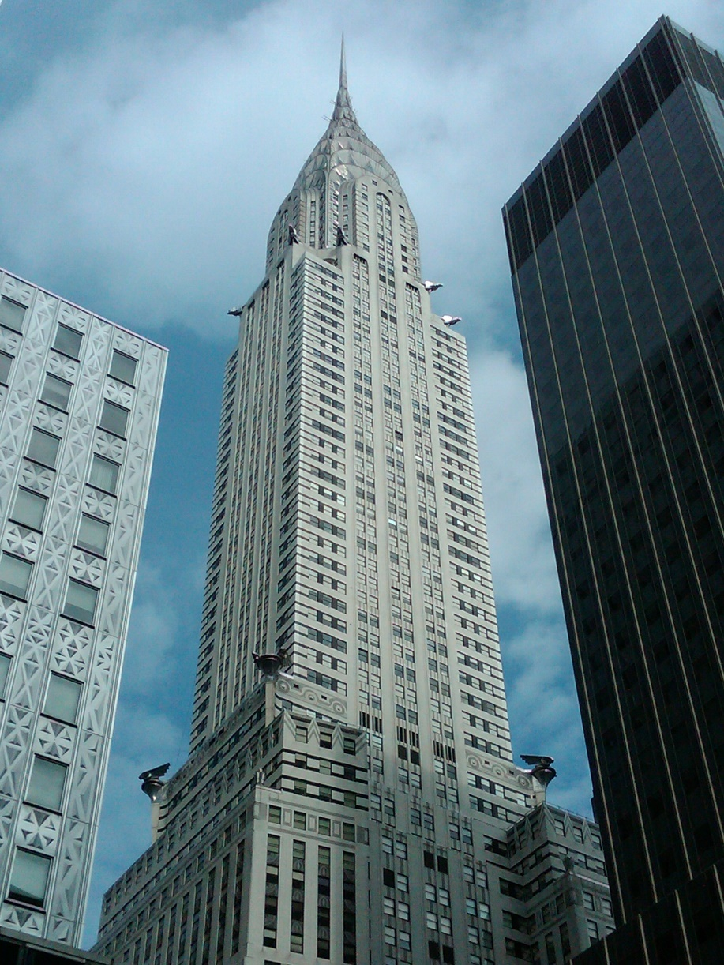
Three-Point Perspective
Two vanishing points on the horizon, and a third above or below it.
Now the verticals converge too.
Third point above the horizon: you are looking up. Below: you are looking down.
Notes:
Three point perspective is often thought of as the most dramatic perspective.
When you add a third vanishing point off the horizon, the vertical lines start converging as well.
With the third point high above means a low-angle view up a tall thing.
With the third point far below means a bird's-eye down onto one.
Three-point is what you reach for when the angle is the point: the low angle up the tower, the drop down onto the street.
It is the angles section of Deck 03, executed as geometry.
And it is the construction most worth practicing, because it is the one you cannot fake convincingly.

Slide 17
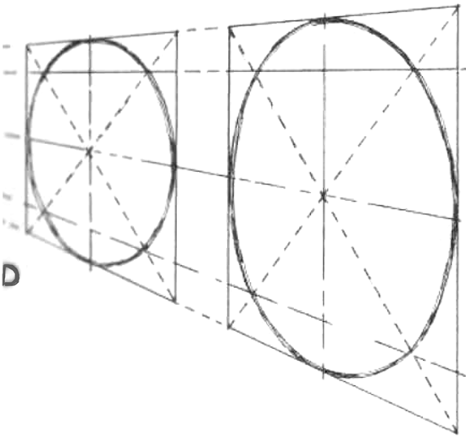
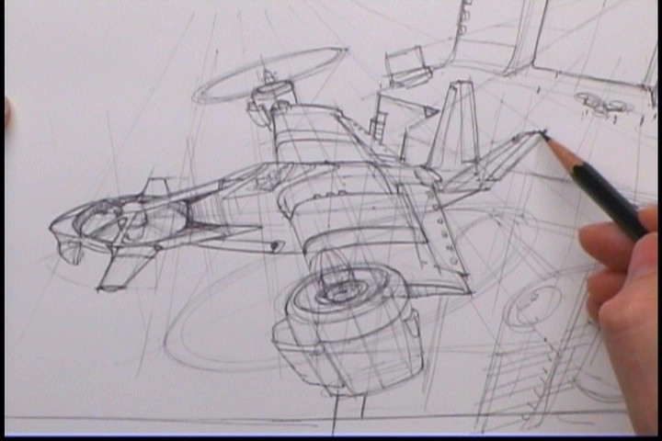

Circles in Perspective
A circle in perspective is an ellipse.
Draw the square in perspective first, then fit the ellipse inside it, touching all four sides.
Wheels, plates, lamps, tables, archways, tunnel mouths.
Notes:
The simple rule has been to trace corners back to the vanishing points –
But what if there are no corners?
Curved objects and circles can be represented the same way by inscribing the curve/ellipse inside the square, with their middles touching each side.
The further an ellipse is from the horizon line, the more open it gets.
On the horizon it collapses to a straight line. That single rule fixes most wheel drawings.

Slide 18
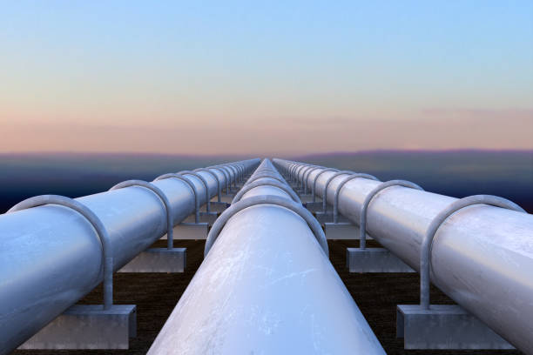
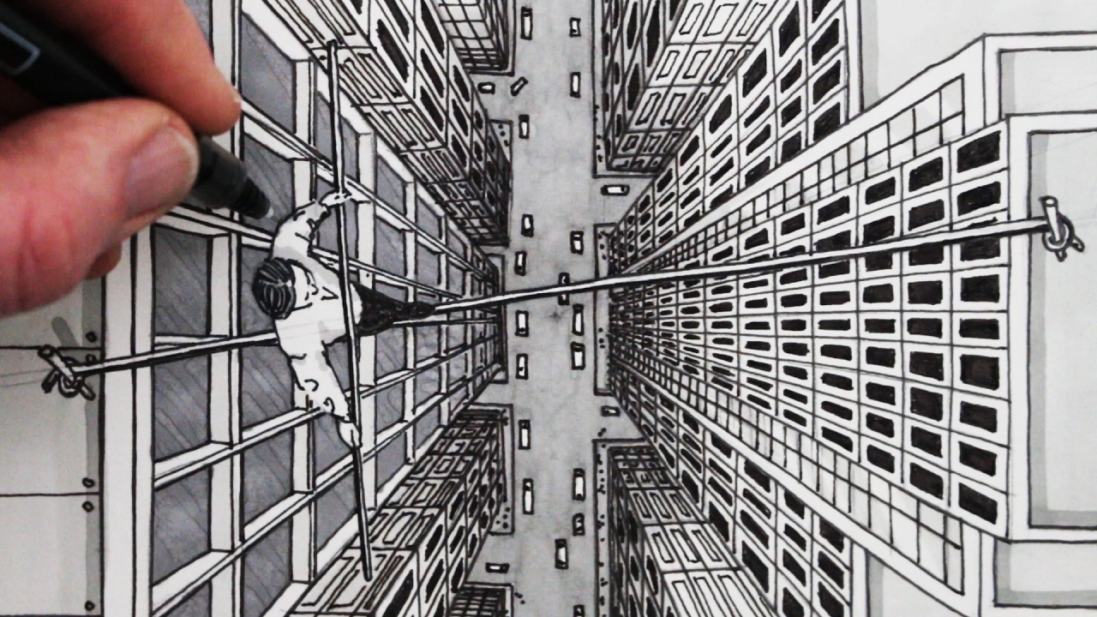
Foreshortening
Applying perspective to a single form, so one part reads as much closer than another.
Easy on a pipe or a box. Hard on an arm or a leg.
The near part gets larger and the length compresses, usually far more than feels right.
Notes:
Foreshortening is perspective applied within a single object.
A pointing arm, a leg kicking towards camera, a body falling towards you. The near end enlarges and the length collapses, usually far more than your hand wants to draw.
And the boarding workaround, which is legitimate: if a foreshortened pose is fighting you, change the camera angle so it is not foreshortened. That is a real professional decision, not a cop-out, though do notice whether you are choosing the angle or avoiding the drawing.

Slide 19
Relative Motion
When the camera moves, near objects sweep past faster than far ones.
Distant mountains barely move at all.
The difference in speed is itself a depth cue, and the only one that needs motion.
Notes:
This is often called parallax, and it is the one depth cue you cannot use on a still panel.
When you move, things close to you slide past quickly and distant things hardly move.
Your brain reads that speed difference as distance.
Which makes it an animatic tool rather than a board tool.
Board a pan across a landscape, put something close in the foreground (a branch, a post, a rock) and let it sweep past.
Your animatic does the rest and the shot suddenly has depth that the individual panel did not.
Plan it at the storyboarding stage though, because it means drawing that foreground element on its own layer.

Slide 20
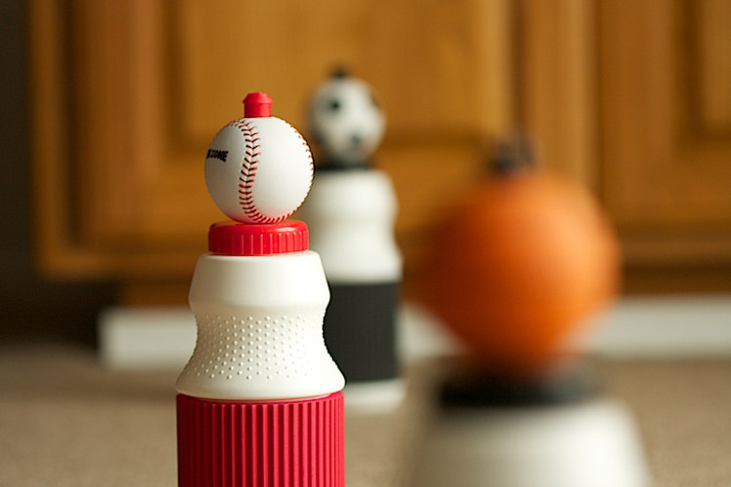
Depth of Field
How much of the frame is in focus, in front of and behind the point focused on.
Shallow: a thin slice sharp, everything else soft.
Wide: most of the frame sharp at once.
Notes:
Focus is a depth cue and a direction of attention at the same time.
Depth of field is how deep the sharp zone is. A shallow depth of field isolates a subject from a soft background; a wide one keeps everything legible.
On a board you indicate it rather than render it. A few soft, low-contrast lines behind a crisply drawn subject reads as shallow focus immediately, and it is faster than drawing the background properly.

Slide 21
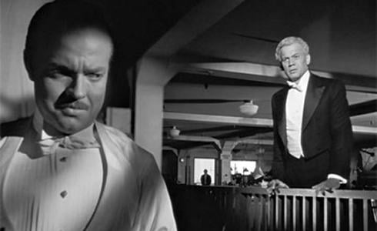
Deep Focus
Foreground, midground and background all sharp.
Every plane equally available, so the audience chooses where to look.
Orson Welles and Gregg Toland, Citizen Kane.
Notes:
Deep focus keeps every plane sharp, which changes the relationship with the audience: instead of the camera telling you where to look, the composition has to.
Citizen Kane is the standard reference:
Orson Welles and Gregg Toland staged action in depth so that foreground, middle and background all carried story simultaneously.
This is composition doing the work that focus usually does.
If everything is sharp, your value structure and your leading lines have to be strong enough to direct attention on their own.
It is the harder way to shoot and it is why those frames are still studied.

Slide 22
Aperture
Aperture is the opening in the lens that lets light in.
Small aperture: less light, greater depth of field. More of the frame is sharp.
Wide aperture: more light, shallower depth of field. A thinner slice is sharp.
Notes:
Small aperture, more in focus.
Wide aperture, less in focus.
It is counterintuitive the first time and then it never leaves you.
You do not need the f-numbers. What you need is to know that a cinematographer choosing a shallow-focus look is trading light for isolation, and that if you board a shot that depends on a soft background, somebody has to be able to light it that way.

Slide 23
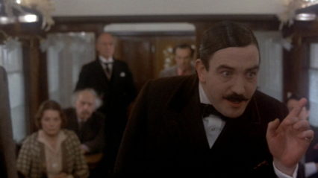
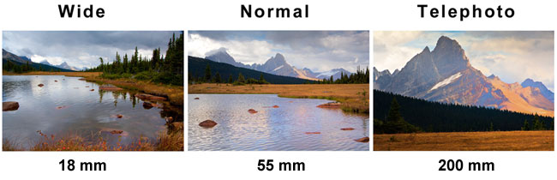
Lenses Tell the Story
Three main lenses: wide angle, normal, telephoto.
Each one describes space differently: the same scene, three different worlds.
In Murder on the Orient Express, the flashbacks are shot on wide lenses to make them feel dramatic and distorted.
Notes:
Lens choice is a storytelling decision, not a technical one, and Sidney Lumet's account in Making Movies is the best example.
On Orient Express the body of the film uses normal lenses,
and the flashbacks switch to wide, which stretches the space, distorts faces slightly, and makes the recollections feel less trustworthy.
Nobody in the audience notices the lens changed.
Everybody notices the flashbacks feel different.

Slide 24
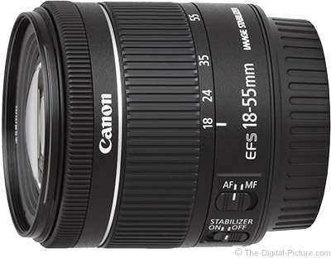
Normal Lens
Roughly mimics the perspective of human vision.
Relationships look the way you expect: figures sized and spaced normally relative to each other.
Looking through it is close to looking with your own eye.
Notes:
A normal lens renders spatial relationships approximately as your eye does, so nothing calls attention to itself.
Which makes it invisible, and invisible is often exactly right.
Most of most films is shot on normal-ish lenses for the same reason most shots are eye level:
you save the conspicuous choices for the moments that deserve them.

Slide 25

Wide Angle
Takes in a much larger area than a normal lens.
Exaggerates the space between near and far.
Foreground and background both tend to stay in focus.
The wider the lens, the more distortion, especially at the edges, and on faces.
Notes:
Wide angle stretches depth. The gap between foreground and background is exaggerated, so a room feels bigger and a corridor feels longer than it is.
It also distorts, particularly at the frame edges and particularly on faces: noses enlarge, edges bow.
A wide angle makes a room feel bigger and a face feel wrong. Both of those are useful, and the second one is used deliberately far more often than students expect.
For boarding: wide angle means strong convergence.
If you draw a wide-lens shot with gentle perspective, it will not read as wide.

Slide 26
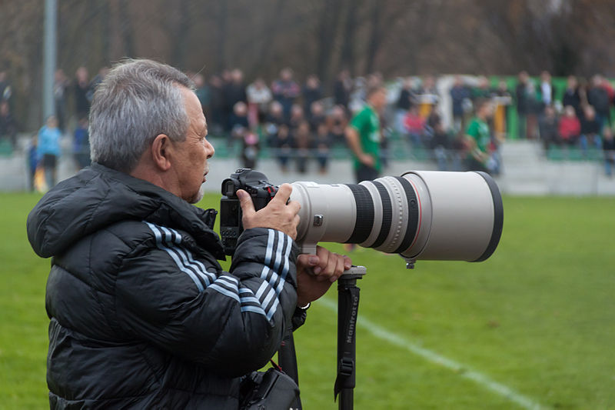
Telephoto
Shallow depth of field: a thin slice in focus, everything else soft.
Compresses foreground and background together.
Objects at different distances appear stacked, closer together than they really are.
Notes:
The opposite of wide. Telephoto compresses depth: things at different distances look flattened together, and the background sits right behind the subject like a painted backdrop.
The classic use is a character running towards camera who never seems to get any closer. The compression is doing that, and you can absolutely draw it.
The practical version for you is that a telephoto shot has almost no convergence.
Parallel lines stay nearly parallel. So if you want a shot to read as long-lens, flatten the perspective rather than sharpening it, which is one of the few places in this session where less construction is more accurate.

Slide 27
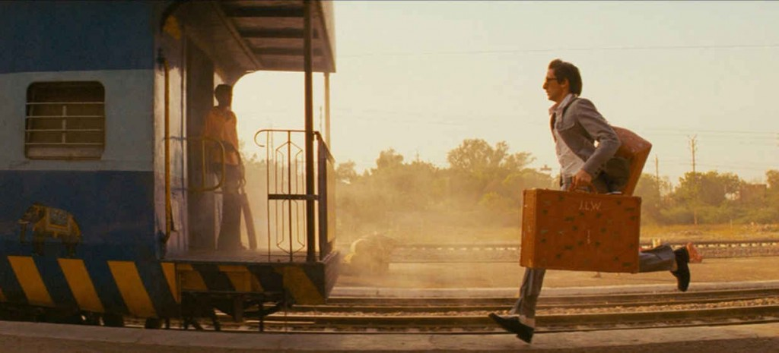
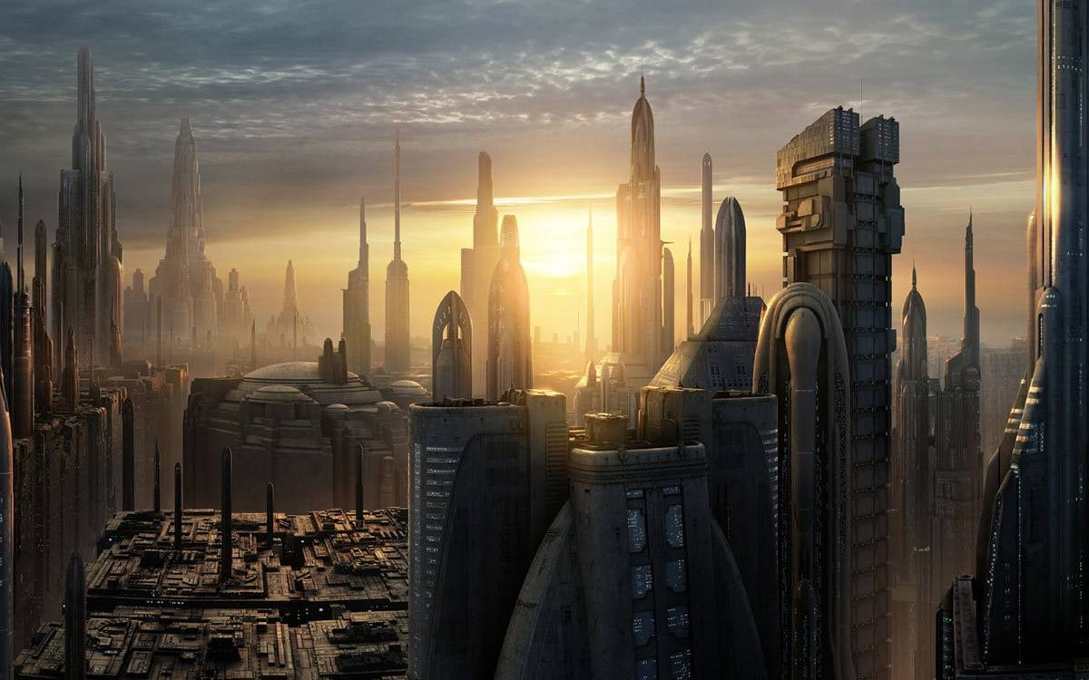
Which Cue Is This Shot Using?
Name the depth cues in each.
Which cue is doing the most work, and what would the frame lose without it?
Notes:
New slide, and it is the decision this session has to land on.
ideally one built on atmosphere, one on overlap and value, one on hard linear construction. Ask the class to name the cues.
Say: I want to hear "overlap and value", not "good perspective". Naming the specific mechanism is the skill, because it is the only version you can then go and use.
Push the second question if there is time: which cue is carrying the shot, and what would you lose if you removed it? That is the question that turns recognition into judgment.

Slide 28
In Conclusion
Several ways to build depth: overlap, size, atmosphere, value, texture, and linear perspective.
The Lens plays a big role in perspective: depth of field, and what wide and long lenses do to space.
The horizon line is your camera height. Move it and you have moved the camera.

