Slide 1
Continuity: Making the Cut Disappear
Notes:
This session moves earlier in the course on purpose. City Park is assigned at the end of today, and City Park is graded on continuity, so it would be unreasonable to assess rules you had not been taught.
The deck is split in two. Today is the rules: the line, screen direction, the three matches. Everything City Park is graded on. The second half, on transitions and montage and editing rhythm, comes later, near the animatic, because you cannot feel cutting rhythm until you have timed something.

Slide 2
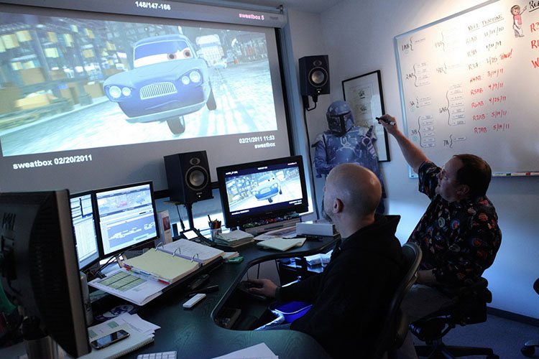
What Continuity Editing Is
Splicing shots of different sizes and angles so the audience perceives one continuous action.
There may be a dozen cuts in a minute. None of them are noticed.
If continuity fails, the illusion of consecutive action is interrupted, and the audience feels it before they can name it.
Notes:
Start with the paradox, because it is counterintuitive.
Continuity editing is the art of splicing together shots that were filmed at different times, from different positions, at different sizes, and producing the experience of one unbroken action.
There can be a dozen cuts in a minute of screen time and a normal viewer will not notice a single one.
Say: the best work in this entire discipline is work nobody sees. Get comfortable with that now, because it is the deal. You will do your most skillful work on the things the audience is specifically not supposed to notice.

Slide 3
It Is Decided at the Board, Not in the Edit
A good director or designer will consider continuity at the storyboard/planning phase.
Pacing and transitions get set during planning, shot by shot.
Notes:
Continuity is often taught as an editing subject. It is not, or at least not only.
Every frame that is sketched gets evaluated shot by shot, and pacing and transitions are established at the planning phase. The editor's options are entirely determined by what was shot, and what was shot is determined by the boards.
Say: an editor can only cut what you gave them. If your boards break the line, the break is in the film, and by the time anyone notices, re-shooting is the only fix and nobody is going to pay for it.
That is why this is your problem rather than somebody else's.

Slide 4
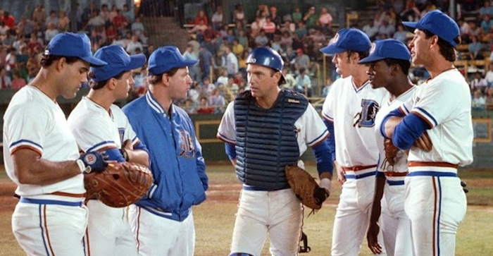
Film Time Is Not Real Time
Editing gives the director control over time, by showing only what is relevant.
A baseball game is three hours. The scene is ninety seconds.
Too fast and the audience cannot follow. Too slow and they are bored.
Notes:
The baseball example on the slide is the clean one: anyone who has been to a game knows it is not a short experience. On screen it is ninety seconds, and nobody feels cheated.
That compression is the point of editing. You show the parts that carry the story and you skip the rest, and the audience reconstructs the whole.
Say: the two failure modes are opposite and they look identical in a first draft. Too fast, and they cannot follow what happened. Too slow, and they stop caring. You will get numbers for this in the animatic session. For now, notice that both are your responsibility and not the editor's.

Slide 5
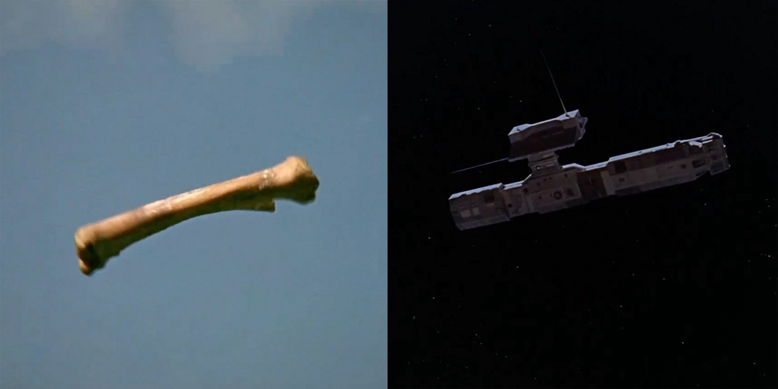
The Most Famous Leap Ever Cut
Example. 2001:
Film begins with ape throwing bone into air that transitions to image of space station.
Notes:
2001: A Space Odyssey. A prehistoric ape throws a bone into the air, and on its descent the film cuts to a spacecraft.
Four million years in one cut.
Say: and it works because of a graphic match: the shapes rhyme. The bone tumbling and the ship drifting occupy the same part of the frame, at the same angle, moving the same way. Your eye accepts the substitution before your brain catches up.
We will come back to this in the second half of continuity, and your composition lecture already showed you the same cut. Three sessions, one example, on purpose, because composition, continuity and montage are the same subject seen from three sides.

Slide 6
The Tools
Matching eyelines
Matching action
The 180-degree rule: the line of action
Consistent screen direction
Notes:
This is the agenda for the rest of the session, so read it as one.
Four tools. The line, screen direction, and the three matches: action, eyeline, and shot/reverse.
Say: all four are checkable. That matters, because unlike most of what this course teaches, these have right answers. You can look at a sequence and say definitively that the line was crossed. That makes them the easiest marks in City Park and the most annoying ones to lose.

Slide 7
The Line of Action (the 180-Degree Rule)
Line of Action (also known as 180 degree rule) helps organize camera angles and movement into consistent screen direction.
Line of Action gives the audience a sense of direction for the scene.
Notes:
The single most important continuity tool, and the one students break most often.
Draw an imaginary line through the scene, between two people in conversation, or along the path of a moving subject. That line divides the space in two. Pick a side and keep the camera on it.
Everything on your side is a legal camera position, which is a 180-degree arc. That is a lot of freedom, and it is why the rule feels restrictive only until you have used it.
Say: the line gives the audience a stable sense of direction for the scene. Who is on the left, who is on the right, which way things are going. Break it and you have taken that away without warning.

Slide 8
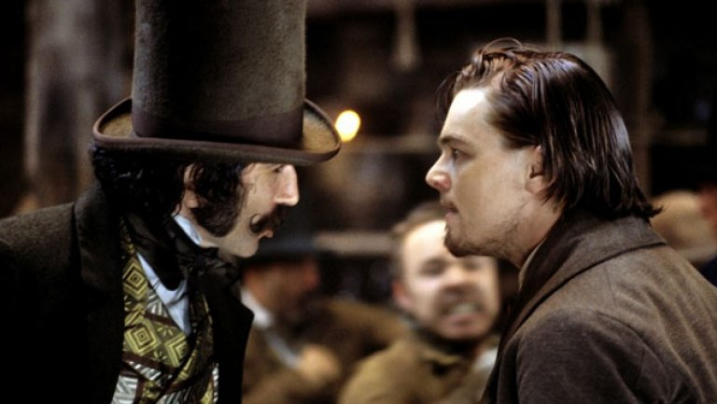
The Half-Circle
Example:
Line of Action is drawn between two individuals.
Once line is in place, there is a space of 180 degrees (half circle) where shots can be rendered
Notes:
Work the diagram live rather than reading it.
Two characters facing each other in profile. Draw the line between them. Now the camera can go anywhere in the 180-degree arc on one side: wide, close, over either shoulder, high, low, and every one of those shots will cut together.
Say: notice what you get for free. Once the line is established, every shot on that side is compatible with every other shot on that side. You do not have to think about it again for the rest of the scene.
Have them draw it. Two dots, a line, a shaded half-circle. It takes ten seconds and it is the thing they will actually use.

Slide 9
What Breaks When You Cross It
Keep every shot on the same side of the line.
If the line is crossed, one character might end up looking at the back of another character's head.
The audience will be confused.
?
Notes:
The concrete failure: one character ends up looking at the back of the other's head. Two people in conversation appear to be facing the same direction, or a character who was on the left is suddenly on the right.
Say: here is the part worth stressing. The audience does not know it is a geometry error. They cannot tell you what is wrong. What they will say is that it feels off, or that it looks cheap, or that they got confused for a second.
That is what a broken line feels like from the audience seat, and it is why you cannot rely on someone flagging it for you. You have to check it yourself, which is what the floor plan from Deck 04 is for.

Slide 10
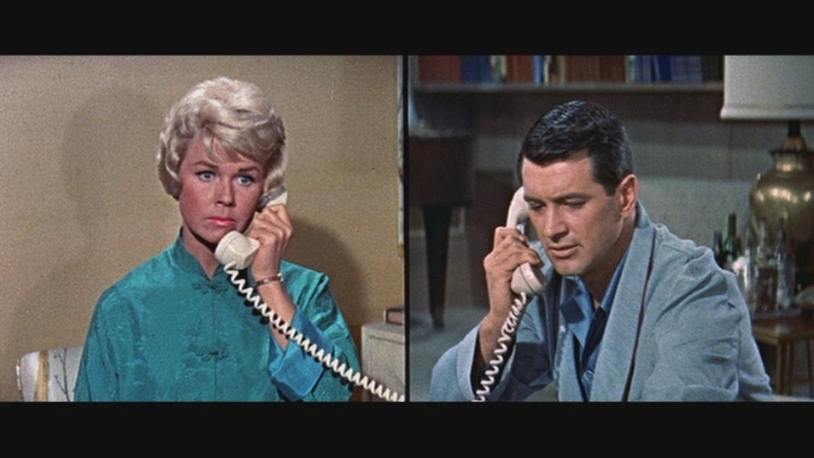
Distant Characters Still Have a Line
Even distant characters still need an imaginary line between them.
Cut between them and they should still appear to face each other, even in separate locations.
Characters are looking at each other’s general direction
Notes:
Two people on the phone, in two different cities, never in the same frame. There is still a line.
Establish an imaginary one between them and stay on one side of it, so that when you cut from her to him, they appear to be facing each other. She looks screen-right, he looks screen-left, and the audience connects them across a thousand miles.
Say: get this wrong and two people having a conversation appear to be facing away from each other, which reads as distance in a way you did not intend, or just as an error. The rule is not about physical space. It is about the space the audience is building in their head.

Slide 11
Crossing It Legally: Move the Camera
A dolly or crane shot can move over the established line, as long as the movement is continuous
Notes:
Once the line is established there are legal ways across, and this is the first: keep the camera moving.
A dolly or a crane can travel over the line as long as the movement is continuous and the audience is carried across with it. Because they watched the journey, the new geography arrives already explained.
Say: this is expensive (it is a move, and moves cost money), but it is the most elegant solution, because nothing is hidden. You simply showed them.

Slide 12
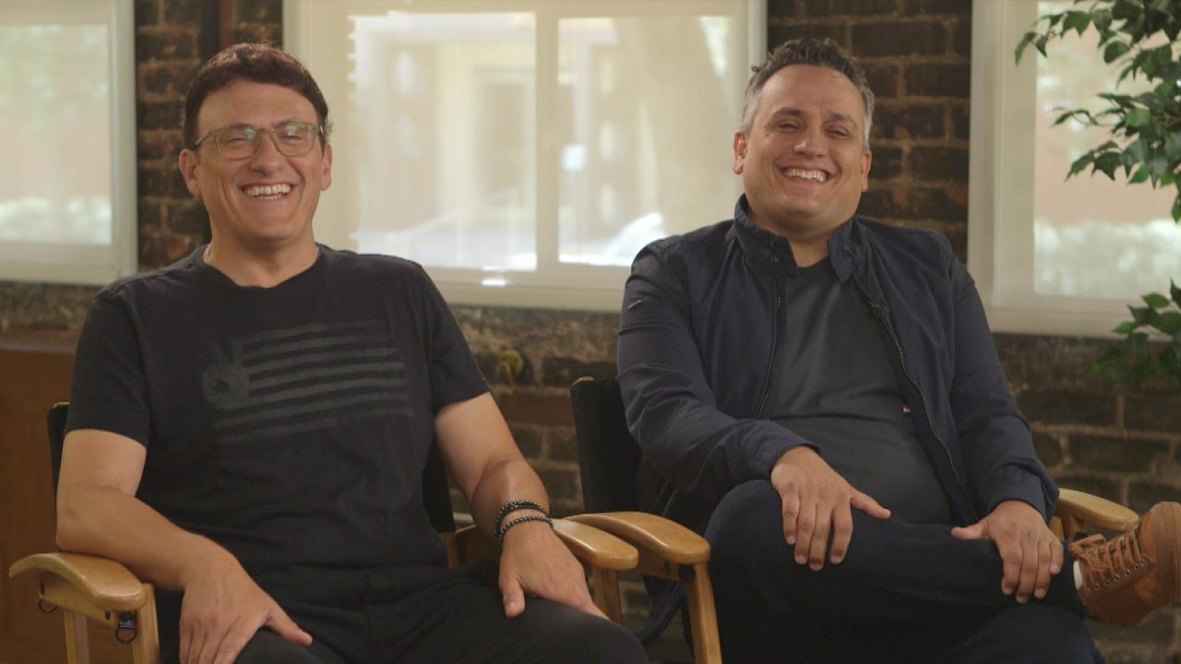
Crossing It Legally: Move a Character
If one of these characters were to get up and move, the camera will be reframed.
Once the character has established his eye contact with the seated character, you have established a new line of action.
Notes:
The second and third legal crossings, and both are free.
A character crosses the line themselves. They get up, walk around the table, sit down opposite. Once they have re-established eye contact from the new position, a new line exists, and that is now the line.
Or a third person enters and somebody turns to acknowledge them. A new sightline is established, so a new line is established.
Say: notice the pattern. In each case, the audience watched the geography change. That is the whole principle: you are not forbidden from crossing, you are forbidden from crossing invisibly.

Slide 13
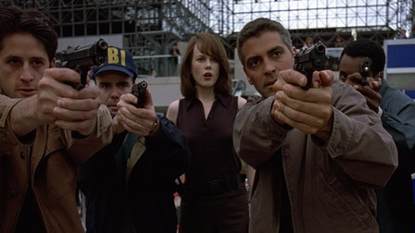
Crossing It on Purpose
Occasionally, the line of action is crossed to convey the character’s confusion. (example: searching for suspect in crowd)
Be aware, however, there is a very fine line between conveying a character’s confusion and confusing your audience.
Notes:
The illegal crossing, used deliberately.
A character running through a crowd looking for someone. A fight. A panic. Crossing the line repeatedly produces exactly the disorientation the scene is about, and that is a legitimate tool.
Say: and here is the warning that matters. There is a very fine line between conveying a character's confusion and simply confusing your audience, and you will not get the benefit of the doubt. A single crossing reads as a mistake. If you are going to break it deliberately, break it hard enough and often enough that nobody could mistake it for an accident.
In City Park, if you cross the line, put a note in the margin saying you meant to. That is not me being generous, it is what a board artist does on a real production.

Slide 14
Screen Direction Is a Promise
It is important to plan the direction a person or object moves or looks toward.
Have clarity of intent, especially across multiple shots.
A good director will rely on the shot list and storyboards to maintain a consistent screen direction.
Three types of screen direction: neutral, constant, and contrasting.
Notes:
Screen direction is which way a person or object moves or looks, held consistently from shot to shot.
If a character faces one direction in the first shot and the opposite direction in the second, continuity is jeopardized, and the audience's mental map of the scene breaks.
Say: think of it as a promise you made in the first shot. The audience believed you, and they are now navigating by it. A shot list and a floor plan are how a director keeps that promise across a day of shooting, in which the shots were almost certainly filmed out of order.

Slide 15
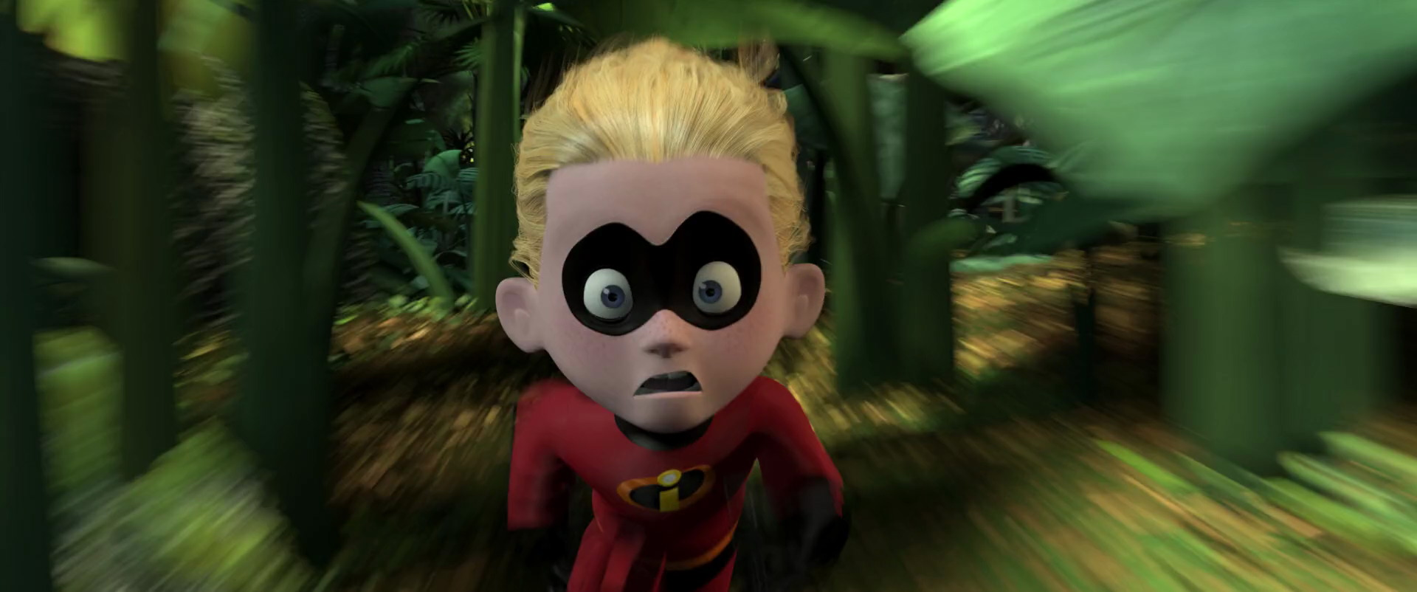
Neutral Screen Direction
movement toward or away from the camera.
shows only the front or back side.
provides impact: the subject grows in frame as it nears the camera.
Notes:
Movement straight toward or away from the camera. You see the front or the back, and no left-right information at all.
Because it carries no direction, it is the safe cut between two shots that contradict each other. If you have a character moving left-to-right and you need them moving right-to-left, put a neutral shot between the two and the audience accepts the change.
Say: it is also dynamic in its own right: a character walking directly at the lens grows in the frame, which is why it is used for arrivals and confrontations.

Slide 16
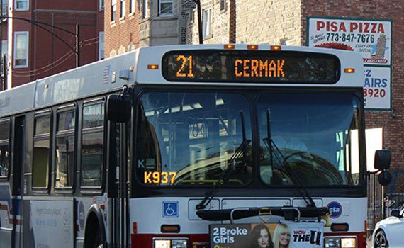
Constant Screen Direction
Constant screen Direction shows movement in one direction only.
You would storyboard the progression of shots of this bus going in the same direction.
Showing the bus going in the opposite direction, this will confuse the audience because the bus appears to be moving back to its starting point.
Notes:
Movement in one direction only, held across every shot in the sequence.
The bus on its route travels left to right. Every shot of that journey has it going left to right, regardless of where the camera actually stood. Cut to a shot of the bus going the other way and the audience believes it turned around and is heading back.
Say: the same applies to characters entering and exiting frame. If somebody exits screen-right, they should enter the next shot from screen-left, because they are continuing the same journey. Get that backwards and they appear to have doubled back.

Slide 17
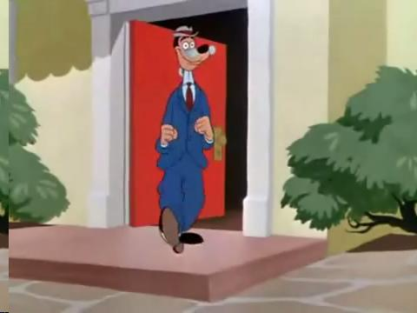
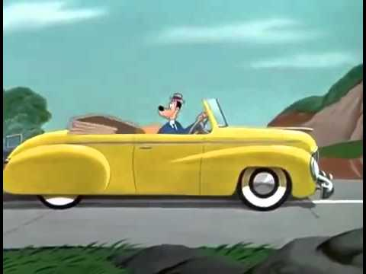
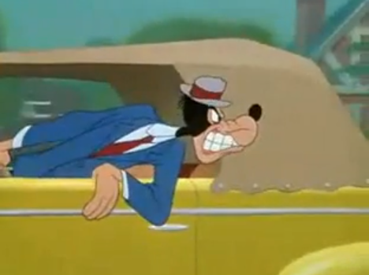
Contrasting Screen Direction
Entering and exiting the frame from opposite directions.
Often called right-to-left and left-to-right movement.
Leaves home moving left to right. Coming home, right to left.
Notes:
This is the deliberate reversal. Out is one direction; back is the other.
Say: this is how you tell an audience "he's going home" without a single word of dialogue. Reversed direction reads as reversed journey. It is free, it is completely reliable, and nobody ever notices you doing it, which is the highest compliment available in this discipline.

Slide 18
Two Directions Colliding
Entering and Exiting frame from opposite directions.
Often called Right to Left and Left to Right movement.
Notes:
The other use of opposing direction: two subjects moving toward each other from opposite sides of the frame.
The audience reads a collision course immediately. And as they converge, the grammar tightens with them: the shots get shorter, the framing gets closer.
Say: notice that the tension is being produced by the direction rather than by the content. Two people walking is not dramatic. Two people walking toward each other from opposite edges of the screen, in alternating shots that keep getting shorter, is the whole of a Western.

Slide 19
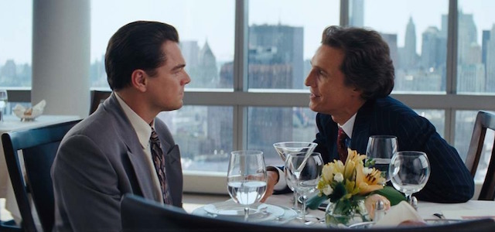
Shot / Reverse Shot
Common technique used to create continuity between two or more characters.
Allows audience to follow the action between characters as camera angles and framing changes.
The simplest form of the shot/reverse shot is staging a conversation between two characters.
Notes:
The most common coverage pattern in narrative film, and it is the line of action put to work.
Establish the space so the audience knows who is where. Draw the line between the two characters. Then place the camera on one side of it and cut back and forth.
Say: because both cameras are on the same side, the two characters appear to be looking at each other across the cut. That is the entire trick, and it is why the establishing shot at the start is not optional: it is what makes the reverses legible.

Slide 20
Match on Action
Match on action is the illusion that the action continues uninterrupted even though the camera positions may have changed from one shot to the next.
To create a match on action, everything at the end of the first shot must closely match the action at the beginning of the next shot.
It is generally easier to create a match cut by noticeably changing the size of the frame and cutting on the movement.
Notes:
The illusion that action continues uninterrupted even though the camera has moved.
Everything at the end of shot A has to closely match the start of shot B: position, posture, direction, speed. Then you cut during the movement rather than before or after it.
Two practical rules from the slide: change the frame size noticeably, and cut on the movement.
Say: cutting on movement hides the cut, because the audience's attention is on the action rather than the frame. Cutting on stillness advertises it. That is most of the technique, and it is why a door opening, a head turning or a hand reaching are the classic cut points.

Slide 21
Cut Late Enough to Be Understood
Only cut after the audience understands what the shot is showing.
If a shot is too fast, the audience will not have time to absorb the details
If the shot is too long, the audience will be irked.
Notes:
Cut only after the audience has actually absorbed the information in the shot.
If the shot is too short they miss the detail and spend the next shot catching up. If it is too long they get irritated and their attention drifts.
Say: this is your first taste of timing, and it is a judgment rather than a rule. You will get actual numbers in the animatic session: a reaction is about a second, an establishing shot three or four.
For now, the test is simple: can you read the shot yourself, out loud, in the time you have given it? If not, it is too short.

Slide 22
Eyeline Match
Creates order and meaning by matching where characters are looking.
If a character looks off-screen, the audience expects to see what they are looking at in the next shot.
Obey the line of sight and characters will appear to look toward each other, maintaining eyelines.
Notes:
An eyeline match creates order in the story space. Somebody looks off-screen; the next shot shows what they saw. The two shots are now bound together and the audience has built a piece of geography out of nothing.
Say: that expectation is a debt. If you show me a character looking hard at something off-screen and then cut to an unrelated shot, you have broken a promise and the audience will feel cheated without knowing why.
And connect it back: the composition lecture called an eyeline a compositional tool, because it directs the viewer's attention inside the frame. Here it is a contract between two frames. Both are true, and that is the pattern of this whole course.

Slide 23
The Continuity Checklist
Where is the line, and am I on one side of it?
Does every character move in a consistent direction?
Does each look off-screen get answered?
Does the action at the end of each panel match the start of the next?
If I crossed the line, did I earn it?
Notes:
This is handout H4, and it is the City Park rubric in five questions.
Give it out now. Every one of these is checkable: they are not matters of taste, and that is deliberate. It means you can self-assess before you submit, and it means when you lose marks here you will know exactly why.
Say: run this on the whole sequence, not on individual panels. Continuity is a property of the sequence; a panel cannot break the line on its own. That is why the last question exists: crossing the line is allowed, and unmarked crossing is not.

Slide 24
Exercise, and City Park Is Assigned
Two panels that break the line. Fix them.
Rule: no redrawing. Reposition the camera only.
Then: City Park is assigned today. This checklist is the rubric.
Beat sheet is due next session.
Notes:
Run the exercise live and keep the constraint tight: they may not redraw anything. The only permitted fix is moving the camera, which forces them to think in floor plans rather than in pictures.
Then assign City Park. Bring the brief up on screen.
Say: City Park is deliberately dull: one park, two characters, fifteen to twenty-five panels. It is not testing your imagination. It is testing whether you can keep a space coherent across a cut, which is what today was about.
And say the thing that matters: the checklist you just got is the rubric. There are no surprises in this course. If you can answer those five questions about your own sequence, you have the marks.
Exit ticket: post the fixed pair of panels before you leave.

