Slide 1
The Cut: Time, Space, and Rhythm
Notes:
This is the second half of continuity. The first half was the rules: the line, screen direction, the three matches. It ran before City Park because City Park is graded on it.
This half is about editing rhythm, and it runs here, near the animatic, because you cannot feel cutting rhythm until you have timed something. Everything today is about what happens in the gap between two panels.

Slide 2
What You Actually Control
Continuity editing compresses or stretches time, depending on what the narrative needs.
It links the action of an individual shot to the bigger picture of the story.
If it works, the audience never sees the manipulation, they see one continuous whole.
Notes:
Open by naming the power, because students underestimate it.
Editing lets you compress three hours into ninety seconds, or stretch two seconds across a minute. It lets you jump four million years, as 2001 does, or hold a moment past comfort.
Say: none of that is an effect. It is structural, it is decided at the board, and the audience is not supposed to notice any of it. If a production achieves continuity, the manipulation of time and space is invisible, which is why editing is the least appreciated craft in film and one of the most decisive.

Slide 3
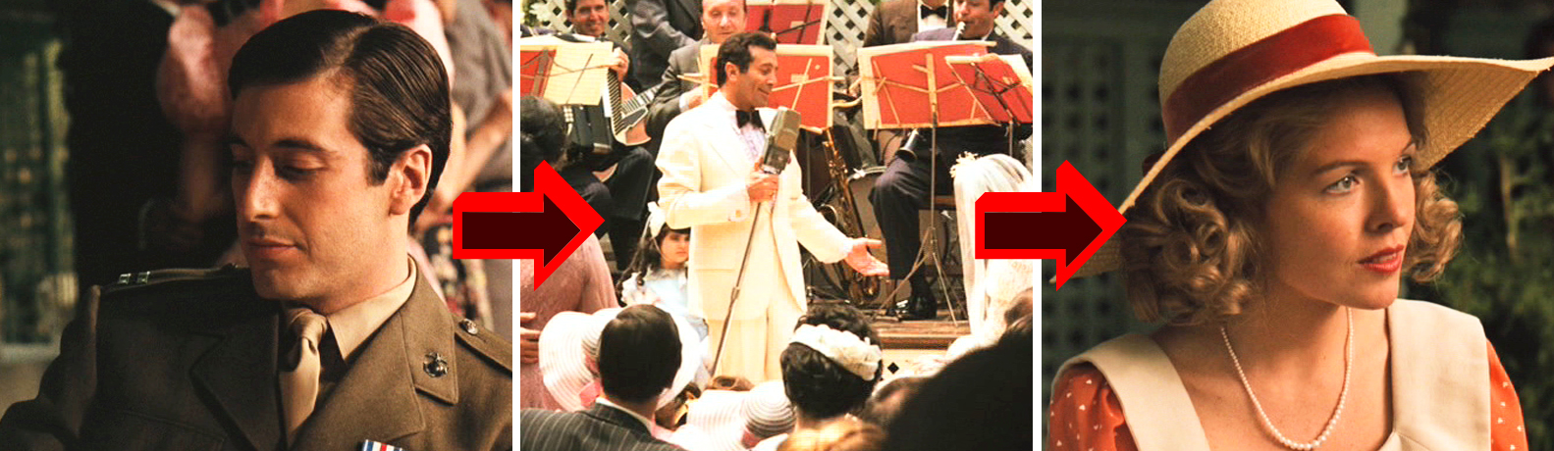
Cutaway
The Cutaway technique is used to manipulate time and space.
The Cutaway should be related to the main action, but not part of it.
The camera cuts away to the singer to complement the main action, which is the conversation between the two characters. In this situation, the cutaway is used to add context to the setting.
Notes:
A shot related to the main action but not part of it.
The example on the slide: two characters talking, and the camera cuts away to a singer performing across the room. The singer is not in the conversation, but she is in the world, and the cut adds context.
Say: mechanically, a cutaway buys you time. You can remove ten seconds of a conversation and cover the join with two seconds of somebody else, and nobody will notice the surgery. Editors love them for exactly that reason, and it is why coverage lists always include a couple.

Slide 4
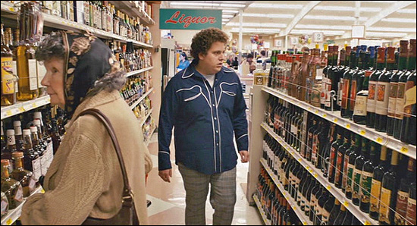
What a Cutaway Is Really For
Making small shifts in time without announcing them.
Building tension by delaying the return.
Working inside the psychological space of an interaction: what somebody is not saying.
Focusing only on the actions that matter to the story.
Notes:
The first slide gave the mechanism; this one gives the reasons.
Time shifts are the practical use. But the interesting use is psychological: cutting away during a conversation can carry hesitation, avoidance, or somebody's attention wandering, without a line of dialogue.
Say: cutting away at the wrong moment tells the audience the moment did not matter. Cutting away at the right moment tells them the character could not stay in it. Same technique, opposite meanings, and the difference is entirely where you put it.

Slide 5
Cut-In
Cut-ins focus on the primary action of a scene.
Rather than cutting away from the main action, the cut-in shot narrows our view to a smaller portion of the action.
Provides dramatic emphasis.
Notes:
The opposite move. Rather than cutting away from the main action, you narrow to a detail inside it.
The baseball example is the clean one: the main action is the game, and the cut-in is the bat meeting the ball. Dramatic emphasis by exclusion.
Say: cutaway goes outside, cut-in goes closer. One buys you time, the other buys you emphasis. Do not confuse them, because they solve completely different problems and reaching for the wrong one is a common note.

Slide 6
Cross-Cutting (Parallel Editing)
Cross-cutting, also called parallel editing, manipulates both time and space.
Action that is happening at the same time is intercut so that the audience may see a parallel action.
Cross-cutting is often used to intensify the drama and to provide suspense in a film or animation.
Notes:
Two actions happening at the same time, in different places, intercut with each other.
It manipulates time and space simultaneously, and it is the standard way to build suspense: the bomb ticking, the hero driving, the bomb, the hero.
Say: cross-cutting also makes an argument. Putting two things next to each other says they are connected, whether or not anybody in the film says so. That is a claim you are making on the audience's behalf, and the next slide is the most famous example of it.

Slide 7
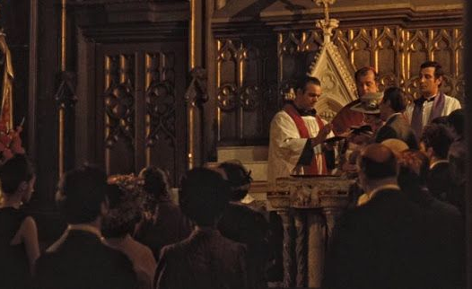
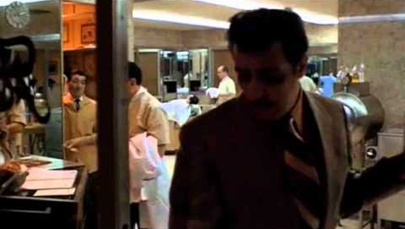
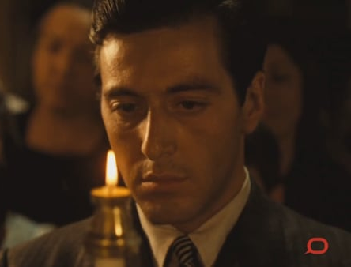
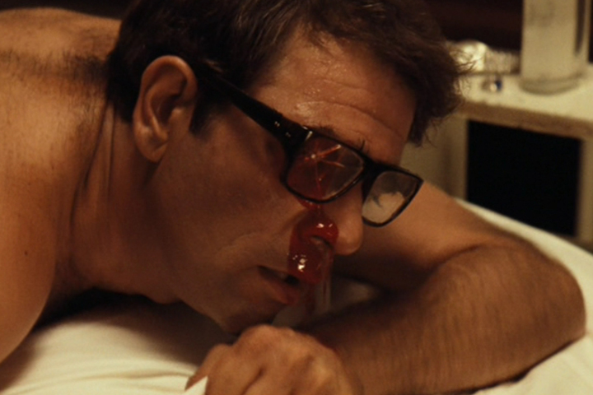
The Godfather Baptism
Example (The Godfather):
The sequence between the baptism of Michael Corleone's nephew cross cuts with the Corleone Mobsters preparing for and ultimately committing murder.
Although the sequence lasts around 6 minutes, it is fairly fast-paced.
Notes:
Six minutes or so, and it moves fast.
Michael Corleone stands as godfather at his nephew's christening. Intercut with it, his men murder the heads of the five families. He is renouncing Satan at the altar while the murders he ordered are carried out.
Say: neither sequence would work alone. A baptism is not dramatic. Five murders is just violence. The meaning is manufactured entirely by the intercutting, and not one shot had to be redrawn to make it.
That is the argument for storyboarding a sequence rather than a shot. The meaning lives in the order.

Slide 8
A Transition Is a Narrative Device
It links two shots that differ in time, place, or focus.
It contributes to the pace of the production, lyrical or abrupt.
The main types: cut, dissolve, fade, wipe.
Notes:
A transition is not decoration. It is a narrative device that tells the audience what kind of gap they are crossing.
Same place a second later, or the other side of the world a year later, the transition is how they know which.
Say: it also sets pace. A sequence of hard cuts feels different from the same sequence with dissolves, even at identical durations. You are choosing a rhythm, not a wipe pattern.

Slide 9
Cut
Over 90% of films use Cuts as a transition to connect two shots together.
Most audiences do not even notice when a program cuts to a different angle or framing within a scene.
The cut is effective for compressing time.
Notes:
Over ninety percent of all transitions in film, and the audience does not notice a single one.
The cut is unobtrusive and it is the best tool for compressing time. Most viewers cannot tell you when a program cut to a different angle within a scene, because they were watching the story.
Say: the default is correct almost always. If you are reaching for something other than a cut, have a reason you could say out loud. "It looked nice" is not one, and it is the reason most student animatics have three dissolves too many.

Slide 10
Dissolve
Basically, when a piece of film strip was superimposed onto another, creating an overlapping image.
Can be any length, and are usually employed to show a time lapse or location change.
Notes:
One image superimposed over another, so the first fades out as the second fades in. Any length.
Conventionally it signals a lapse of time or a change of location: the limousine pulls away, the shot dissolves, we are somewhere else and later.
Say: a long dissolve is also an emotional device. Holding two images on screen together for a full second asks the audience to consider them at the same time, which is a montage idea wearing a transition's clothes.

Slide 11
Fade
Used to denote a passage of time and should not be used in the present tense.
Fades are usually very subtle as the screen fades in or out from black. (if it fades to white, it's often called a white out)
A Fade-In is used to ease the audience into a setting by starting in black, and gradually lightening up the setting to full brightness.
A Fade Out is usually the last shot of a scene that gradually disappears into darkness.
Notes:
The screen goes to black, or comes up from it. If it goes to white it is a white-out.
Fades denote a passage of time and should not be used in the present tense. A fade-in eases the audience into a setting; a fade-out is usually the last shot of a scene or a film.
Say: a fade is the strongest punctuation available to you. It is a full stop, and possibly a chapter break. Using one in the middle of a continuous scene tells the audience the scene ended, and then they have to un-learn that when it does not.

Slide 12
Wipe
Wipes function the same way as the cut, transitioning from one shot to the next, but here it pushes one image off the screen with another image.
This showy technique was quite popular during the 1930s and 40s, but went out of fashion shortly after World War II.
The wipe made a resurgence in the 1970s with the release of Star Wars, and can be seen in a handful of films today.
Notes:
One image pushes the other off the screen. Functionally a cut, cosmetically a performance.
Popular in the 1930s and 40s, out of fashion after the war, and resurrected almost single-handedly by Star Wars, which used them deliberately to evoke the serials Lucas grew up on.
Say: which is the useful lesson. The wipe is not neutral any more. It carries a period association, so using one now is a reference whether or not you intended it. Very few techniques stay neutral forever.

Slide 13
Jump Cut
Jump cuts are the opposite of continuity shots, using abrupt changes in movement to disrupt the illusion of a continuous flow of action .
A jump can be achieved between shots by maintaining the background and abruptly changing a character's position.
Jump cuts are also achieved when character framing is the same from one shot to the next, but the camera has moved its position.
Notes:
The deliberate opposite of continuity. Same background, character position jumps. Or the same framing with the camera moved only slightly, so the subject snaps.
It disrupts the illusion of continuous action, which is the entire point.
Say: a jump cut is a broken rule used on purpose, exactly like crossing the line. And the difference between this and a mistake is entirely whether the audience believes you meant it. One jump cut is an error. A sequence of them is a style.

Slide 14
Juxtaposition Creates Meaning
Cinematic montage is a series of images that can be juxtaposed to create meaning by evoking an emotional response.
The shots maintained information relating to a single idea or theme. Music videos are often assembled around the montage sequence of a band or singer.
In such scenarios, the rhythm and pacing of the video depends on the structure of the song.
Notes:
Cinematic montage: a series of images juxtaposed to create meaning and provoke an emotional response.
The shots are unrelated in time and space. Placed together, they produce a third thing that is in neither of them.
Say: this is one of the strangest and most important ideas in editing theory. Meaning appears in a gap. Nobody drew it and nobody photographed it, the audience manufactured it between two frames.

Slide 15


The Demonstration
Notes:
Run the example on the slide as an actual exercise, not an anecdote.
Shot one: students slumped over an exam in a classroom. Shot two: somebody asleep in bed. Two unrelated images, different times, different places.
Put them together and ask the room what it means. They will produce boredom, exhaustion, the exam being so dull it put someone to sleep, a student who stayed up all night. Every one of those readings came from the audience.
Say: this is the closure slide from your composition lecture, operating across a cut instead of inside a frame. The brain completes what you leave out: that is what made crude boards legible, and it is what makes montage work. Same principle, different scale.

Slide 16
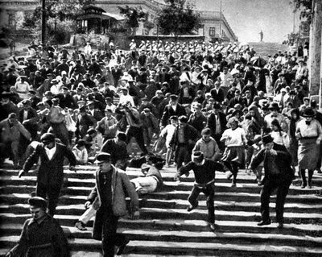
Soviet Montage, 1920s
Developed by Soviet filmmakers: Sergei Eisenstein and Dziga Vertov.
The most famous sequence is the Odessa Steps from Eisenstein's Battleship Potemkin.
Soldiers' boots descending. A mother screaming. A pram on the steps.
No single shot contains the massacre. The sequence does.
Notes:
Note the corrections on this slide. The original notes read "Sergi eisenstein ablnd Dziga Vertov", and both the slide and the notes attributed Battleship Potemkin to "Einstein". It is Eisenstein (Sergei Eisenstein), and it is fixed in both places.
Eisenstein theorized montage as collision: two shots striking each other to produce an idea neither contains.
The Odessa Steps is the demonstration. Boots. A face. A pram. Assembled, they are a massacre, and the massacre is not in any individual frame.
Say: this is a hundred years old and it is exactly what you did four slides ago with an exam and a bed. The mechanism has not changed at all.

Slide 17
Music Video Montage
Assembled around the song rather than around a story.
The rhythm and pacing of the cut follow the structure of the track.
Shots hold information relating to a single idea or theme, not a continuous action.
Notes:
The modern everyday use of montage, and the one students have seen most.
A music video is usually assembled to the song: the cutting rhythm is dictated by the track, and the shots relate to a theme rather than to a continuous action.
Say: which makes it the clearest possible demonstration that cutting rhythm is a separate variable from content. Take the same footage and cut it to a different track and it is a different piece.
Worth connecting forward: this is exactly what your animatic exercise is going to prove. Same panels, different timing, different film.

Slide 18
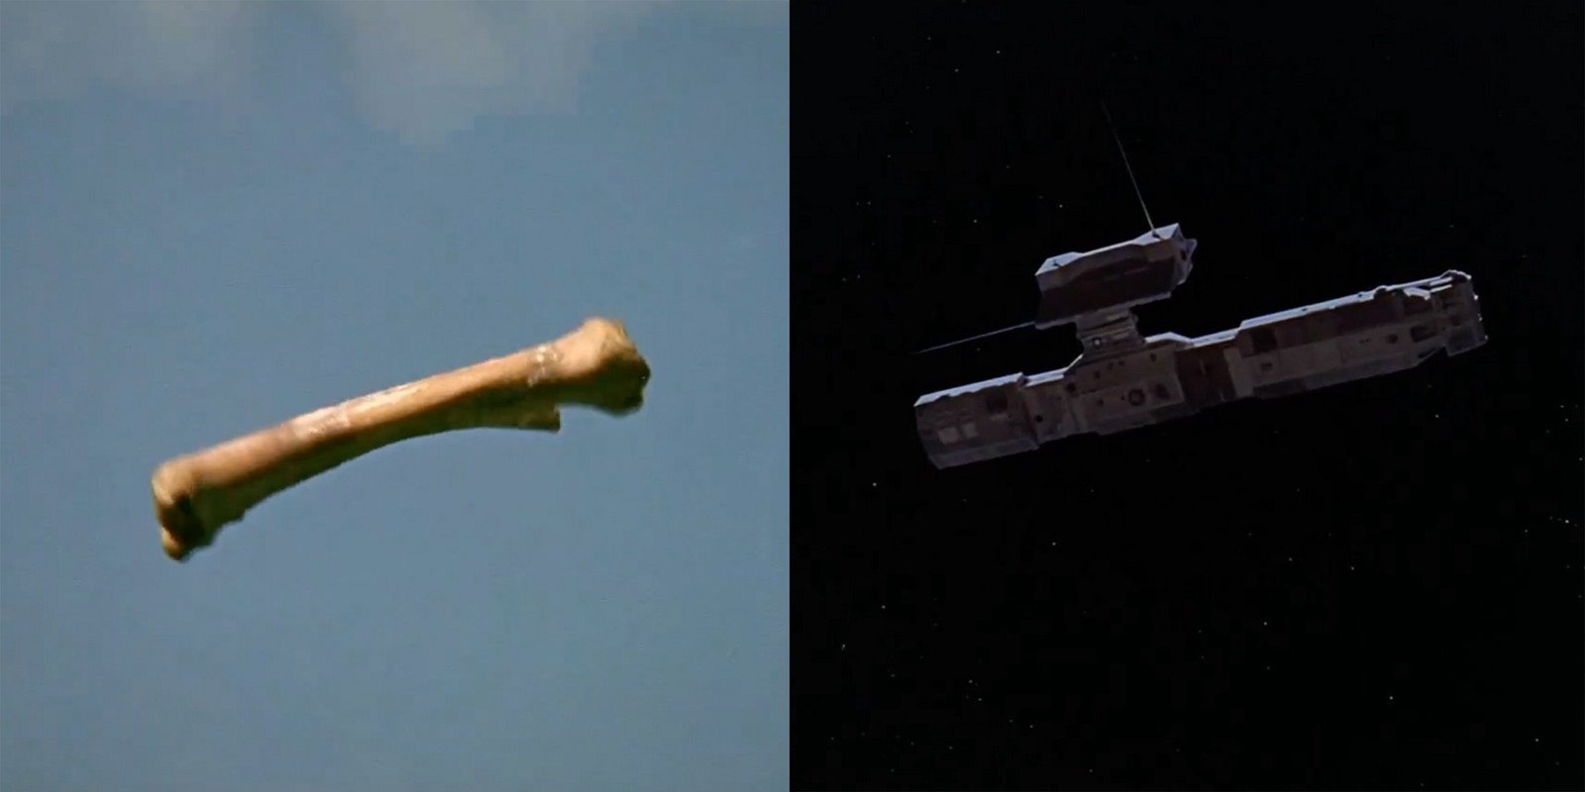
The Graphic Match
A shape in one shot echoed by a shape in the next.
2001: the bone tumbling in the air becomes a spacecraft.
The eye accepts the substitution before the brain catches up.
Notes:
This section is new, and it exists because the composition lecture explicitly promises it: Deck 05 says "your continuity lecture will show you this again."
The graphic match: the shape, position and movement in the outgoing frame are echoed in the incoming one, so the cut is bridged visually rather than logically.
2001 again, third time this term.
Say: I have now shown you this cut in three different sessions for three different reasons. In composition it was about shape. In continuity it was about the leap in time. Here it is about montage. Composition, continuity and montage are the same subject looked at from three sides, and if you take one structural idea out of this course, take that.

Slide 19
Contrast Across the Cut
Wide to close. Light to dark. Empty to full.
If two consecutive panels have the same composition, the cut is invisible in the bad way.
Change something deliberately, or the audience registers a stutter rather than a cut.
Notes:
There is invisible-good and invisible-bad, and this is the difference.
A cut between two shots with near-identical composition does not read as a cut. It reads as a glitch: the audience senses something happened but cannot see what, which is exactly the jump-cut effect arriving by accident.
Say: this is also the practical reason for the shot-size progression from Deck 03. Wide to medium to close is not just grammar, it is a guarantee that consecutive shots differ enough to cut.
Run the check on your own boards: lay two consecutive panels side by side and ask what changed. If the answer is "not much", one of them is doing no work.

Slide 20
Continuity of Position
The audience's eye is already somewhere when your cut lands.
Put the next subject there, or move it deliberately and make them travel.
Either is fine. Neither by accident.
Notes:
The subtlest of the four and the one that separates competent sequences from good ones.
When a cut lands, the viewer's eye is already fixed on wherever the previous frame directed it. If the new subject is in that same screen area, the cut is seamless. If it is somewhere else, the eye has to travel, and that travel costs a beat.
Say: both are legitimate. Matching position gives you smoothness. Deliberately displacing gives you a jolt, which is useful when you want one.
What is not legitimate is not knowing which you did. Look at where the eye is at the end of a panel and where you are asking it to go at the start of the next.

Slide 21
Motif and Visual Echo
Repeating a composition so that its return means something.
Same frame, changed meaning.
One of the more satisfying tools in visual storytelling, and it costs nothing but planning.
Notes:
Callback to the Hero's Journey return slide in Deck 01: the binary sunset in Star Wars, the same framing with a different character standing in it.
A motif is a composition you repeat on purpose so that the repetition carries meaning. The second time the audience sees it, they measure the difference.
Say: same frame, changed meaning. That is the whole trick, and it costs you nothing but planning, which is precisely why it has to be planned at the boarding stage. You cannot add an echo in the edit if you never shot the original.
For your final: if there is a shot worth echoing, decide it now, and put both panels in the same sequence deliberately.

Slide 22
Summary and Exercise
Continuity editing joins shots together to create dynamic meaning.
Done well, the audience does not notice how shots of different sizes and angles were spliced.
They see one continuous whole of uninterrupted action.
That is what we mean by CONTINUITY.
Notes:
Close on the original summary, and then set the exercise.
Exercise: take three panels from your animatic and change only the transition between them. Cut, then dissolve, then a hold with a fade. Nothing else changes: same panels, same order.
Say: report back on what changed. Not what looked nicer: what the sequence appeared to mean. You will find that the transition alters the perceived time gap, and sometimes the emotional weight, without a single frame of new artwork.
That is the argument for treating transitions as a narrative decision rather than a finishing touch, and it is the last thing you need before the animatic.

