Slide 1
Animatics
Notes:
Open cold. Do not read the title slide. Go straight to the question: you have all made storyboards now. What can a storyboard not tell you? Let them sit with it before you answer.

Slide 2
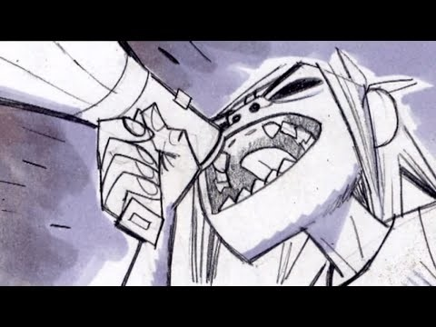
Animatics
Notes:
For a long time, storyboards have been the tool for working out character blocking, camera placement, and action, and they are very good at all three. But as film and animation developed, film-makers ran into something boards cannot do. A board tells you what is in the shot. It cannot tell you how long that shot stays on screen. That is why animatics exist.

Slide 3
Animatics
Animatics are a “moving storyboard” that helps a production understand how scenes flow together.
Notes:
An animatic is a moving storyboard. Your panels, cut together and timed, so a director can see how the scenes actually flow into one another. Everything you already know still applies. This is the same artwork. What is new is the fourth dimension.

Slide 4
Animatics
Begins with script, that is translated to storyboard and then timed in an animatic.
Individual panels are brought into computer or editing software.
By using stopwatch or cutting together footage, the animatic artist can decide how long each movement, dialogue or action will take.
Sound can also be used in an animatic, to give the viewer a sense of the dialogue in the scene, or the emotional buildup when matched to the music.
Notes:
The pipeline: script, then boards, then animatic, then production. Your panels get brought into editing software and given a duration. Sound goes underneath. Now, for the first time, someone can watch the film before the film exists. That is the point of it, and it is why this is the last major thing I teach you.

Slide 5
Animatics
There is no set rule for how animatics should be done.
Artists may want creative license to emphasize action or emotion.
Without animatics, production time and the expense could be greatly increased.
Notes:
There is no fixed rule for how this is done. Different studios, different directors, different workflows. And the artist keeps creative license throughout. If a beat needs to breathe longer than the stopwatch says, hold it longer. The stopwatch is a reference, not an authority. What is not optional is doing it at all. Without a well-timed animatic, a shot can take three or four times longer to build in production, which is thousands of dollars and weeks of someone's life.

Slide 6
Animatics
Animatics help coordinate productions by ensuring everyone is following the same vision:
Directors use animatics to help them visualize a scene.
Animators can use it to block out timing for a scene.
Notes:
Almost everyone on a production uses the animatic. Directors use it to see whether the sequence they imagined actually works. Animators use it as their timing template, and they will be animating to your holds, frame for frame.

Slide 7
Animatics
Animatics help coordinate productions by ensuring everyone is following the same vision:
Actors may use animatics when interacting with CG characters that aren’t there.
Special effects artists can use the animatic to clearly identify timing issues.
Voice actors or sound effects artists can also use the animatic for visualization.
Notes:
It goes further than that. Actors working opposite a computer-generated character use the animatic to know what they are reacting to and when. Effects artists use it to find timing problems early, while they are still cheap to fix. Voice actors and sound designers use it to feel the rhythm of the scene. The animatic is often the single document the whole production is looking at.

Slide 8
Types of Animatics
Hand-Drawn Animatics
Motion Tests
Videomatics
3D Animatics
Notes:
Four kinds you should be able to name: hand-drawn, pencil tests and motion previews, videomatics, and 3D animatics. You will be making the first one, but you should know the others exist because you will hear all four terms in a studio.

Slide 9
Types of Animatics
Hand drawn animatics
Basically “timed storyboards”.
The storyboards themselves are hand drawn sketches that are animated to show how is seen should flow.
Oftentimes can be simpler to produce, and help director communicate complex action scenes.
Notes:
Hand-drawn animatics are timed storyboards, and they are still the most common form in animation. Your boards, cut to length, with sound. Simple to produce, and extremely effective for communicating complicated action that a static page cannot convey.

Slide 10
Types of Animatics
Pencil Tests
Pencil tests are commonly found in cel animation.
The purpose of a pencil test is to preview the motion of characters or objects.
Once pencil tests are analyzed, they are cleaned up by the artist.
Notes:
Pencil tests come out of cel animation. The purpose is to preview the motion itself before anyone commits to cleanup. Rough drawings, shot in sequence, watched at speed. The principle is one you will use constantly: test the thing that is expensive to fix while it is still cheap to change.

Slide 11
Types of Animatics
Motion Previews
Camera movement
Character placement
Timing
Pacing
Notes:
A motion preview explores camera movement, character placement, timing, and pacing. Here is my favorite example of it. Before anyone could render a space battle, George Lucas cut together real World War Two aerial dogfight footage to preview the trench run. He was not testing the visuals. He was testing the rhythm. You have a phone. You can do exactly this.

Slide 12
Types of Animatics
Videomatic
A Videomatic is a rough videotaped version of a scene that uses actors or production staff to assist in blocking the action, actor placement, timing, and camera angles.
Videomatics are usually shot on or near the studio lot, using existing equipment.
Usually shot against bluescreen.
Notes:
A videomatic is a rough live-action version of a scene, shot with whoever is standing around, to work out blocking, placement, timing, and camera angles. Usually shot on the lot with whatever equipment is already there.

Slide 13
Types of Animatics
Videomatic
Blue background is then removed and replaced with new background.
Usually directing is minimal, and cinematography style is simple.
The idea is to test out the script, timing and feel of the shot.
Notes:
The director's car becomes a spaceship. A picnic table becomes a ledge over a canyon. Someone from the production office sits in front of a blue screen and performs the scene. The background gets replaced later so it looks as if the character is sixteen storeys up. The directing is minimal and the cinematography is plain, because the point is not to make it look good. The point is to test the script, the timing, and the feel of the shot.

Slide 14
Types of Animatics
3D Animatic
Some will prefer to create animatics from computer generated material rather than hand-drawn storyboards.
This can give the artist and the team the ability to easily adapt the storyboard to a production that has a lot of changes.
Notes:
Some productions build their animatics from computer-generated material instead of drawings. This is increasingly the default on large live-action films, where it is called previs, and it is a real department with real job titles.

Slide 15
Types of Animatics
3D Animatic
3D Artist will create “proxy model”, of characters and props. These will be updated later.
A “layout” animation is created to get a sense of the action.
Allows the production team to experiment with different camera positions, blocking movements, and camera framing, which are difficult to explore with storyboard panels.
Notes:
The 3D artist builds low-resolution proxy models of the sets, characters, and props, understanding that all of it gets replaced later. Then they animate a rough layout pass. The advantage over drawn panels is that you can move the camera freely and try setups that would be expensive to draw. The disadvantage is that it is slower to get the first version, and it tempts people to fiddle with the model instead of solving the shot.

Slide 16
Rough-Cut
Rough cut is a well-developed animatic that is constantly updated as the film or animation develops.
This is very useful to visualize the progress of a film.
Just as with any animatic, it also helps the production understand how the different pieces flow together as a story.
Notes:
A rough cut is an animatic that never dies. It gets updated continuously as the production develops, with finished shots gradually replacing boarded ones. On an animated feature, a version of this exists from month one until delivery. The film is always watchable, start to finish, at every stage.

Slide 17
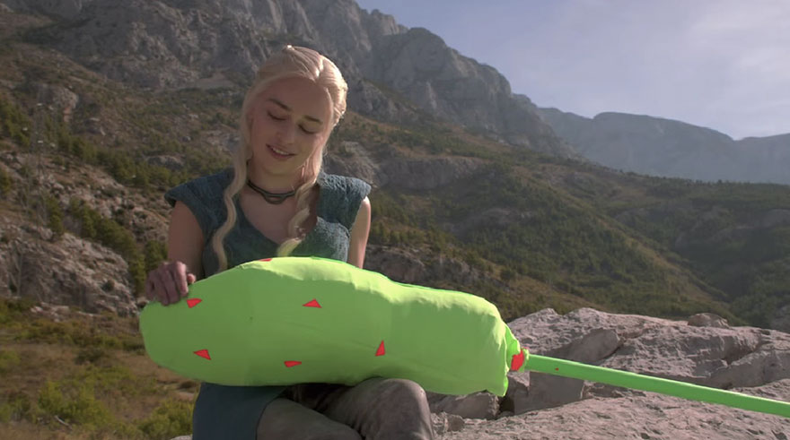
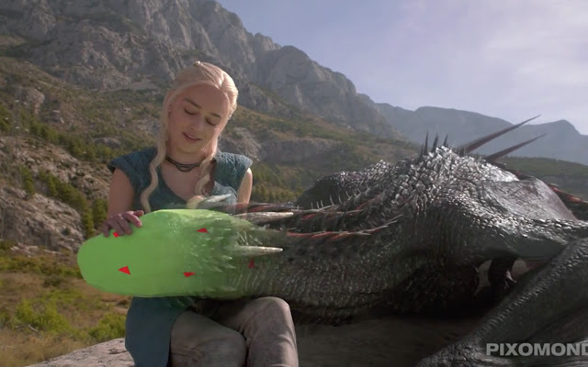
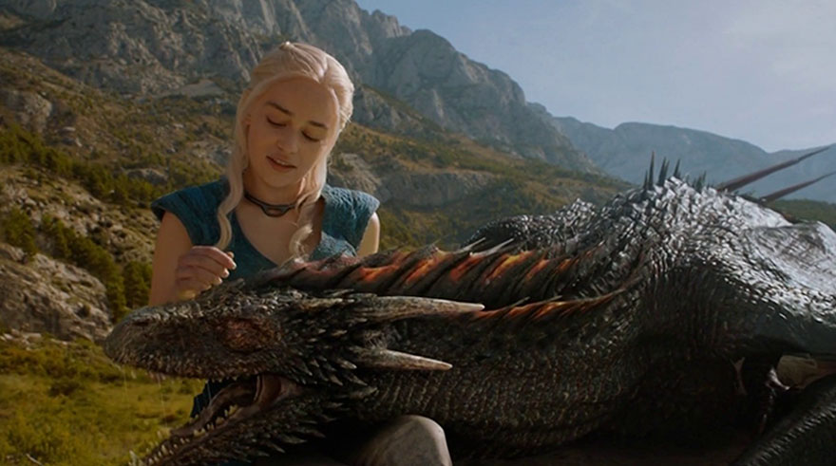
Rough-Cut
Once a shot is ready for review, the artist replaces the existing animatic shot with the actual final footage.
The updated rough-cut is then presented to the director or department head for approval.
The rough cut animatic should reflect the tools and techniques needed to create each scene.
If a shot requires special effect, the rough cut should have that same, or a proximate, special
effect in it.
Notes:
As each shot gets approved, it replaces its animatic panel, and the updated cut goes back to the director or department head. One important detail: the rough cut should reflect the techniques the finished shot will use. If a shot needs an effect, put an approximation of that effect in the rough cut. If an actor picks up a CG object, show them picking up something. Otherwise you are approving a version of the film that does not exist.

Slide 18
Software
Every animatic artist uses software to either produce images or to load hand-drawn shots into the computer and manipulate them.
Among many other things, Photoshop and After Effects are often chosen to prepare storyboards and animatics.
Both have compatible features
Each specializes in different areas: Photoshop for stills and manipulation, After Effects is very similar, but deals more with motion.
Ideal workflow tends to be a combination of both.
Notes:
Every animatic artist works in software, either to make the images or to bring them in and manipulate them. Photoshop and After Effects are the common pairing and they overlap deliberately. Photoshop is built for the still image and its manipulation. After Effects does much of the same work but in motion. The realistic workflow is both, moving between them.

Slide 19
Software
Storyboard Pro
Frameforge
Storyboard Quick
Shot Master
Notes:
There are dedicated tools as well. Storyboard Pro is the industry standard in animation and it does boarding and animatic timing in one application. FrameForge, Storyboard Quick, and Shot Master all exist and you may encounter them. You are welcome to use any of them, or DaVinci Resolve or Premiere for the editing, once you have shown me you can do it in the tools we covered.

Slide 20
Software
Remember though, storyboards are not about software, but stories.
Technology is only the means for articulating and executing the director artist's vision.
Notes:
Remember though: storyboards are not about software. They are about stories. Technology is only the means for articulating and executing the vision. I want you to hear this right before we spend the next twenty minutes on file formats and export settings, because that section is useful and it is also completely subordinate to whether your sequence works.

Slide 21
Working Resolution
1920 x 1080 is your baseline for 16:9
Match your panel size to your delivery aspect ratio
Working at 2x gives you room for pushes and pans
You can always scale down. You can never scale up.
Notes:
The old rule in this lecture used to be "scan larger than you need." Same rule, new numbers. If you draw at 1920 by 1080 and then decide you want to push in on that panel, you have nothing left to push into and the image goes soft. Draw big, deliver small. Storage is free; redrawing is not.

Slide 22
Document Setup
Your panels are already at the right ratio from your template assignment
Export panels as individual files, not one big page
The multi-panel page is for the printed board
The animatic wants one frame per file
Notes:
Here is a distinction that confuses people every semester. The storyboard page with three panels on it is a document for humans to read on paper or on screen. The animatic needs each panel as its own image file. Same drawings, two different deliverables. Set up your Photoshop file with artboards, or keep each panel as its own document from the start, and you will save yourself an hour of cropping.

Slide 23
Naming and Numbering
SEQ01_SH010.png, SEQ01_SH020.png, SEQ01_SH030.png
Increment by ten, not by one
Zero-pad your numbers so they sort correctly
Consistent names let software import a sequence automatically
Notes:
Increment by ten. This is a real studio convention and there is a specific reason for it. When the director asks for a new shot between shot 20 and shot 30, you name it shot 25 and you are done. If you numbered by ones, you now rename every file after it and rebuild your timeline. Zero-padding matters too. Without it your computer sorts shot 10 before shot 2. This will happen to you at two in the morning the night before it is due, and you will remember this slide.

Slide 24
Export
PNG for anything going into an animatic
Lossless, supports transparency, universally supported
JPG only for flat stills you will never re-edit
Keep the layered PSD. Export the PNG. Keep both.
Notes:
PNG is your export format. It is lossless, which means no compression artifacts building up, and it supports transparency, which you need the moment you separate an element onto its own layer. JPG throws away data every single time you save it. For a finished still that is invisible; for artwork you re-open and re-export five times it is not. Your PSD is the master. Your PNG is what you hand to After Effects. You keep both, always.

Slide 25
Separating Elements for Motion
If something moves independently, it needs its own layer
A waving arm, a walking figure, a foreground element you push past
Cut the element out, put it on its own layer, and fill the hole behind it
Transparent PNG or a layered PSD import will carry this into After Effects
Notes:
This is the bridge between a static panel and a moving one. If an arm waves, that arm has to exist separately from the body. If your camera pushes past a foreground tree, the tree is a layer and there has to be background behind it. The part students forget is filling the hole. When you cut the arm out, there is now a gap in the torso underneath. Fix it while you are there, or you will see it the first time you preview the motion.

Slide 26
Selection Tools
The Marquee tools are good for selecting large rectangular or elliptical areas.
Magic Wand tool selects large areas. It is useful for removing the background color from an image.
Lasso tools that you can choose from.
The Pen tool can also be used as a very flexible selection tool by converting the path to selection.
Notes:
These are the tools for the job on the previous slide. Marquee for large rectangular or elliptical areas. Magic wand for areas of flat value, which is very effective on board art because your panels are mostly flat. Lasso for freehand. The pen tool for anything with a clean curved edge, converted to a selection when you are done. Whichever you use, put the result on its own named layer. Naming your layers is not tidiness, it is how you find things two weeks from now.

Slide 27
Pans and Pushes
For a pan: draw wider than the frame
For a push: draw at higher resolution than the frame
For a tilt: draw taller than the frame
You cannot invent detail you did not draw
Notes:
This is the slide that saves your final project. If you plan a camera move, you have to draw for it before you draw the panel, not after. A pan across a city street means drawing the whole street, not the part visible in frame one. A push into a character's face means drawing that face at enough resolution to survive the magnification. Students discover this at the animatic stage, after the boards are done, and then either redraw or settle for a soft blurry push. Plan the move first.

Slide 28
Bringing It Into After Effects
File > Import > File, select the first image
Check "PNG Sequence" to bring the whole set in as one clip
Or import as individual layers if you want to set holds by hand
Set your composition frame rate BEFORE you start timing
Notes:
Demo this live rather than reading it. Two ways in: as a sequence, which treats your panels like frames of footage and gives you one clip you can retime; or as individual layers, which gives you a layer per panel that you stretch to the hold length you want. For a board-driven animatic the second way is usually easier to control. Set your frame rate first. Changing it later reinterprets all your timing and you will have to redo it.

Slide 29
Sound Changes Everything
An animatic without audio is a slideshow
An animatic with audio is a film
Temp music, ambience, a few effects, scratch dialogue
This is the cheapest upgrade available to you
Notes:
Do this live. Play twenty seconds of an animatic silent. Then play the same twenty seconds with a temp music track under it. Do not explain it first, just play both and let the room react. It is not the same piece of work. Nothing about the drawings changed. This is about the cheapest improvement available to you in this project, and most students skip it because it is not on the list of things they think they are being graded on.

Slide 30
What to Put Under It
Temp music to establish tone and drive pacing
Ambience so the world feels inhabited
A few key sound effects, only where they carry a beat
Scratch dialogue that you record yourself
Notes:
Scratch dialogue means you, on your phone, doing all the voices badly. That is the standard practice and it is what professionals do at this stage. Timing needs something to time against. If your sequence has dialogue and your animatic is silent, you are guessing at the length of every line, and you will guess wrong. Record it badly. Badly is infinitely better than not at all.

Slide 31
Sourcing Audio Legally
Freesound, YouTube Audio Library, Pixabay, Incompetech
Look for Creative Commons or royalty-free licenses
Credit your sources in your submission
Industry temp tracks get replaced. Your portfolio piece does not.
Notes:
In the industry, temp tracks are pulled from released films and swapped out before anything ships. You do not have that luxury, because the version you make in this class is the version that goes in your portfolio and on your reel. Use licensed or Creative Commons material so you can actually show the work without taking it down later. Credit what you use. That habit costs you nothing now and protects you later.

Slide 32
Timing
Each production has a specified length, whether it is a 30-second television spot or a two-hour feature film.
The mood and pace of our production is determined by the cutting and motion of every scene.
Acting effects the timing of each shot.
Bad timing sticks out like a sore thumb in any medium and any format.
Notes:
Three things to hold onto about timing. First, every production has a specified length, whether that is a thirty-second spot or a two-hour feature. You are working inside a fixed container. Second, the mood and pace of the whole thing comes from the cutting and the motion of every scene. Third, acting affects the timing of every shot. A character who hesitates needs the extra beat. Bad timing is obvious in any medium and any format. Everyone in an audience can feel it, even people who could not tell you what a cut is.

Slide 33
Developing a sense for Timing
Timing is important. Just as in music, where it gives meaning to the notes. Timing in storyboards does the same for the visual elements.
If a shot is too long, it may slow down the pace and make it boring.
If the shot is too short, it may seem ambiguous and confusing.
Trial-and-error perfect or timing skills.
Notes:
Timing does for your images what it does for notes in music. It is what turns a set of drawings into a piece with rhythm. Two failure modes and they are opposites. Too long: the pace drags and the audience gets bored. Too short: the shot is ambiguous and the audience is confused. Both of these feel like "my animatic is bad," and they need completely different fixes. Learning to tell them apart is most of the skill.

Slide 34
How Long Should a Shot Hold?
Establishing shot: 3 - 4 seconds
Wide with new information: 2 - 3 seconds
Dialogue beat: around 2 seconds
Reaction: 0.75 - 1.5 seconds
Insert or detail: 0.5 - 1 second
Action cut: as fast as it still reads
A held silence for effect: 2 - 5 seconds
Notes:
These are starting points, not rules, and I want to be clear about why I am giving them to you. You need something to deviate FROM. Guessing from zero is why student timing feels random, and it is why you cannot diagnose your own animatic when it feels wrong. Start here, watch it back, then break these numbers on purpose. Deliberately holding a reaction for four seconds is a directing choice. Accidentally holding it for four seconds is a mistake. From the outside they look identical, so you have to know which one you are doing.

Slide 35
Developing a sense for Timing
If you don't know how long a shot should be, make an educated guess.
Remember, the animatic is created to block out the timing.
Using a nonlinear software to edit and the animatic makes it easy for animators to add or subtract frames from a shot.
Notes:
If you do not know how long a shot should be, make an educated guess and move on. Do not stall. The animatic exists precisely to block out timing, and non-linear editing software makes adding or removing frames trivial. Your first pass will be wrong. Everyone's first pass is wrong. Budget for three passes and stop treating the first one as a verdict on your ability.

Slide 36
Developing a sense for Timing
The single most important thing to remember when blocking out your timing is the FPS or framerate.
FPS or “Frames per Second” is your guiding rule. This is how many frames equal one second of actual, real-world time.
Frame count, blocking the animation, dialogue tracks, and specific shot movements are also main factors used in determining the timing of the animatic.
Notes:
The single most important thing when you block out timing is frame rate. Frames per second is your ruler: how many frames make one second of real time. Frame count, blocking, dialogue tracks, and specific camera movements are all measured against it. Pick your frame rate at the start and never change it mid-project.

Slide 37
Developing a sense for Timing
Film speed is 24 frames per second and television is 30 fps.
Some games and different media use other frame rates.
Some modern cameras have a very high framerate that allows the animator/director to slow down time when needed.
Knowing the frames per second for a project can save you time when creating an animatic.
Notes:
Film runs at 24 frames per second. Broadcast television is 30. Games vary widely and often target 60. Modern cameras can shoot at very high frame rates, which is what lets a director slow time down smoothly rather than stretching frames. Know the number for your project before you start and you will save yourself conversions later.

Slide 38
Developing a sense for Timing
Timing is a difficult skill to acquire. While some have a natural sense, most of us acquire it with practice.
Use a timing device such as a stopwatch to get a sense of how long actions take.
Observe how other artists treat timing in their films.
Observe real life to get a sense of how long real movements should last.
Notes:
Some people have natural timing. Most of us do not, and that group includes plenty of working professionals. It is a learned skill. Every animator and animatic artist should own a stopwatch. Here is the part that always gets a laugh and should not: the hardest thing for most artists is actually using it. People buy one and never touch it, because they are confident they already know how long an action takes. They do not. Neither do you. Neither do I. Time it.

Slide 39
Developing a sense for Timing
Observing the real world is also a great way to get a sense of timing.
Video reference is oftentimes a crucial tool when it comes to animation.
Long before motion capture technology was ever invented, animators would use film reference to get a good sense of timing and natural poses.
Notes:
Observing the real world is the other half. Video reference is a crucial tool in animation, not a beginner's crutch. Long before motion capture existed, animators shot film reference to understand timing and to find natural poses. You have a better camera in your pocket than any of them had.

Slide 40
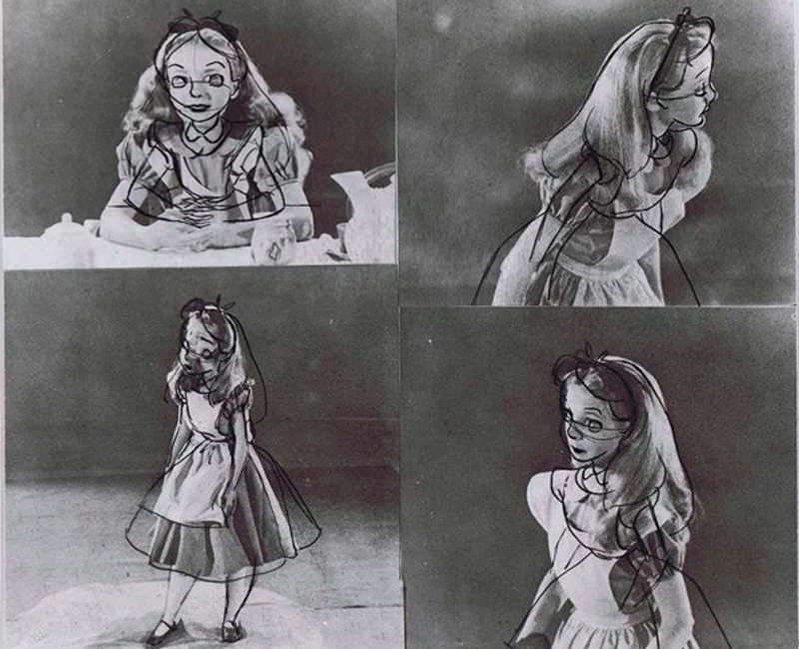
Developing a sense for Timing
No matter the skill level of an artist, reference can only make your work better.
Disney pioneered using test footage to create a new high quality standard of animation at the time.
The footage not only captured the subtlety of the natural gestures and the timing, but more importantly, the relationship between the two.
Notes:
No matter your skill level, reference makes the work better. That is true at every stage of a career. Disney pioneered shooting live-action test footage and it raised the standard of animation industry-wide. What that footage captured was not just the gestures and not just the timing, but the relationship between the two, which is the thing that is almost impossible to invent from imagination. Then hand it to them: your final project is due in four sessions. Go shoot your reference this week.

Slide 41
Previs, AI, and What the Job Actually Is
Previs is now a real department on most large productions
Generative tools can produce panels quickly, and studios are testing them
What they cannot do: know which shot serves THIS story
Or hold a sequence in their head, or take a note and understand what it really meant
That judgment is the job. The drawing was only ever how you delivered it.
Notes:
I am going to be straight with you rather than reassuring, because you will find out anyway. The part of this job that is "make a picture of a thing" is under real pressure right now. Tools can generate panels, and they are getting better at it quickly. The part that is not under pressure is everything else we have done this semester. Knowing which shot the story needs. Reading a sequence and feeling that the third cut lands wrong. Sitting in a room, hearing a note, working out what the note was actually about, and proposing the fix. That is not a consolation prize. It is the reason this course grades clarity and judgment instead of rendering, and it is why we spend a whole session on pitching. The drawing was always just how you delivered the thinking.

