Slide 1
Intro Storyboarding
Notes:
Do not open on the title slide. Go straight to the three images on the next slide and ask the question. Come back to housekeeping after the thesis has landed.

Slide 2
Which One Mattered Most?
A finished piece of concept art
A rough production board panel: scratchy, arrows everywhere
The final frame of the film that panel became
Notes:
[ADD IMAGES: three images side by side: polished concept art, a genuinely crude production board panel, and the finished film frame that panel became.]
Do not introduce yourself yet. Do not open the syllabus. Put these up and ask the question.
Let them answer wrong. Most rooms pick the concept art or the final frame. Then tell them it was the middle one, and that by the end of today they will understand why.

Slide 3
The Thesis of This Course
A storyboard's only job is to make a sequence understandable and engaging
: before anyone spends money
Beauty is optional
Clarity is not
Notes:
This is the sentence the whole course hangs on, so say it slowly and write it somewhere they can see it all semester.
A board exists to answer a question: will this sequence work? It gets asked before the money is spent, which is the only time the answer is useful.
Then the part that matters to the nervous people in the room: this class grades clarity. Not rendering. Not draftsmanship. Whether the sequence communicates.

Slide 4
What Professional Boards Actually Look Like
Rough. Scratchy. Arrows everywhere.
Three marks for a face, or no face at all
Drawn fast and thrown away
Panels are disposable thinking
Notes:
[ADD IMAGES: a grid of genuinely crude professional production boards: the kind with visible construction lines and stick-figure staging.]
This slide exists to defuse the objection that is about to arrive, and it works better before someone says it out loud than after.
These shipped. These are from films everyone in this room has seen. Board artists draw fast and badly on purpose, because a panel is a thought, not an artwork, and thoughts get revised.
If someone still says "I can't draw" after this, the honest answer is: neither can most of the people who do this for a living, in the sense that you mean it.

Slide 5
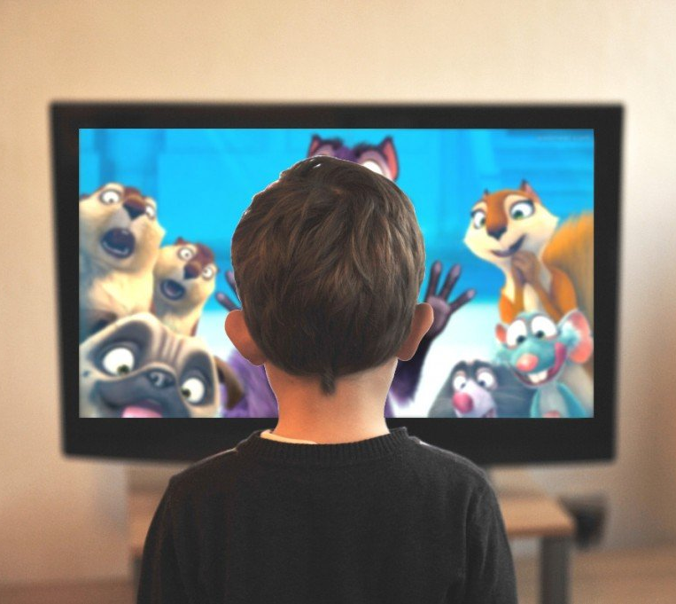

Visual Storytelling
We are constantly confronted with visual media:
Notes:
We are surrounded by visual media constantly, and almost all of it is constructed. Somebody decided what you would see and in what order.
That decision-making is the subject of this course.

Slide 6
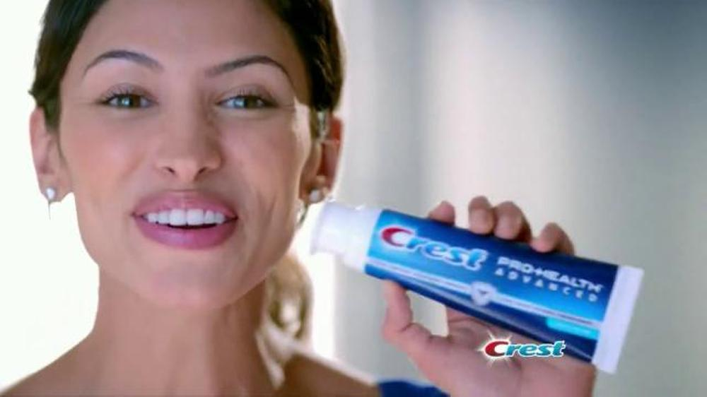
Visual Storytelling
Message can be:
To buy product.
Evoke an emotion from audience.
Notes:
Every piece of visual media is trying to do something to you: sell you something, make you feel something, or make you understand something.
None of that is accidental, and none of it happens without staging.

Slide 7
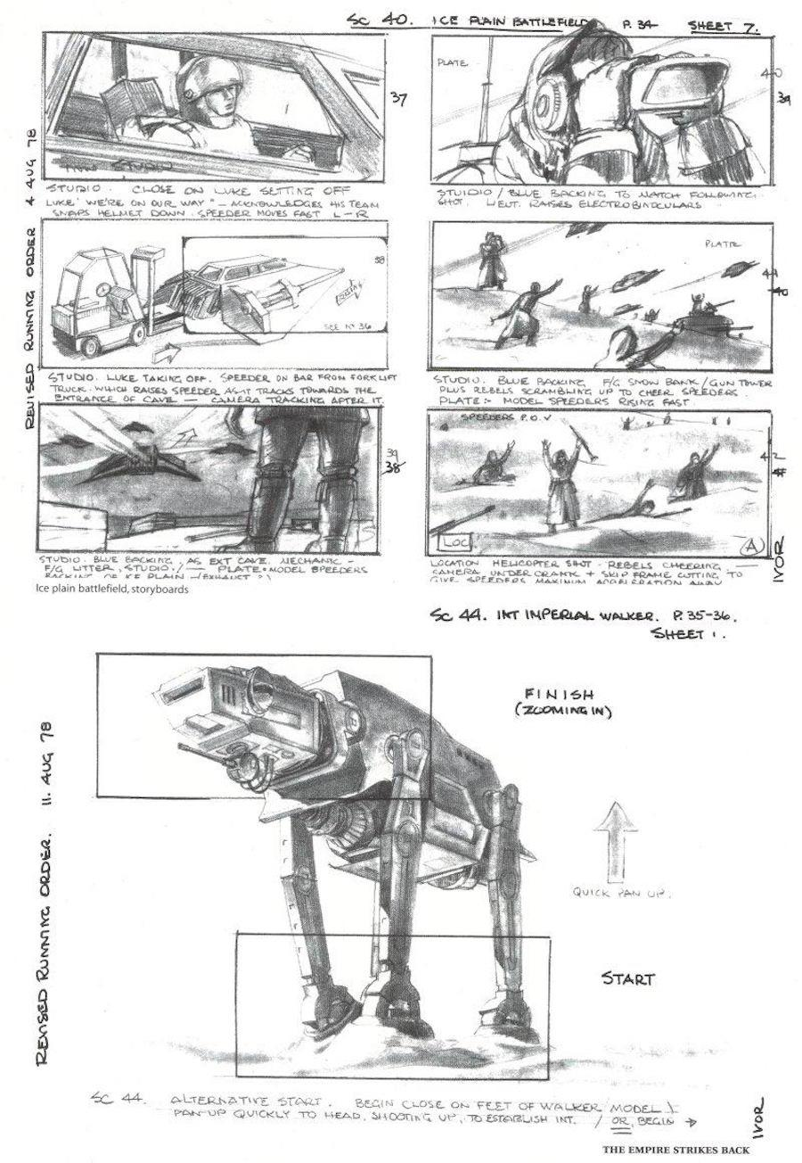
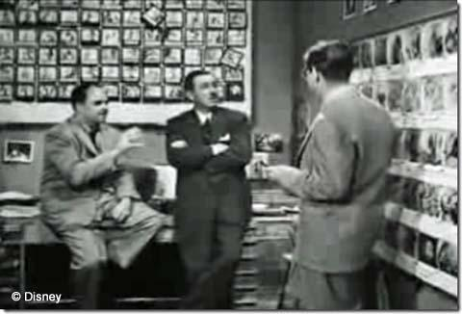
Storyboarding
The visual representation of the script.
Notes:
The formal definition: a storyboard is the visual representation of the script.
But note what that implies. It is a translation. Something that existed as words now has to exist as images, and the translation is where all the decisions live.

Slide 8
Storyboarding
Consists of a number of panels that show the visual action of a sequence in a logical narrative.
Notes:
A number of panels showing the visual action of a sequence in logical narrative order.
The closest visual cousin is a comic strip. The critical difference is that comics are the finished product and boards are the plan, which is why boards can be rough and comics cannot.

Slide 9
Storyboarding
Stories entertain
Storyboards are production tools to assist in selling an idea.
Notes:
Stories entertain. Storyboards are production tools used to sell an idea.
Hold on to that distinction all semester. Your board is not the thing the audience sees. It is the thing that convinces people to build the thing the audience sees.

Slide 10
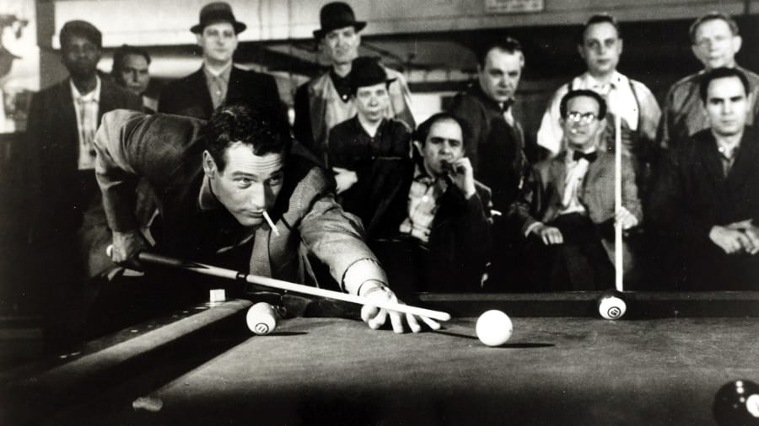
Visual Storytelling
What questions can be answered?
Who is this character?
Where is he playing pool?
Who is he playing against?
Notes:
Here is a single image. Let them look at it, then ask the questions on the slide: who is this character, where are they, who are they playing against, what happens next.
The room will generate a story from one frame. That is what good staging does, and none of it was written down.

Slide 11
Visual Storytelling
The image conveys the intended message through staging the character and props, establishing the background, and portraying the action.
Notes:
Everything they just inferred came from staging, where the character is, what is around them, what the props say, where the camera was put.
This is the whole course in one image. You are about to spend a month learning to do this on purpose.

Slide 12
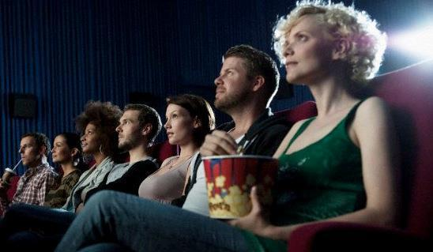
Linear vs. Nonlinear Storytelling
Movies
Animation
Comics
Notes:
Linear storytelling: the audience receives events in a fixed order. Film, animation, comics.
This is what most of the course assumes, because the grammar was developed here.

Slide 13

Linear vs. Nonlinear Storytelling
Games
Interactive Applications
Some forms of theater or art
Notes:
Non-linear and interactive: the audience also manipulates the experience. Games, interactive applications, some theatre.
Say this out loud early, because it earns the game production students in the room: the grammar is the same. What changes is who controls the camera. We will spend a full session on exactly what breaks when you give that control away.

Slide 14
Storytelling through Visuals
Storyboarding and storytelling is about communication
draws an audience into the story.
Visuals deliver story and message
Also a perspective of this story and message.
Notes:
Whatever the medium and however the technology changes, the purpose has not moved: communicate a message to an audience, and hold their attention while you do it.
Everything else on this syllabus is technique in service of that.

Slide 15
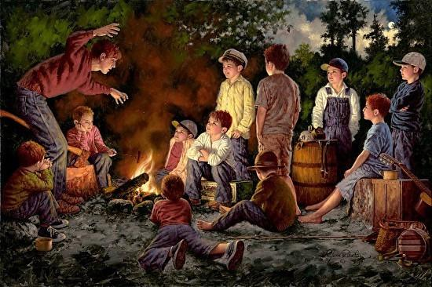
Show, don’t Tell.
If you tell a story, you try to entice the audience into imagining its content.
Notes:
Show, don't tell. The oldest rule in visual storytelling and the one this course is graded against.
When you tell a story, you are asking the audience to imagine the content. When you show it, you are handing it to them directly. Both are legitimate in prose. Only one of them is available to you in a board.

Slide 16
Show, don’t Tell.
when you show a story, you are molding the message into visual imagery
Notes:
When you show a story, you are moulding the message into visual imagery, which means you are making choices the audience never sees but always feels.
This is the point where writing and boarding separate.

Slide 17
Telling Example:
Jake, who was considered the bully of the neighborhood, stood on the corner of 10th and Main in his blue jeans, black T-shirt, and a cigarette pack rolled up in his sleeve.
The rest of the kids avoided the corner where Jake stood. They were intimidated by the high school dropout who derived pleasure from flicking the burning embers of his cigarette into the hair of any kid who crossed his path.
Notes:
Read this one aloud. It is the 'telling' version. Everything explained, nothing seen.
Then ask the room: what did you picture? Let two or three people answer. They will all have pictured something different, which is a fatal flaw in a document whose job is to get a crew building the same thing.

Slide 18
Showing Example:
Jake, a burly teen with pock marks on his cheeks and a skull tattoo scroll across his bicep, kicks a scuffed military boot in the dirt.
The dust circles his feet as he pulls a cigarette from behind his ear and slips it between his lips. His eyes dart to several schoolchildren that are standing in single file line waiting for their bus. He settles his gaze on a pint-size boy with a space rangers backpack slung over his small shoulders. Jake smirks as he takes a long drag from his cigarette and quickly steps forward toward the boy.
Notes:
Now the 'showing' version. Same character, same information, delivered through what is visible.
Ask again: what did you picture? This time the answers converge. That convergence is the entire value of a storyboard.

Slide 19
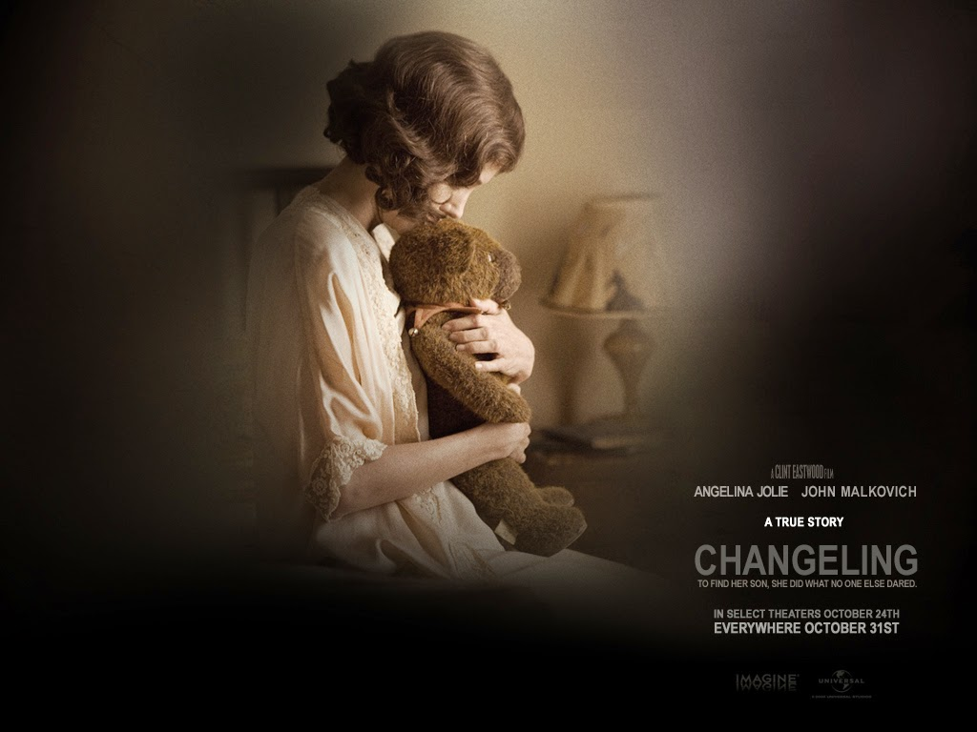
Description
Image of a mother absently touching frayed toys in a child's room is much richer than explaining verbally that the child no longer lives at home.
Notes:
The clearest contrast I know. 'The child no longer lives at home' versus a mother absently touching frayed toys in an empty child's room.
The second version is richer AND shorter. That is what visual economy buys you, and it is why a good board can replace a page of description.

Slide 20
Description
In other words:
A picture is worth a thousand words
Leave enough in there to inform, but let the audience decide how they feel.
Notes:
A picture is worth a thousand words, but the useful half of that saying is the second half. Leave enough in the frame that the audience can construct the meaning themselves.
An audience that works slightly for the meaning holds onto it. An audience that is told, forgets.

Slide 21

Elements of a Story
Most stories start out as an idea without structure (for example dreams)
Notes:
Most stories start as an idea with no structure: a dream, an image, a fragment. That is normal and it is not a problem.
Structure is what gets added afterwards, deliberately. Which is good news, because it means structure is a craft skill rather than a talent.

Slide 22
Watch This
One complete sequence, start to finish
Watch it once
Don't take notes
Just watch it the way an audience would
Notes:
This replaces the abstract structure discussion. Screen a short complete sequence, three to eight minutes, with a clean, visible arc.
Good options: 'Married Life' from Up (a full arc with no dialogue), the opening of WALL-E (a world established without a word), Bao (a complete story in eight minutes), or One Froggy Evening if you want comedy escalation.
Tell them not to take notes. You want them watching as an audience, because the next slide depends on them having had an experience rather than performed an analysis.

Slide 23
Now Break It Down
Where does it start?
What is the first thing that changes?
What does the character want?
What stops them?
Where does it turn?
How does it end?
Notes:
Build this live on the board. Do not present it: ask the questions and write down what they say.
They will do this much faster than they expect, and the speed is the actual lesson. When you have the list on the board, tell them: you just derived three-act structure from a cartoon in four minutes. You already knew this. What you do not know yet is how to stage it.
This also quietly models the analytical habit the midterm requires, which is why it is worth the class time.

Slide 24
Dramatic Structure:
as the beginning, middle, and end,
act 1, act 2, and act 3
Notes:
Beginning, middle, end. Act one, act two, act three.
They just derived this themselves from the sequence you screened, so present it as confirmation rather than instruction. The naming is the only thing you are adding.

Slide 25
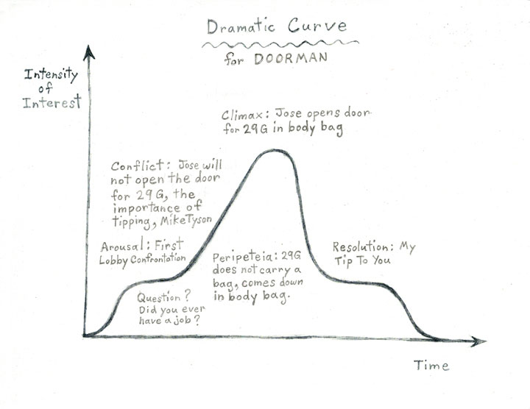
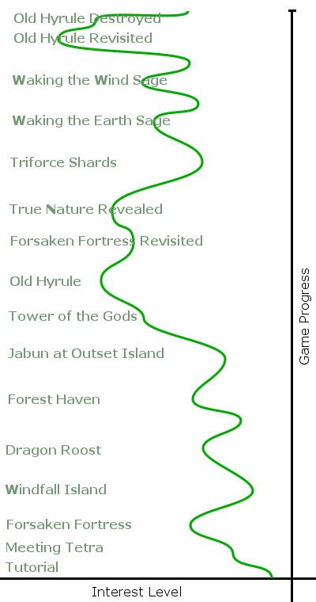
The Beginning
Interest Curve:
“The quality of an entertainment experience can be measured by the extent to which its unfolding sequence of events is able to hold a guest’s interest”
- Jesse Schell ( Art of Game Design)
Notes:
The interest curve, borrowed from game design: the quality of an entertainment experience can be measured by the pattern of interest it creates over time.
This is the most modern idea in this lecture and it is worth dwelling on. Attention is not constant. It rises and falls, and managing that rise and fall is your responsibility shot by shot.
It also maps directly onto animatic pacing, which is where you will feel it for real in about three weeks.

Slide 26
The Hook
The opening beat that raises a question
A murder, a stranger arriving, an eviction notice, a door left open
It does not have to be big
It has to be unanswered
Notes:
The hook is whatever makes the audience decide to keep watching, and the mechanism is always the same: it raises a question and withholds the answer.
Students tend to think a hook means an explosion. It does not. A hook can be entirely quiet: someone packing a suitcase, a phone ringing that nobody answers. What matters is that the audience now wants something they do not have.
Ask them what the hook was in the sequence you just screened. Someone will get it immediately.

Slide 27
Joseph Campbell and the Monomyth
The Hero with a Thousand Faces, 1949
The same pattern appears in hero myths across unrelated cultures
You are not here to learn to write
You are here because every stage of it is a staging problem
Notes:
Campbell compared hero myths from cultures with no contact with each other and kept finding the same shape. He called it the monomyth.
Now the framing that makes this a storyboarding lecture rather than a screenwriting one, and say it explicitly: I am not teaching you this so you can write a screenplay. I am teaching it because knowing which stage of the story you are in tells you where to put the camera.
Every slide in this section ends in a shot decision. That is the whole point of covering it.

Slide 28
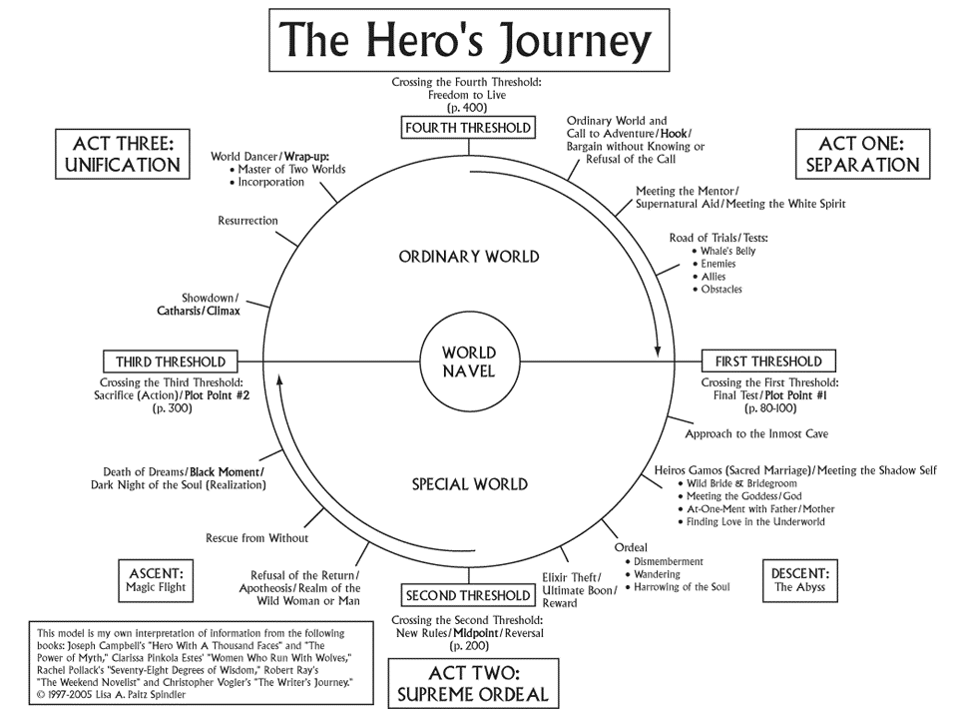
Notes:
The shape of the monomyth. Do not walk every station on this diagram. It is here as a reference and it will be on Canvas.
We are going to walk the major stages, and at each one I am only going to ask a single question: what does this look like?

Slide 29
Ordinary World → How Do You Show "Normal"?
Wide establishing shots, neutral eye level
Repetition and routine as visual rhythm
Frame the hero slightly out of place: off-centre, wrong scale, alone in a crowd
Luke on Tatooine · Shrek's swamp · the Shire
Notes:
The staging problem: normal has to be established before it can be disrupted, and "normal" is genuinely hard to make interesting.
The tools are compositional. Neutral camera height, because a neutral world should not feel dramatic yet. Repetition, because routine is visual rhythm. And then the one detail that says this character does not fit, which is usually just where you place them in frame.
Note what you are not doing: you are not telling the audience the hero is restless. You are staging them so the audience concludes it.

Slide 30
Call to Adventure → Break the Pattern
A cut that violates the rhythm you just built
Something enters frame that does not belong
A change in shot size as an alarm
The audience should feel the break before they understand it
Notes:
The staging problem: the audience has just been trained on a visual rhythm. The call is where you break it, and the break should register physically before it registers intellectually.
Practically that means changing something structural (the shot size, the camera height, the cutting rate) not just introducing a new character. If the call arrives in the same visual language as the ordinary world, it does not feel like a call.

Slide 31
Refusal → Staging Hesitation
Blocking that moves away from the goal
Thresholds the character does not cross: doorways, gates, edges
Held shots: reluctance reads as duration
Without the refusal, there is no decision, and no story
Notes:
The staging problem: how do you show someone not doing something? It is harder than showing action, and it is where beginners tend to fall back on dialogue.
Two tools. Blocking: physically move the character away from the thing. And time: hold the shot. Reluctance reads as duration, which means this is the first stage where your timing decisions carry story weight. You will feel this properly when you build your animatic.
Star Wars is the clean example: Luke refuses until his aunt and uncle are dead. The refusal is what makes the acceptance mean something.

Slide 32
Crossing the Threshold → Make It Literal
Doors, gates, tunnels, horizons, the water's edge, the ramp of a ship
The most reliably visual moment in the entire structure
The wardrobe · the rabbit hole · the Falcon's ramp · the bridge in Spirited Away
The metaphor is already a set: build it
Notes:
This is the stage board artists love, and it is worth telling them why.
Every other stage requires you to invent a visual equivalent for an abstract idea. This one arrives pre-visualised. Crossing into the unknown is already a physical action in a physical space, so the metaphor and the set are the same object.
Which means if your story has a threshold moment and you have not built a literal threshold into the frame, you have left the easiest shot in the film on the table.

Slide 33
The New World → Re-establish Everything
New establishing shots: the audience has no map
Deliberately contrast the visual language of Act One
Change camera height, value range, density, lens behaviour
Scale shots: the hero small in frame
Notes:
The staging problem: the audience has been dropped somewhere unfamiliar and needs orienting again, fast.
The mistake is making the new world look like the old one. If you do that, you have wasted the threshold you just built: the audience crossed something and nothing changed.
So change the visual language on purpose. If Act One was eye-level and evenly lit, go high-contrast and off-axis. And use scale: a hero who was competent in the ordinary world should look small here.

Slide 34
Tests, Allies, Enemies → Escalation You Can See
Each test staged tighter, faster, or higher than the last
Repeat a setup and change one variable
The audience reads the difference without being told
If shot 40 looks like shot 10, it does not feel harder
Notes:
The staging problem: the middle of a story is a series of obstacles, and they have to feel progressively worse.
Escalation is a compositional job, not a writing job. Most student sequences are evenly staged from beginning to end, which means the last obstacle lands with the same weight as the first, and the middle sags.
The reliable trick: repeat a shot setup and change exactly one thing. Same framing, closer. Same framing, darker. The audience compares automatically and feels the escalation.

Slide 35
The Ordeal → The Climax Needs Its Own Grammar
Your widest and your tightest shot probably both live here
The cutting rate changes
This is where you spend your best drawing
Budget your effort, if everything is emphasised, nothing is
Notes:
The staging problem: the climax has to feel different from everything around it.
Give it its own grammar. Extremes of shot size, a change in the cutting rhythm, the strongest value contrast in the sequence.
And here is a practical note about your own labour, which nobody tells students: most student boards are rendered evenly from the first panel to the last. That means nothing is emphasised. Budget your effort the way you budget your shots: spend it here.

Slide 36
The Return → The Visual Echo
Repeat a shot from Act One and change what it means
Same framing. Different character standing in it.
The binary sunset in Star Wars
The most satisfying tool you own, and it costs nothing but planning
Notes:
The staging problem: how do you show that someone has changed?
The answer is the visual echo. Return to a composition from earlier and let everything that happened in between change its meaning. The frame is identical; the person standing in it is not; the audience does the rest.
Say this plainly: if you take one thing from this entire lecture into your final project, take this one. Plan your last shot to echo your first. It is free, it requires only that you decide early, and it is the difference between a sequence and a story.

Slide 37
Storyboards
Series of sketches that are used as a planning tool
Visually shows how the action of a story unfolds.
Facilitates production.
Main purpose – to clearly convey the narrative flow of a story by defining the challenges and problems of a project.
Understanding the elements is critical.
Notes:
A storyboard is a series of sketches used as a planning tool, showing visually how the production will unfold.
By now that definition should feel obvious, which is the point. You have arrived at it from several directions in one session.

Slide 38
Who uses Storyboards?
Advertising Campaigns
Video Games
Animations
Feature Films
Television Series
Notes:
Advertising, games, animation, feature films, television, and previs, which is a large and growing department on most big productions.
The skills in this room transfer across every one of these. That is worth knowing when you are thinking about where the work actually is.

Slide 39
What Changes by Industry
Animation: the boards ARE the film; everything downstream follows them
Live action: usually only complex or expensive sequences get boarded
Advertising: highly finished, key frames only, made to sell
Games: cinematics, plus a set of problems we will spend a session on
Notes:
The job is not identical everywhere, and knowing the difference is interview-level knowledge.
In animation, the board is the primary document. Nothing exists before it and everything is built from it. In live action, boarding is targeted: stunts, effects, anything expensive enough that guessing is unaffordable.
Advertising boards are the most finished-looking, because they are shown to clients rather than crews. And games have a whole additional category of problem, which is why it gets its own session later in the course.

Slide 40
Who You Would Be Working For
Director · production designer · previs supervisor
Animation director · creative director
In every case: someone else's vision
Your job is to make it legible, and then to make it better
Notes:
In almost every professional context, you are boarding someone else's idea.
That sounds limiting and it is not. The skill being hired is the ability to take a description and return something clearer than the description was, and then to notice the thing the director had not thought of and offer it.
That second part is the difference between a board artist people request by name and one they do not. Keep it in mind; we come back to it when we talk about pitching.

Slide 41
"I Can't Draw"
You are not being asked to draw
You are being asked to NOTATE
Remember the production boards from the start of class
The bar is: can someone else understand this?
Notes:
This objection is arriving whether or not anyone has said it, so meet it directly.
Point back to slide four. Those boards are crude and they are professional work. The skill being assessed in this course is notation: recording a visual idea clearly enough that another person can act on it.
That is a learnable skill with a low floor, and the next four slides are the entire toolkit. If someone wants to become genuinely good at figure drawing on top of that, excellent, and I will point you at resources. It is not required to do well here.

Slide 42
The Three-Shape Figure
1: LINE OF ACTION
2: THREE SHAPES
3: CONNECT IT
head
ribcage
pelvis
Line of action first. Shapes second. Never the other way round.
Notes:
Demo this live rather than talking about it. Draw ten figures in about ninety seconds so they see the speed, and narrate as you go.
The order matters and it is the thing beginners get backwards. Draw the line of action first, one curve describing what the body is doing, and then hang the shapes on it. If you build the shapes first and try to add energy afterwards, you get a mannequin.
Three shapes. That is a complete figure for board purposes.

Slide 43
The Silhouette Test
READS
DOESN'T READ
throwing
…throwing? waiting? falling?
If the action does not survive being filled in black, the pose has failed.
Notes:
Show them this and then tell them it is the grading standard, on day one, so there are no surprises later.
Animation has used the silhouette test for a century, and character designers in games are hired on it. It is also completely independent of skill level, which is exactly why it is fair: a badly drawn figure with a strong silhouette communicates, and a beautifully drawn figure with a weak one does not.
In this class, the first one gets the better grade.

Slide 44
Economy
One curve for the spine
Hands are mittens
Faces are three marks, or nothing at all
Detail where it matters. Nowhere else.
Notes:
Economy is not laziness, it is triage. You have limited time and the sequence has one thing it needs to communicate in each panel.
The classic beginner failure is a beautifully rendered face on a pose that does not read. That is an hour spent on the least important part of the panel.
Draw what carries the story. Suggest everything else, and trust the audience to fill it in, which, as we will see in the composition session, they will do automatically.

Slide 45
Notation
Motion arrow: what the subject does
Camera arrow: what the camera does
PAN · TRUCK IN / OUT · TILT · CUT · HOLD
Number every panel. Always.
Notes:
Hand out the notation sheet here.
This is real professional shorthand and it is worth learning properly now, because it is the difference between a board that reads as amateur and one that reads as a working document.
The single most common student error: using one arrow style for both subject motion and camera motion. They mean completely different things and a crew will read them literally.
Learn the notation and you will never again write a paragraph where an arrow would do.

Slide 46
Exercise: Ten Poses
Ten reference actions: 60 to 90 seconds each
Three-shape figures only
Then fill two of them in as solid silhouettes
Have your neighbour name the action
Notes:
Project ten clear, readable actions: reaching, falling, throwing, listening, hiding, running, pointing, lifting, recoiling, waiting. Sixty to ninety seconds each: fast enough that nobody has time to render.
Then the silhouette pass and the peer check, which takes four minutes and is the real lesson. Having someone else name your action is a very different experience from deciding privately that it reads.
This is the exit ticket. Post it before you leave. Graded on existing, not on quality: rough, wrong, and ugly all receive full credit.

