Slide 1
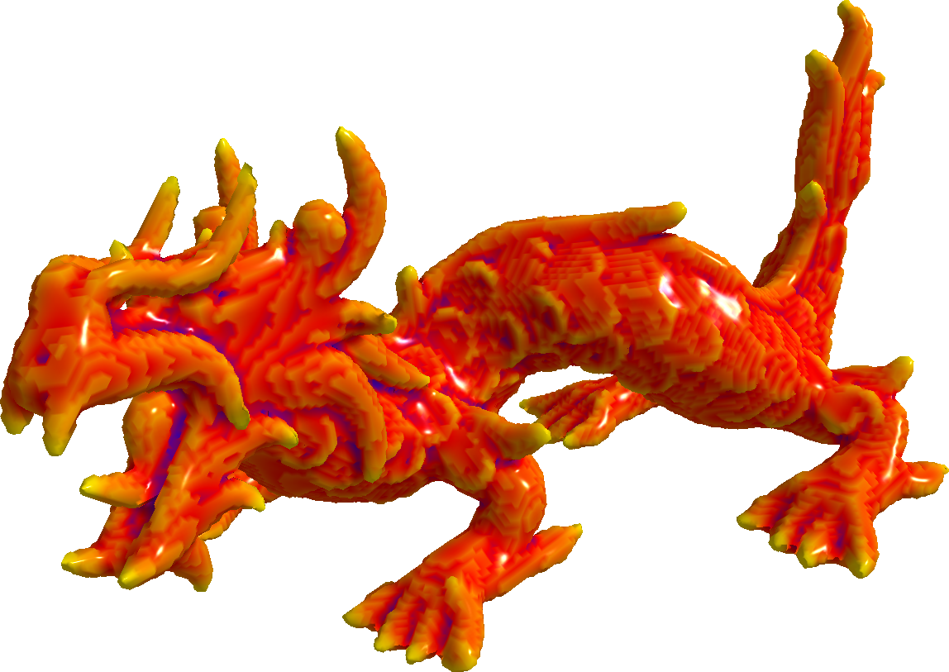
Interactive Curvature
Tensor Visualisation
Hélène Perrier, Jérémy Levallois, David Coeurjolly,
Jacques-Olivier Lachaud, Jean-Philippe Farrugia, Jean-Claude Iehl

Slide 2
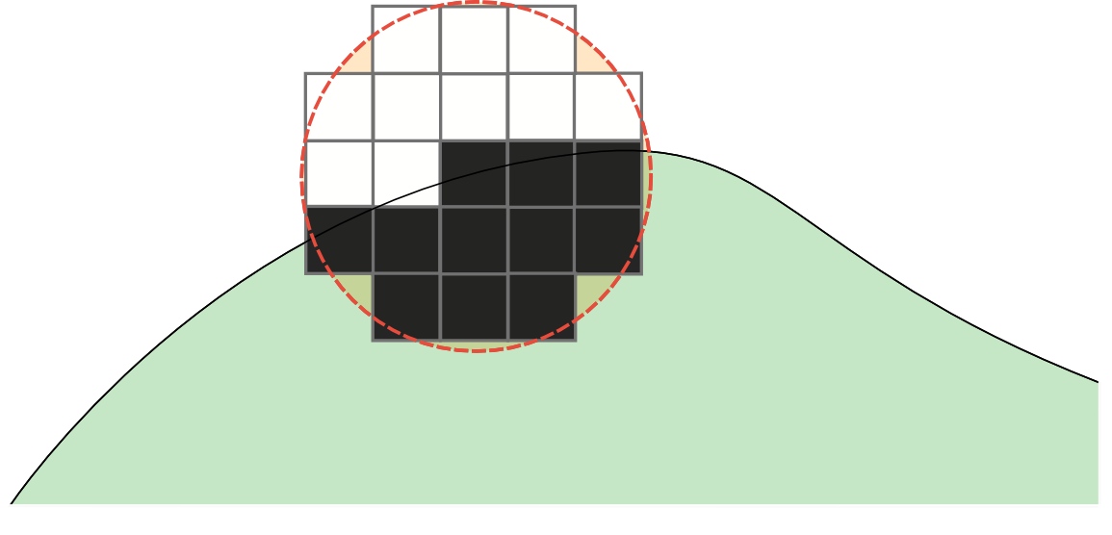
Objectives
Being able to visualise digital curvature in interactive time
  Computing digital curvature may be a long process
  Curvature radius ?
  Feature detection
  [LCL14][LCL15]

Slide 3
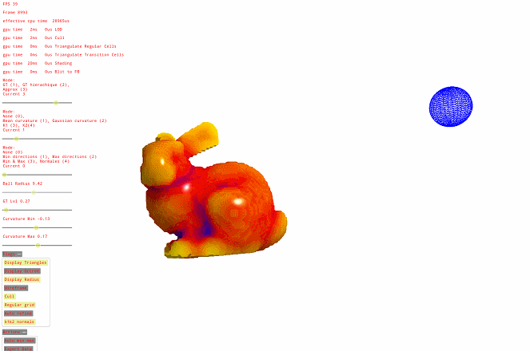
Objectives
Here, we propose a GPU implementation that allows on the fly isosurface extraction and curvature computation

Slide 4
Pipeline
Our pipeline works in two steps
  First, we extract a triangulated mesh from the object to visualise it and manipulate it
  Second, we compute the curvature value on each vertex of the extracted mesh
Both those steps run in real time and can be done on the fly
  Thanks to the GPU !

Slide 5
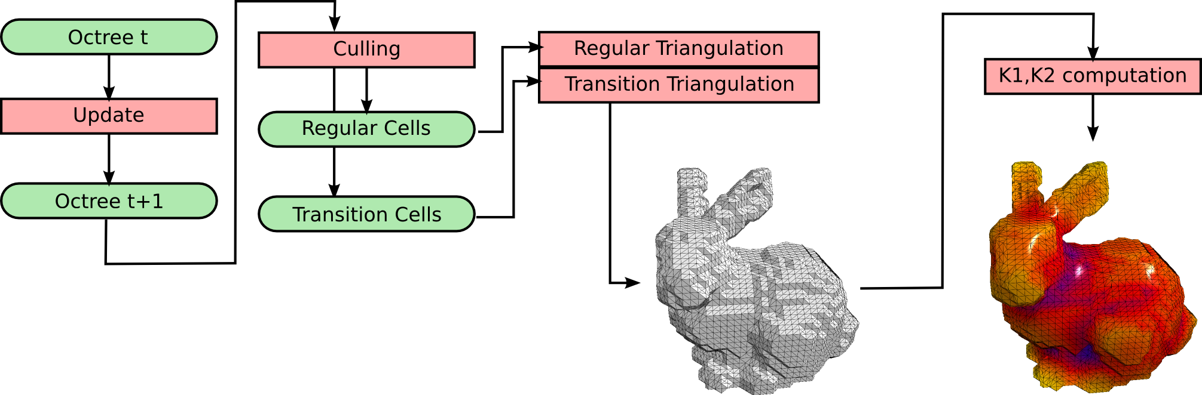
Pipeline

Slide 6
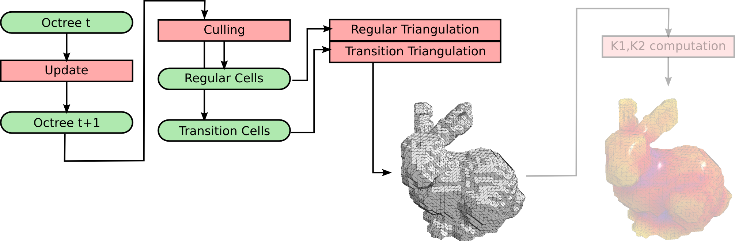
Isosurface Extraction

Slide 7
Isosurface Extraction
There are already solutions that allow to visualise large datasets in real time
  But there are often heavy to implement
  Or rely on caching strategies that prevent animated geometry
Here we use a more straigth forward approach

Slide 8
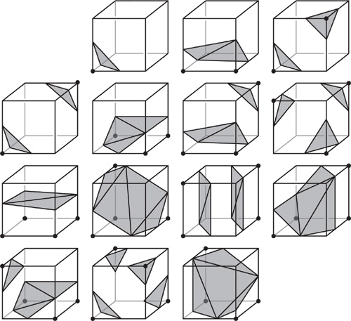
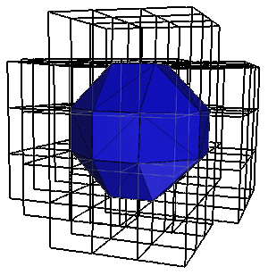
Isosurface Extraction
Marching Cubes based [LC87]

Slide 9
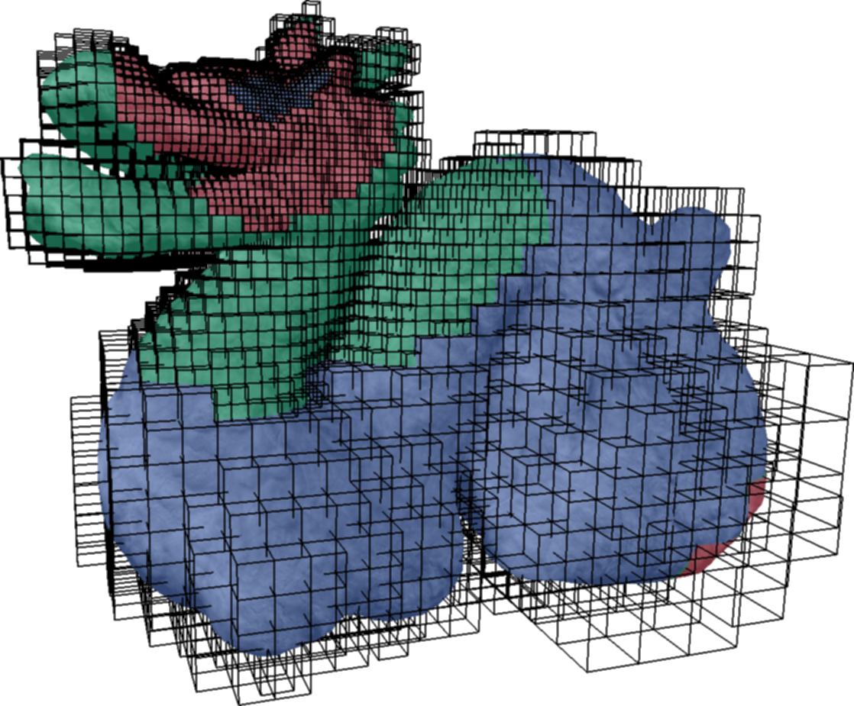
Isosurface Extraction
Why Marching Cubes ?
  GPU loves Marching Cubes
  But a regular grid is too much to handle
  Adaptivity ?
    [TODO]

Slide 10
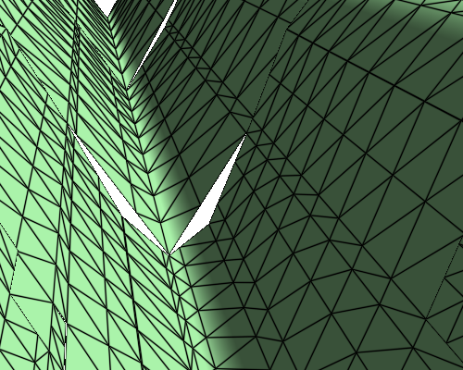
Isosurface Extraction
Adaptive Grid
  Original Marching cubes is made for regular grids only
  GPU don't like recursivity

Slide 11
Isosurface extraction
Using Marching Cubes in an Octree on the GPU ?
Transvoxels [Len10]
  Adaptive Marching cubes within an octree
Quadtrees on the GPU [DIP14]
  Derecursifying a tree on the GPU

Slide 12
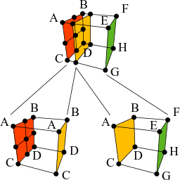
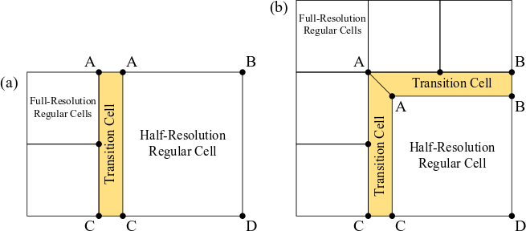
Transvoxels [Len10]
Using a second modified Marching cubes algorithm to patch the cracks

Slide 13
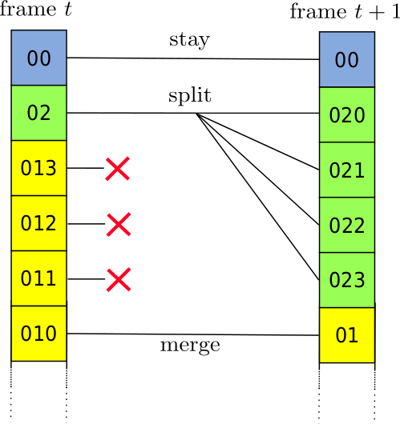
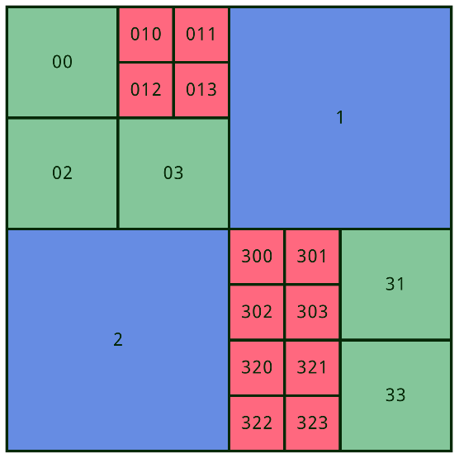
Quadtrees on the GPU [DIP14]
Derecursifying a tree using Morton codes

Slide 14
Isosurface Extraction
Real time
  Adaptive
Easy
  Two Marching Cubes
Can even be used for animated datasets !
Triangulation quality
  No mesh export, rasterization only

Slide 15
Isosurface Extraction

Slide 16
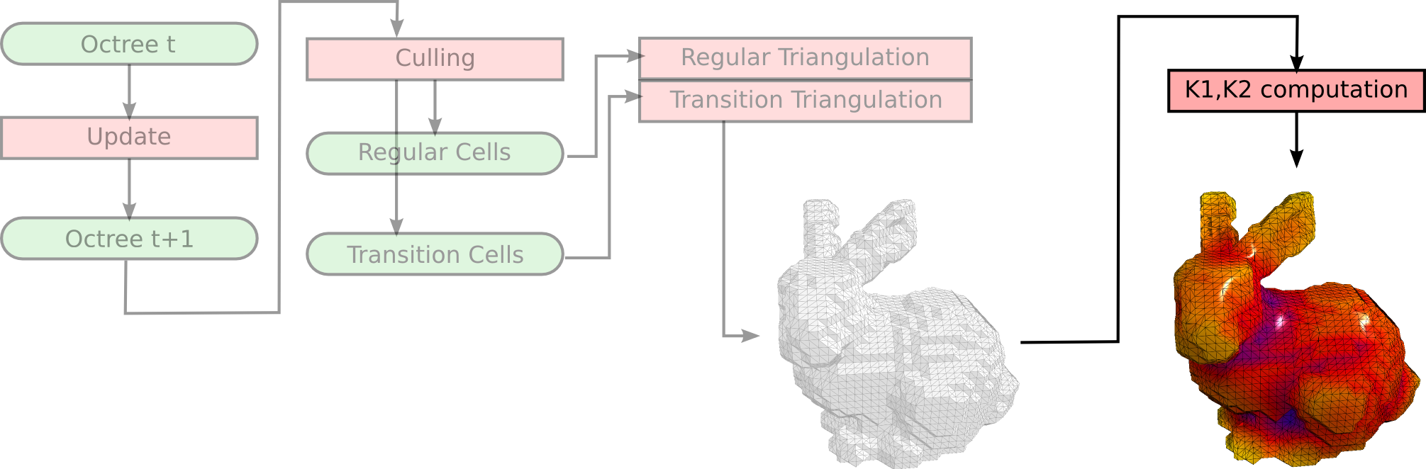
Curvature Computation

Slide 17
Curvature computation
We tried two methods
  Exact computation
    Slow
    Exact
  Approximated computation
    Fast
    Approximated

Slide 18
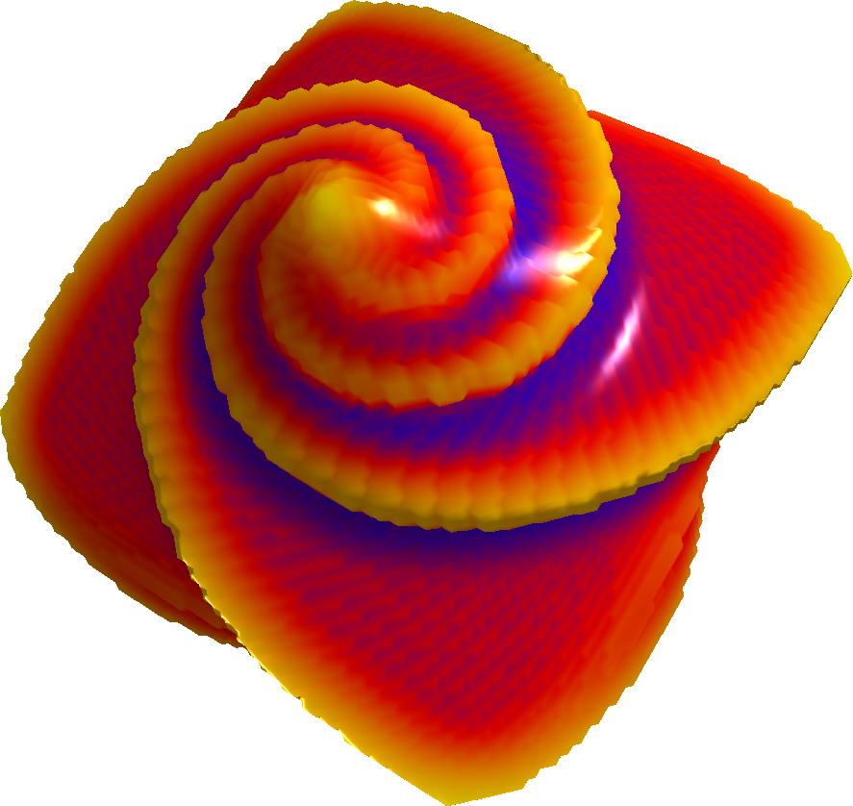
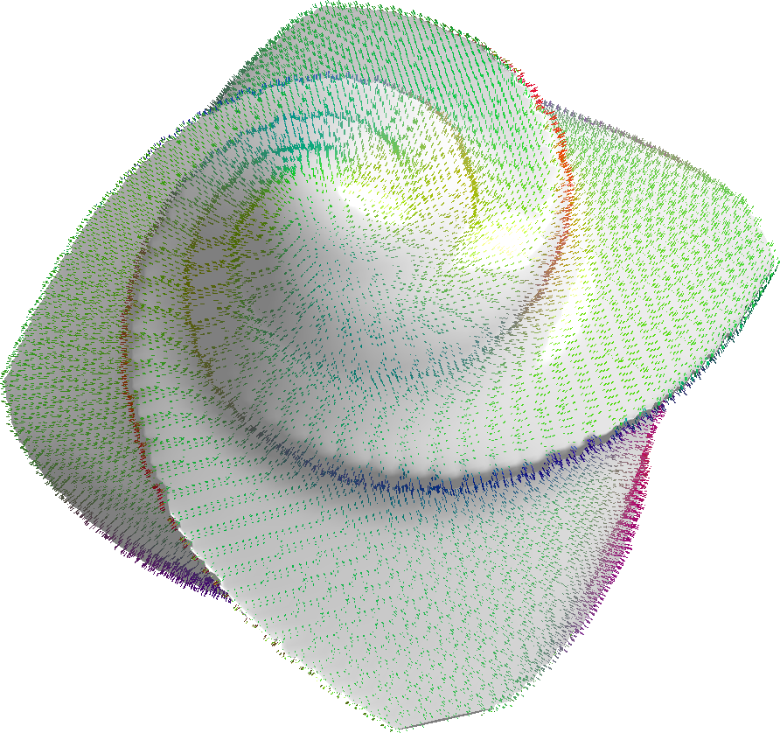
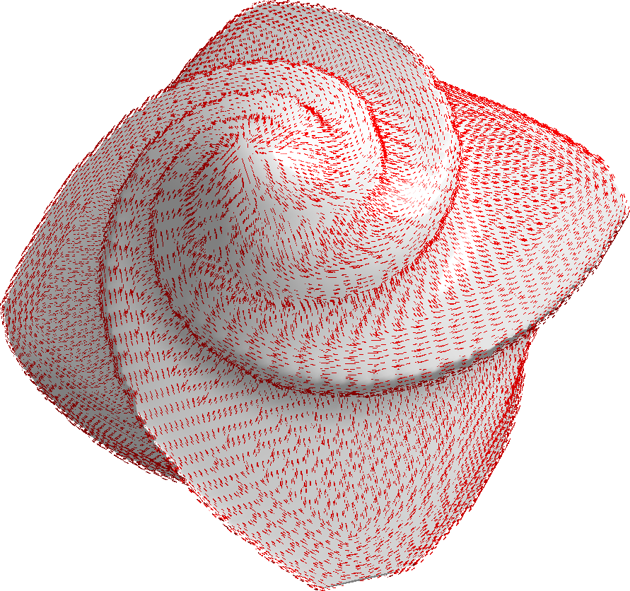
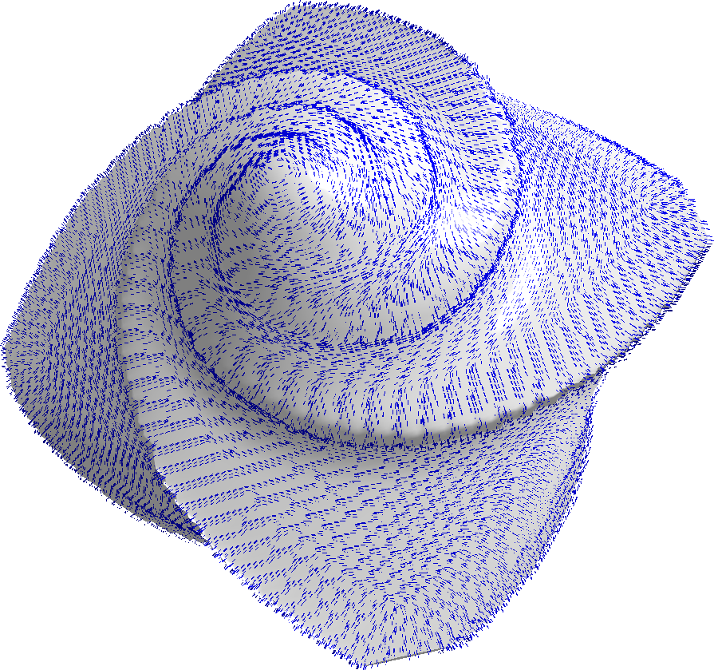
Exact computation
For each vertex
  Sum all the DGtal points in the sphere
  Compute the covariance matrix
  Compute K1, K2
≈ 4πR² texture accesses

Slide 19
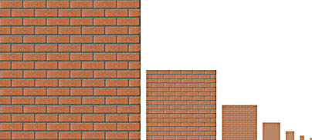


Approximate computation
The exact computation is slow
The DGtal dataset is loaded as a texture
  Mipmaps

Slide 20
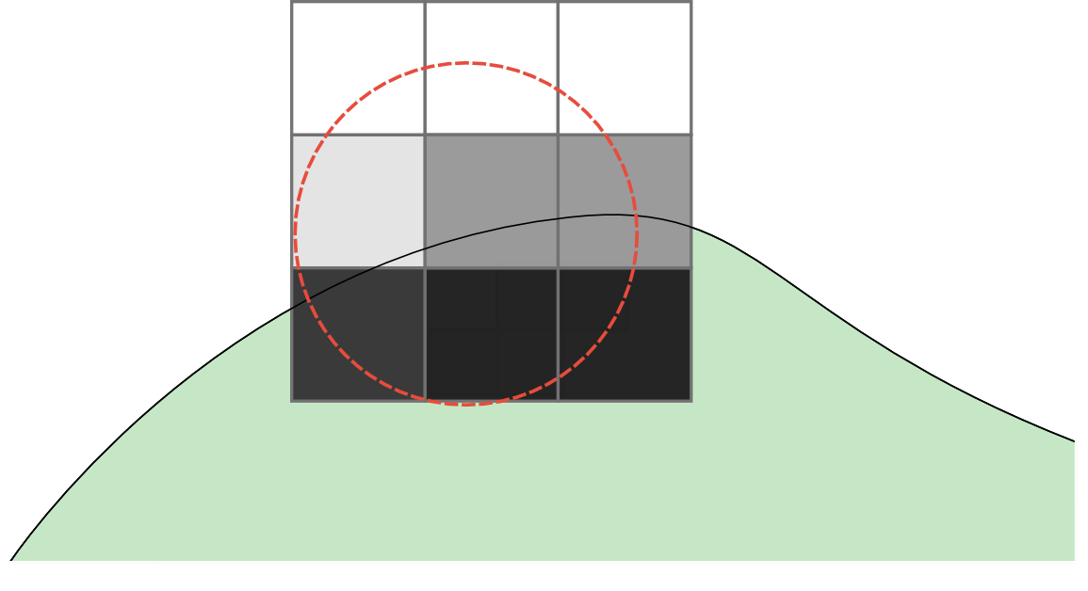
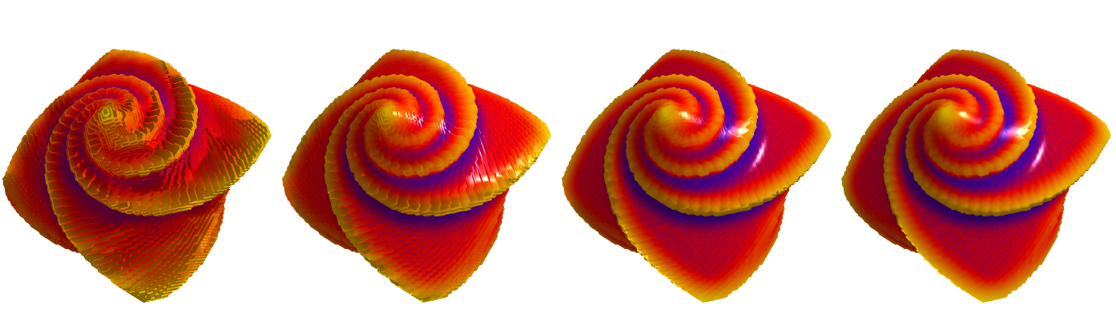
Approximate computation
For each vertex
  Sum all the densities points in the sphere at a certain level L
  Compute the covariance matrix
  Compute K1, K2
≈ 4πR²/(2^(3L)) texture accesses

Slide 21
Pipeline

Slide 22
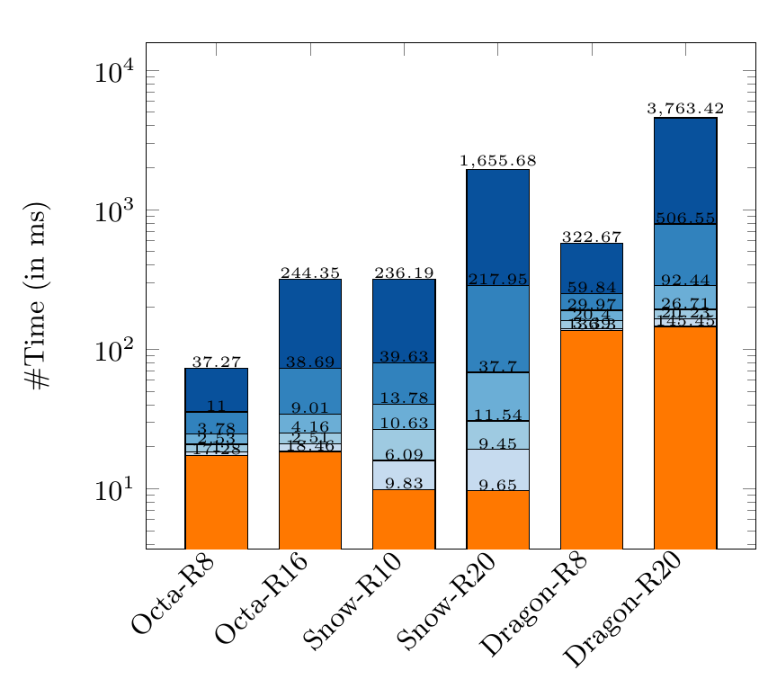
Results
Orange: Adaptive
Isosurface extraction
Blue: Curvature
computation
  Dark blue: exact
  Light blue: maximum approximation

Slide 23
Refinement over time
Keeping an exact curvature visualisation while maintaining a real time manipulation of the object
The curvature is approximated at level L at each frame
  At each frame the object is not being manipulated, L = L-1
  Otherwise, L = 1

Slide 24
Demo !

Slide 25
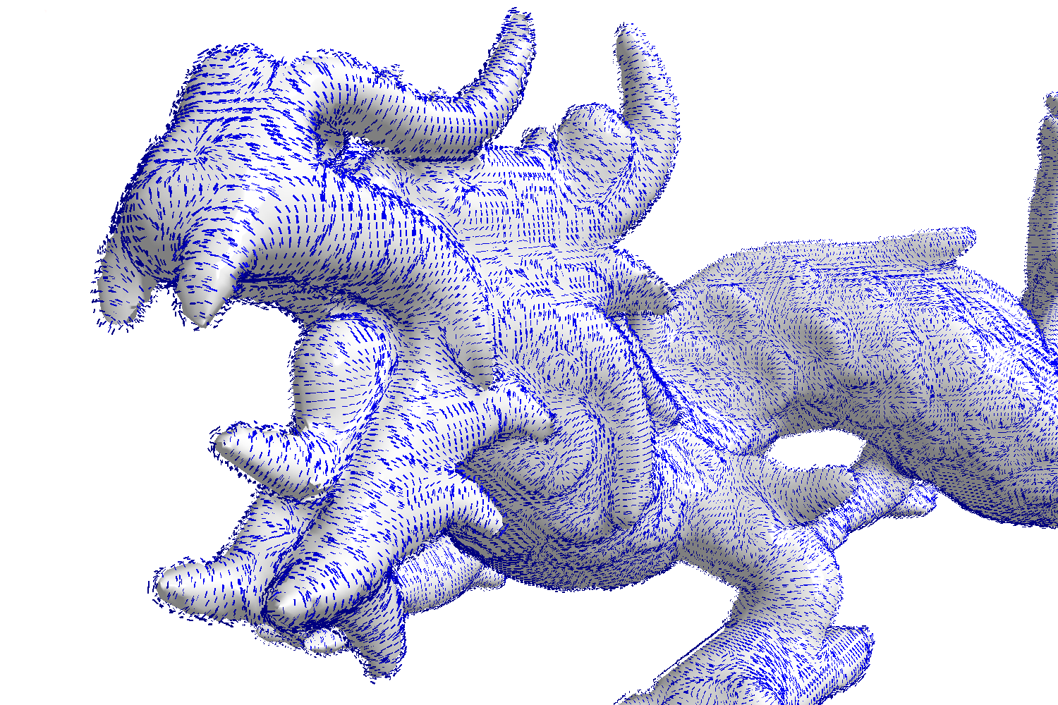
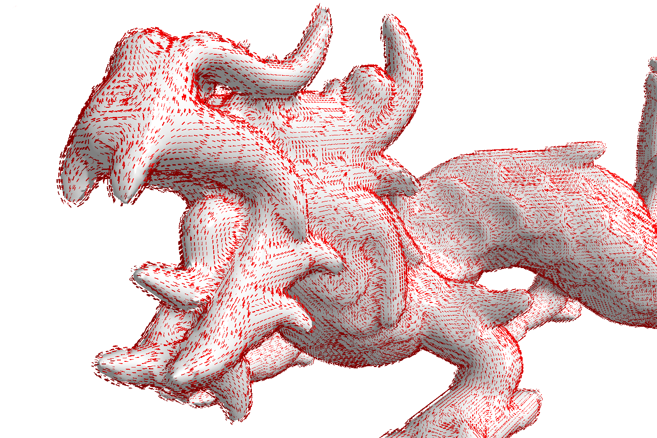
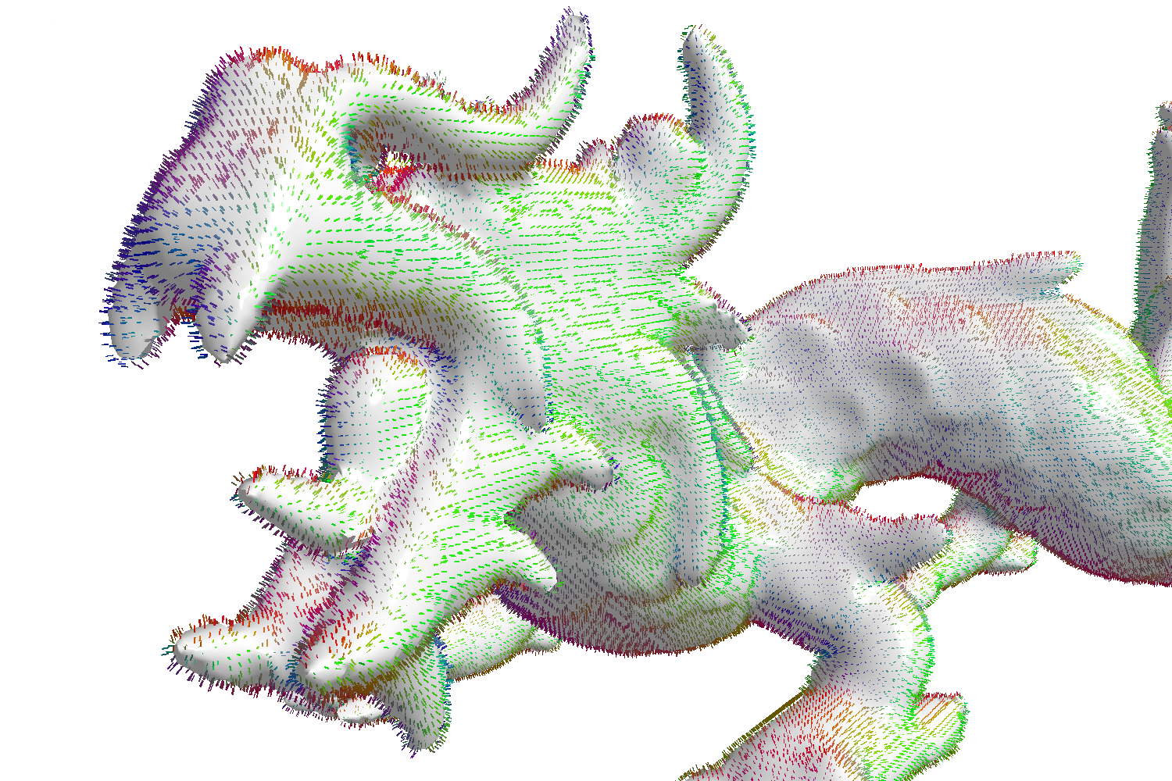
Thanks for listening !
Questions ?
[LC87] Lorensen, W. E.; Cline, Harvey E. (1987). "Marching cubes: A high resolution 3d surface construction algorithm". ACM Computer Graphics
[Len10] Lengyel, E.S., Owens, J.D. (2010). “Voxel-based terrain for real-time virtual simulations”. University of California at Davis
[DIP14] Dupuy, J., Iehl, J.C., Poulin, P. (2014) : “Quadtrees on the GPU.” GPU Pro 5, chap.
[LCL14] Levallois, J., Coeurjolly, D., Lachaud, J.O. (2014) “Parameter-free and multigrid conver-
gent digital curvature estimators.” In: Discrete Geometry for Computer Imagery.
[LCL15] Levallois, J., Coeurjolly, D., Lachaud, J.O. (2015) “Scale-space feature extraction on digital
surfaces”. Computers and Graphics

