Slide 1
Vaccinations vs.
Influenza
Team 5: analyticus
Team Members:
Daniel Ohriner
Patrick Humpphries
Xiangyu Zhang
Yachen Yu

Slide 2
Agendas
Introduction
The Story Begins
Challenges and Lessons Learned
Geographic Perspective
Graphical Perspective
Questions and Answers

Slide 3
The Story Begins
Problem: During the recent flu season, the effectiveness of the vaccine was questioned.
Hypothesis: If the vaccine was effective, then states with high vaccination rates will have low influenza rates.
Test: Compare vaccination rates from Health and Human Services (HHS) and compare them to the rates of influenza from the Center of Disease Control (CDC)

Slide 4
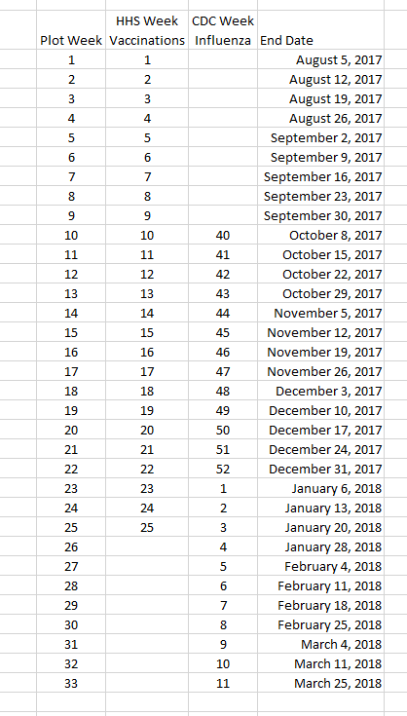
Challenges Data Normalization
CDC Calendar Weeks
HHS Used Flu Season
Normalized on HHS

Slide 5
Lessons Learned
pandas Dataframes facilitates data manipulation.
Government APIs return JSON objects.
JSON objects can be loaded directly into pandas DataFrames.
pandas DataFrames can write directly to JSON files.
JSON files can be read directly into pandas

Slide 6
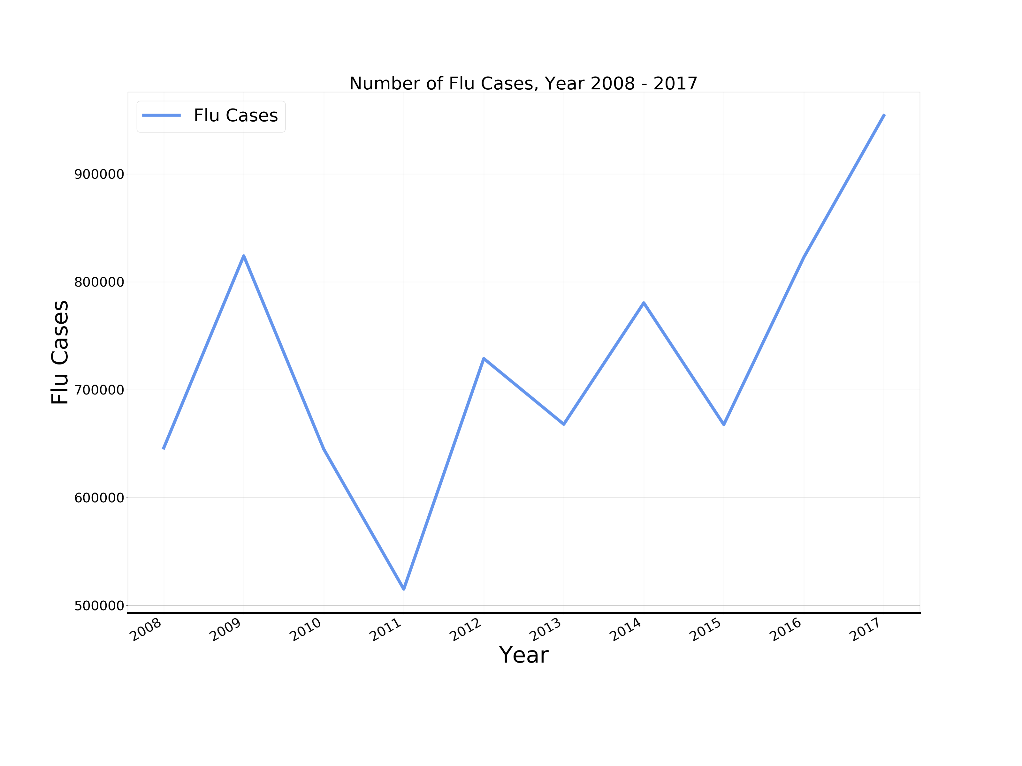

National Level Flu Trend
2017 flu season is the worst in nearly a decade

Slide 7
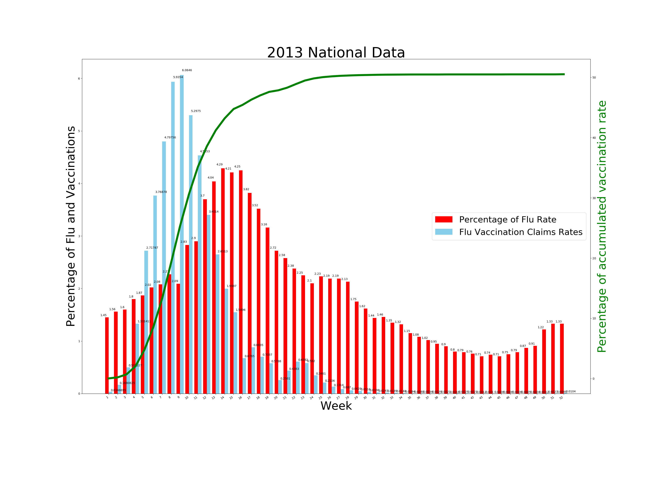
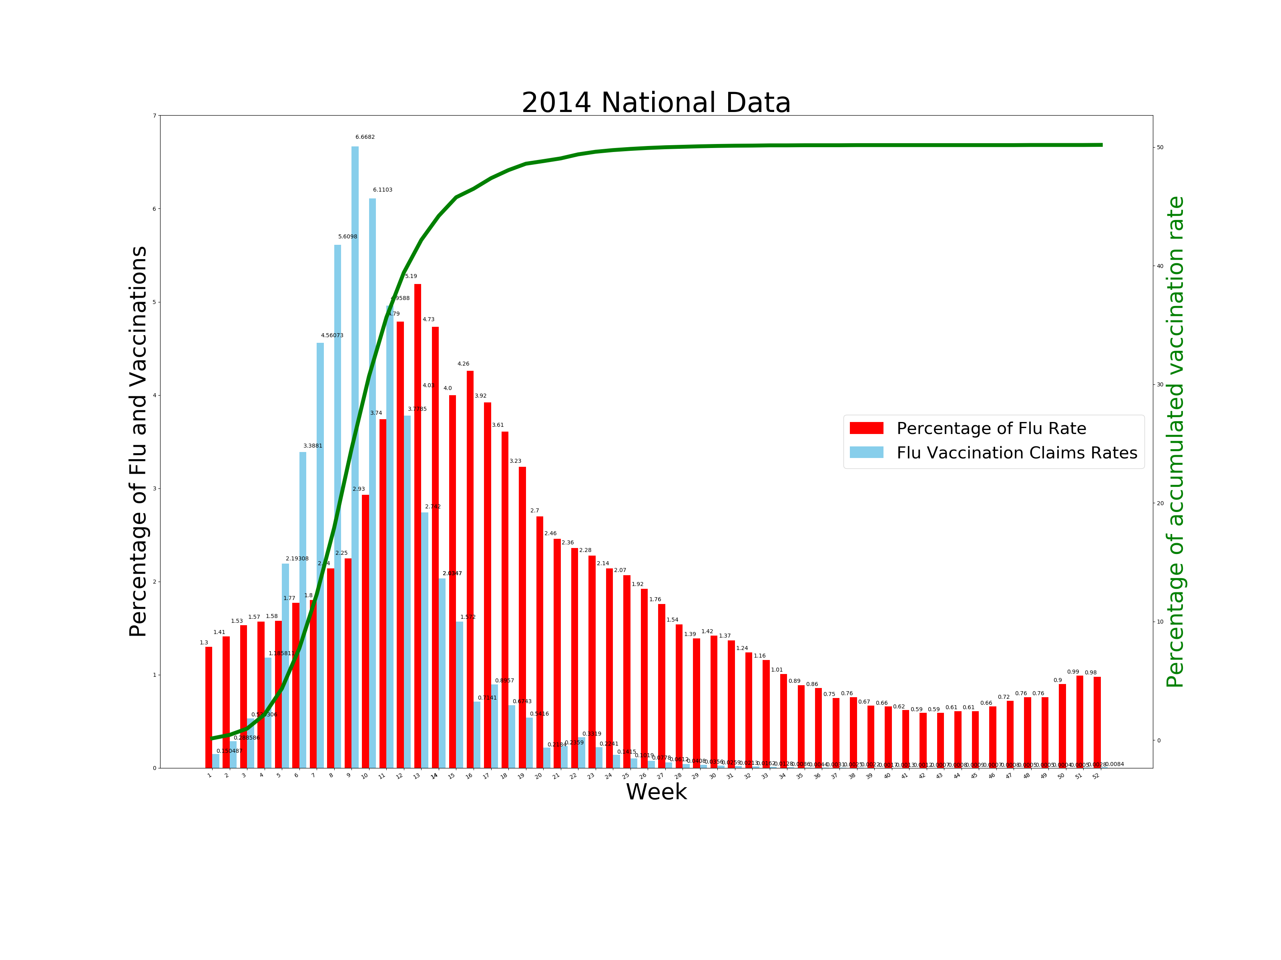
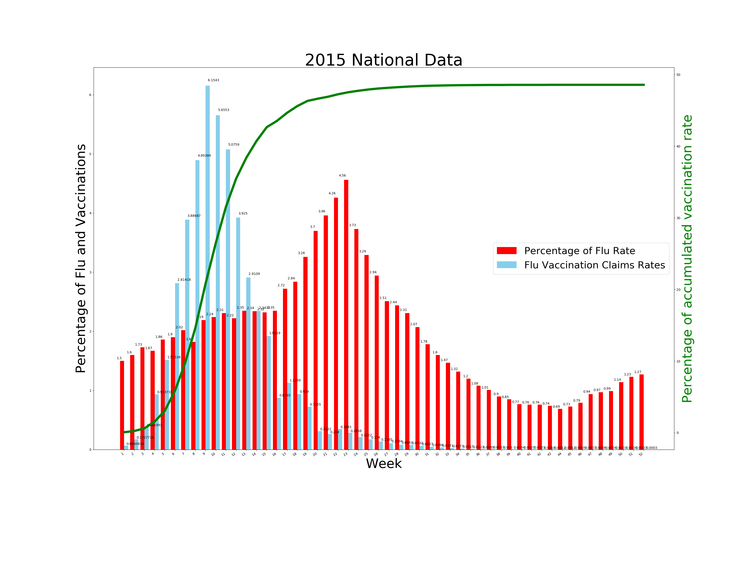
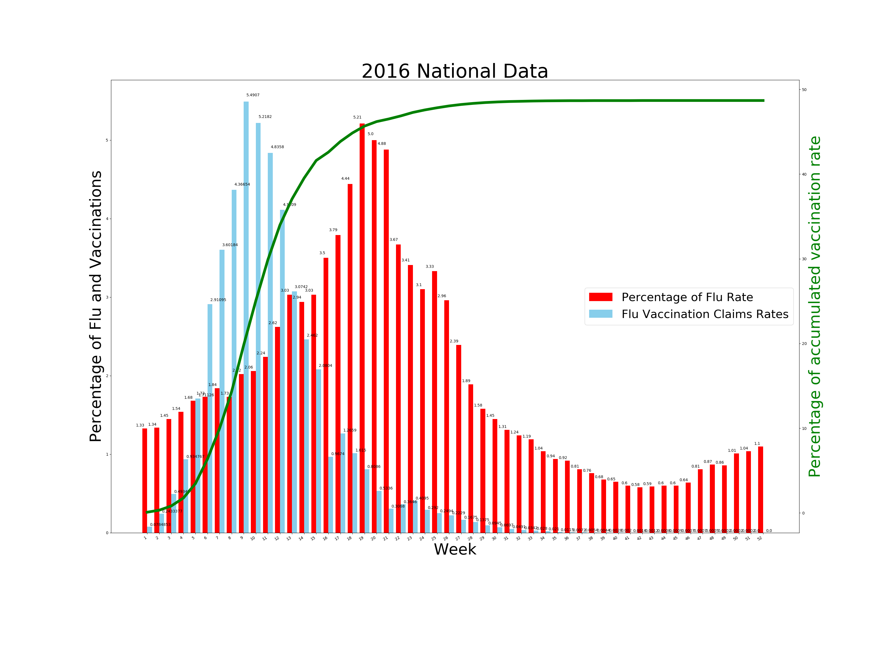
Previous Years Data (2013 – 2016)
Higher vaccination rate would have lower flu rate.
2016 was getting worse.

Slide 8
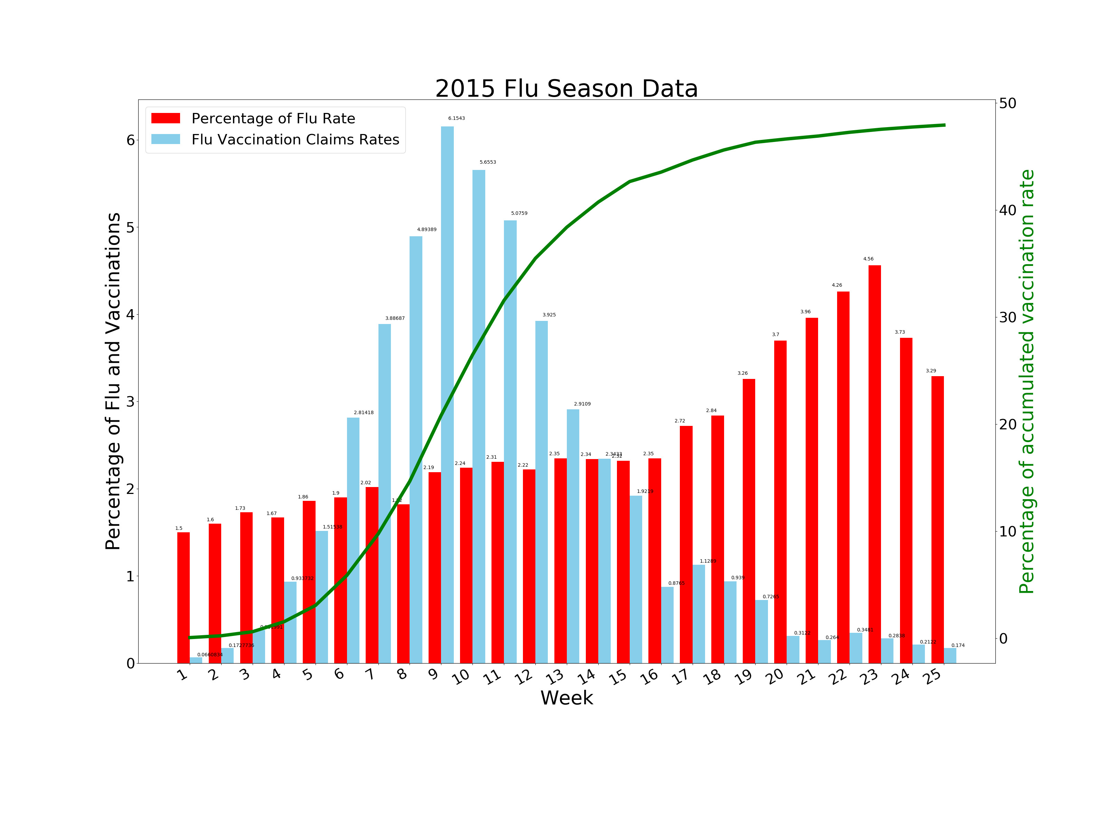
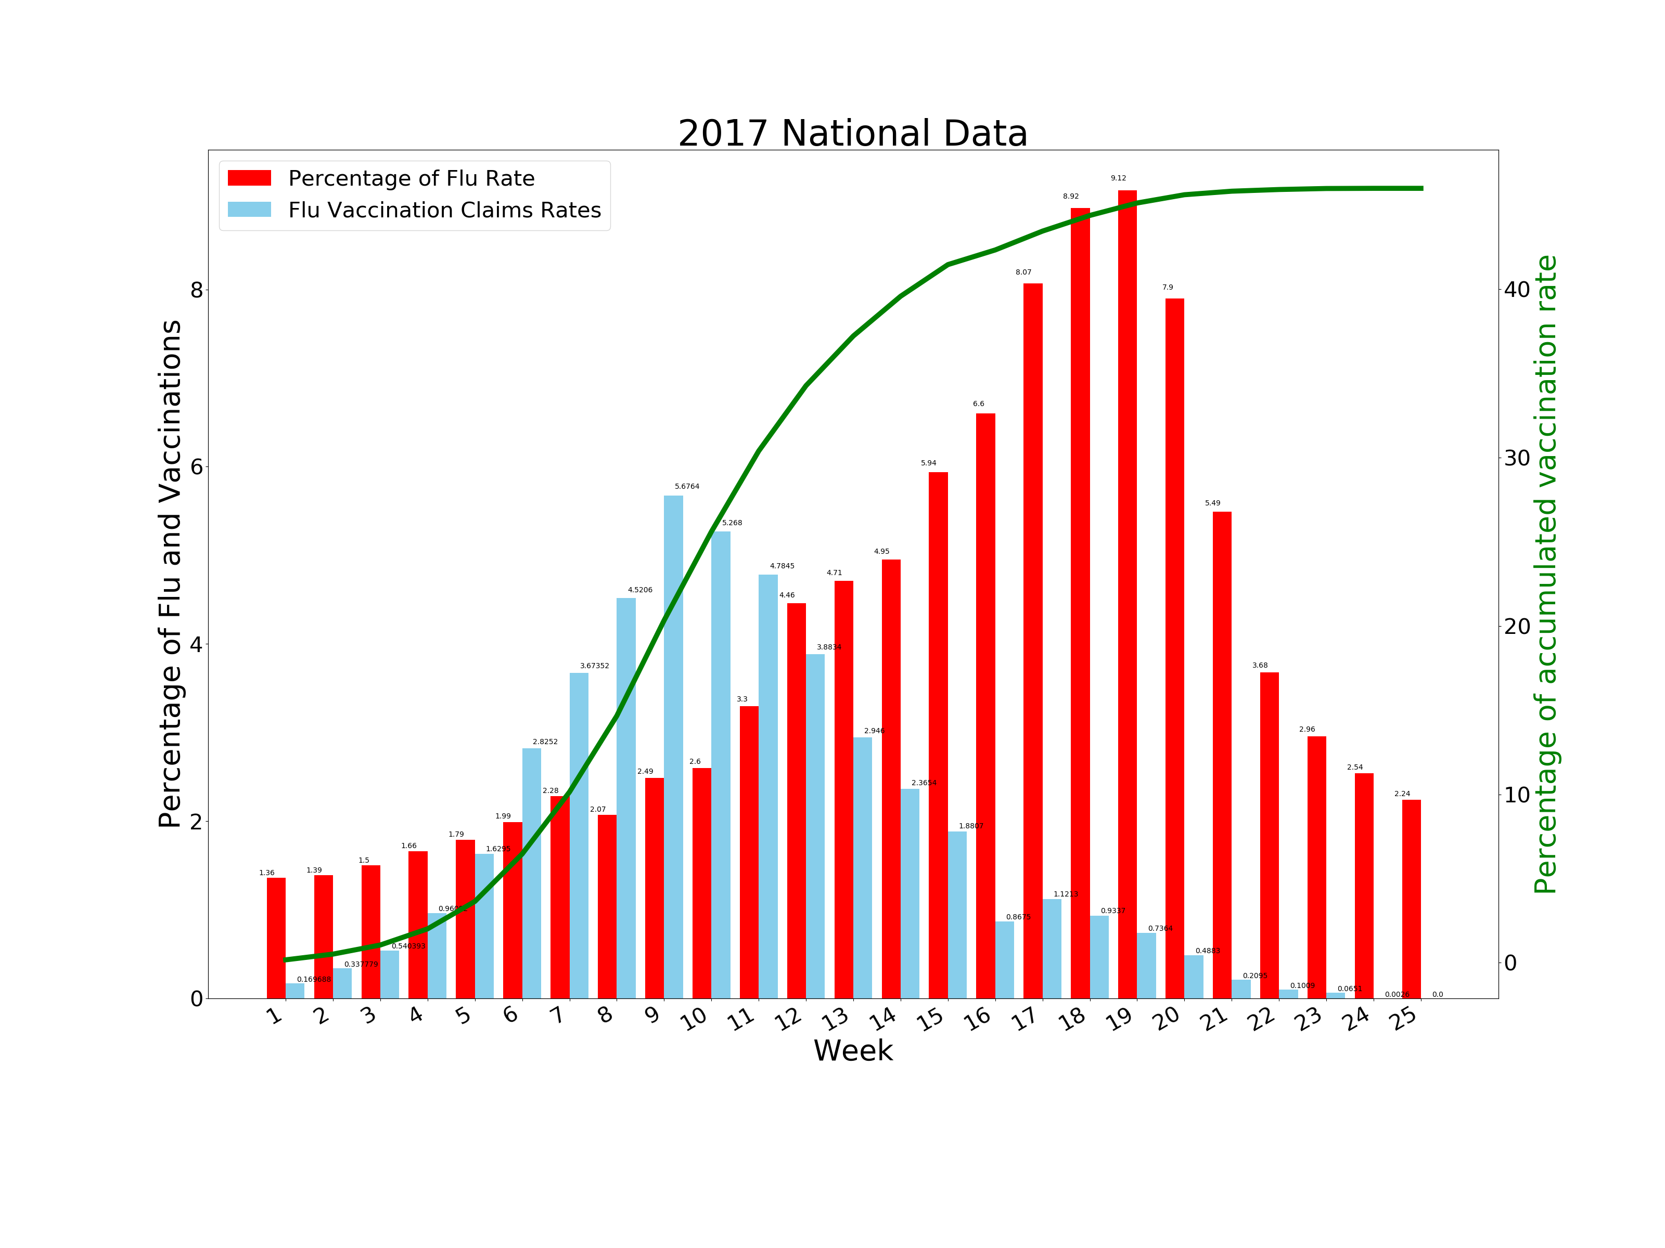
2015 vs. 2017 Flu Season
2017 is the first time the flu rate higher than the vaccine rate.
Notes:
Why 2015? Because 2015 has the lowest flu cases in past 5 years.

Slide 9
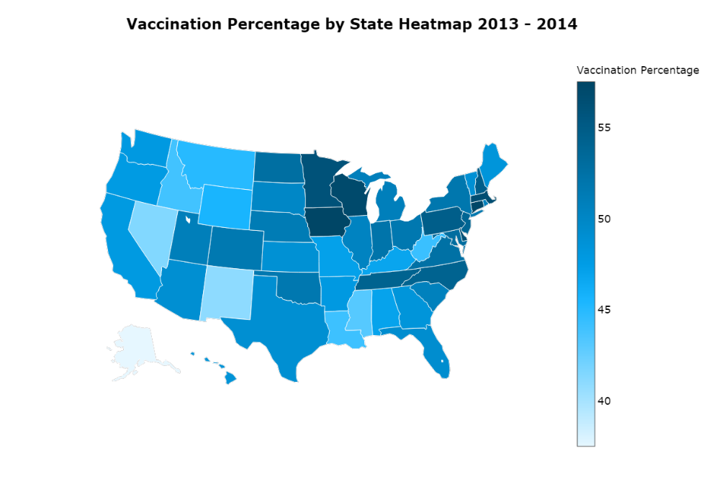
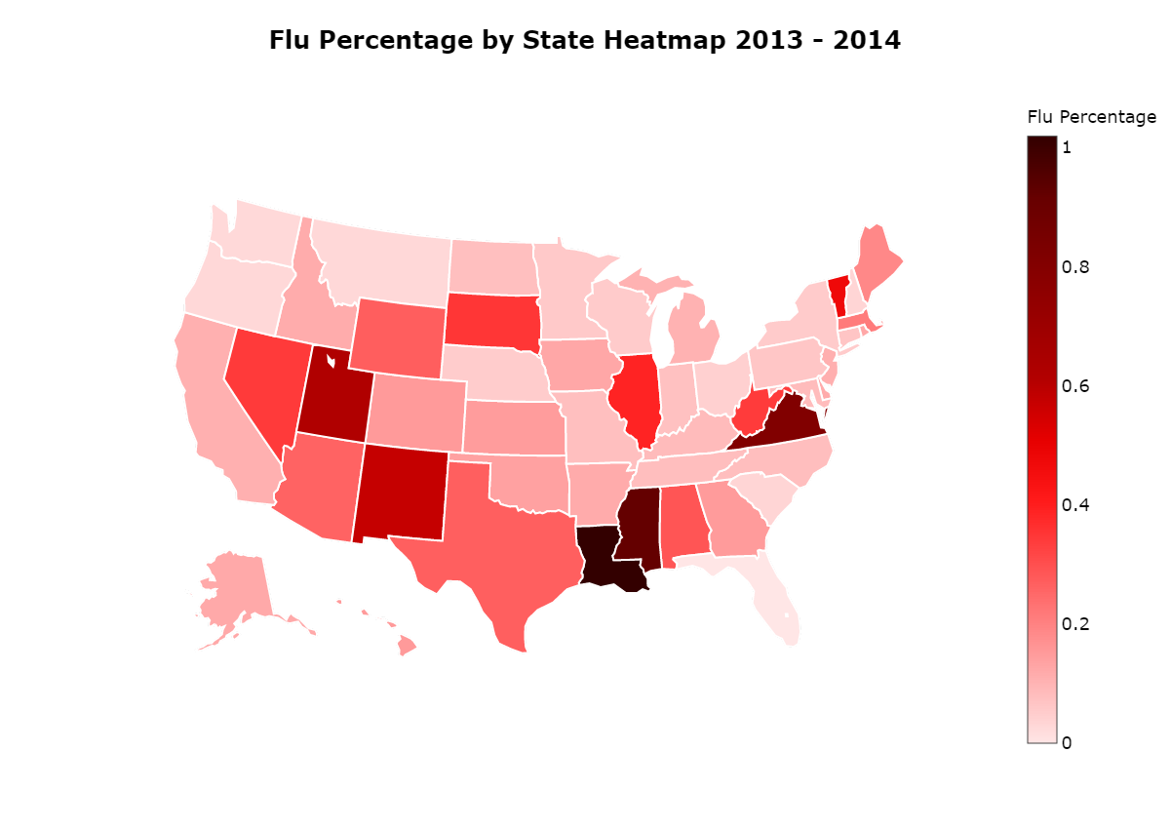
Vaccinations vs. Influenza
Generally, states higher vaccination rate would have lower influenza rate.
Notes:
Initial proposal: higher vaccination rate will lead to lower influenza rate.
Result: generally true in most of the 50 states (can tell by color):
Louisiana, Mississippi, new Mexico: low vaccination rate and high flu rate
Possible reason: educational level, cultural background leads to different belief.
Wisconsin, Iowa, Minnesota: high vaccination rate and low flu rate

Slide 10
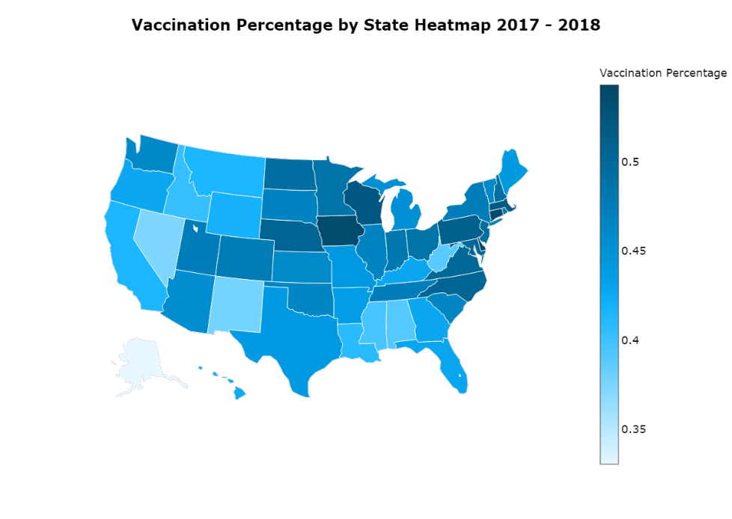
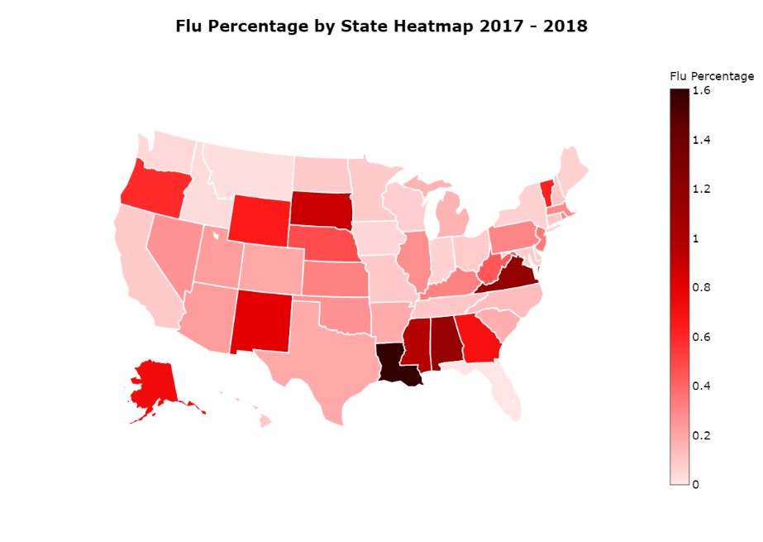
Vaccinations vs. Influenza
Outlier: Virginia
Notes:
2013-2014 date support the hypothesis in previous slide, higher the vaccination rate, lower the flu rate.
There also outliers in both years cases. For example, Virginia.
Possible reason: humidity, temperature

Slide 11

Vaccinations vs. Influenza
Virginia Flu Rate:
2013-2014: 0.81%
2017-2018: 1.17%
Alabama Flu Rate:
2013-2014: 0.29%
2017-2018: 1.13%
Louisiana Flu Rate:
2013-2014: 1.02%
2017-2018: 1.61%
Notes:
2017-2018 season has becoming an extremely serious flu-spreading year.
States that used to have high rate of influenza this years had a significant increase on number of reported cases.
Louisiana, Virginia, Alabama

Slide 12

Questions?

