Slide 1
head room
the hood marauders

Slide 2
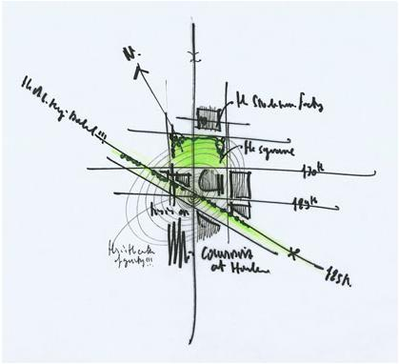
the architect
http://rpbw.r.ui-pro.com/
Notes:
Renzo emerges from Starbucks with the above drawing scrawled on a napkin. Inspired, he starts to brainstorm about elevations. However, he wants to work within the legal constraints for development rights. He dons his nifty AR goggles, grabs his map grounding board and wand, and begins to visualize possible landscapes.
has a background that includes fairly modern CAD tools
Workshop has been using all digital models for years to specify building data, but rarely does the digital cross over into the purely creative
prefers to brainstorm in a freeform fashion, but to have hard data available when he needs it. Wishes to have his creative flourishes constrained by data when necessary
specifically needs information about building heights and air rights.

Slide 3
definitions
development rights
air rights
Notes:
A development includes the construction of a new building or other structure on a zoning lot, the relocation of an existing building to another lot, or the use of a tract of land for a new use.
Development rights →maximum amount of floor area permissible on a zoning lot.
Air rights→ difference between the maximum permitted floor area and actual floor area is referred to as “unused development rights.”

Slide 4
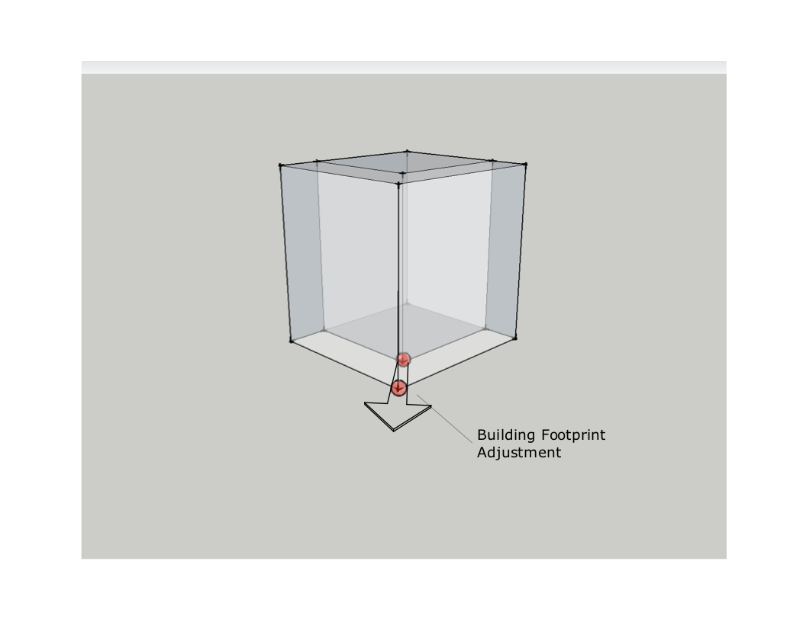
footprint

Slide 5
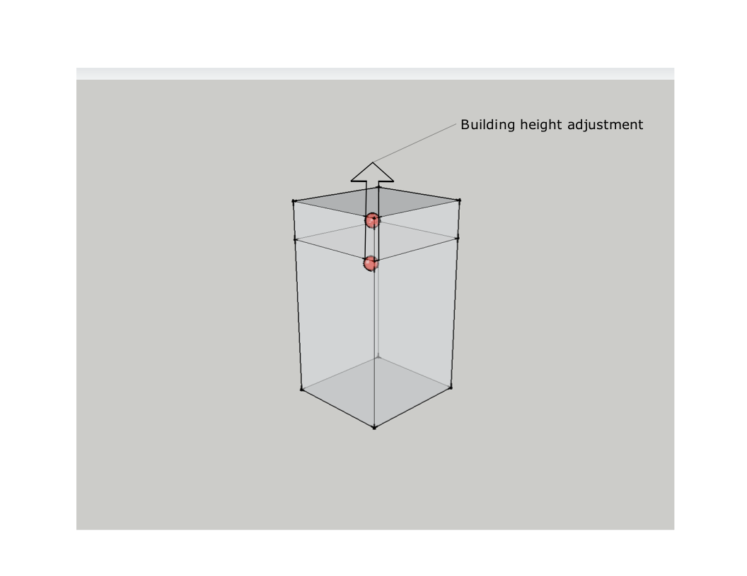
height

Slide 6
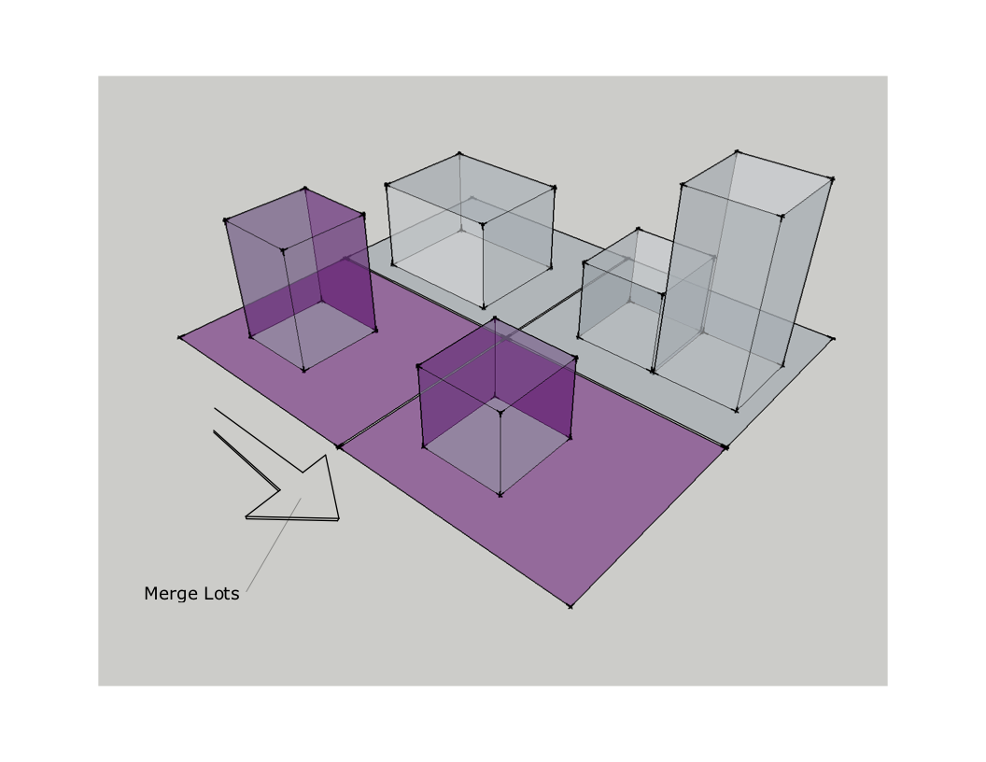
merge

Slide 7
the toolset
what we’ve settled on

Slide 8

magic wand

Slide 9
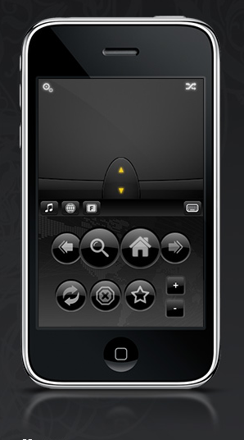
air mouse
Notes:
2-dof + 2 buttons
easy to control without looking at it
Using thumb action to
bring up menu
select menus

Slide 10
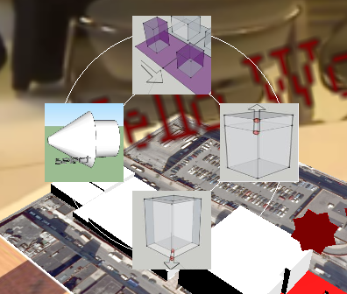
marking menu

Slide 11
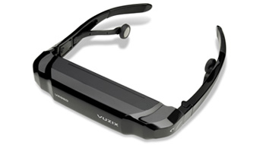
visor orientation
Notes:
to view edited building sizes at real scale

Slide 12
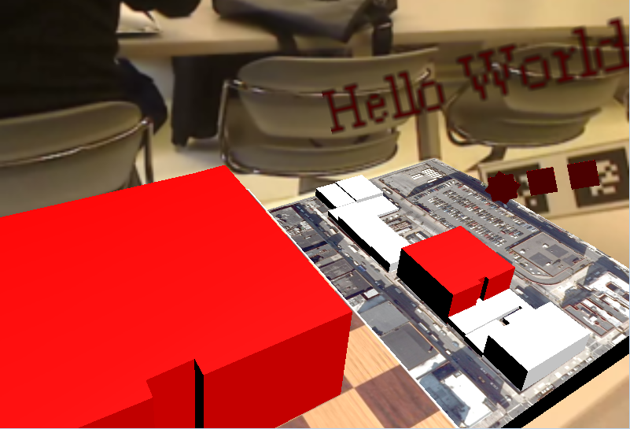
the workbench

