Slide 1
air mouse task menu

Slide 2
selection
the wand

Slide 3
3d text
an extension of GoblinXNA

Slide 4
data load
combination of sources
csv extended
Notes:
extend model csv file

Slide 5
class structure
lots
buildings
handles

Slide 6
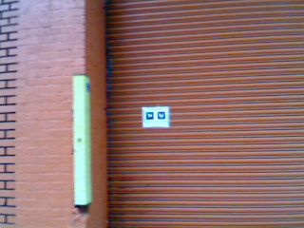
outdoors
Notes:
took footage of building
placed a toolbar fiducial

Slide 7
errors and solutions
csv >> compilible = "package error“
sharing project files

Slide 8
things to do
manipulation techniques
data representation on large scale
merging lots

