Slide 1
head room
jacky j and the hood marauders

Slide 2
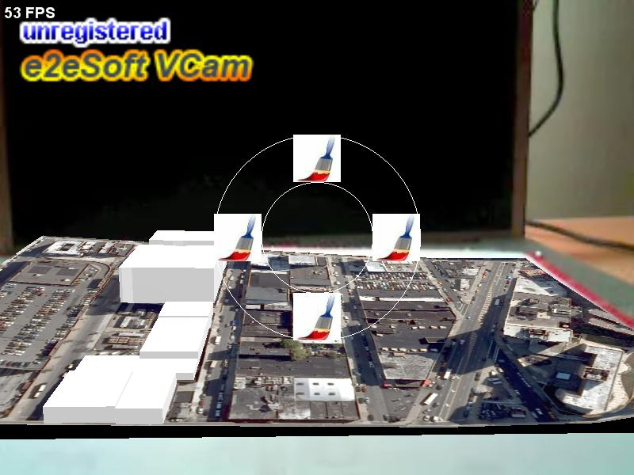
air mouse task menu

Slide 3

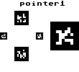
selection
the wand

Slide 4
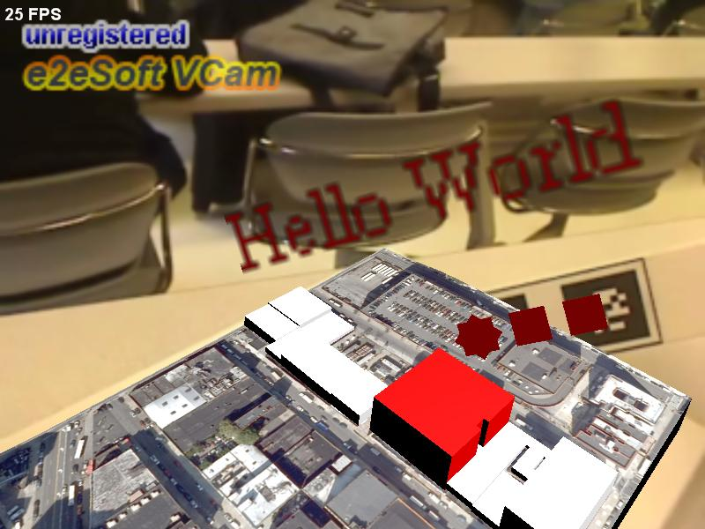
3d text
an extension of GoblinXNA

Slide 5
data load
combination of sources
csv extended
Notes:
extend model csv file

Slide 6
class structure
Revision 37
Building.cs
Data.cs
Lot.cs
Manhattanville.cs
Program.cs
Settings.cs
TexturedBox.cs
Tool.cs
Utilities.cs
building-info.csv
buildings_detailed.csv
buildings_plain.csv
buildings_plain_subset.csv
manhattanville.xml
pointer3.pdf
lots
buildings
handles
Revision 17
Manhattanville.cs
Program.cs
buildings_detailed.csv
buildings_plain.csv
buildings_plain_subset.csv
manhattanville.xml

Slide 7
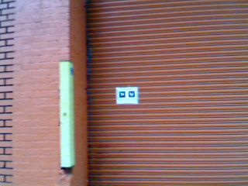
outdoors
Notes:
took footage of building
placed a toolbar fiducial

Slide 8
errors and solutions
csv >> compilible = "package error“
sharing project files

Slide 9
things to do
manipulation techniques
data representation on large scale
merging lots

