Slide 1
head room
building high in manhattanville

Slide 2
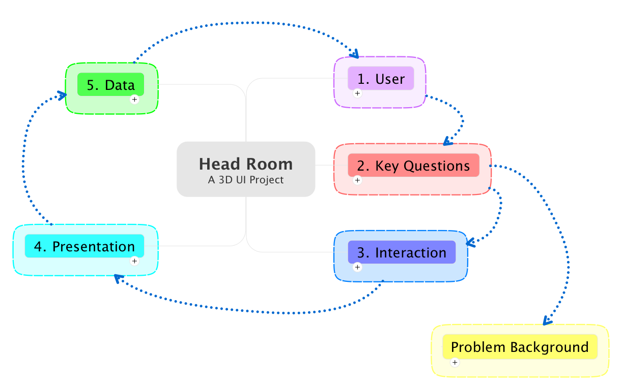
road map

Slide 3
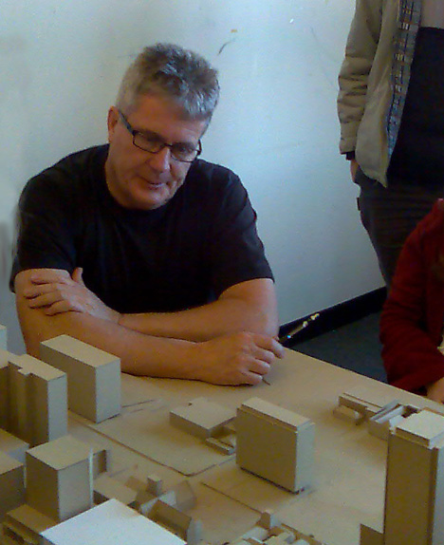

renzo piano
architect
http://rpbw.r.ui-pro.com/
Notes:
Biography
Renzo Piano was born in Genoa (Italy) on September 14, 1937. He graduated in 1964 from the schooll of Architecture of the Milan Polytechnic.
As a student, he was working under the design guidance of Franco Albini, while also regularly attending his father’s building sites where he got a valuable practical experience. Between 1965 and 1970, he completed his formation and work experiments with study travels in Britain and America. It was at that time he met Jean Prouve: their friendship would have a deep influence on this professional life.
In 1971, he founded the “Piano & Rogers” agency with Richard Rogers, his partner on the Centre Pompidou project in Paris. In 1977, he founded “l’Atelier Piano & Rice” with the engineer Peter Rice, who would work with him on many projects, until his death in 1992.
He then founded Renzo Piano Building Workshop, with offices in Paris and Genoa. Some 100 people work with him (among which are architects, engineers, specialists…) in close collaboration with some associated architects, linked to him by years of experience.

Slide 4
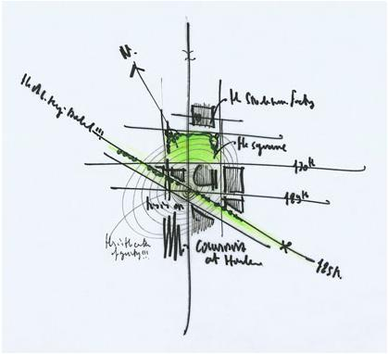
what he needs
Notes:
has a background that includes fairly modern CAD tools
Workshop has been using all digital models for years to specify building data, but rarely does the digital cross over into the purely creative
prefers to brainstorm in a freeform fashion, but to have hard data available when he needs it. Wishes to have his creative flourishes constrained by data when necessary
specifically needs information about building heights and air rights.
what are air rights

Slide 5
definitions
development rights
air rights
Notes:
A development includes the construction of a new building or other structure on a zoning lot, the relocation of an existing building to another lot, or the use of a tract of land for a new use.
Development rights →maximum amount of floor area permissible on a zoning lot.
Air rights→ difference between the maximum permitted floor area and actual floor area is referred to as “unused development rights.”

Slide 6
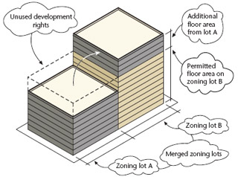
zoning lot merger
Notes:
A zoning lot merger is the joining of two or more adjacent zoning lots into one new zoning lot. Unused development rights may be shifted from one lot to another, as-of-right, only through a zoning lot merger.

Slide 7
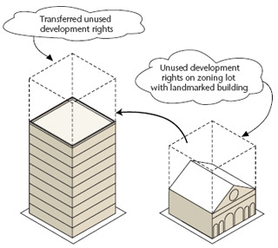
transfer of development rights
Notes:
A transfer of development rights (TDR) allows for the transfer of unused development rights from one zoning lot to another in special circumstances, usually to promote the preservation of historic buildings, open space or unique cultural resources.

Slide 8
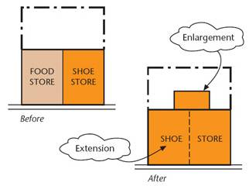
extension and enlargement
Notes:
Enlargement* An enlargement is a built addition to an existing building that increases the floor area of the building. Extension* An extension is an expansion of the existing floor area occupied by an existing use

Slide 9
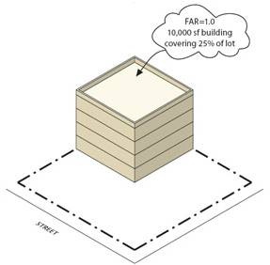
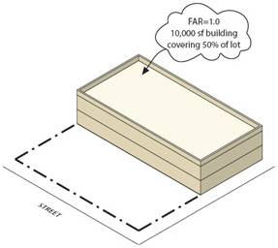
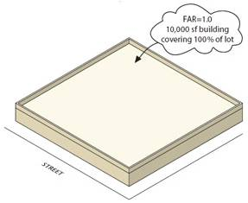
floor area
Notes:
The floor area of a building is the sum of the gross area of each floor of the building, excluding mechanical space, cellar space, floor space in open balconies, elevators or stair bulkheads and, in most zoning districts, floor space used for accessory parking that is located less than 23 feet above curb level
Floor Area Ratio (FAR)* The floor area ratio (FAR) is the principal bulk regulation controlling the size of buildings. FAR is the ratio of total building floor area to the area of its zoning lot. Each zoning district has an FAR control which, when multiplied by the lot area of the zoning lot, produces the maximum amount of floor area allowable in a building on the zoning lot. For example, on a 10,000 square-foot zoning lot in a district with a maximum FAR of 1.0, the floor area of a building cannot exceed 10,000 square feet.

Slide 10
utility

Slide 11

current rights

Slide 12
proposed rights

Slide 13
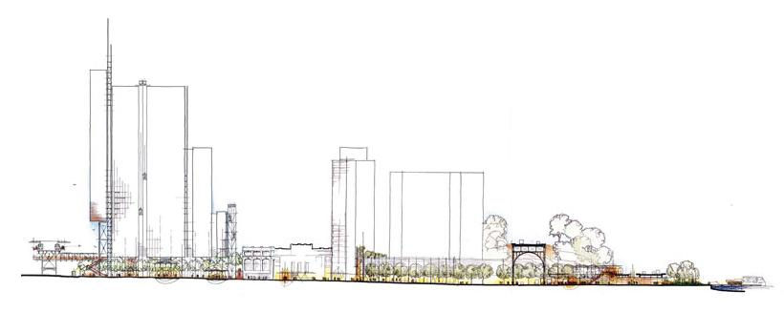
building sizes

Slide 14
interactions

Slide 15
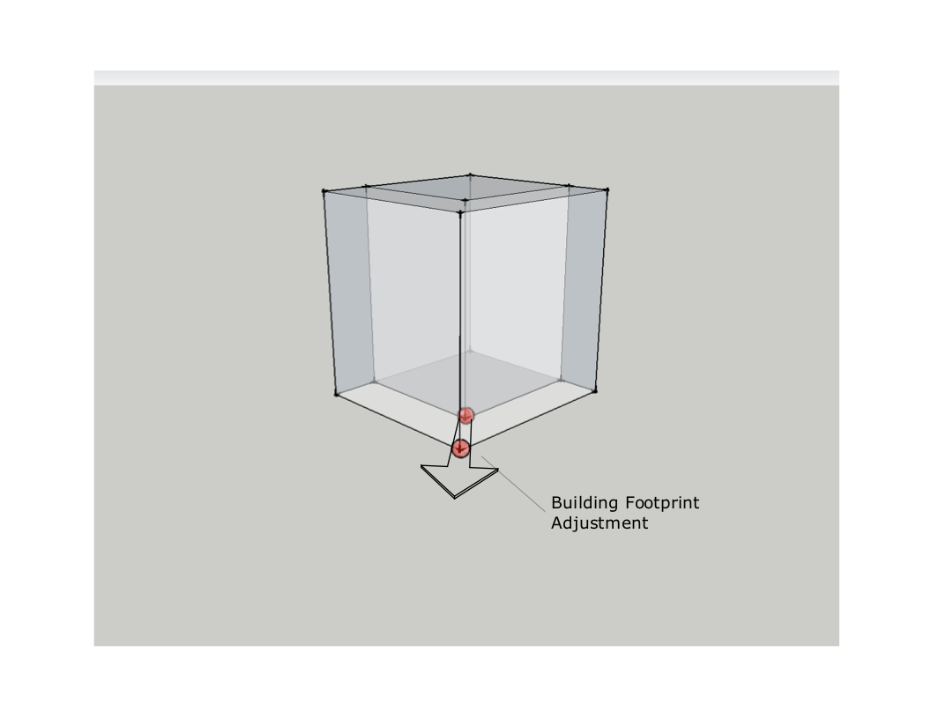
footprint

Slide 16
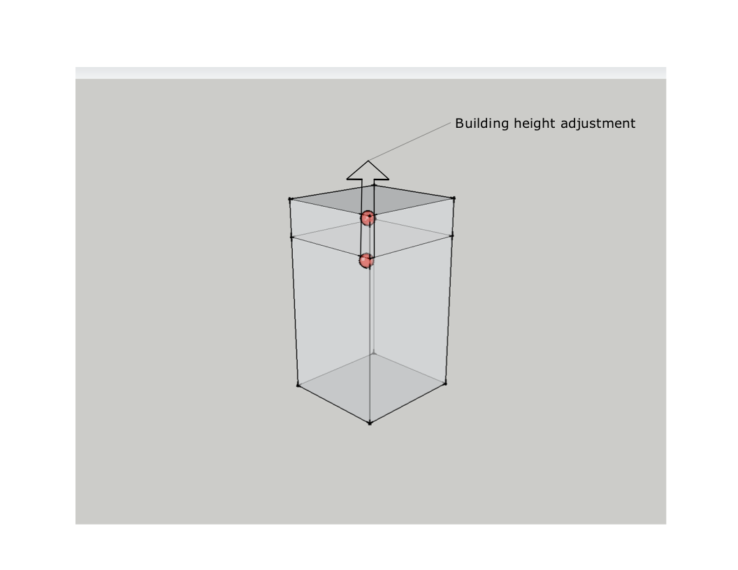
height

Slide 17
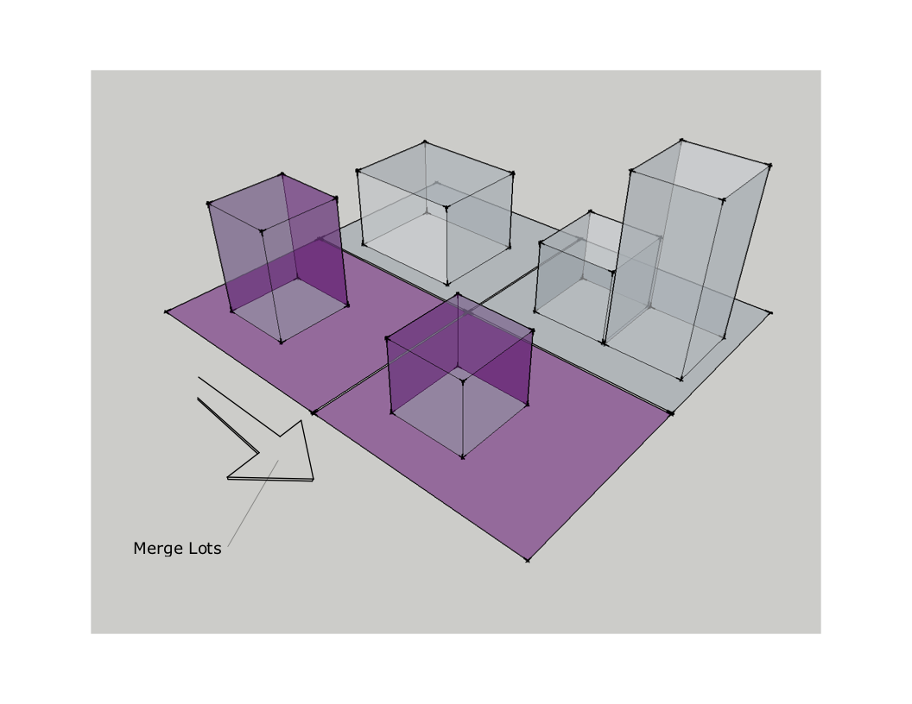
merge

Slide 18
data

Slide 19
available data
residential units
commercial units
campus buildings
Notes:
The segregation of the different building units on the basis of occupancy and the data corresponding to each of these are depicted as well.
Residential
Year built
Building class
Toxic sites
Rent Price
Rented date
Unused buildable square feet
Zoning map
Zoning district
Buildings around
Commercial
Year built
Building class
Rent/Sale price
Unused buildable square feet
Zoning map
Zoning district
Campus
Year built
Cost of infrastructure
Unused buildable square feet
Zoning map
Zoning district

Slide 20
data for interactions
finding a lot
adding/removing floors
tinkering with buildings
evaluating surrounding buildings
Notes:
finding a lot
1.Address
2.Height of building
3.Transferable air rights
4. Violated air rights
adding/removing floors
1.Square feet area before
2.Square feet area after
3.Air rights transferred, bought or leased
tinkering with buildings
1.Address of surrounding buildings
2.Air rights available
evaluating surrounding buildings
1.Air rights available
2. Violated air rights
3.Total square feet area.

Slide 21
dynamic data
for old buildings
for new buildings
Notes:
On selection and manipulation of the building for operations required by user, these data are shown for the old and new structures.
Purchase price
Total square feet
Air rights transferred.
Number of floors added or subtracted
Rents for housing
Occupancy
Current Occupancy
Total cost of construction
Property value

Slide 22
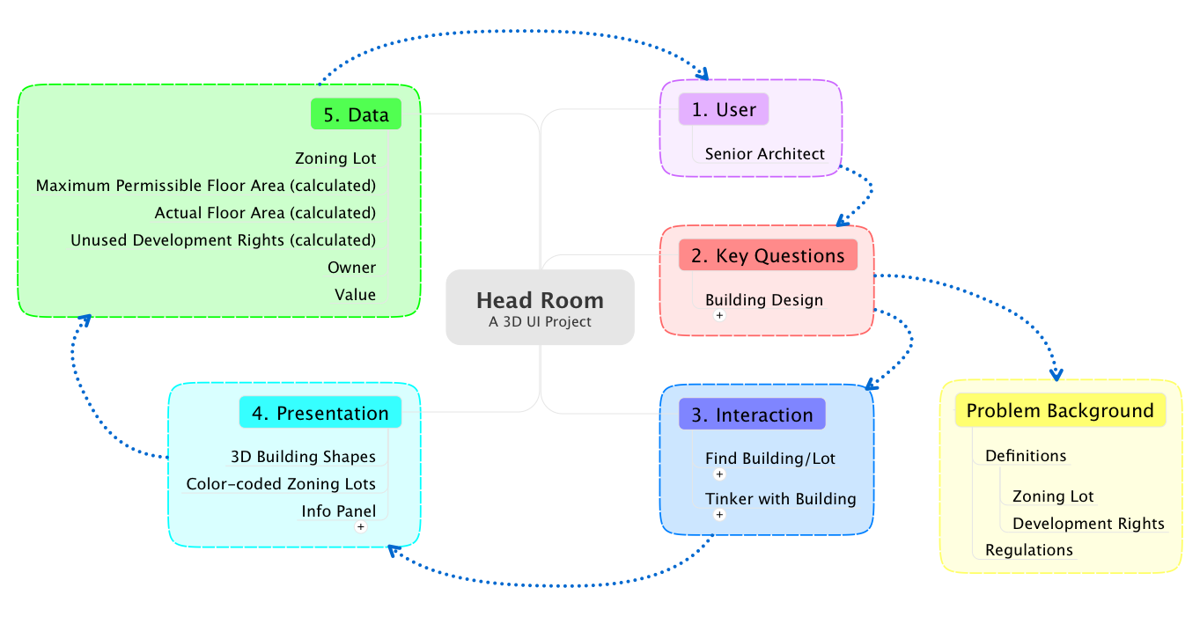
road map

