Slide 1
Head room
the hood marauders

Slide 2
our team
jacky: project manager
mengu: technical lead
colin: documentor

Slide 3
presentation roadmap
design choices
implementation
testing

Slide 4
design choices
what to do
Notes:
The design choices we made are as follows:
define effects/interactions
define selection technique
define manipulation technique
develop methods to depict the information necessary

Slide 5
camera
Notes:
display mounted or hat mounted

Slide 6
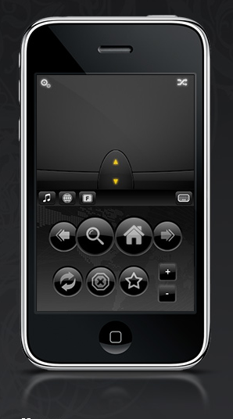
air mouse
Notes:
2-dof + 2 buttons
easy to control without looking at it
Using thumb action to
bring up menu
select menus

Slide 7
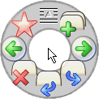
marking menu
Notes:
Hierarchical menus to perform manipulation or to interact with the models

Slide 8

magic wand

Slide 9
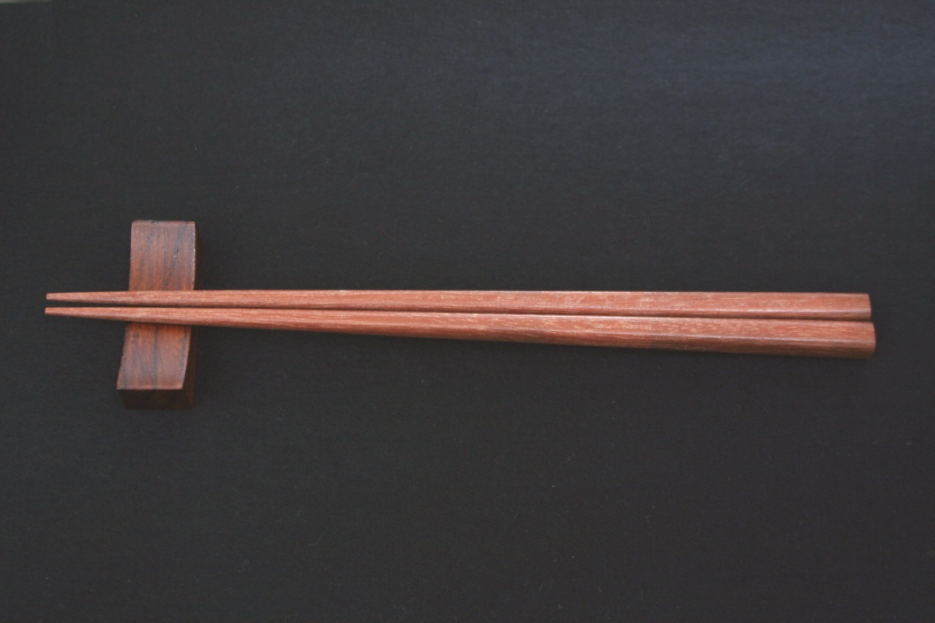
chopsticks

Slide 10
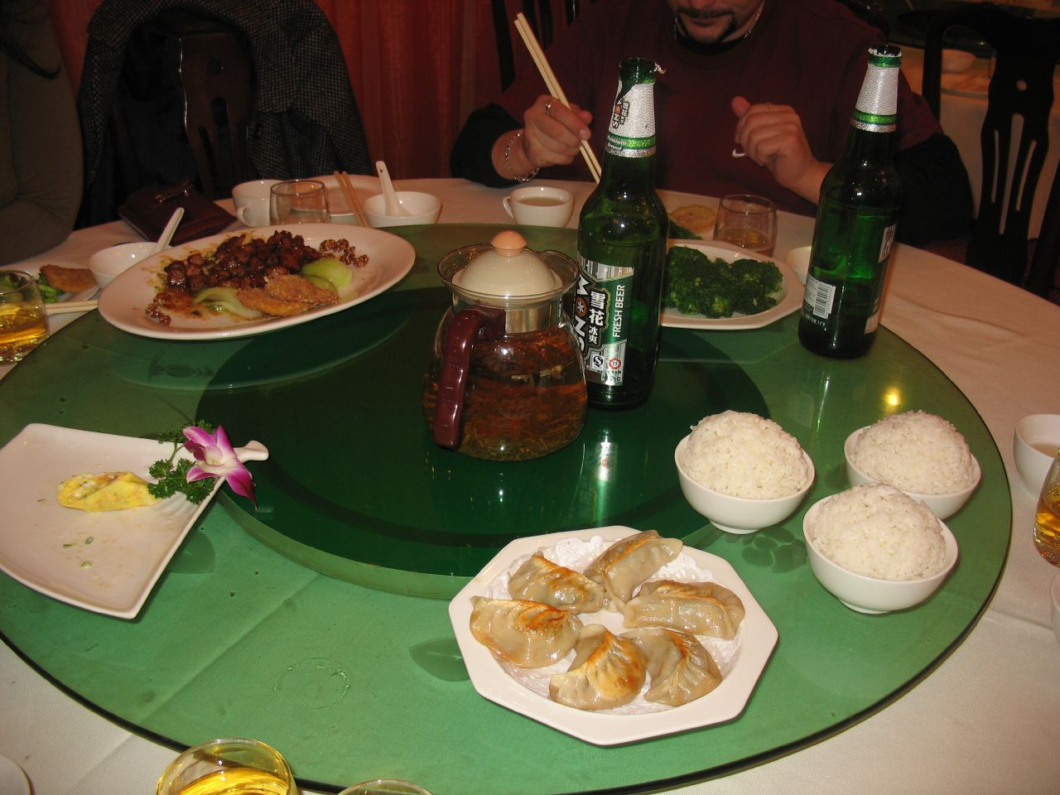
lazy susan
Notes:
bimanual choices

Slide 11
map handle
Notes:
using a handle on the map so it can be manipulated with non-dominate hand, but leaving all other functionality asymmetrically to the wand hand

Slide 12
outdoors
Notes:
most exciting thing – if we can get manipulation techniques down, map will still be usable and will augment the “live” experience outdoors.
Changes to model objects will be reflected immediately in surrounding environment.
Use of orientation tracking could be excellent for seeing changes in the landscape.

Slide 13
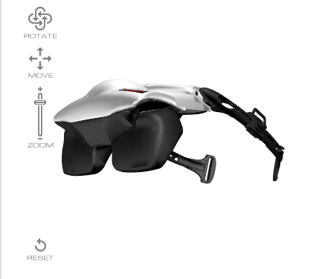
visor orientation
Notes:
to view edited building sizes at real scale

Slide 14
data display
Notes:
display data in 3D - either using animation in Goblin XNA - draw transparent quadrants in 3D space to display data on each of the planes

Slide 15
implementation
class architecture and structure
Notes:
Map class (may already exist)
zoom()
MergedLot class
- constructed new MergeLot(Lot1, Lot2)
Lot class
- select()
Building class (may already exist, or extends TransformNode)
- Method: select()
Hierarchy: Map >> MergedLot >> Lot >> Building
Extension of building class called EditableBuilding
- Method: selectHandle()
Handle class extends TransformNode
Extension of building class called LiveBuilding or BigBuilding
- Takes building object as a parameter (building to mimic)
Wand class extends GeometryNode
- Method: changeFootprint()
- Method: changeNumFloors()
- Method: makeMarkingMenu()
Data class
- Method: show()
PieMenu (no work needed, may package as dll)
Application class to indicate states: Viewing, Editing, HeightAdjustment, FootPrintAdjustment, etc.
- show state

Slide 16
the “lot” class
Notes:
properties include
air rights
sq. footage
zoning classification

Slide 17
the “building” class
Notes:
extensible to “editablebuilding” class
also may include a subclass that mimics the adjusted size of a building but writ large upon reality

Slide 18
the “handle” class
Notes:
small spheres at the corners of a building that allow manipulation
of square footage
of number of floors

Slide 19
“application state” class
Notes:
Viewing,
Editing,
HeightAdjustment,
FootprintAdjustment
etc.

Slide 20
“marking menu” class
Notes:
extends PieMenu class which extends DrawableGameComponent (an XNA-native component)
may package PieMenu as a dll since it is already developed and unchanging

Slide 21
the “data” class
Notes:
extends GeometryNode (if we're displaying something in 3D)
or DrawableGameComponent

Slide 22
properties file (xml)
Notes:
load parameters from an XML file - if we want to change something we can just adjust the XML file and relaunch the executable

Slide 23
testing
Notes:
Test each method in each class with unit test case.

Slide 24
indoors
Notes:
select buildings
edit them – footprint and height
see the changes reflected on the map
see hard data when required
Test with real values of air rights from the data given

Slide 25
outdoors
Notes:
same set of steps as indoors, but
use visor and fiducials to see the effects on the landscape
Use fiducials to see data corresponding to the effects

