Slide 1
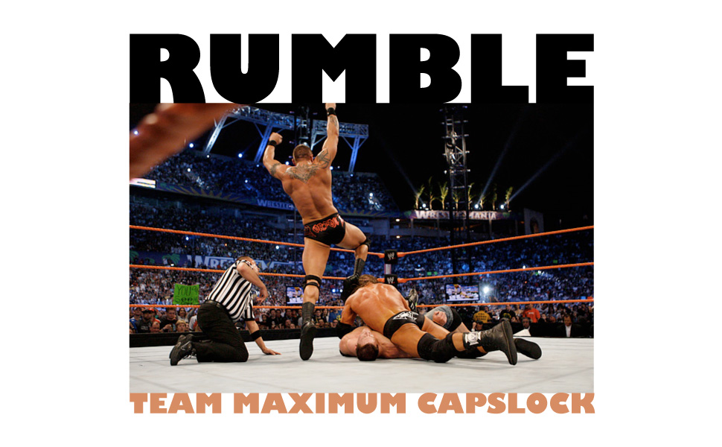
Notes:
Welcome
We’re going to talk about:
What our language does
How it does it
The variety of uses for it

Slide 2
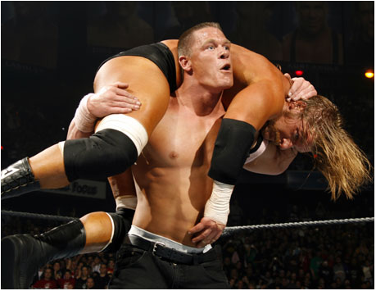
What is Rumble?
Rumble is a scripting language for creating simulation environments and their dynamic participants.
Notes:
Environment – The ARENA: defines the attributes that each participant may possess and actions that can be called by participants to invoke changes
Simulation – The MATCH: defines the goals of the simulation, and separated out the most variable aspects of the environment. The simulation describe aspects that are unique to this one instance.
Participants – The PLAYERS: define strategies for coping with and competing in a given environment
Possible Rumble Programs:
SOLO: fieldmouse, sun, rain, drought, illness. One mouse, alone, pitted against his environment.
COMPETITIVE: educational tool in programming classes, each student is told the boundaries of their environment and writes their own participant file in order to compete in that environment. Wrestling tournaments
NON-COMPETITIVE: elevator pick-up algorithms
PREDICTIVE: presidential elections

Slide 3
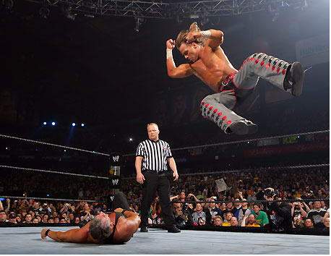
The Wrestling Simulation
Environment
Participants
Simulation
Notes:
Environment:
States that participants must possess a health and strength attribute
Defines three actions - punch, kick, and polish_hammer - which modify other participants’ attributes in a specified manner
Participants:
Hulk's getting old, keeps it old-school, sticks to the fundamentals, so that's why his strategy is to Polish Hammer, no matter what, every chance he gets.
With our other participant, the Rock, we have a more interesting style. As an actor he's been working on his character development, so he changes up his routine a bit, puts a little unpredictability in his performance.
Simulation file:
Used to initialize a given instance of a simulation.
Saves time when trying comparing multiple scenarios of a simulation.
Reuses code.

Slide 4
wrestlingenvironment.rue
  //Environment File - wrestling.rue
  environment name "Wrestling Environment";
  global {
  int moves;
  }
  attributes {
  int health {n >= 0};
  int strength {n >= 0};
  }
  def required step() {
  moves += 1;
  int i;
  i = $last_part + 1;
  if (i >= $num_parts){
  i = 0;
  }
  $part[i].step();
  }
//continued…
def action punch(participant enemy) {
set(enemy.health, enemy.health - 2);
set(me.strength, me.strength - 3);
}
def action kick(participant enemy) {
set(enemy.health, enemy.health - 1);
set(me.strength, me.strength - 1);
}
def action polish_hammer(participant enemy){
int i;
i = $randi;
if ((i % 10) >= 8) {
set(enemy.health, enemy.health - 10);
set(me.strength, me.strength - 2);
}
else {
set(me.strength, me.strength - 1);
}
}

Slide 5
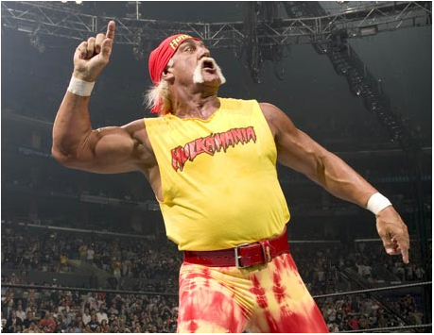
hulkhogan.rup
//Participant Hulk Hogan hulkhogan.rup
participant name "Hulk Hogan";
def required step() {
polish_hammer($part[0]);
}

Slide 6
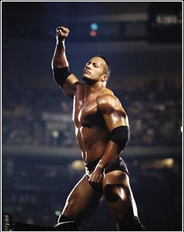
therock.rup
//Participant The Rock therock.rup
participant name "The Rock";
def required step() {
if($randi % 2 == 0){
kick($part[0]);
}
else {
punch($part[0]);
}
}

Slide 7
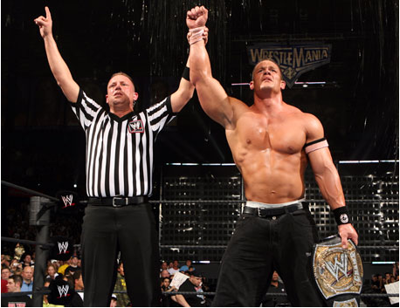
wrestlingsimulation.rus
//Simulation File wrestlingsimulation.rus
simulation name "Wrestling Simulation";
environment "wrestlingenvironment.rue" {
moves = 0;
}
participant "hulkhogan.rup" hulk_hogan {
strength = 20;
health = 30;
}
participant "therock.rup" the_rock {
strength = 30;
health = 20;
}
def required end () {
return ($part.hulk_hogan.health <= 0 || $part. hulk_hogan.strength <= 0 || $part. the_rock.health <= 0 || $part. the_rock.strength <= 0);
}
Notes:
So how does the referee in your simulation know who's won? We must tell him the rules, and we do this in the end() function, required of all simulations. The end function measures attributes and declares a winner when one of the participants meets established criteria.

Slide 8
Example Output
Notes:
Output in JSON
Human Readable
Can be interpreted by other programs
GUI displays
Statistical analyzers
Web frontend

Slide 9




Compilation Environment
$ RumbleCompiler wrestlingenvironment.rus
Simulation File (*.rus)‏
Environment File (*.rue)‏
Participant Files (*.rup)‏
Lexical Analyzer (Scanner - JLex)‏
Java_cup.runtime.Symbol
ERROR
OUTPUT
Syntax Analysis
(Parser – CUP)‏
Settings
Data Structure
AST
Semantic Analysis and Validation
Java Code Generation
AST
Environment and Participant *.java runtime files

Slide 10
Tools
Notes:
Eclipse with SVN
Jlex – Lexical Analysis
CUP – Syntactic Analysis and AST generation
Google Apps

Slide 11
The Prisoners' Dilemma

Slide 12
Closing Remarks

Slide 13
GET READY TO RUMBLE!

