Slide 1
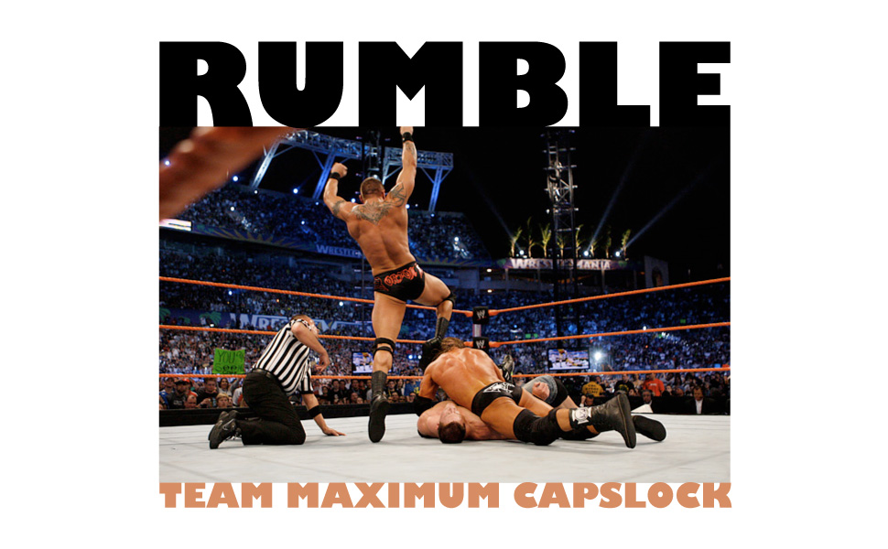
Notes:
Welcome
We’re going to talk about:
What our language is
What it can do
The process of creating it

Slide 2
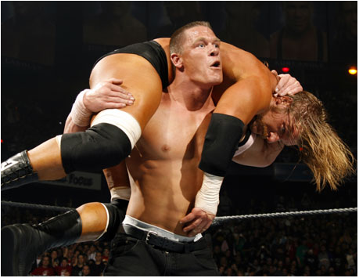
Rumble is a scripting language for creating simulation environments and their dynamic participants.
Rumble is a scripting language for creating simulation environments and their dynamic participants.
Notes:
Environment – defines the attributes that each participant may possess and actions that can be called by participants to invoke changes
Participants – define strategies for manipulating and competing in a given environment
Possible Rumble Programs: wrestling tournaments, presidential elections, elevator pick-up algorithms, and more!

Slide 3
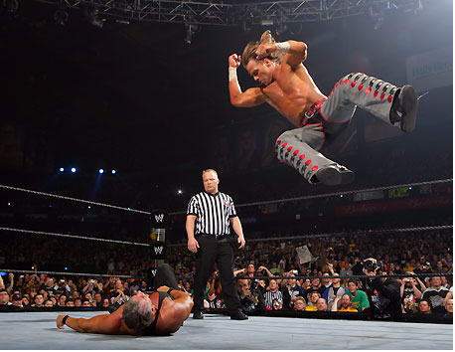
The Wrestling Simulation
Environment
Participants
Simulation file
Notes:
Environment:
States that participants must possess a health and strength attribute
Defines three actions - punch, kick, and polish_hammer - which modify other participants’ attributes in a specified manner
Participants:
Hulk's getting old, keeps it old-school, sticks to the fundamentals, so that's why his strategy is to Polish Hammer, no matter what, every chance he gets.
With our other participant, the Rock, we have a more interesting style. As an actor he's been working on his character development, so he changes up his routine a bit, puts a little unpredictability in his performance.
Simulation file:
Separated out the most variable aspects of the environment. Used to initialize a given instance of a simulation.
Saves time when trying comparing multiple scenarios of a simulaiton.
Reuses code.

Slide 4
wrestlingenvironment.rue
  //Environment File - wrestling.rue
  environment name "Wrestling Environment";
  global {
  int moves;
  }
  attributes {
  int health {n >= 0};
  int strength {n >= 0};
  }
  def required step() {
  moves += 1;
  int i;
  i = $last_part + 1;
  if (i >= $num_parts){
  i = 0;
  }
  $part[i].step();
  }
//continued…
def action punch(participant enemy) {
set(enemy.health, enemy.health - 2);
set(me.strength, me.strength - 3);
}
def action kick(participant enemy) {
set(enemy.health, enemy.health - 1);
set(me.strength, me.strength - 1);
}
def action polish_hammer(participant enemy){
int i;
i = $randi;
if ((i % 10) >= 8) {
set(enemy.health, enemy.health - 10);
set(me.strength, me.strength - 2);
}
else {
set(me.strength, me.strength - 1);
}
}

Slide 5
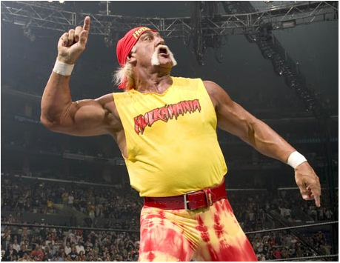
//Participant Hulk Hogan hulkhogan.rup
participant name "Hulk Hogan";
def required step() {
polish_hammer($part[0]);
}
//Participant Hulk Hogan hulkhogan.rup
participant name "Hulk Hogan";
def required step() {
polish_hammer($part[0]);
}

Slide 6
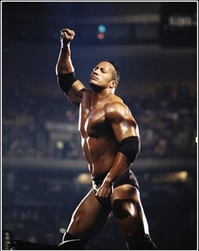
//Participant The Rock therock.rup
participant name "The Rock";
def required step() {
int i;
i = randi;
if(randi % 2 == 0){
kick($part[0]);
}
else {
punch($part[0]);
}
}
//Participant The Rock therock.rup
participant name "The Rock";
def required step() {
int i;
i = randi;
if(randi % 2 == 0){
kick($part[0]);
}
else {
punch($part[0]);
}
}

Slide 7
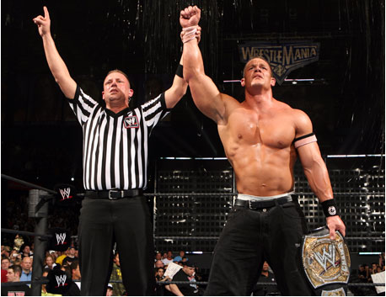
//Simulation File wrestlingsimulation.rus
simulation name "Wrestling Simulation";
environment "wrestlingenvironment.rue" {
moves = 0;
}
participant "hulkhogan.rup" hulk_hogan {
strength = 20;
health = 30;
}
participant "therock.rup" the_rock {
strength = 30;
health = 20;
}
def required end () {
return ($part.hulk_hogan.health <= 0 || $part. hulk_hogan.strength <= 0 || $part. the_rock.health <= 0 || $part. the_rock.strength <= 0);
}
//Simulation File wrestlingsimulation.rus
simulation name "Wrestling Simulation";
environment "wrestlingenvironment.rue" {
moves = 0;
}
participant "hulkhogan.rup" hulk_hogan {
strength = 20;
health = 30;
}
participant "therock.rup" the_rock {
strength = 30;
health = 20;
}
def required end () {
return ($part.hulk_hogan.health <= 0 || $part. hulk_hogan.strength <= 0 || $part. the_rock.health <= 0 || $part. the_rock.strength <= 0);
}
Notes:
So how does the referee in your simulation know who's won? We must tell him the rules, and we do this in the end() function, required of all simulations. The end function measures attributes and declares a winner when one of the participants meets established criteria.

Slide 8
Example Output
Notes:
Output in JSON
Human Readable
Can be interpreted by other programs
GUI displays
Statistical analyzers
Web frontend

Slide 9




Compilation Environment
$ RumbleCompiler wrestlingenvironment.rus
Simulation File (*.rus)‏
Environment File (*.rue)‏
Participant Files (*.rup)‏
Lexical Analyzer (Scanner - JLex)‏
Java_cup.runtime.Symbol
ERROR
OUTPUT
Syntax Analysis
(Parser – CUP)‏
Settings
Data Structure
AST
Semantic Analysis and Validation
Java Code Generation
AST
Environment and Participant *.java runtime files

Slide 10
Tools
Notes:
Eclipse with SVN
Jlex – Lexical Analysis
CUP – Syntactic Analysis and AST generation
Google Apps

Slide 11
The Prisoners' Dilemma

Slide 12
Closing Remarks
Notes:
Solo: The Field Mouse
Competitive: Classroom Learning
Predictive: Election Campaigns

Slide 13
GET READY TO RUMBLE!

